Slide 1
CAN PROTOCOL
Suraj Verma

Slide 2
Agenda
Overview
Protocol
Message Frames
Bit Timing
Error Handling

Slide 3
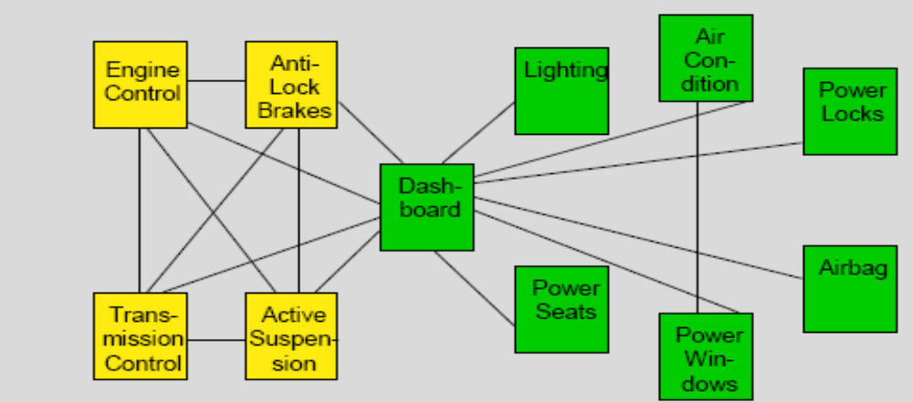
How it all began...
The development of CAN began when more and more electronic devices were implemented into modern motor vehicles.

Slide 4
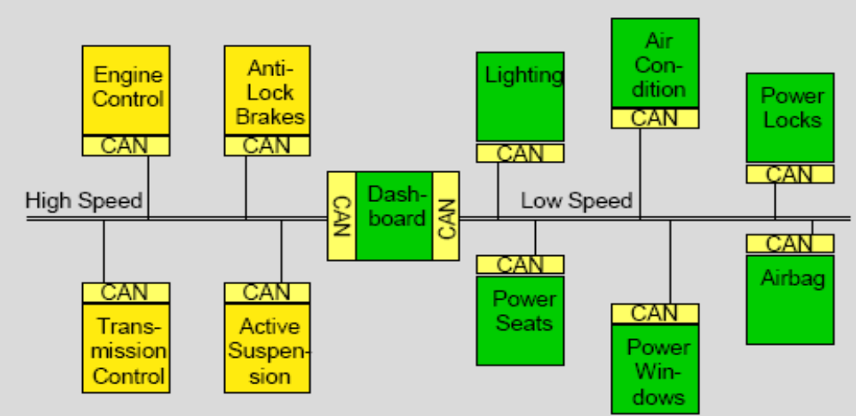
With the use of CAN
With the use of CAN, point-to-point wiring is replaced by one serial bus connecting all control systems. This is accomplished by adding some CAN-specific hardware to each control unit that provides the "rules" or the protocol for transmitting and receiving information via the bus.

Slide 5
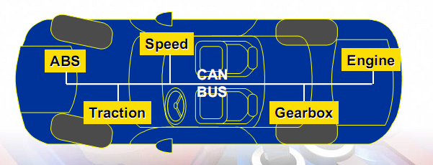

Slide 6
INTRODUCTION
CAN or Controller Area Network is an advanced serial bus system that efficiently supports distributed control systems. It was initially developed for the use in motor vehicles by Robert Bosch GmbH, Germany, in the late 1980s, also holding the CAN license.
CAN is internationally standardized by the International Standardization Organization (ISO) and the Society of Automotive Engineers (SAE).
Strengths of CAN
Widely accepted Standards.
Handles extreme conditions.
Simple to configure & good error detection.
Lot of HW & SW that support CAN.
Easy to add a receiver node.
Message are delivered according to priority.

Slide 7
It works on a bus topology
All nodes must be using the same baud rate
The system designer must specify the identifiers of each node and the messages that the nodes will transmit.

Slide 8
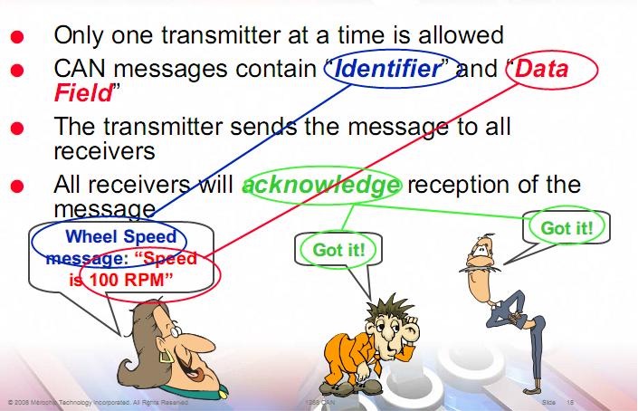

Slide 9
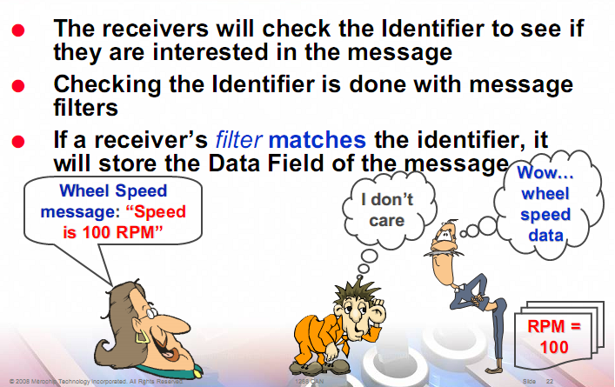

Slide 10
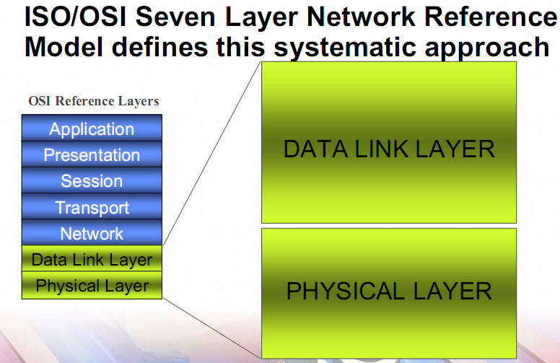

Slide 11
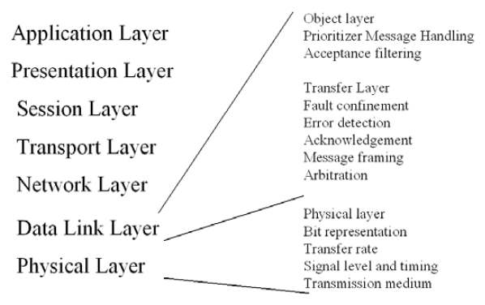
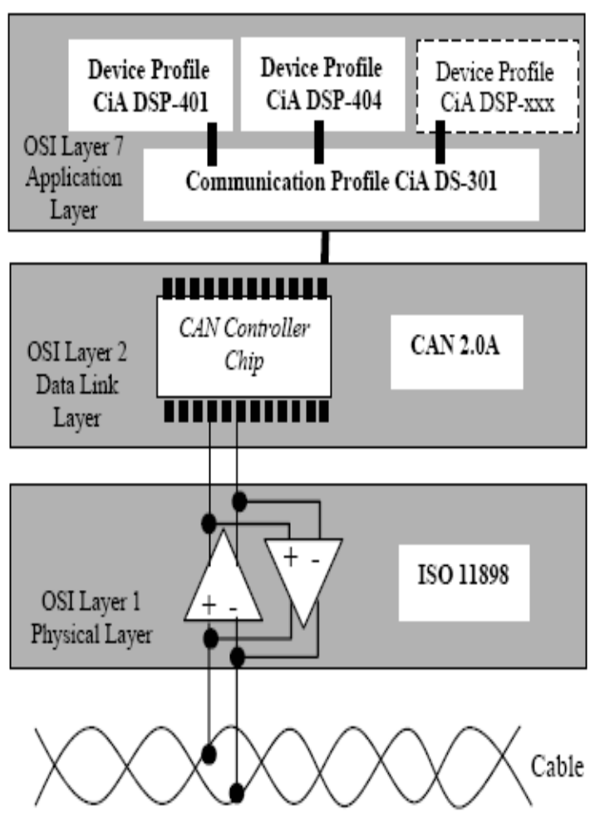
7 Layers of the OSI Model
CAN 2.0A(11 bit Identifier), CAN 2.0B Active(29 bit Identifier)

Slide 12
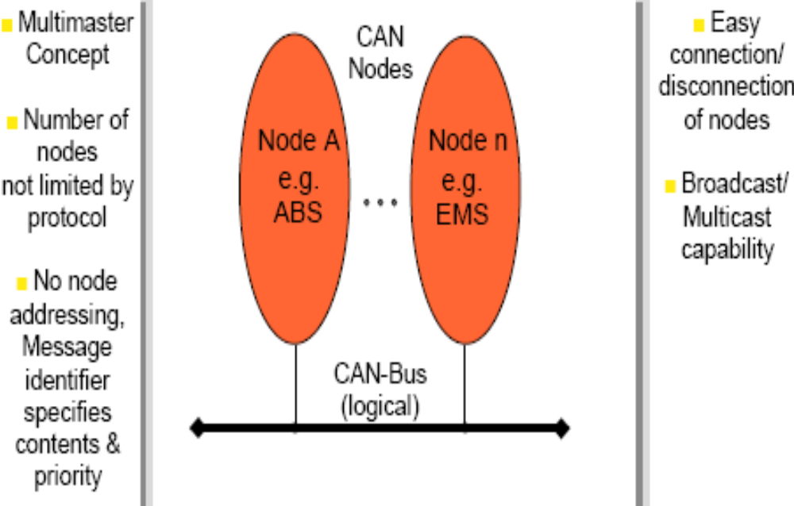
Basic Concepts

Slide 13
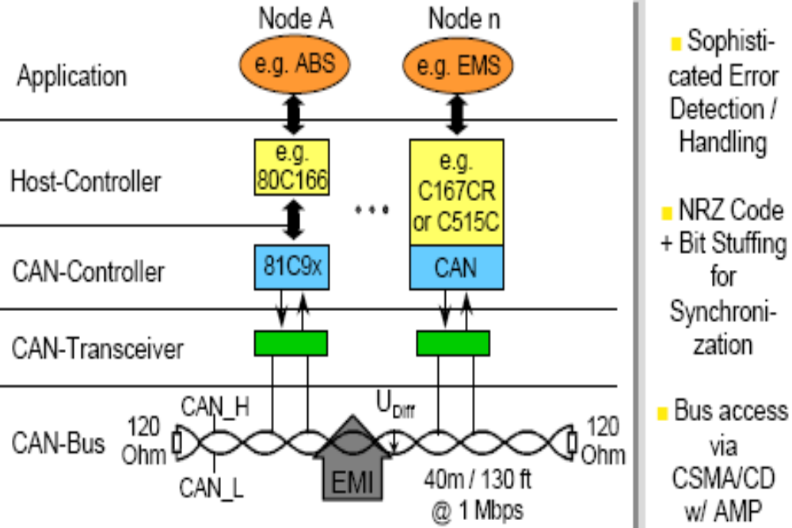
Basic Concepts (cont.)

Slide 14
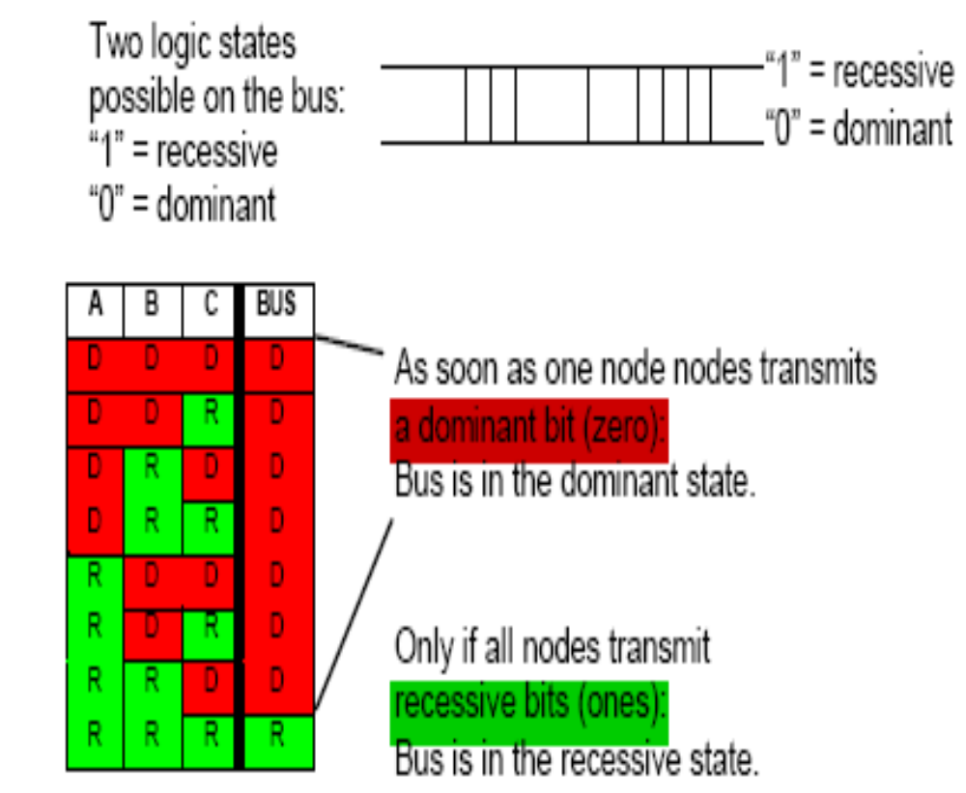
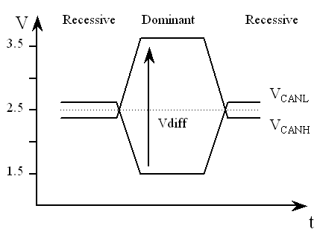
CAN Bus States
There are two bus states, called "dominant" and "recessive".
Dominant=“0”
Recessive=“1”

Slide 15
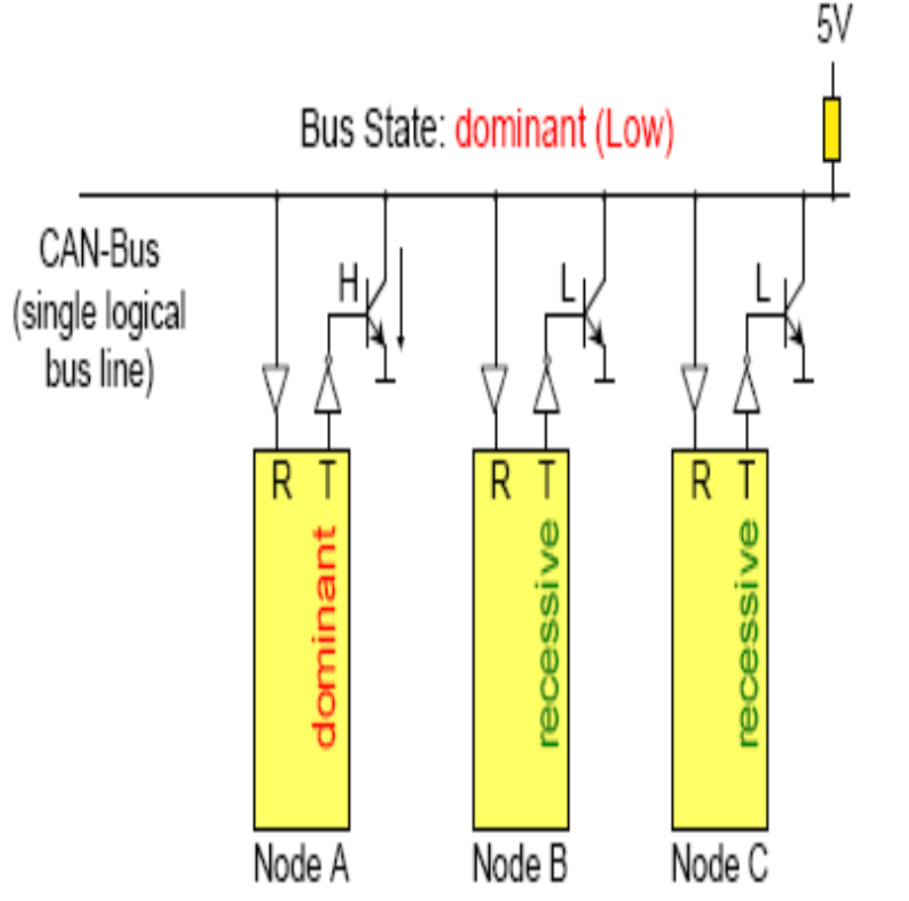
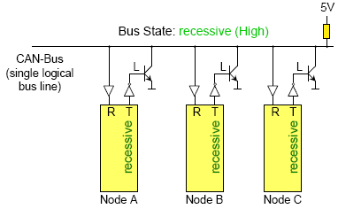
Dominant
Recessive
As soon as one node transmits a dominant bit (zero), the bus is in the dominant state.
Only if all nodes transmit recessive bits (ones), the Bus is in the recessive state.

Slide 16
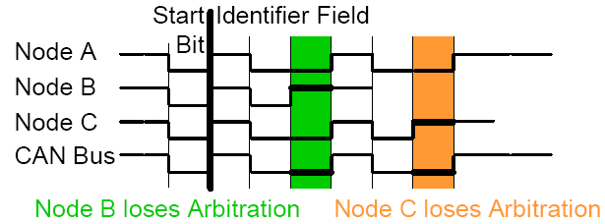
CAN Bus Arbitration
The CAN protocol handles bus accesses according to the concept called “Carrier Sense Multiple Access with Arbitration on Message Priority”. This arbitration concept avoids collisions of messages whose transmission was started by more than one node simultaneously and makes sure the most important message is sent first without time loss.
If two or more bus nodes start their transmission at the same time after having found the bus to be idle, collision of the messages is avoided by bitwise arbitration. Each node sends the bits of its message identifier and monitors the bus level.

Slide 17
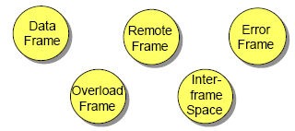
Frame Formats - Overview

Slide 18
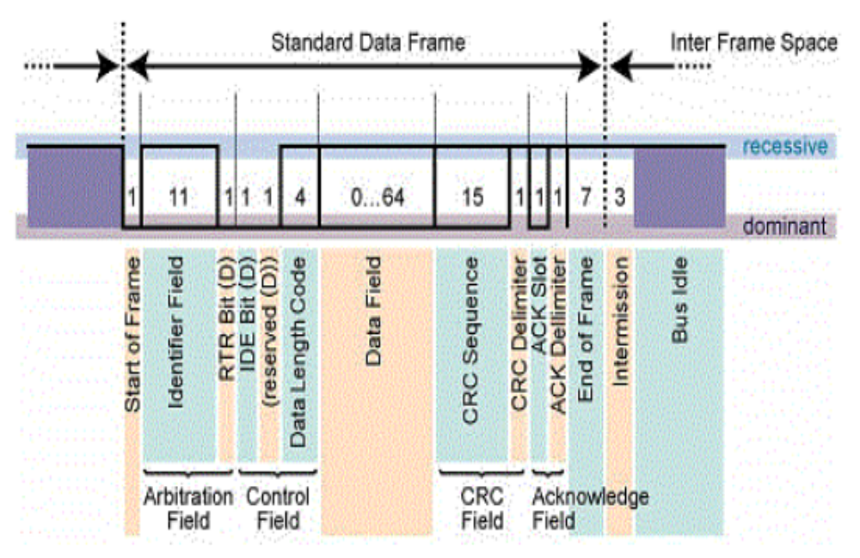
Data Frame

Slide 19
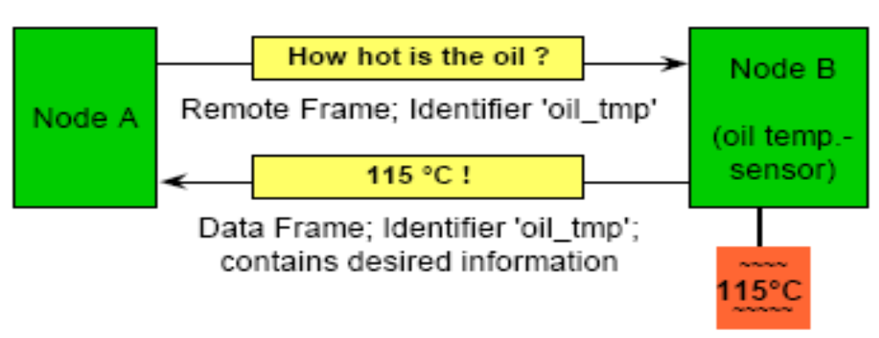
Remote Frame
There are 2 differences between a Data Frame and a Remote Frame. Firstly the RTR-bit is transmitted as a dominant bit in the Data Frame and secondly in the Remote Frame there is no Data Field.
In the very unlikely event of a Data Frame and a Remote Frame with the same identifier being transmitted at the same time, the Data Frame wins arbitration due to the dominant RTR bit following the identifier. In this way, the node that transmitted the Remote Frame receives the desired data immediately.
Example

Slide 20
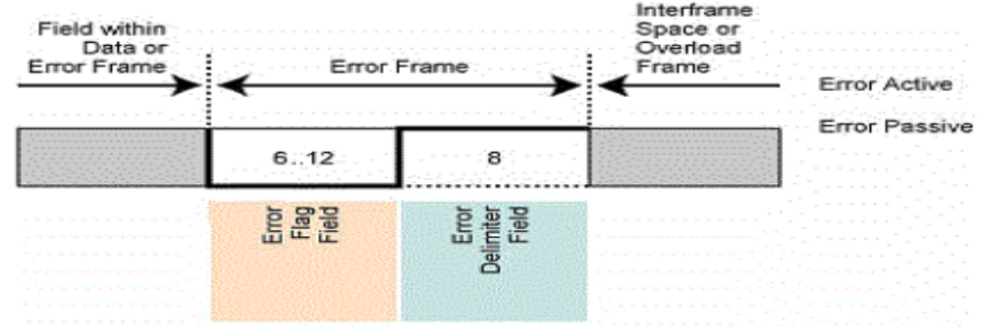
Error Frame
An Error Frame is generated by any node that detects a bus error. The Error Frame consists of 2 fields.
The Error Delimiter consists of 8 recessive bits and allows the bus nodes to restart bus communications cleanly after an error.
Error Flag Field
“Error Active”=composed of six consecutive dominant bits.
“Error Passive”=consists of six consecutive recessive bits, and therefore the Error Frame (for an “error passive” node) consists of 14 recessive bits (i.e. no dominant bits).

Slide 21
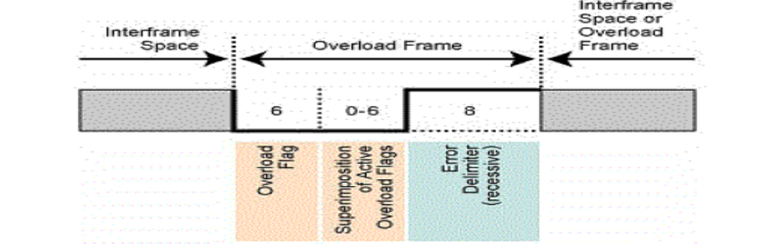
Overload Frame
An Overload Frame has the same format as an “active” Error Frame. An Overload Frame, however can only be generated during Interframe Space (delay).
The Overload Frame consists of 2 fields, an Overload Flag
followed by an Overload Delimiter. The Overload Flag consists of six dominant bits followed by Overload Flags generated by other nodes (again giving a maximum of twelve dominant bits).
An Overload Frame can be generated by a node if due to internal conditions the node is not yet able to start reception of the next message.

Slide 22
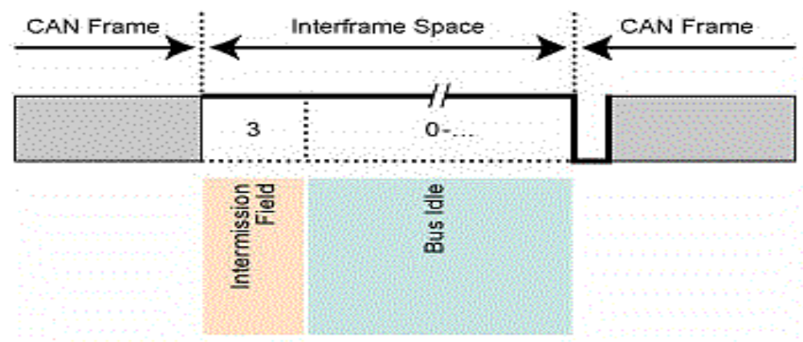
Interframe Space
Interframe space is composed of at least 3 recessive bits, these bits are termed the Intermission. This time is provided to allow nodes time for internal processing before the start of the next message frame. After the Intermission, the bus line remains in the recessive state (Bus Idle) until the next transmission starts.

Slide 23
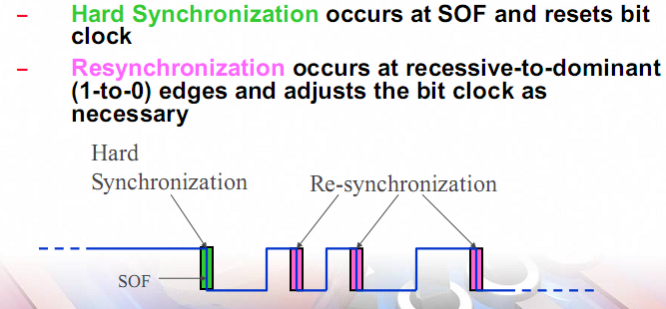
Synchronization

Slide 24
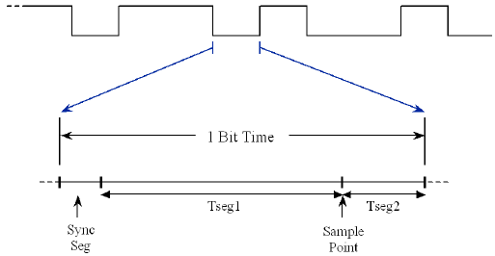
Bit Timing
Unlike many other serial protocols,the CAN bit rate is not just defined by baud Rate prescaler(Baud rate prescaler is used to generate time quanta).The No. of these time quanta are added together to to get the overall bit timing.
First is the sync. Segment,which is fixed at one time quanta long.
The next to region is Tseg1 & Tseg2.User can define No. of time quanta in a bit period.(minimum 8 & maximum 25).
The amount that each bit rate adjusted is called as “Synchronous Jump Width(SJW)”.

Slide 25
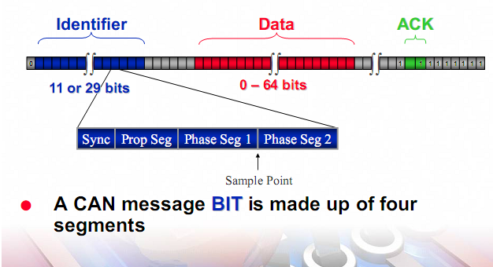
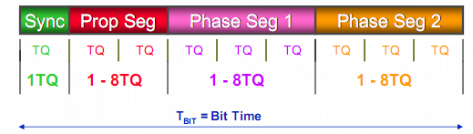
Bit Time can range from 8 to 25 TQ

Slide 26
How to Calculate Bit Timing
Bit Rate=Pclk/(BRP*(1+Tseg1+Tseg2))
Consider we want to reach a bit rate of 125k with a 60MHz Pclk & the sample Point of about 70%.
Here is how the BRP calculation is performed
Total no. of TIME QUANTA in a bit period=1+Tseg1+Tseg2
BRP=Pclk/(Bit Rate*QUANTA)
BRP=60 MHz/(125K*QUANTA)
We know that time QUANTA limit is 8 to 25 in a bit period.Using spreadsheet we can substitute integer value b/w 8-25 for QUANTA until we get a integer value for BRP.
In this case when QUANTA=(1+Tseg1+Tseg2)=16
Then BRP=30
Adjust Tseg1 & Tseg2 to get a desired sample point.
Sample Point=(QUANTA*70)/100=11.2
This gives Sync=1,Tseg1=10,Tseg2=5

Slide 27
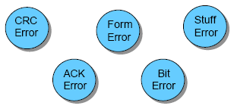
Error Detection - Overview

Slide 28
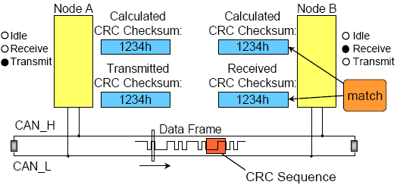
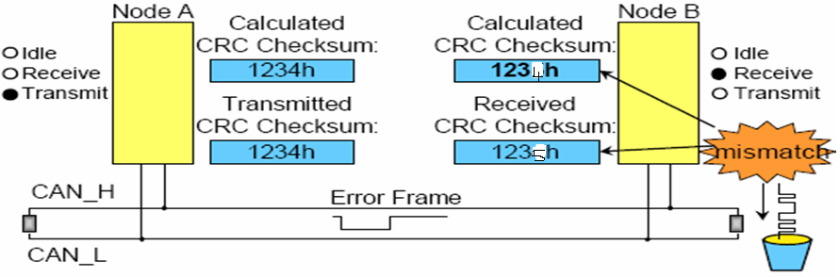
Cyclic Redundancy Check

Slide 29
How to calculate CRC Checksum
Add the values b/w SOF to the beginning of CRC.
Eg.0x25,0x62,0x3f,0x52
Result=0x118
Drop the 1st bit
Result=0x18
Take 2’s Complement
Result=0xE8
Result=(0xE8+0x18)=0x100
Drop the 1st bit
Result=0x00 means no error.

Slide 30
Frame Check
Another error detection mechanism is the Frame Check. If a transmitter detects a dominant bit in one of the four segments:
CRC Delimiter, Acknowledge Delimiter, End of Frame or Interframe Space then a Form Error has occurred and an Error Frame is generated.
Bit Monitoring
All nodes perform Bit Monitoring:
A Bit Error occurs if a transmitter sends a dominant bit but detects a recessive bit on the bus line or, sends a recessive bit but detects a dominant bit on the bus line.

Slide 31
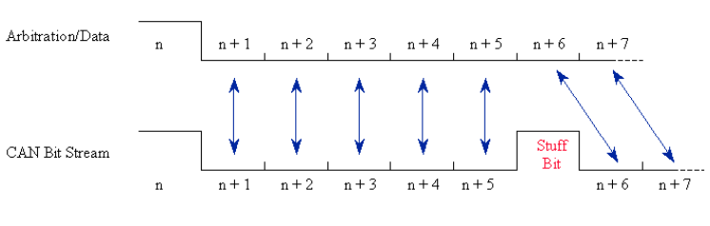
Bit Stuffing Check
If six consecutive bits with the same polarity are detected between Start of Frame and the CRC Delimiter, the bit stuffing rule has been violated. A stuff error occurs and an Error Frame is generated.
If no error is their then the receiver remove the stuff bit from the frame and is called as “Destuffing”

Slide 32
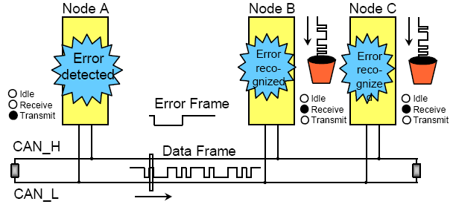
Error Handling
Detected errors are made public to all other nodes via Error Frames.
The transmission of the erroneous message is aborted and the frame is repeated as soon as possible.

Slide 33
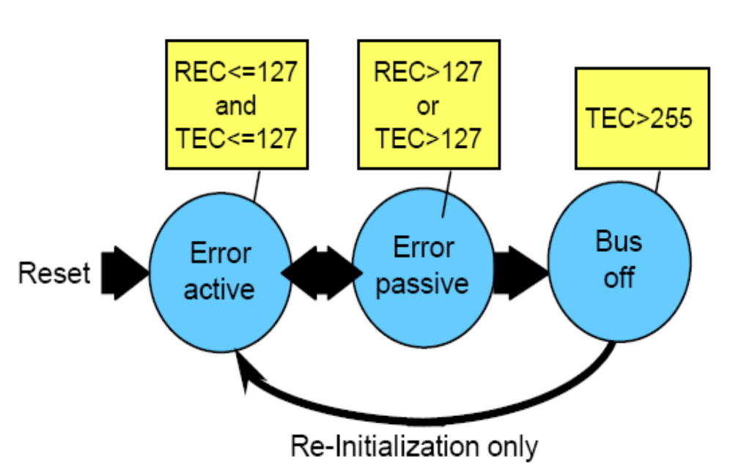
Error Handling (cont.)

Slide 34
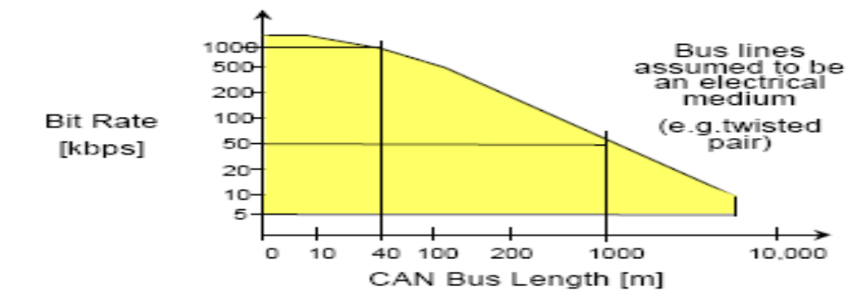
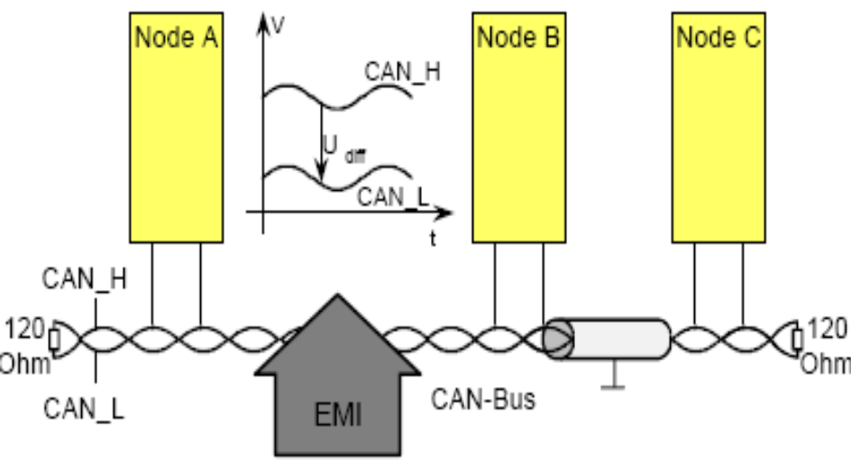
Relation between Baud Rate and Bus Length
Up to 1Mbit / sec @40m bus length (130 feet)
CAN and EMI
Due to the differential nature of transmission CAN is insensitive to electromagnetic interference, because both bus lines are affected in the same way which leaves the differential signal unaffected.
To reduce the sensitivity against ectromagnetic interference even more, the bus lines can additionally be shielded. This also reduces the electromagnetic emission of the bus itself, especially at high baudrates.

Slide 35
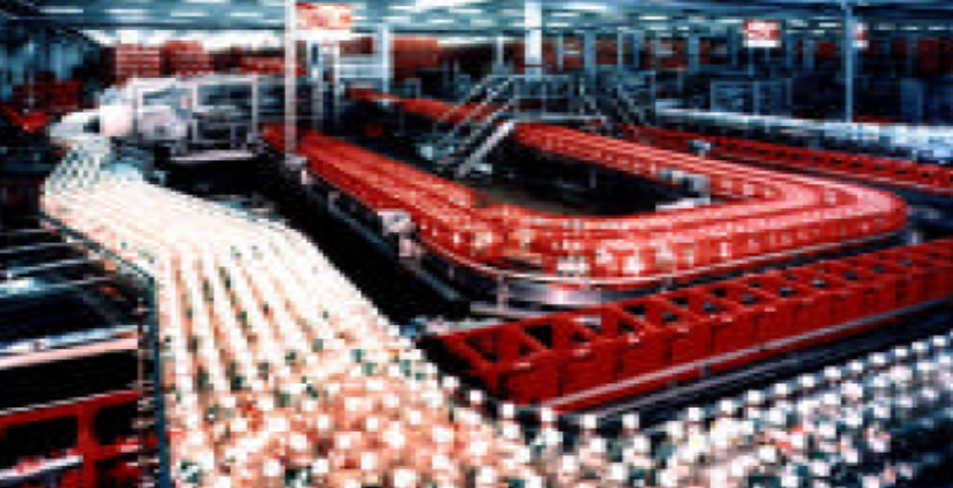
Undetected Errors - an example
To understand the error detection capabilities of CAN, imagine a vehicle equipped with CAN running 2000 hours per year at a CAN bus speed of 500 kbps with 25% bus load.
This will result in 1 undetected error every 1000 years.

Slide 36
THE
END

Slide 37
References
http://CAN Protocol\HTML\Webopedia The 7 Layers of the OSI Model.
http://CAN Protocol\HTML\Cyclic redundancy check - Wikipedia, the free encyclopedia.htm
http ://CAN Protocol\HTML\CAN Introduction.htm
CAN Specification Version 2.0(pdf)
The Insider’s guide to philips ARM7 based microcontroller by Trevor Martin Bsc.(hons.)CEng.MIEE(pdf).

