Slide 1
Retail Sales Performance Analysis
Name – suraj mondal
Course - TCS iON AIP 135 - Integrated Retail Sales Performance Tracking and Analysis
Date- 14/04/2026

Slide 2
Objective
Analyze retail sales data
Identify trends and patterns
Understand customer behavior
Build interactive dashboard

Slide 3
Dataset Overview
Transaction ID, Date, Customer ID
Gender, Age, Product Category
Quantity, Price per Unit
Total Amount

Slide 4
Data Preprocessing
Removed duplicates
Handled missing values
Standardized columns
Converted date format

Slide 5
Feature Engineering & ML
Created Month, Quarter, Age Groups
Calculated Total Amount
Applied K-Means clustering
Segments: Low, Medium, High value

Slide 6
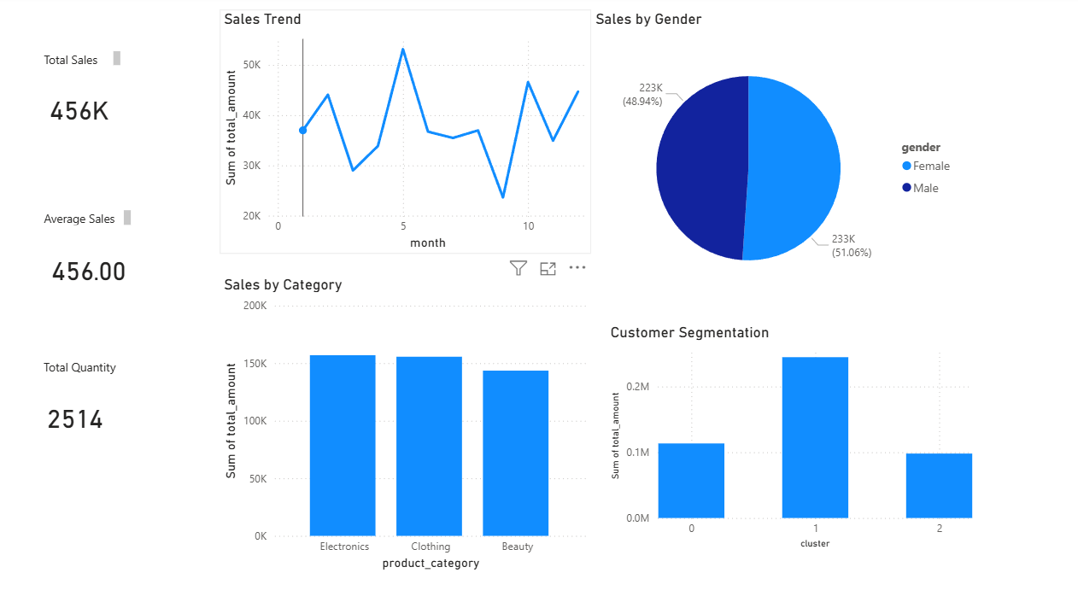
Dashboard Visualization

Slide 7
Key Insights
Electronics generates highest revenue
Sales vary across months
Female contribution slightly higher
High-value customers identified

Slide 8
Conclusion
Provides actionable business insights
Improves decision making
ML enhances customer analysis

