Slide 1
Industrial training presentation
Machine learning internship
Suraj nishad
Roll no. :20dcs016

Slide 2


table of contents
About the company
Internship overview
Challenges
Achievements
Certificate
Conclusion
Output images

Slide 3
About the company
Bharat intern is a company that helps college students kickstart their careers. They provide internships that are like on-the-job training, so students can learn important skills and get real-world experience. This helps them start their careers strongly and stand out in the job market. Bharat intern is all about helping students reach their dreams and goals by offering them the right tools and opportunities. They want to make sure students don't just begin well but also finish their careers strongly. So, they're there to guide and support them all the way to success.

Slide 4



Internship overview
Tasks:
1. House price prediction : Machine learning model to predict house price using linear regression ( Jupyter notebook code )
2. Wine quality prediction : Machine learning model to predict the quality of wine using linear regression
( Jupyter notebook code )

Slide 5
Internship overview
Duration: SEPT 10, 2023 – OCT 10, 2023.
Role: Machine Learning Engineer
Objective: The objectives of completing projects like house price and wine quality prediction are skill development, portfolio building, problem-solving, and proof of competence for data science and machine learning roles.

Slide 6
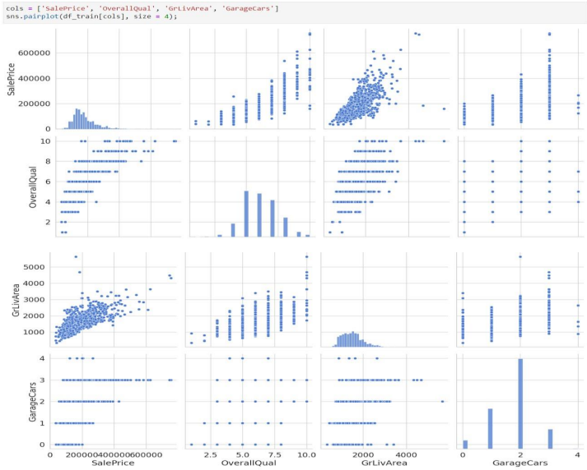
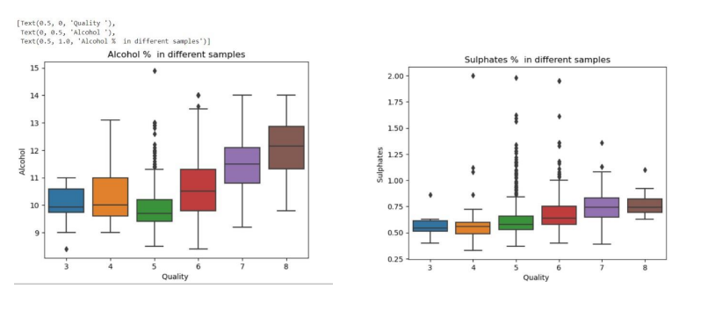
Output images

Slide 7

CHALLENGES
Data quality
Feature selection
Assumptions
Overfitting
Coding and implementation

Slide 8
ACHIEVEMENTS
Practical skills
Problem-solving
Technical proficiency
Learning and growth
Proof of competence

Slide 9
CONCLUSION
My internship provided invaluable hands-on experience and skill development in machine learning. I successfully completed projects, improved my problem-solving abilities, and forged meaningful connections in the field, positioning me for future success in this dynamic industry.

Slide 10
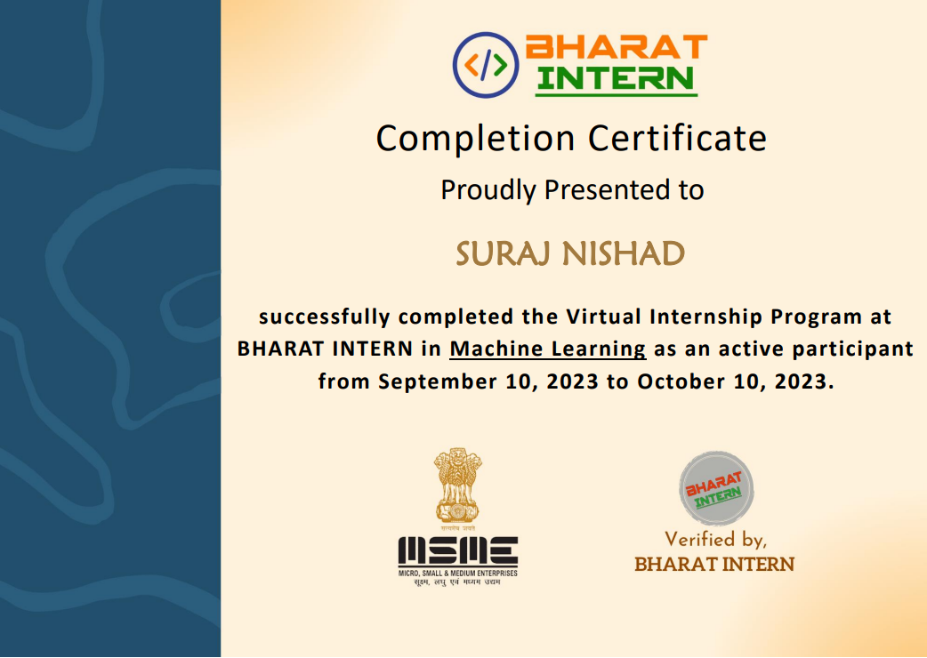
CERTIFICATE

