Slide 1
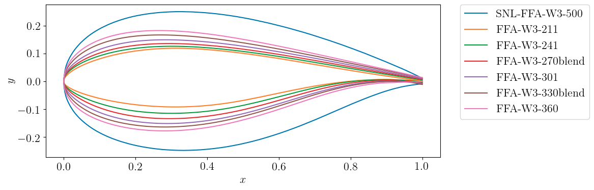
Different airfoil shapes in IEA 15 MW turbine database
The number of points provided for 5 is 200. However, for two airfoils (270blend and 330blend), they have provided 257 points.
I think we can fix the number of points to 200 for all airfoils and we can fix the x-coordinate location of these points. We can get the y-coordinate at these 200 points via interpolation.
This will also reduce the input space to the neural network. As the x-coordinates are same, we can just use the y-coordinates as the input features.

Slide 2
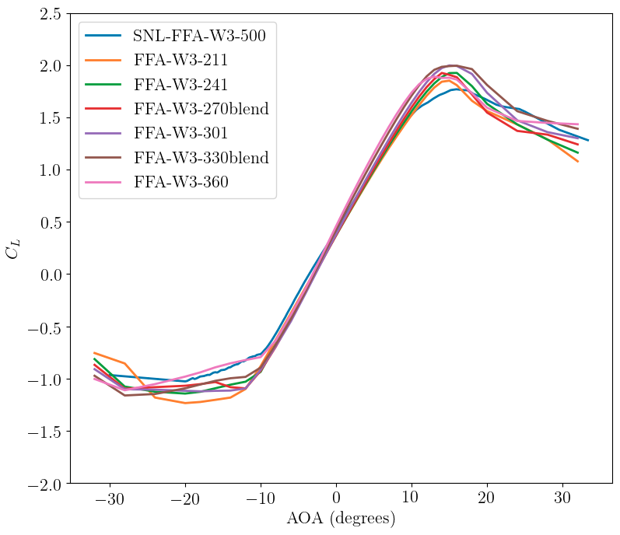
The excel sheet of the IEA 15 MW Turbine also has the data for aerodynamic coefficients computed using the CFD for AOA between –32 degree to 32 degree with the spacing of 2 degrees.
The plot shows the variation of C_L with AOA for 7 airfoils included in the database.

Slide 3
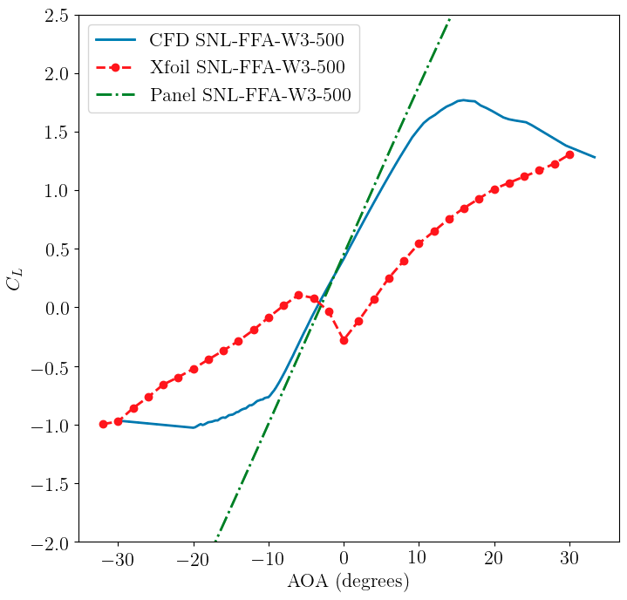
The CFD data for this airfoil is available for Re = 8.1e6.
The Xfoil does not give the accurate prediction even if I change the Reynolds number. The Xfoil results are for Re = 1.0e6.
The blade is too thick as compared to other airfoils, and that might be the reason behind this weird result.

Slide 4
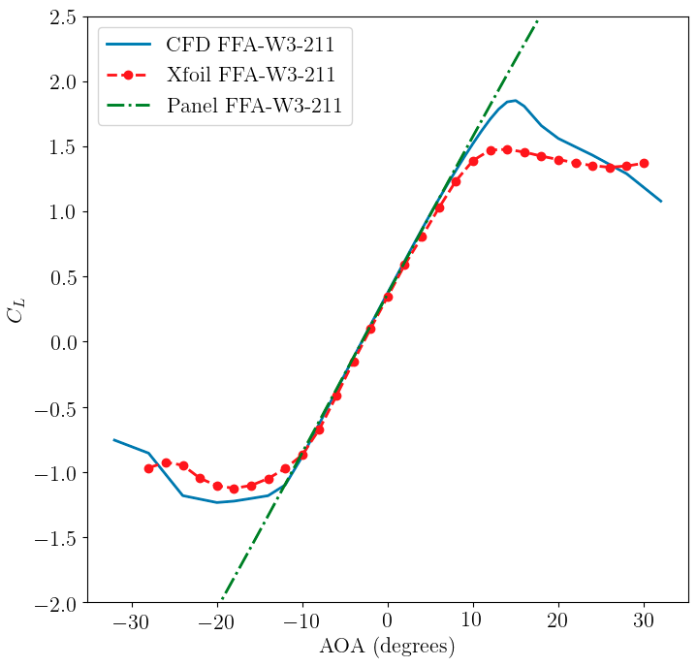
The CFD data for this airfoil is available for Re = 1e7.
The Xfoil does not give the stable result for this Reynolds number. I had to reduce the Reynolds number and the Xfoil results are for Re = 1.8e6.

Slide 5
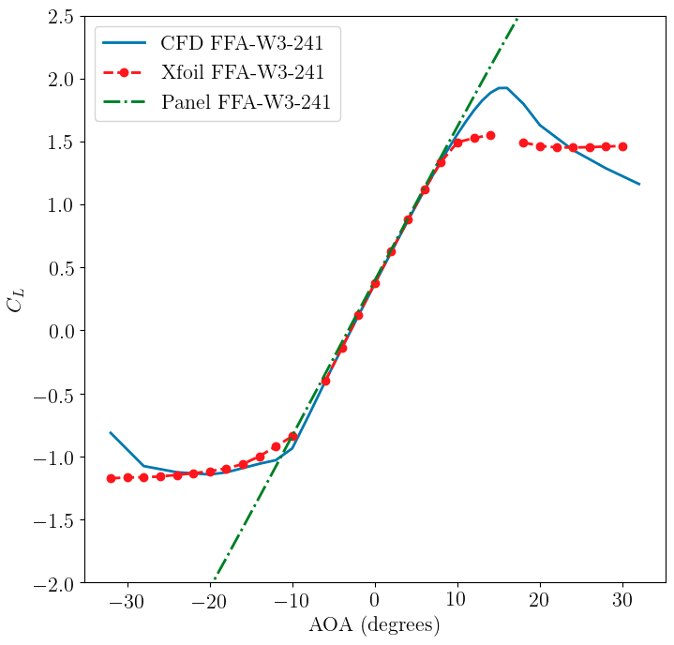
The CFD data for this airfoil is available for Re = 1e7.
The Xfoil does not give the stable result for this Reynolds number. I had to reduce the Reynolds number and the Xfoil results are for Re = 1.8e6.

Slide 6
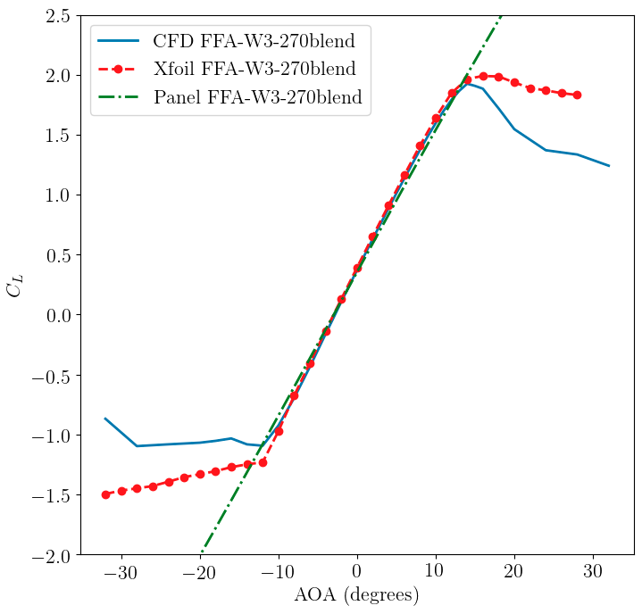
The CFD data for this airfoil is available for Re = 1e7.
The Xfoil results are also for Re = 1e7.

Slide 7
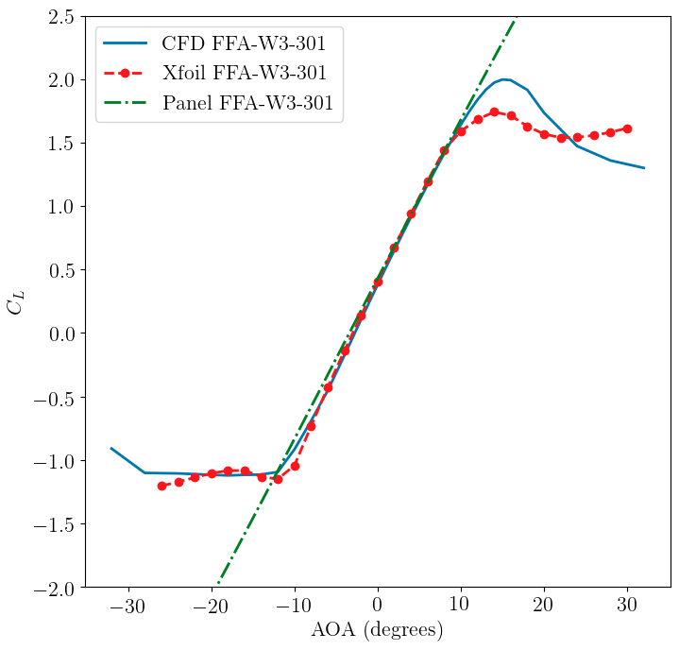
The CFD data for this airfoil is available for Re = 1e7.
The Xfoil results are also for Re = 1e7.

Slide 8
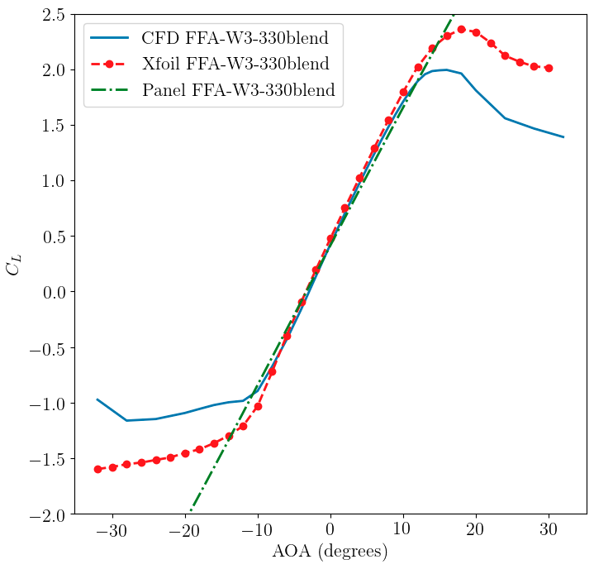
The CFD data for this airfoil is available for Re = 1e7.
The Xfoil results are also for Re = 1e7.

Slide 9
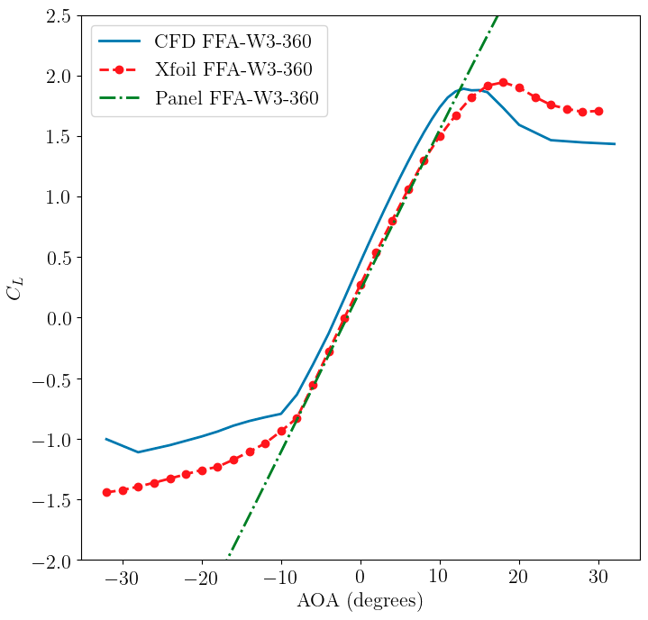
The CFD data for this airfoil is available for Re = 1e7.
The Xfoil results are also for Re = 1e7.

