Slide 1
PROGRAMMING ON PHP

Slide 2
PROGRAMMING ON PHP
4.1 Web concepts in PHP
4.2 Get and Post
4.3 File Inclusion and Files & I/O
4.4 Functions
4.5 Cookies
4.6 Sessions
4.7 Sending Emails
4.8 File Uploading
4.9 Error handling
4.10 Bugs Debugging

Slide 3
WEB CONCEPTS IN PHP
Passing variables with data between pages
1. Get and Post Method
2. Cookies
3. Sessions

Slide 4
GET AND POST
We have two HTTP request methods in PHP for handling the forms, where submitted form-data from users can be collected using these methods. In order to send information to the web server from the browser client, we use GET and POST methods.
GET Method: Data is requested from a specific resource
POST Method: Data is submitted to be processed to a specific resource
The GET Method
The GET method sends the encoded user information appended to the page request. The page and the encoded information are separated by the ? character.
http://www.test.com/index.htm?name1=value1&name2=value2

Slide 5
<?php
if( $_GET["name"] || $_GET["age"] )
{
echo "Welcome ". $_GET['name']. "<br />";
echo "You are ". $_GET['age']. " years old.";
exit();
}
?>
<html>
<body>
<form action = "<?php $_PHP_SELF ?>" method = "GET">
Name: <input type = "text" name = "name" />
Age: <input type = "text" name = "age" />
<input type = "submit" />
</form>
</body>
</html>

Slide 6
The POST Method
The POST method transfers information via HTTP headers. The information is encoded as described in case of GET method and put into a header called QUERY_STRING.

Slide 7
<?php
if( $_POST["name"] || $_POST["age"] )
{
if (preg_match("/[^A-Za-z'-]/",$_POST['name'] ))
{
die ("invalid name and name should be alpha");
}
echo "Welcome ". $_POST['name']. "<br />";
echo "You are ". $_POST['age']. " years old.";
exit();
}
?>
<html>
<body>
<form action = "<?php $_PHP_SELF ?>" method = "POST">
Name: <input type = "text" name = "name" />
Age: <input type = "text" name = "age" />
<input type = "submit" />
</form>
</body>
</html>

Slide 8
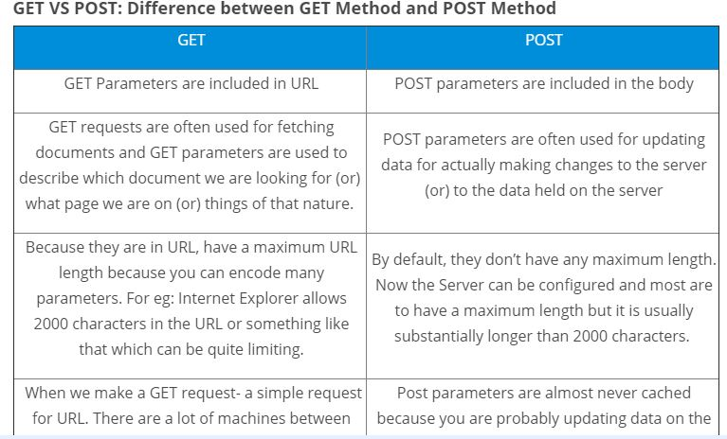

Slide 9
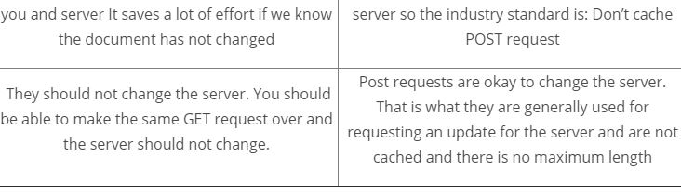

Slide 10
The $_REQUEST variable
The PHP $_REQUEST variable contains the contents of both $_GET, $_POST, and $_COOKIE.
The PHP $_REQUEST variable can be used to get the result from form data sent with both the GET and POST methods.
Try out following example by putting the source code in test.php script.

Slide 11
<?php
if( $_REQUEST["name"] || $_REQUEST["age"] )
{
echo "Welcome ". $_REQUEST['name']. "<br />";
echo "You are ". $_REQUEST['age']. " years old.";
exit();
}
?>
<html>
<body>
<form action = "<?php $_PHP_SELF ?>" method = "POST"> Name: <input type = "text" name = "name" />
Age: <input type = "text" name = "age" />
<input type = "submit" />
</form>
</body>
</html>

Slide 12
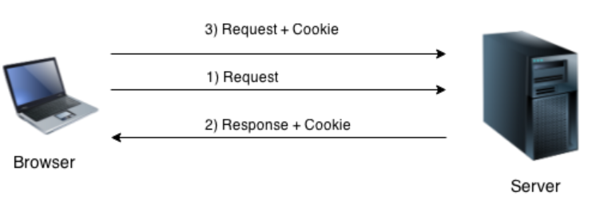
COOKIE
What is a cookie
PHP cookie is a small piece of information which is stored at client browser. It is used to recognize the user.
Cookie is created at server side and saved to client browser. Each time when client sends request to the server, cookie is embedded with request. Such way, cookie can be received at the server side.
Web Technologies -2 Note made by Lecturer Nabraj Koirala

Slide 13
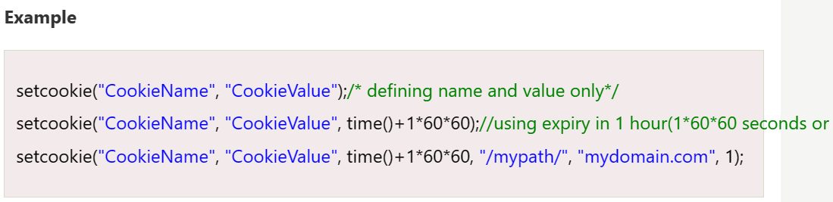
In short, cookie can be created, sent and received at server end.
PHP setcookie() function
PHP setcookie() function is used to set cookie with HTTP response. Once cookie is set, you can access it by $_COOKIE superglobal variable.

Slide 14
PHP $_COOKIE
PHP $_COOKIE superglobal variable is used to get cookie.
Example
$value=$_COOKIE["CookieName"];//returns cookie value

Slide 15
HOW TO CREATE A COOKIE IN PHP
PHP has a setcookie() function to send a cookie. We will discuss this function in detail now.
Syntax:
setcookie(name, value, expire)

Slide 16
Example to Create/Retrieve a Cookie:
<html>
<?php
$cookie_name = "user";
$cookie_value = “Suraj Pandey";
setcookie($cookie_name, $cookie_value, time() + 10);
?>
<html>
<body>
<?php
if(!isset($_COOKIE[$cookie_name])) {
echo "Cookie named " . $cookie_name . "'is not set!";
} else {
echo "Cookie " . $cookie_name . "' is set!<br>";
echo "Value is: " . $_COOKIE[$cookie_name];
}
?>
</body>
</html>

Slide 17
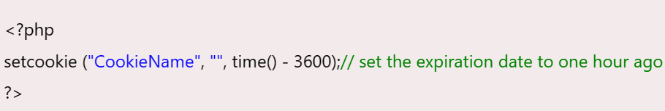
Firstly cookie is not set. But, if you refresh the page, you will see cookie is set now.
PHP Delete Cookie
If you set the expiration date in past, cookie will be deleted.
File: cookie1.php

Slide 18
PHP SESSIONS
A session is a way to store information (in variables) to be used across multiple pages.
Unlike a cookie, the information is not stored on the users computer.
When you work with an application, you open it, do some changes, and then you close it. This is much like a Session. The computer knows who you are. It knows when you start the application and when you end. But on the internet there is one problem: the web server does not know who you are or what you do, because the HTTP address doesn't maintain state.
Session variables solve this problem by storing user information to be used across multiple pages (e.g. username, favorite color, etc). By default, session variables last until the user closes the browser.

Slide 19
Start a PHP Session:
A session is started with the session_start() function.
Session variables are set with the PHP global variable: $_SESSION.
<?php
// Start the session
session_start();
?>
<html>
<body>
<?php
// Set session variables
$_SESSION["favcolor"] = "green";
$_SESSION["favanimal"] = "cat";
echo "Session variables are set.";
?>
</body>
</html>

Slide 20
Get PHP Session Variable Values:
<?php
session_start();
?>
<html>
<body>
<?php
// Echo session variables that were set on previous page
echo "Favorite color is " . $_SESSION["favcolor"] . ".<br>";
echo "Favorite animal is " . $_SESSION["favanimal"] . ".";
?>
</body>
</html>
Web Technologies -2 Note made by Lecturer Nabraj Koirala

Slide 21
DESTROY A PHP SESSION
To remove all global session variables and destroy the session, use session_unset() and session_destroy():
Example
<?php
session_start();
?>
<html>
<body>
<?php
// remove all session variables
session_unset();
// destroy the session
session_destroy();
echo "All session variables are now removed, and the session is destroyed."
?>
</body>
</html>
Web Technologies -2 Note made by Lecturer Nabraj Koirala

Slide 22
FILE INCLUSION AND FILES & I/O
PHP - File Inclusion
You can include the content of a PHP file into another PHP file before the server executes it. There are two PHP functions which can be used to included one PHP file into another PHP file.
The include() Function
The require() Function
Both include and require are identical to each other, except failure.
include only generates a warning, i.e., E_WARNING, and continue the execution of the script.
require generates a fatal error, i.e., E_COMPILE_ERROR, and stop the execution of the script.

Slide 23
The include() Function
The include() function takes all the text in a specified file and copies it into the file that uses the include function. If there is any problem in loading a file then the include() function generates a warning but the script will continue execution.
Assume you want to create a common menu for your website. Then create a file menu.php with the following content.
<a href="http://www.tutorialspoint.com/index.htm">Home</a> - <a href="http://www.tutorialspoint.com/ebxml">ebXML</a> - <a href="http://www.tutorialspoint.com/ajax">AJAX</a> - <a href="http://www.tutorialspoint.com/perl">PERL</a> <br />

Slide 24
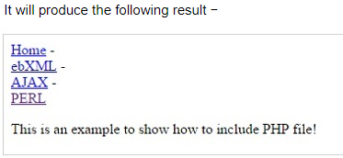
Now create as many pages as you like and include this file to create header. For example now your test.php file can have following content.
<html>
<body>
<?php
include("menu.php");
?>
<p>This is an example to show how to include PHP file!</p> </body>
</html>

Slide 25
The require() Function
The require() function takes all the text in a specified file and copies it into the file that uses the include function. If there is any problem in loading a file then the require() function generates a fatal error and halt the execution of the script.

Slide 26
You can try using above example with require() function and it will generate same result. But if you will try following two examples where file does not exist then you will get different results.
<html>
<body>
<?php
include("xxmenu.php");
?>
<p>This is an example to show how to include wrong PHP file!</p>
</body>
</html>

Slide 27
Now lets try same example with require() function.
<html>
<body>
<?php
require("xxmenu.php");
?>
<p>This is an example to show how to include wrong PHP file!</p>
</body>
</html>

Slide 28
PHP - FILES & I/O
following functions related to files −
Opening a file
Reading a file
Writing a file
Closing a file

Slide 29
Opening and Closing Files
The PHP fopen() function is used to open a file. It requires two arguments stating first the file name and then mode in which to operate.
Files modes can be specified as one of the six options in this table.

Slide 30
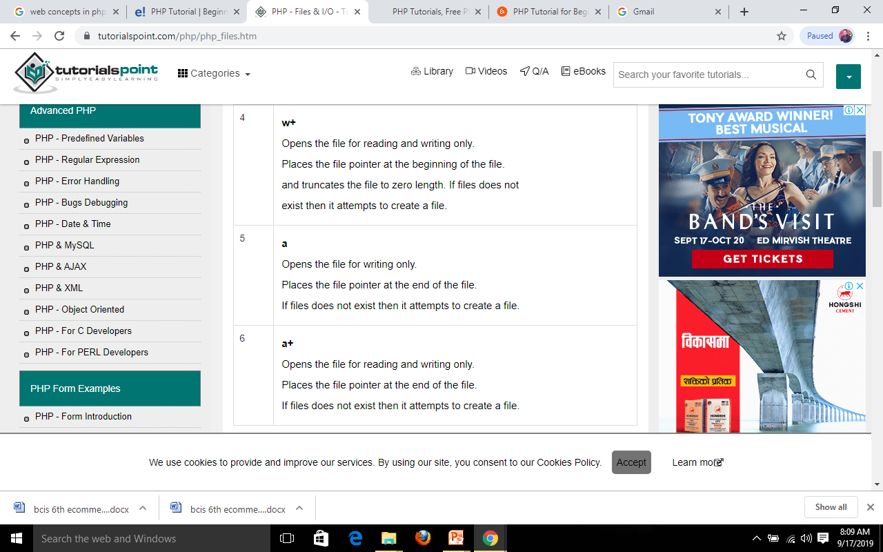
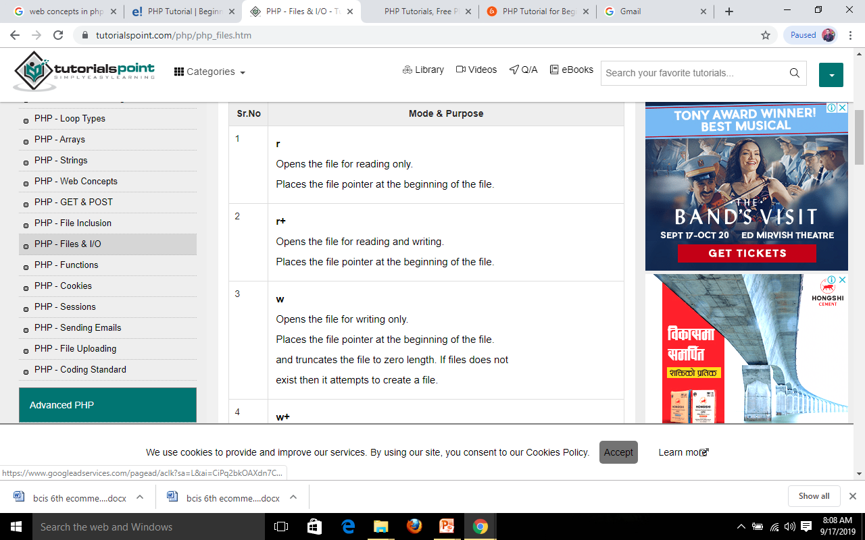

Slide 31
Reading a file
Once a file is opened using fopen() function it can be read with a function called fread(). This function requires two arguments. These must be the file pointer and the length of the file expressed in bytes.
So here are the steps required to read a file with PHP.
Open a file using fopen() function.
Get the file's length using filesize() function.
Read the file's content using fread() function.
Close the file with fclose() function.
The following example assigns the content of a text file to a variable then displays those contents on the web page.

Slide 32
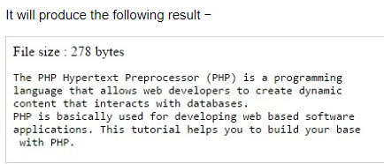
html>
<head>
<title>Reading a file using PHP</title> </head>
<body>
<?php
$filename = "tmp.txt";
$file = fopen( $filename, "r" );
if( $file == false )
{
echo ( "Error in opening file" );
exit();
}
$filesize = filesize( $filename );
$filetext = fread( $file, $filesize );
fclose( $file );
echo ( "File size : $filesize bytes" );
echo ( "<pre>$filetext</pre>" );
?>
</body>
</html>

Slide 33
Writing a file
A new file can be written or text can be appended to an existing file using the PHP fwrite() function.
The following example creates a new text file then writes a short text heading inside it. After closing this file its existence is confirmed using file_exist() function which takes file name as an argument

Slide 34
<?php
$filename = "/home/user/guest/newfile.txt";
$file = fopen( $filename, "w" );
if( $file == false )
{
echo ( "Error in opening new file" );
exit();
}
fwrite( $file, "This is a simple test\n" );
fclose( $file );
?>
<html>
<head>
<title>Writing a file using PHP</title> </head>
<body>
<?php
$filename = "newfile.txt";
$file = fopen( $filename, "r" );
if( $file == false )
{
echo ( "Error in opening file" );
exit();
}

Slide 35
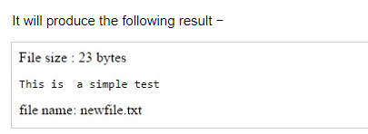
$filesize = filesize( $filename );
$filetext = fread( $file, $filesize );
fclose( $file );
echo ( "File size : $filesize bytes" );
echo ( "$filetext" );
echo("file name: $filename");
?>
</body>
</html>

Slide 36
FUNCTIONS
A function is a piece of code which takes one more input in the form of parameter and does some processing and returns a value.
PHP provides us with two major types of functions:
Built-in functions : PHP provides us with huge collection of built-in library functions. These functions are already coded and stored in form of functions. To use those we just need to call them as per our requirement like, var_dump, fopen(), print_r(), gettype() and so on.
User Defined Functions : Apart from the built-in functions, PHP allows us to create our own customised functions called the user-defined functions.
Using this we can create our own packages of code and use it wherever necessary by simply calling it.

Slide 37
Creating a Function
While creating a user defined function we need to keep few things in mind:
Any name ending with an open and closed parenthesis is a function.
A function name always begins with the keyword function.
To call a function we just need to write its name followed by the parenthesis
A function name cannot start with a number. It can start with an alphabet or underscore.
A function name is not case-sensitive.
Syntax:
function function_name()
{
executable code;
}

Slide 38
<?php function funcGeek() { echo "This is Geeks for Geeks"; } // Calling the function funcGeek(); ?>

Slide 39
PHP Function Arguments
Information can be passed to functions through arguments. An argument is just like a variable.
Arguments are specified after the function name, inside the parentheses. You can add as many arguments as you want, just separate them with a comma.
The following example has a function with one argument ($fname). When the familyName() function is called, we also pass along a name (e.g. Jani), and the name is used inside the function, which outputs several different first names, but an equal last name:

Slide 40
<?php
function familyName($fname) {
echo "$fname Refsnes.<br>";
}
familyName("Jani");
familyName("Hege");
familyName("Stale");
familyName("Kai Jim");
familyName("Borge");
?>

Slide 41
<?php
function familyName($fname, $year) {
echo "$fname Refsnes. Born in $year <br>";
}
familyName("Hege", "1975");
familyName("Stale", "1978");
familyName("Kai Jim", "1983");
?>

Slide 42
USER DEFINED FUNCTIONS
A function is a block of statements that can be used repeatedly in a program.
A function will not execute immediately when a page loads. A function will be executed by a call to the function.
Function names are NOT case-sensitive.
Syntax
function functionName() {
code to be executed;
}
Web Technologies -2 Note made by Lecturer Nabraj Koirala

Slide 43
EXAMPLE OF USER DEFINED FUNCTIONS
<html>
<body>
<?php
function writeMsg() {
echo "Hello Nabraj!";
}
writeMsg();
?>
</body>
</html>
Output:
Hello Nabraj!
Web Technologies -2 Note made by Lecturer Nabraj Koirala

Slide 44
FUNCTION ARGUMENTS
Information can be passed to functions through arguments. An argument is just like a variable.
Arguments are specified after the function name, inside the parentheses. You can add as many arguments as you want, just separate them with a comma.
Web Technologies -2 Note made by Lecturer Nabraj Koirala

Slide 45
FUNCTION ARGUMENTS
<html>
<body>
<?php
function familyName($fname) {
echo "$fname<br>";
}
familyName("Nabraj");
familyName("Ramesh");
familyName("Pawan");
familyName("Nabin");
familyName("Khim");
?>
</body>
</html>
Output:
Nabraj
Ramesh
Pawan
Nabin
Khim
Web Technologies -2 Note made by Lecturer Nabraj Koirala

Slide 46
FUNCTIONS - RETURNING VALUES
To let a function return a value, use the return statement:
<html>
<body>
<?php
function sum(int $x, int $y) {
$z = $x + $y;
return $z;
}
echo sum(5,10);
echo "<br>";
echo sum(7,13);
?>
</body>
</html>
Output:
15
20
Web Technologies -2 Note made by Lecturer Nabraj Koirala

Slide 47
FUNCTION TO FIND AREA OF RECTANGLE AND RETURN THE VALUE
<html>
<body>
<?php
function sum( int $l, int $b) {
$a = $l * $b;
return $a;
}
$b= sum(15,200);
echo $b;
?>
</body>
</html>
Web Technologies -2 Note made by Lecturer Nabraj Koirala

Slide 48
FUNCTION TO ADD TWO NUMBER
<html>
<body>
<?php
function sum(int $x, int $y) {
$z = $x + $y;
echo $z;
}
echo sum(5,10);
?>
</body>
</html>
Web Technologies -2 Note made by Lecturer Nabraj Koirala

Slide 49
SENDING EMAILS
What is PHP mail?
PHP mail is the built in PHP function that is used to send emails from PHP scripts.
The mail function accepts the following parameters;
Email address
Subject
Message
CC or BC email addresses

Slide 50
Sending mail using PHP
The PHP mail function has the following basic syntax
<?php mail($to_email_address,$subject,$message,[$headers],[$parameters]);
?>

Slide 51
HERE,
“$to_email_address” is the email address of the mail recipient
“$subject” is the email subject
“$message” is the message to be sent.
“[$headers]” is optional, it can be used to include information such as CC, BCC
  CC is the acronym for carbon copy. It’s used when you want to send a copy to an interested person i.e. a complaint email sent to a company can also be sent as CC to the complaints board.
  BCC is the acronym for blind carbon copy. It is similar to CC. The email addresses included in the BCC section will not be shown to the other recipients.

Slide 52
Simple Mail Transmission Protocol (SMTP)
PHP mailer uses Simple Mail Transmission Protocol (SMTP) to send mail.
On a hosted server, the SMTP settings would have already been set.
The SMTP mail settings can be configured from “php.ini” file in the PHP installation folder.
Configuring SMTP settings on your localhost Assuming you are using xampp on windows, locate the “php.ini” in the directory “C:\xampp\php”.
Open it using notepad or any text editor. We will use notepad in this example. Click on the edit menu

Slide 53
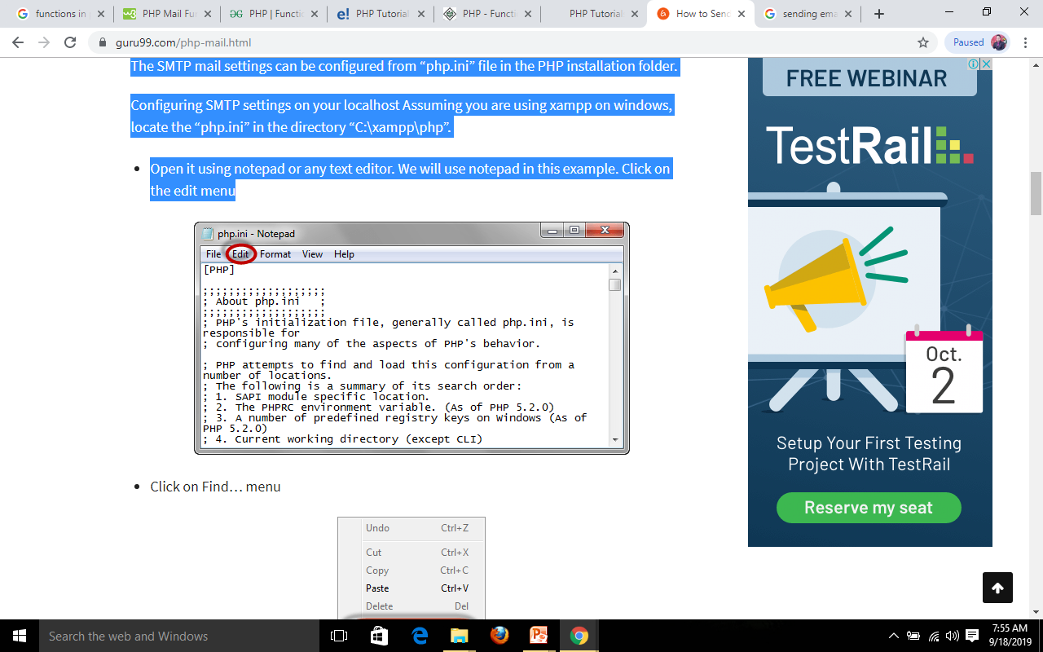
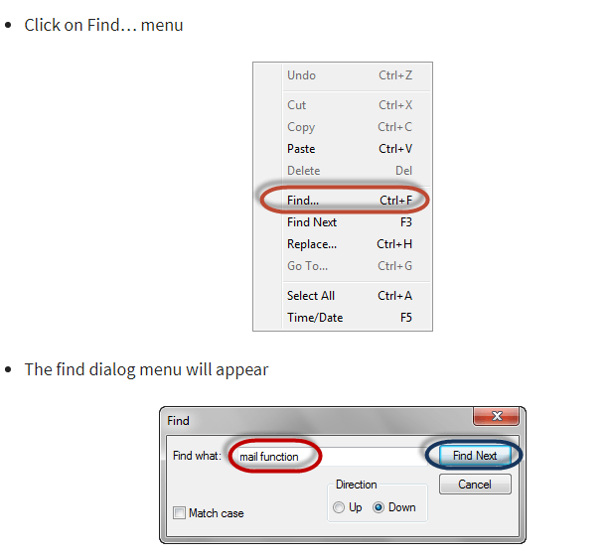

Slide 54
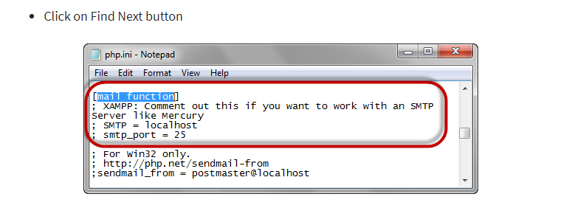

Slide 55
ocate the entries[mail function]
; XAMPP: Don’t remove the semi column if you want to work with an SMTP Server like Mercury
; SMTP = localhost
; smtp_port = 25
Remove the semi colons before SMTP and smtp_port and set the SMTP to your smtp server and the port to your smtp port. Your settings should look as follows
  SMTP = smtp.example.com
  smtp_port = 25
  Note the SMTP settings can be gotten from your web hosting providers.
  If the server requires authentication, then add the following lines.
    auth_username = example_username@example.com
    auth_password = example_password
    Save the new changes.
    Restart Apache server.

Slide 56
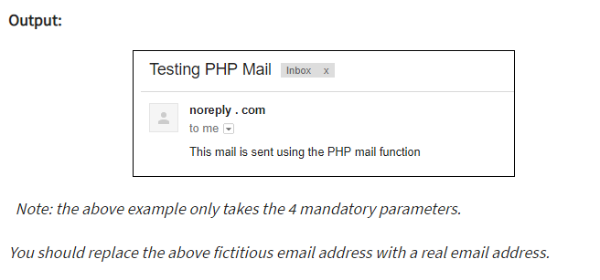
Let’s now look at an example that sends a simple mail.
<?php
$to_email = 'name @ company . com';
$subject = 'Testing PHP Mail';
$message = 'This mail is sent using the PHP mail function'; $headers = 'From: noreply @ company . com'; mail($to_email,$subject,$message,$headers);
?>

Slide 57
FILE UPLOADING
With PHP, it is easy to upload files to the server.
Configure The "php.ini" File
First, ensure that PHP is configured to allow file uploads.
In your "php.ini" file, search for the file_uploads directive, and set it to On:
file_uploads = On

Slide 58
CREATE THE HTML FORM
Next, create an HTML form that allow users to choose the image file they want to upload:

Slide 59
UPLOAD.PHP
<html>
<body>
<form method='post' enctype='multipart/form-data' action='receive.php'>
<input type='file' name='myfile' />
<input type='submit' name='upload' value='SEND' />
</form>
</body>
</html>

Slide 60
RECEIVE.PHP
<?php
$name=$_FILES['myfile']['name'];
$tmp_name=$_FILES['myfile']['tmp_name'];
if(move_uploaded_file($tmp_name, $name))
{
echo "file uploaded";
}
else
{
echo "not successful";
}
?>

Slide 61
Some rules to follow for the HTML form above:
Make sure that the form uses method="post"
The form also needs the following attribute: enctype="multipart/form-data". It specifies which content-type to use when submitting the form
Without the requirements above, the file upload will not work.
Other things to notice:
The type="file" attribute of the <input> tag shows the input field as a file-select control, with a "Browse" button next to the input control
The form above sends data to a file called "upload.php", which we will create next.

Slide 62
ACCESSING FORM ELEMENTS IN PHP
If the form method is GET then the form fields values are stored into the $_GET array. If it is POST, then the values are posted with the $_POST array. In the PHP file, the $_GET or $_POST request array is used to access and process the user input submitted via the form.
The PHP superglobals $_GET and $_POST are used to collect form-data.

Slide 63
PHP - A Simple HTML Form
The example below displays a simple HTML form with two input fields and a submit button:
<html>
<body>
<form action="welcome.php" method="post">
Name: <input type="text" name="name"><br>
E-mail: <input type="text" name="email"><br>
<input type="submit">
</form>
</body>
</html>

Slide 64
When the user fills out the form above and clicks the submit button, the form data is sent for processing to a PHP file named "welcome.php". The form data is sent with the HTTP POST method.
To display the submitted data you could simply echo all the variables. The "welcome.php" looks like this:

Slide 65
<html>
<body>
Welcome <?php echo $_POST["name"]; ?><br>
Your email address is: <?php echo $_POST["email"]; ?>
</body>
</html>

Slide 66
GET
<html>
<body>
<form action="welcome_get.php" method="get">
Name: <input type="text" name="name"><br>
E-mail: <input type="text" name="email"><br>
<input type="submit">
</form>
</body>
</html>

Slide 67
<html>
<body>
Welcome <?php echo $_GET["name"]; ?><br>
Your email address is: <?php echo $_GET["email"]; ?>
</body>
</html>

Slide 68
FORM VALIDATION IN PHP
When processing a form, it’s critical to validate user inputs to ensure that the data is in a valid format.
There are two types of validations: client-side & server-side:
The client-side validation is performed in the web browsers of the users.
The server-side validation validates data in the web server using PHP.

Slide 69
PHP validates the data at the server-side, which is submitted by HTML form. You need to validate a few things:
Empty String
Validate String
Validate Numbers
Validate Email
Validate URL
Input length

Slide 70
Empty String
The code below checks that the field is not empty. If the user leaves the required field empty, it will show an error message. Put these lines of code to validate the required field.
if (emptyempty ($_POST["name"])) {
$errMsg = "Error! You didn't enter the Name.";
echo $errMsg;
} else
{
$name = $_POST["name"];
}

Slide 71
Validate String
The code below checks that the field will contain only alphabets and whitespace, for example - name. If the name field does not receive valid input from the user, then it will show an error message:
$name = $_POST ["Name"];
if (!preg_match ("/^[a-zA-z]*$/", $name) ) {
$ErrMsg = "Only alphabets and whitespace are allowed."; echo $ErrMsg;
} else {
echo $name;
}

Slide 72
Validate Number
The below code validates that the field will only contain a numeric value. For example - Mobile no. If the Mobile no field does not receive numeric data from the user, the code will display an error message:
$mobileno = $_POST ["Mobile_no"];
if (!preg_match ("/^[0-9]*$/", $mobileno) ){
$ErrMsg = "Only numeric value is allowed.";
echo $ErrMsg;
} else {
echo $mobileno;
}

Slide 73
Validate Email
A valid email must contain @ and . symbols. PHP provides various methods to validate the email address. Here, we will use regular expressions to validate the email address.
The below code validates the email address provided by the user through HTML form. If the field does not contain a valid email address, then the code will display an error message:
$email = $_POST ["Email"];
$pattern = "^[_a-z0-9-]+(\.[_a-z0-9-]+)*@[a-z0-9-]+(\.[a-z0-9-]+)*(\.[a-z]{2,3})$^";
if (!preg_match ($pattern, $email) ){
$ErrMsg = "Email is not valid.";
echo $ErrMsg;
} else {
echo "Your valid email address is: " .$email;
}

Slide 74
Input Length Validation
The input length validation restricts the user to provide the value between the specified range, for Example - Mobile Number. A valid mobile number must have 10 digits.
The given code will help you to apply the length validation on user input:
$mobileno = strlen ($_POST ["Mobile"]);
$length = strlen ($mobileno);
if ( $length < 10 && $length > 10) {
$ErrMsg = "Mobile must have 10 digits.";
echo $ErrMsg;
} else {
echo "Your Mobile number is: " .$mobileno;
}

Slide 75
Validate URL
The below code validates the URL of website provided by the user via HTML form. If the field does not contain a valid URL, the code will display an error message, i.e., "URL is not valid".
$websiteURL = $_POST["website"];
if (!preg_match("/\b(?:(?:https?|ftp):\/\/|www\.)[-a-z0-9+&@#\/%?=~_|!:,.;]*[-a-z0-9+&@#\/%=~_|]/i",$website)) {
$websiteErr = "URL is not valid";
echo $websiteErr;
} else {
echo "Website URL is: " .$websiteURL;
}

Slide 76
Button Click Validate
The below code validates that the user click on submit button and send the form data to the server one of the following method - get or post.
if (isset ($_POST['submit']) {
echo "Submit button is clicked.";
if ($_SERVER["REQUEST_METHOD"] == "POST") {
echo "Data is sent using POST method ";
}
} else {
echo "Data is not submitted";
}

Slide 77
EXCEPTION HANDLING
What is an Exception?
An exception is an unexcepted outcome of a program, which can be handled by the program itself.
Why needs Exception Handling?
PHP provides a powerful mechanism, exception handling. It allows you to handle runtime errors such as IOException, SQLException, ClassNotFoundException, and more. A most popular example of exception handling is - divide by zero exception, which is an arithmetic exception.

Slide 78
PHP offers the following keywords for this purpose:
try -
The try block contains the code that may have an exception or where an exception can arise. When an exception occurs inside the try block during runtime of code, it is caught and resolved in catch block. The try block must be followed by catch or finally block. A try block can be followed by minimum one and maximum any number of catch blocks.

Slide 79
catch -
The catch block contains the code that executes when a specified exception is thrown. It is always used with a try block, not alone. When an exception occurs, PHP finds the matching catch block.
throw -
It is a keyword used to throw an exception. It also helps to list all the exceptions that a function throws but does not handle itself.
Remember that each throw must have at least one "catch".

Slide 80
finally -
The finally block contains a code, which is used for clean-up activity in PHP. Basically, it executes the essential code of the program.

Slide 81
Let's take an example to explain the common flow of throw and try-catch block:

Slide 82
<?php
function checkNumber($num) {
if($num>=1) {
//throw an exception
throw new Exception("Value must be less than 1");
}
return true;
}
//trigger an exception in a "try" block
try {
checkNumber(5);
//If the exception throws, below text will not be display
echo 'If you see this text, the passed value is less than 1';
}
//catch exception
catch (Exception $e) {
echo 'Exception Message: ' .$e->getMessage();
}
?>

Slide 83
ERROR HANDLING
When creating scripts and web applications, error handling is an important part. If your code lacks error checking code, your program may look very unprofessional and you may be open to security risks.
some of the most common error checking methods in PHP.
Simple "die()" statements
Custom errors and error triggers
Error reporting

Slide 84
Basic Error Handling: Using the die() function
The first example shows a simple script that opens a text file:
Example
<?php
$file=fopen("mytestfile.txt","r");
?>
If the file does not exist you might get an error like this:
Warning: fopen(mytestfile.txt) [function.fopen]: failed to open stream:
No such file or directory in C:\webfolder\test.php on line 2
To prevent the user from getting an error message like the one above, we test whether the file exist before we try to access it:

Slide 85
Example
<?php
if(file_exists("mytestfile.txt")) {
$file = fopen("mytestfile.txt", "r");
} else {
die("Error: The file does not exist.");
}
?>
Now if the file does not exist you get an error like this:
Error: The file does not exist.
The code above is more efficient than the earlier code, because it uses a simple error handling mechanism to stop the script after the error.
However, simply stopping the script is not always the right way to go. Let's take a look at alternative PHP functions for handling errors.

Slide 86
Creating a Custom Error Handler
Creating a custom error handler is quite simple. We simply create a special function that can be called when an error occurs in PHP.
This function must be able to handle a minimum of two parameters (error level and error message) but can accept up to five parameters (optionally: file, line-number, and the error context):
Syntax
error_function(error_level,error_message,
error_file,error_line,error_context)

Slide 87
Parameter | Description
error_level | Required. Specifies the error report level for the user-defined error. Must be a value number. See table below for possible error report levels
error_message | Required. Specifies the error message for the user-defined error
error_file | Optional. Specifies the filename in which the error occurred
error_line | Optional. Specifies the line number in which the error occurred
error_context | Optional. Specifies an array containing every variable, and their values, in use when the error occurred

Slide 88
Error Report levels
These error report levels are the different types of error the user-defined error handler can be used for:
Value | Constant | Description
1 | E_ERROR | A fatal run-time error. Execution of the script is stopped
2 | E_WARNING | A non-fatal run-time error. Execution of the script is not stopped
8 | E_NOTICE | A run-time notice. The script found something that might be an error, but could also happen when running a script normally
256 | E_USER_ERROR | A fatal user-generated error. This is like an E_ERROR, except it is generated by the PHP script using the function trigger_error()
512 | E_USER_WARNING | A non-fatal user-generated warning. This is like an E_WARNING, except it is generated by the PHP script using the function trigger_error()
1024 | E_USER_NOTICE | A user-generated notice. This is like an E_NOTICE, except it is generated by the PHP script using the function trigger_error()
2048 | E_STRICT | Not strictly an error.
8191 | E_ALL | All errors and warnings (E_STRICT became a part of E_ALL in PHP 5.4)

Slide 89
Now lets create a function to handle errors:
function customError($errno, $errstr) {
echo "<b>Error:</b> [$errno] $errstr<br>";
echo "Ending Script";
die();
}
The code above is a simple error handling function. When it is triggered, it gets the error level and an error message. It then outputs the error level and message and terminates the script.
Now that we have created an error handling function we need to decide when it should be triggered.

Slide 90
Set Error Handler
The default error handler for PHP is the built in error handler. We are going to make the function above the default error handler for the duration of the script.
It is possible to change the error handler to apply for only some errors, that way the script can handle different errors in different ways. However, in this example we are going to use our custom error handler for all errors:
set_error_handler("customError");
Since we want our custom function to handle all errors, the set_error_handler() only needed one parameter, a second parameter could be added to specify an error level.

Slide 91
Example
Testing the error handler by trying to output variable that does not exist:
<?php
//error handler function
function customError($errno, $errstr) {
echo "<b>Error:</b> [$errno] $errstr";
}
//set error handler
set_error_handler("customError");
//trigger error
echo($test);
?>
The output of the code above should be something like this:
Error: [8] Undefined variable: test

Slide 92
Trigger an Error
In a script where users can input data it is useful to trigger errors when an illegal input occurs. In PHP, this is done by the trigger_error() function.
Example
In this example an error occurs if the "test" variable is bigger than "1":
<?php
$test=2;
if ($test>=1) {
trigger_error("Value must be 1 or below");
}
?>
The output of the code above should be something like this:
Notice: Value must be 1 or below
in C:\webfolder\test.php on line 6
An error can be triggered anywhere you wish in a script, and by adding a second parameter, you can specify what error level is triggered.

Slide 93
Possible error types:
E_USER_ERROR - Fatal user-generated run-time error. Errors that can not be recovered from. Execution of the script is halted
E_USER_WARNING - Non-fatal user-generated run-time warning. Execution of the script is not halted
E_USER_NOTICE - Default. User-generated run-time notice. The script found something that might be an error, but could also happen when running a script normally

Slide 94
Example
In this example an E_USER_WARNING occurs if the "test" variable is bigger than "1". If an E_USER_WARNING occurs we will use our custom error handler and end the script:

Slide 95
<?php
//error handler function
function customError($errno, $errstr) {
echo "<b>Error:</b> [$errno] $errstr<br>";
echo "Ending Script";
die();
}
//set error handler
set_error_handler("customError",E_USER_WARNING);
//trigger error
$test=2;
if ($test>=1) {
trigger_error("Value must be 1 or below",E_USER_WARNING);
}
?>
The output of the code above should be something like this:
Error: [512] Value must be 1 or below
Ending Script

Slide 96
BUGS DEBUGGING
Debugging is the process of detecting and removing of existing and potential errors (also called as ‘bugs’) in a software code that can cause it to behave unexpectedly or crash. To prevent incorrect operation of a software or system, debugging is used to find and resolve bugs or defects.
Programs rarely work correctly the first time. Many things can go wrong in your program that cause the PHP interpreter to generate an error message. You have a choice about where those error messages go. The messages can be sent along with other program output to the web browser. They can also be included in the web server error log.
To make error messages display in the browser, set the display_errors configuration directive to On. To send errors to the web server error log, set log_errors to On. You can set them both to On if you want error messages in both places.

Slide 97
There are following points which need to be verified while debugging your program.
Missing Semicolons − Every PHP statement ends with a semicolon (;). PHP doesn't stop reading a statement until it reaches a semicolon. If you leave out the semicolon at the end of a line, PHP continues reading the statement on the following line.
Not Enough Equal Signs − When you ask whether two values are equal in a comparison statement, you need two equal signs (==). Using one equal sign is a common mistake.
Misspelled Variable Names − If you misspelled a variable then PHP understands it as a new variable. Remember: To PHP, $test is not the same variable as $Test.

Slide 98
Missing Dollar Signs − A missing dollar sign in a variable name is really hard to see, but at least it usually results in an error message so that you know where to look for the problem.
Troubling Quotes − You can have too many, too few, or the wrong kind of quotes. So check for a balanced number of quotes.
Missing Parentheses and curly brackets − They should always be in pairs.
Array Index − All the arrays should start from zero instead of 1.

