Slide 1
PHP and Database Connection

Slide 2
Basic database concepts

Slide 3
How to Create a MySQL Database with phpMyAdmin
Make sure you have phpMyAdmin Installed. This guide assumes you have phpMyAdmin installed and ready to use.
Go to your phpMyAdmin homepage. For this guide you need to navigate to the phpMyAdmin homepage. It can usually be found under these directories, depending on your server setup.http://localhost:8888/phpMyAdmin/
http://localhost/phpmyadmin
http://{your-ip-address}/phpmyadmin/

Slide 4
Login to your phpMyAdmin Page. Make sure you are logged in to phpMyAdmin.
Enter your database name. Enter the name you want to call your new database, here we have named it "my_new_database".
Click "Create" and then you're done!

Slide 5
MySQL Database
With PHP, you can connect to and manipulate databases.
MySQL is the most popular database system used with PHP.
The data in a MySQL database are stored in tables. A table is a collection of related data, and it consists of columns and rows.
MySQL is a database system used on the web
MySQL is a database system that runs on a server
MySQL is ideal for both small and large applications MySQL is very fast, reliable, and easy to use
MySQL uses standard SQL
MySQL compiles on a number of platforms
MySQL is free to download and use
MySQL is developed, distributed, and supported by Oracle Corporation

Slide 6
Connecting to MySQL Server
Before we can access data in the MySQL database, we need to be able to connect to the server:
The process to connect MySQL server is given below:
<?php
$user = 'root';
$pass = '';
// Create connection
$conn = mysqli_connect('localhost', $user, $pass);
// Check connection
if (!$conn) {
die("Connection failed: " . mysqli_connect_error());
}
else
{
echo "Connected successfully";
}
?>

Slide 7
Create a MySQL Database
The CREATE DATABASE statement is used to create a database in MySQL.
The following examples create a database named “nawaraj":
<?php
$user = 'root';
$pass = '';
$conn = mysqli_connect('localhost', $user, $pass);
// Check connection
//Create database
$sql = "CREATE DATABASE cct1";
if (mysqli_query($conn, $sql)) {
echo "Database created successfullyyy";
} else {
echo "Error creating database: " . mysqli_error($conn);
}
?>

Slide 8
Create MySQL Tables
A database table has its own unique name and consists of columns and rows.
The CREATE TABLE statement is used to create a table in MySQL.
We will create a table named “contacts", with five columns: "id", "firstName", "lastName", "email" :
CREATE TABLE contacts (
id INT(6) UNSIGNED AUTO_INCREMENT PRIMARY KEY,
firstname VARCHAR(30) NOT NULL,
lastname VARCHAR(30) NOT NULL,
email VARCHAR(50),
)

Slide 9
Create table
<?php
$server = "localhost";
$dbuser = "root";
$dbpass = "";
$dbname = "n1";
$conn = mysqli_connect($server, $dbuser, $dbpass,$dbname);
$sqlQuery = "CREATE TABLE contacts (
id INT(6) UNSIGNED AUTO_INCREMENT PRIMARY KEY,
firstName VARCHAR(35) NOT NULL,
lastName VARCHAR(35) NOT NULL,
email VARCHAR(55)
)";
?>

Slide 10
Insert Data Into MySQL
After a database and a table have been created, we can start adding data in them.
The INSERT INTO statement is used to add new records to a MySQL table:
INSERT INTO table_name (column1, column2, column3,...)
VALUES (value1, value2, value3,...)
Here are some syntax rules to follow:
The SQL query must be quoted in PHP
String values inside the SQL query must be quoted
Numeric values must not be quoted
The word NULL must not be quoted

Slide 11
Example to insert single record into a table
<?php
$user = 'root';
$pass = '';
$dbname = "n1";
// Create connection
$conn = mysqli_connect('localhost', $user, $pass, $dbname);
$sql = "INSERT INTO contacts (id,firstName, lastName, email)
VALUES (' ', 'John', 'Doe', 'john@example.com')";
?>

Slide 12
Example to insert multiple record into a table
<?php
$user = 'root';
$pass = '';
$dbname = "nabraj";
// Create connection
$conn = mysqli_connect('localhost', $user, $pass, $dbname);
$sql = "INSERT INTO MyGuests (firstname, lastname, email)
VALUES ('Nabraj', 'Koirala', 'koiralanabraj@gmail.com'),
('Apil', 'Koirala', 'apil@gmail.com'),
('Ram', 'Pandey', 'rampandey@gmail.com')";
?>

Slide 13
Select Data From a MySQL Database
The SELECT statement is used to select data from one or more tables:
SELECT column_name(s) FROM table_name
or we can use the * character to select ALL columns from a table:
SELECT * FROM table_name

Slide 14
Example of Select Data From a MySQL Database
<?php
$user = 'root';
$pass = '';
$dbname = "n1";
// Create connection
$conn = mysqli_connect('localhost', $user, $pass, $dbname);
$sql = "SELECT * FROM contacts";
$result = mysqli_query($conn, $sql);
// output data of each row
while($row = $result->fetch_assoc()) {
echo "<br> id: ". $row["id"]. " - Name: ". $row["firstName"]. " " . $row["lastName"] ." Email:".$row["email"]."<br>";
}
?>
</body>
</html>

Slide 15
Select particular data from table
<?php
$user = 'root';
$pass = '';
$dbname = "n1";
// Create connection
$conn = mysqli_connect('localhost', $user, $pass, $dbname);
$sql = "SELECT id, firstName, lastName FROM contacts";
$result = $conn->query($sql);
// output data of each row
while($row = $result->fetch_assoc()) {
echo "<br> id: ". $row["id"]. " - Name: ". $row["firstName"]. " " . $row["lastName"] ."<br>";
}
?>
</body>
</html>

Slide 16
Delete Data From MySQL
The DELETE statement is used to delete records from a table:
DELETE FROM table_name
WHERE some_column = some_value

Slide 17
Example of Delete Data From MySQL
<?php
$user = 'root';
$pass = '';
$dbname = "n1";
// Create connection
$conn = mysqli_connect('localhost', $user, $pass, $dbname);
// sql to delete a record
$sql = "DELETE FROM contacts WHERE id=5";
?>

Slide 18
Update Data in MySQL
The UPDATE statement is used to update existing records in a table:
UPDATE table_name
SET column1=value, column2=value2,...
WHERE some_column=some_value

Slide 19
Example of Update Data in MySQL
<?php
$user = 'root';
$pass = '';
$dbname = "n1";
// Create connection
$conn = mysqli_connect('localhost', $user, $pass, $dbname);
// sql to update a record
$sql = "UPDATE contacts SET lastname='Koirala' WHERE id=4";
?>

Slide 20
Close the Connection
The connection will be closed automatically when the script ends. To close the connection before, use the following:
MySQLi Object-Oriented:
$conn->close();
MySQLi Procedural:
mysqli_close($conn);
PDO:
$conn = null;

Slide 21
Opening Database Connection
PHP provides mysql_connect function to open a database connection. This function takes five parameters and returns a MySQL link identifier on success, or FALSE on failure.
Syntax
connection mysql_connect(server,user,passwd,new_link,client_flag);

Slide 22
Closing Database Connection
Its simplest function mysql_close PHP provides to close a database connection. This function takes connection resource returned by mysql_connect function. It returns TRUE on success or FALSE on failure.
Syntax
bool mysql_close ( resource $link_identifier );

Slide 23
Example
<?php
$dbhost = 'localhost:3036';
$dbuser = 'guest';
$dbpass = 'guest123';
$conn = mysql_connect($dbhost, $dbuser, $dbpass); if(! $conn ) {
die('Could not connect: ' .mysql_error()); }
echo 'Connected successfully';
mysql_close($conn);
?>

Slide 24
Create MySQL Database Using PHP
Creating a Database
To create and delete a database you should have admin privilege. Its very easy to create a new MySQL database. PHP uses mysql_query function to create a MySQL database. This function takes two parameters and returns TRUE on success or FALSE on failure.
Syntax
bool mysql_query( sql, connection );

Slide 25
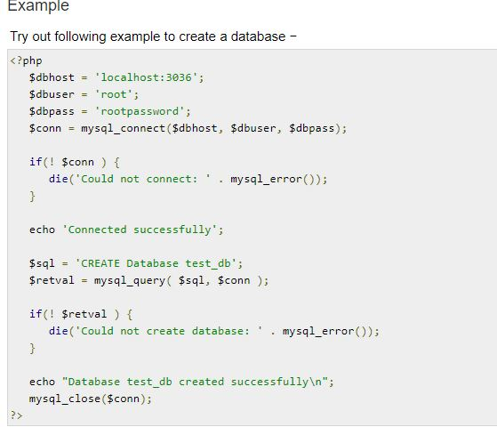

Slide 26
Selecting a Database
Once you establish a connection with a database server then it is required to select a particular database where your all the tables are associated.
PHP provides function mysql_select_db to select a database.It returns TRUE on success or FALSE on failure.
Syntax
bool mysql_select_db( db_name, connection );

Slide 27
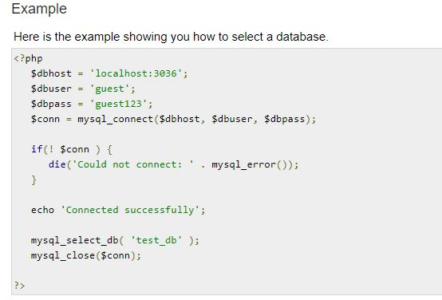

Slide 28
Creating Database Tables
To create tables in the new database you need to do the same thing as creating the database. First create the SQL query to create the tables then execute the query using mysql_query() function.

Slide 29
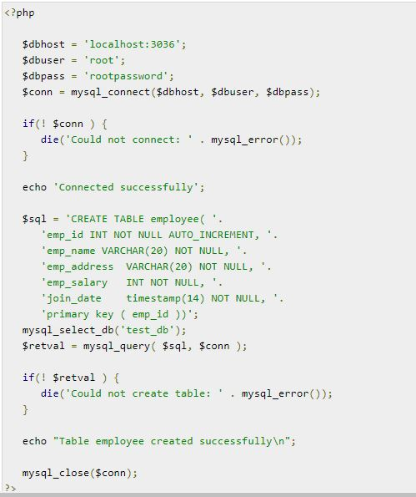

Slide 30
n case you need to create many tables then its better to create a text file first and put all the SQL commands in that text file and then load that file into $sql variable and excute those commands.
Consider the following content in sql_query.txt file
CREATE TABLE employee( emp_id INT NOT NULL AUTO_INCREMENT, emp_name VARCHAR(20) NOT NULL, emp_address VARCHAR(20) NOT NULL, emp_salary INT NOT NULL, join_date timestamp(14) NOT NULL, primary key ( emp_id ));

Slide 31
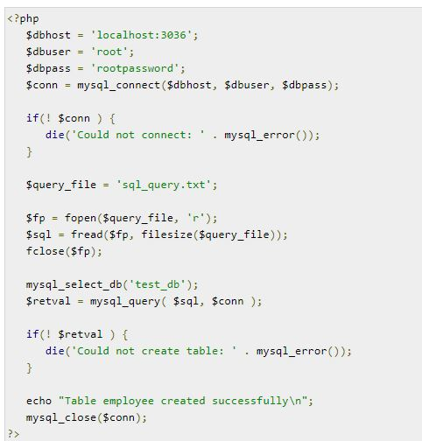

Slide 32
Deleting MySQL Database Using PHP
Deleting a Database
If a database is no longer required then it can be deleted forever. You can use pass an SQL command to mysql_query to delete a database.
Example
Try out following example to drop a database.

Slide 33
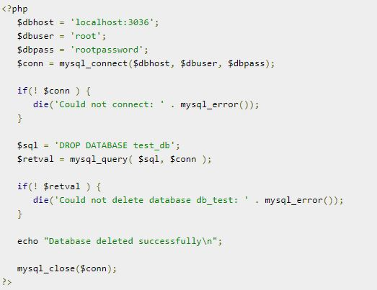

Slide 34
Deleting a Table
Its again a matter of issuing one SQL command through mysql_query function to delete any database table. But be very careful while using this command because by doing so you can delete some important information you have in your table.
Example
Try out following example to drop a table −

Slide 35
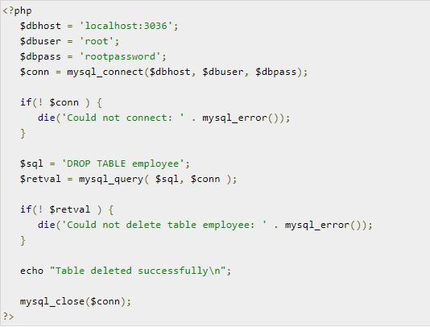

Slide 36
Insert Data into MySQL Database
Data can be entered into MySQL tables by executing SQL INSERT statement through PHP function mysql_query. Below a simple example to insert a record into employee table.
Example
Try out following example to insert record into employee table.

Slide 37
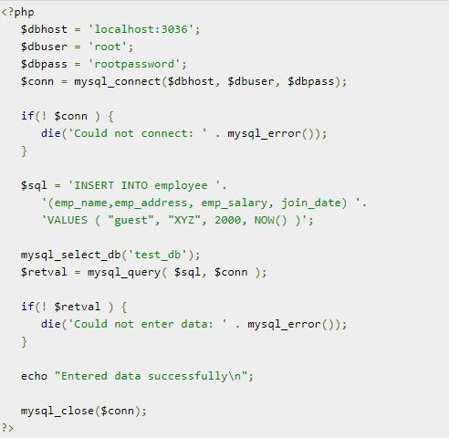

Slide 38
Getting Data From MySQL Database
Data can be fetched from MySQL tables by executing SQL SELECT statement through PHP function mysql_query. You have several options to fetch data from MySQL.
The most frequently used option is to use function mysql_fetch_array(). This function returns row as an associative array, a numeric array, or both. This function returns FALSE if there are no more rows.
Below is a simple example to fetch records from employee table.

Slide 39
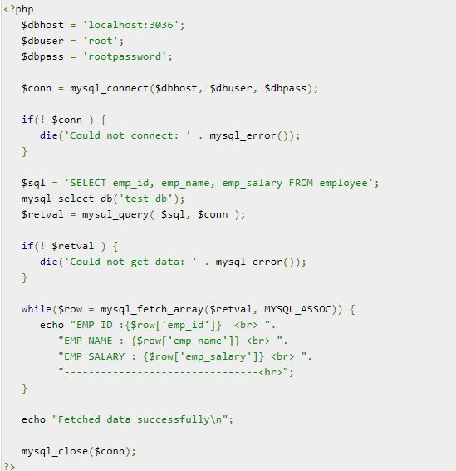

Slide 40
Example
Try out following example to display all the records from employee table using mysql_fetch_assoc() function.

Slide 41
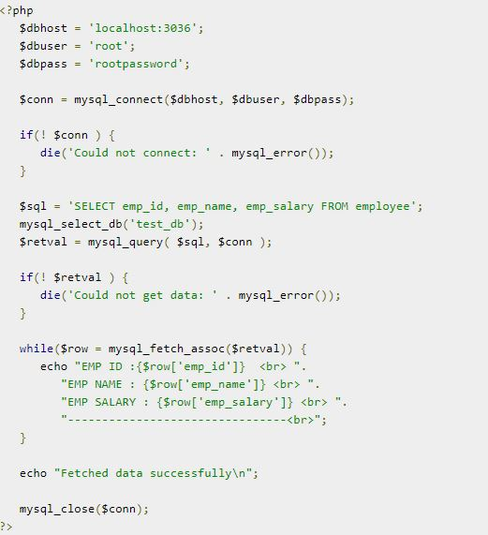

Slide 42
You can also use the constant MYSQL_NUM, as the second argument to mysql_fetch_array(). This will cause the function to return an array with numeric index.
Example
Try out following example to display all the records from employee table using MYSQL_NUM argument.

Slide 43
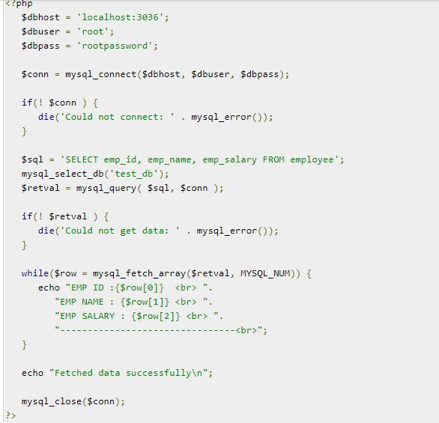

Slide 44
Releasing Memory
Its a good practice to release cursor memory at the end of each SELECT statement. This can be done by using PHP function mysql_free_result(). Below is the example to show how it has to be used.
Example
Try out following example

Slide 45
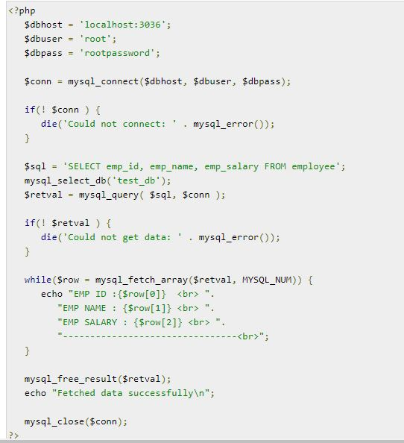

Slide 46
Using Paging through PHP
Paging means showing your query result in multiple pages instead of just put them all in one long page.
MySQL helps to generate paging by using LIMIT clause which will take two arguments. First argument as OFFSET and second argument how many records should be returned from the database.
Below is a simple example to fetch records using LIMIT clause to generate paging.
Example
Try out following example to display 10 records per page.

Slide 47
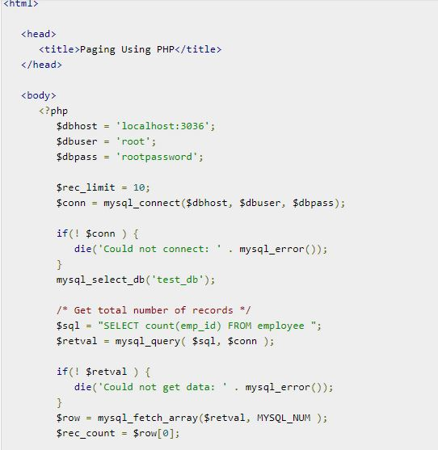

Slide 48
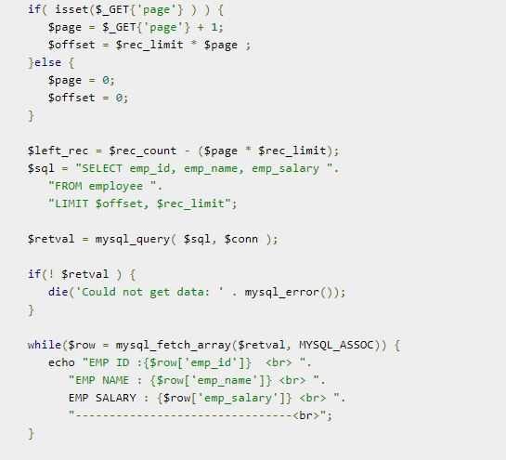

Slide 49
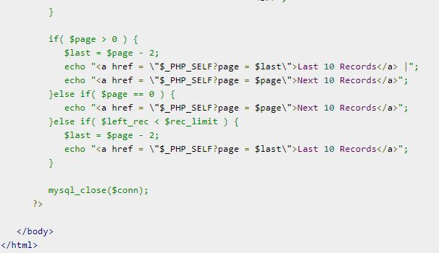

Slide 50
Updating Data into MySQL Database
Data can be updated into MySQL tables by executing SQL UPDATE statement through PHP function mysql_query.
Example
Try out following example to understand update operation. You need to provide an employee ID to update an employee salary.

Slide 51
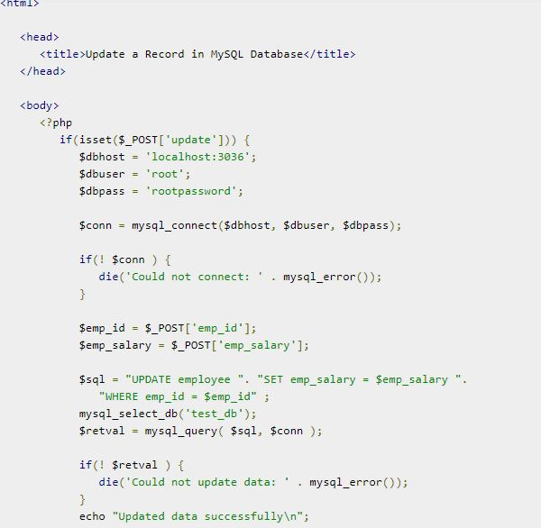

Slide 52
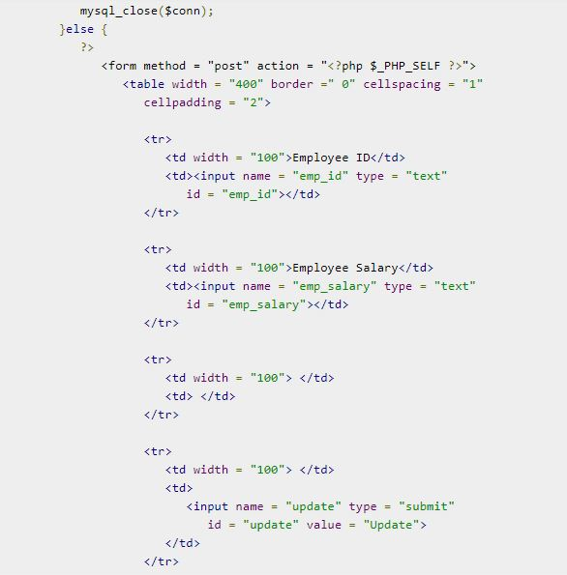

Slide 53
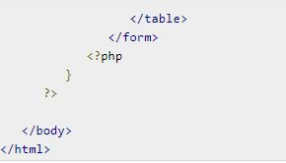

Slide 54
Deleting Data from MySQL Database
Data can be deleted from MySQL tables by executing SQL DELETE statement through PHP function mysql_query.
Example
Try out following example to understand delete operation. You need to provide an employee ID to delete an employee record from employee table.

Slide 55
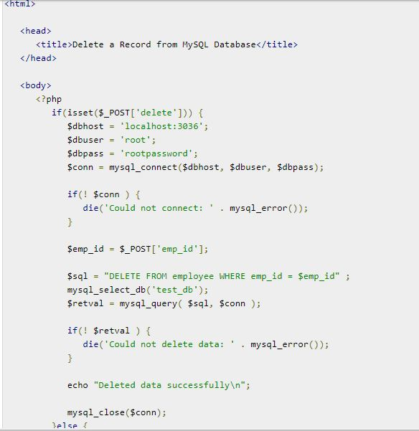

Slide 56
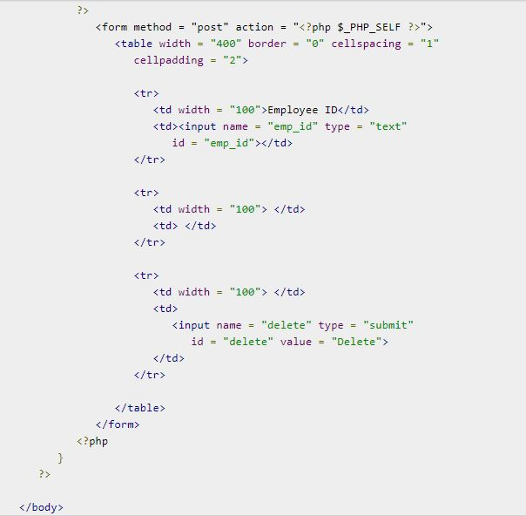

Slide 57
Perform MySQL backup using PHP
It is always good practice to take a regular backup of your database. There are three ways you can use to take backup of your MySQL database.
Using SQL Command through PHP.
Using MySQL binary mysqldump through PHP.
Using phpMyAdmin user interface.
Using SQL Command through PHP
You can execute SQL SELECT command to take a backup of any table. To take a complete database dump you will need to write separate query for separate table. Each table will be stored into separate text file.

Slide 58
Example
Try out following example of using SELECT INTO OUTFILE query for creating table backup −

Slide 59
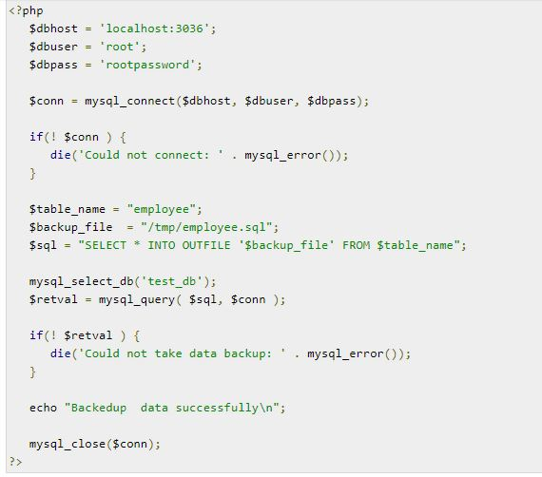

Slide 60
There may be instances when you would need to restore data which you have backed up some time ago. To restore the backup you just need to run LOAD DATA INFILE query like this −

Slide 61
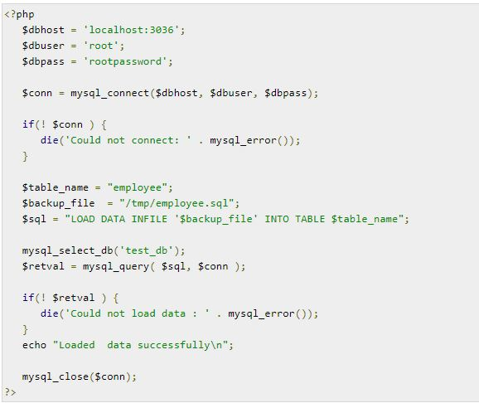

Slide 62
Using MySQL binary mysqldump through PHP
MySQL provides one utility mysqldump to perform database backup. Using this binary you can take complete database dump in a single command.
Example
Try out following example to take your complete database dump −

Slide 63
<?php $dbhost = 'localhost:3036';
$dbuser = 'root';
$dbpass = 'rootpassword';
$backup_file = $dbname . date("Y-m-d-H-i-s") . '.gz'; $command = "mysqldump --opt -h $dbhost -u $dbuser -p $dbpass ". "test_db | gzip > $backup_file"; system($command);
?>

Slide 64
Using phpMyAdmin user interface
If you have phpMyAdmin user interface available then its very easy for your to take backup of your database.
To backup your MySQL database using phpMyAdmin click on the "export" link on phpMyAdmin main page. Choose the database you wish to backup, check the appropriate SQL options and enter the name for the backup file.

