Slide 1
AJAX
BY LECTURER SURAJ PANDEY CCT COLLEGE

Slide 2
WHAT IS AJAX?
AJAX stands for Asynchronous JavaScript and XML. AJAX is a new technique for creating better, faster, and more interactive web applications with the help of XML, HTML, CSS, and Java Script.
BY LECTURER SURAJ PANDEY CCT COLLEGE

Slide 3
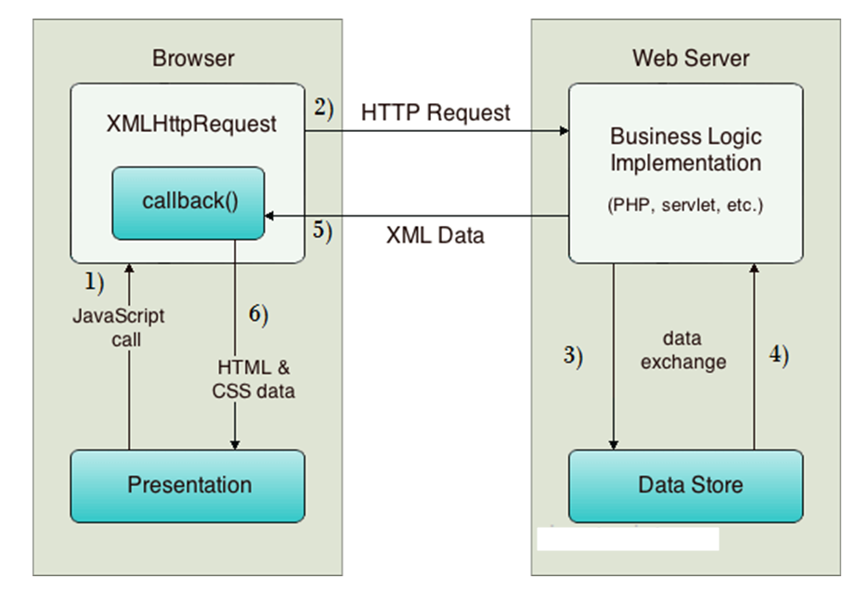
BY LECTURER SURAJ PANDEY CCT COLLEGE

Slide 4
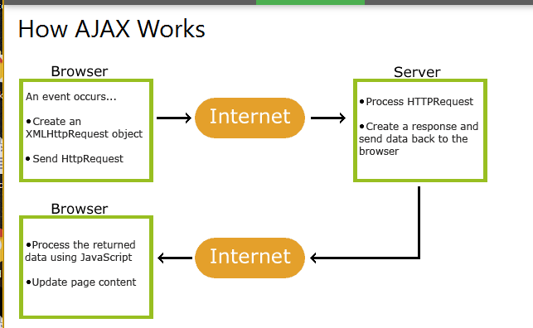
BY LECTURER SURAJ PANDEY CCT COLLEGE

Slide 5
As you can see in the above example, XMLHttpRequest object plays a important role.
User sends a request from the UI and a javascript call goes to XMLHttpRequest object.
HTTP Request is sent to the server by XMLHttpRequest object.
Server interacts with the database using JSP, PHP, Servlet, ASP.net etc.
Data is retrieved.
Server sends XML data or JSON data to the XMLHttpRequest callback function.
HTML and CSS data is displayed on the browser.
BY LECTURER SURAJ PANDEY CCT COLLEGE

Slide 6
Ajax behind Process (How to Work Ajax)
HTML/CSS
HTML/CSS is website markup language for defining web page layout, such as fonts style and colors.
JavaScript
JavaScript is a web scripting language. JavaScript special object XMLHttpRequest that was designed by Microsoft. XMLHttpRequest provides an easy way to retrieve data from web server without having to do full page refresh. Web page can update just part of the page without interrupting what the users are doing.
Document Object Model
Document Object Model (DOM) method provides a tree structure as a logical view of web page.
BY LECTURER SURAJ PANDEY CCT COLLEGE

Slide 7
XML
XML is a format for retrieve any type of data, not just XML data from the web server. However you can use other formats such as Plain text, HTML or JSON (JavaScript Object Notation). and it supports protocols HTTP and FTP.
BY LECTURER SURAJ PANDEY CCT COLLEGE

Slide 8
ADVANTAGES OF AJAX
AJAX Concept
Before you starting AJAX you'll need to have a strong knowledge of JavaScript. AJAX is not a difficult, you can easy implement AJAX in a meaningful manner. Some IDE are help us to implement AJAX.
Speed
Reduce the server traffic in both side request. Also reducing the time consuming on both side response.
Interaction
AJAX is much responsive, whole page(small amount of) data transfer at a time.
XMLHttpRequest
XMLHttpRequest has an important role in the Ajax web development technique. XMLHttpRequest is special JavaScript object that was designed by Microsoft. XMLHttpRequest object call as a asynchronous HTTP request to the Server for transferring data both side. It's used for making requests to the non-Ajax pages.
BY LECTURER SURAJ PANDEY CCT COLLEGE

Slide 9
Asynchronous calls
AJAX make asynchronous calls to a web server. This means client browsers are avoid waiting for all data arrive before start the rendering.
Form Validation
This is the biggest advantage. Form are common element in web page. Validation should be instant and properly, AJAX gives you all of that, and more.
Bandwidth Usage
No require to completely reload page again. AJAX is improve the speed and performance. Fetching data from database and storing data into database perform background without reloading page.
BY LECTURER SURAJ PANDEY CCT COLLEGE

Slide 10
DISADVANTAGES OF AJAX
1. AJAX application would be a mistake because search engines would not be able to index an AJAX application.
2. Open Source: View source is allowed and anyone can view the code source written for AJAX.
3. ActiveX requests are enabled only in Internet Explorer and newer latest browser.
4 The last disadvantage, XMLHttpRequest object itself. For a security reason you can only use to access information from the web host that serves initial pages. If you need to fetching information from another server, it's is not possible with in the AJAX.
BY LECTURER SURAJ PANDEY CCT COLLEGE

Slide 11
AJAX - EXAMPLES
Here is a list of some famous web applications that make use of AJAX.
Google Maps
A user can drag an entire map by using the mouse, rather than clicking on a button.
https://maps.google.com/
Google Suggest
As you type, Google offers suggestions. Use the arrow keys to navigate the results.
https://www.google.com/webhp?complete=1&hl=en
Gmail
Gmail is a webmail built on the idea that emails can be more intuitive, efficient, and useful.
https://gmail.com/
BY LECTURER SURAJ PANDEY CCT COLLEGE

Slide 12
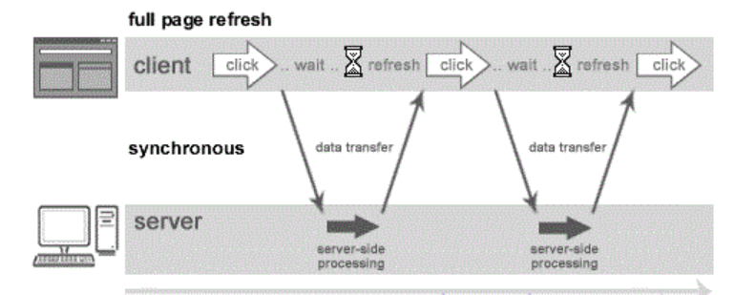
Understanding Synchronous vs Asynchronous
Synchronous (Classic Web-Application Model)
A synchronous request blocks the client until operation completes i.e. browser is unresponsive. In such case, javascript engine of the browser is blocked.
BY LECTURER SURAJ PANDEY CCT COLLEGE

Slide 13
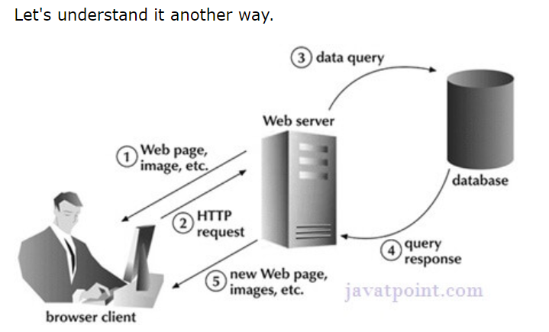
As you can see in the above image, full page is refreshed at request time and user is blocked until request completes.
BY LECTURER SURAJ PANDEY CCT COLLEGE

Slide 14
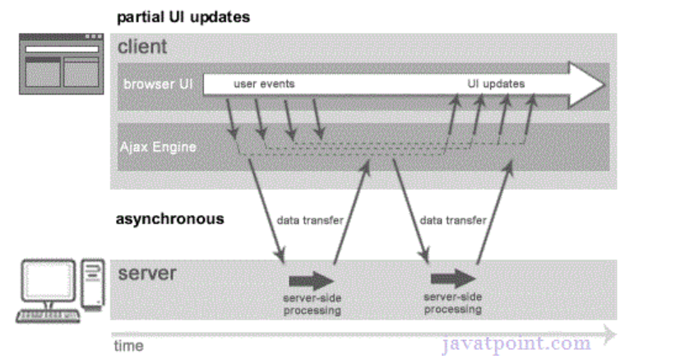
Asynchronous (AJAX Web-Application Model)
An asynchronous request doesn’t block the client i.e. browser is responsive. At that time, user can perform another operations also. In such case, javascript engine of the browser is not blocked.
BY LECTURER SURAJ PANDEY CCT COLLEGE

Slide 15
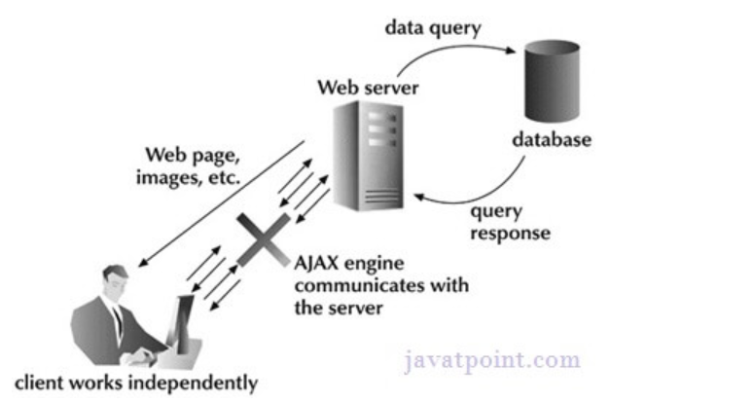
As you can see in the above image, full page is not refreshed at request time and user gets response from the ajax engine.
Let's try to understand asynchronous communication by the image given below.
BY LECTURER SURAJ PANDEY CCT COLLEGE

Slide 16
WHAT IS AJAX XMLHTTPREQUEST OBJECT?
XMLHttpRequest object is an API for fetching any text base format data, including XML without user/visual interruptions.
All most all browser platform support XMLHttpRequest object to make HTTP requests.
Following are sequence of step for working with XMLHttpRequest object:
Define instance of this XMLHttpRequest.
Create a asynchronous call to a server page, also defining a callback function that will automatically execute when the server response is received.
Callback function getting server response.
DOM manipulate received data and added into live page.
BY LECTURER SURAJ PANDEY CCT COLLEGE

Slide 17
Define instance of this XMLHttpRequest object
Create new instance of the XMLHttpRequest object, using new keyword,
var xhr = new XMLHttpRequest();
BY LECTURER SURAJ PANDEY CCT COLLEGE

Slide 18
XMLHttpRequest Object Methods
Method | Description
new XMLHttpRequest() | Creates a new XMLHttpRequest object
abort() | Cancels the current request
getAllResponseHeaders() | Returns header information
getResponseHeader() | Returns specific header information
open(method,url,async,user,psw) | Specifies the request method: the request type GET or POST url: the file location async: true (asynchronous) or false (synchronous) user: optional user name psw: optional password
send() | Sends the request to the server Used for GET requests
send(string) | Sends the request to the server. Used for POST requests
setRequestHeader() | Adds a label/value pair to the header to be sent
BY LECTURER SURAJ PANDEY CCT COLLEGE

Slide 19
XMLHttpRequest Object Properties
Property | Description
onreadystatechange | Defines a function to be called when the readyState property changes
readyState | Holds the status of the XMLHttpRequest. 0: request not initialized 1: server connection established 2: request received 3: processing request 4: request finished and response is ready
responseText | Returns the response data as a string
responseXML | Returns the response data as XML data
status | Returns the status-number of a request 200: "OK" 403: "Forbidden" 404: "Not Found"
statusText | Returns the status-text (e.g. "OK" or "Not Found")
BY LECTURER SURAJ PANDEY CCT COLLEGE

Slide 20
Synchronous Ajax requests: In this, the script stops and waits for the server to reply before continuing. In the web application world, one has to happen after the other, i.e. the interaction between the customer and the server is synchronous. Synchronous is not recommended as it blocks/hangs the page until the response is received from the server.
Asynchronous Ajax requests handle the reply as and when it comes and allows the page to continue to be processed. Under Asynchronous, if there is any problem in the request it can be modified and recovered. The request doesn’t block the client as the browser is responsive. The user can perform other operations as well.
BY LECTURER SURAJ PANDEY CCT COLLEGE

Slide 21
1) Synchronous: Any validation you want to perform before the form submits on client side. For ex you want to check if a field on other table has data or not for this you will make a Synchronous Ajax call to get the Data from Server Side to client and based on response you may submit the record or return false.
2)Asynchronous: If you need to perform any server side action and there is no need to show anything on current form . i.e. for any background server actions you can use Asynchronous Ajax.
In short, async happens "in the background". The user doesn't wait.
Synchronous holds the client's browser hostage while it waits for a response from the remote system.
BY LECTURER SURAJ PANDEY CCT COLLEGE

Slide 22
IMPLEMENTING AJAX FRAMEWORK
The AJAX Framework is a cross browser framework that allows developers to quickly develop web pages that can call web services, web pages and other types of content through JavaScript without having to submit the current page.The AJAX Framework is:
Easy to use.
Works well with other existing frameworks.
Supports both "GET" and "POST".
Works with Internet Explorer 6+, Opera 8+, Safari 3+, Firefox 2+, Google's Chrome and other Mozilla based browsers.
BY LECTURER SURAJ PANDEY CCT COLLEGE

Slide 23
SIMPLE AJAX EXAMPLE
Game-list.php
<ul>
<li>ravi</li>
<li>raj</li>
<li>can</li>
<li>home</li>
</ul>
BY LECTURER SURAJ PANDEY CCT COLLEGE

Slide 24
<script type="text/javascript">
function getcontent()
{
var xmlHttp=new XMLHttpRequest();
xmlHttp.open("GET","game-list.php", false);
xmlHttp.send(null);
var element=document.getElementById("content");
element.innerHTML=xmlHttp.responseText;
}
function hidecontent()
{
var element=document.getElementById("content");
element.innerHTML="";
}
</script>
<form>
<input onclick=getcontent(); type="button" value="get content" />
<input onclick=hidecontent(); type="button" value="hide content" />
</form>
<div id="content">
</div>
BY LECTURER SURAJ PANDEY CCT COLLEGE

