Slide 1
Laravel Example

Slide 2
Laravel 6 Hello World
Topics to be covered
Artisan command line tool
Artisan command to generate boiler plate code for a controller
Basic routing
Call a controller method from a route
Loading a view from a controller
Passing variables from controllers to views
Artisan maintenance mode commands

Slide 3
Artisan command line tool
Artisan is a command line tool that automates common tasks in Laravel. The tool is run from the command line. The artisan command line tool can be used to perform the following tasks and many more
Generate boilerplate code – easily create controllers, models etc.
Database migrations – migrations are used to manipulate database objects. Migrations can be used to create and drop tables etc.
Database seeding – seeding is a term used to add dummy records to the database.
Routing
Application configuration
Run unit tests
Set application name space
Publish package resources

Slide 4
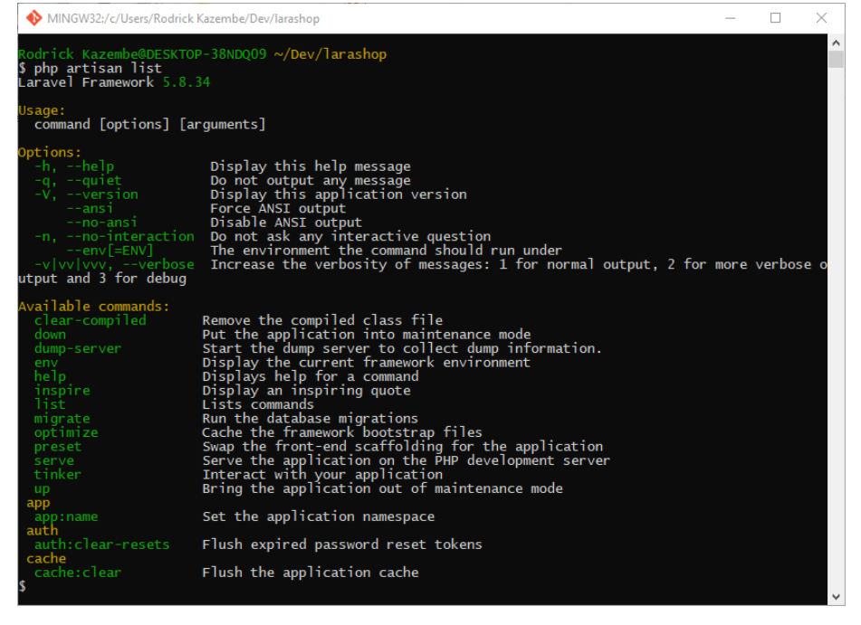
How to use the artisan command line tool
Open the command line and browser to the root of the project that you created in the previous lesson.
  cd ~/Dev/larashop
Run the following command to view the list of available commands
php artisan list

Slide 5
Artisan command to generate boiler plate code for a controller
In this section, we are going to create a simple controller that will hand the HTTP request and load the hello world view.
Run the following command to generate a controller
  php artisan make:controller HelloController
HERE,
php artisan make:controller HelloController uses the make command to generate boiler plate code for a controller named HelloController
Executing the above command produces the following results
Controller created successfully.

Slide 6
Open the file /app/Http/Controllers/HelloController.php
You will see the following code
<?php
namespace App\Http\Controllers;
use Illuminate\Http\Request;
class HelloController extends Controller
{
//
}
HERE,
<?php is the standard PHP opening tag
namespace App\Http\Controllers; defines the controllers namespace
use Illuminate\Http\Request; imports the Request object
class HelloController extends Controller{...} defines a class HelloController that extends the parent class Controller. The parent class Controller is part of the Laravel framework.

Slide 7
Let's now define a function called index in our HelloController like so
  public function index(Request $request){
  HERE,
public function index(Request $request){...} defines a public function index that accepts a parameter $request which is of type Request. The type Request is part of the Laravel framework.
return 'Hello World'; returns the words Hello World

Slide 8
Basic routing
In this section, we will create a new route that will display hello world in the web browser
Route anonymous functions
Open /routes/web.php file. The routes directory is in the root of the application.
Add the following code to web.php
Route::get('/hello',function(){ return 'Hello World!'; });
HERE,
Route::get('/hello',function(){...} defines a route called hello that can be accessed via the web browser
return 'Hello World!'; returns the words Hello World

Slide 9
Let's now start the built-in server that comes with Laravel using artisan like so
php artisan serve HERE,
php artisan serve calls the serve command of artisan to start the built-in PHP server. By default, the built-in command runs on port 8000
Executing the above command produces the following results
Laravel development server started: http://127.0.0.1:8000

Slide 10
Let's now load the following URL in our browser
http://localhost:8000/hello The above URL produces the following result
Hello World!

Slide 11
Route to controller routing
In the above section, we used an anonymous function that return the results to the user. In this section, we will call a function that is in a controller to return the results.
Modify our route defined above like so
Route::get('hello', 'HelloController@index');
HERE,
Route::get('hello', 'HelloController@index'); maps the URI hello to the method index that is defined in the controller HelloController.

Slide 12
Load the following URL in your browser
http://localhost:8000/hello You will get the following results
Hello World

Slide 13
Loading a view from a controller
Our above example returned a string directly from a controller. In the real world, results are usually returned from a view. Let's now do that in this section.
Create a new file hello.blade.php in the directory /resources/views.
Open /resources/views/hello.blade.php file
Add the following code
Hello World!!!

Slide 14
Passing variables from controllers to views
Would it be nice if we actually greeted a real person instead of the world? I think so. In this example, we will modify our application to pass in a name variable and greet the user.
Modify the route that we defined in /routes/web.php like so
Route::get('hello/{name}', 'HelloController@index'); HERE,
Route::get('hello/{name}', 'HelloController@index'); adds the variable name as specified by the curly brackets to our route. This allows us to pass in any value where we have {name}

Slide 15
Let's now modify our controller index method in /app/Http/Controllers/HelloController.php to accept a parameter called name like so.
public function index(Request $request,$name){
$params = [ 'name' => $name
];
return view('hello')->with($params);
}
HERE,
public function index(Request $request,$name){} our function definition accepts a parameter name
$params = ['name' => $name] defines an associative array with a key of name that is assigned the value of the variable $name.
return view('hello')->with($params); calls the with method on our view helpers and passes in the variable params as the argument.

Slide 16
Finally we modify our view /resources/views/hello.blade.php to print our the value of our name variable like so.
Hello {{$name}}
HERE,
{{$name}} double curly brackets are used to print out the value of the $name variable. We will talk more about blade in the coming lessons.
Load the following URL into your web browser
http://localhost:8000/hello/rodrick You should be able to see the following results.
Hello rodrick

