Slide 1
Vb.net Procedure, Function, Exception Handling
BY LECTURER SURAJ PANDEY CCT COLLEGE

Slide 2
What Are Subroutines and Functions?
A procedure is a group of statements that together perform a task when called. After the procedure is executed, the control returns to the statement calling the procedure. VB.Net has two types of procedures:
Functions
Sub procedures or Subs
Functions return a value, whereas Subs do not return a value.
BY LECTURER SURAJ PANDEY CCT COLLEGE

Slide 3
Defining a Function
The Function statement is used to declare the name, parameter and the body of a function. The syntax for the Function statement is:
[Modifiers] Function FunctionName [(ParameterList)] As ReturnType
[Statements]
End Function
BY LECTURER SURAJ PANDEY CCT COLLEGE

Slide 4
Example
Following code snippet shows a function FindMax that takes two integer values and returns the larger of the two.
Function FindMax(ByVal num1 As Integer, ByVal num2 As Integer) As Integer
' local variable declaration */
Dim result As Integer
If (num1 > num2) Then
result = num1
Else
result = num2
End If
FindMax = result
End Function
BY LECTURER SURAJ PANDEY CCT COLLEGE

Slide 5
Function Returning a Value
In VB.Net, a function can return a value to the calling code in two ways:
By using the return statement
By assigning the value to the function name
The following example demonstrates using the FindMax function:
BY LECTURER SURAJ PANDEY CCT COLLEGE

Slide 6
Module myfunctions
Function FindMax(ByVal num1 As Integer, ByVal num2 As Integer) As Integer
' local variable declaration */
Dim result As Integer
If (num1 > num2) Then
result = num1
Else
result = num2
End If
FindMax = result
End Function
Sub Main()
Dim a As Integer = 100
Dim b As Integer = 200
Dim res As Integer
res = FindMax(a, b)
Console.WriteLine("Max value is : {0}", res)
Console.ReadLine()
End Sub
End Module
BY LECTURER SURAJ PANDEY CCT COLLEGE

Slide 7
When the above code is compiled and executed, it produces the following result:
Max value is : 200
BY LECTURER SURAJ PANDEY CCT COLLEGE

Slide 8
Recursive Function
A function can call itself. This is known as recursion. Following is an example that calculates factorial for a given number using a recursive function:
BY LECTURER SURAJ PANDEY CCT COLLEGE

Slide 9
Module myfunctions
Function factorial(ByVal num As Integer) As Integer
' local variable declaration */
Dim result As Integer
If (num = 1) Then
Return 1
Else
result = factorial(num - 1) * num
Return result
End If
End Function
Sub Main()
'calling the factorial method
Console.WriteLine("Factorial of 6 is : {0}", factorial(6))
Console.WriteLine("Factorial of 7 is : {0}", factorial(7))
Console.WriteLine("Factorial of 8 is : {0}", factorial(8))
Console.ReadLine()
End Sub
End Module
BY LECTURER SURAJ PANDEY CCT COLLEGE

Slide 10
When the above code is compiled and executed, it produces the following result:
Factorial of 6 is: 720
Factorial of 7 is: 5040
Factorial of 8 is: 40320
BY LECTURER SURAJ PANDEY CCT COLLEGE

Slide 11
Param Arrays
At times, while declaring a function or sub procedure, you are not sure of the number of arguments passed as a parameter. VB.Net param arrays (or parameter arrays) come into help at these times.
The following example demonstrates this:
BY LECTURER SURAJ PANDEY CCT COLLEGE

Slide 12
Module myparamfunc
Function AddElements(ParamArray arr As Integer()) As Integer
Dim sum As Integer = 0
Dim i As Integer = 0
For Each i In arr
sum += i
Next i
Return sum
End Function
Sub Main()
Dim sum As Integer
sum = AddElements(512, 720, 250, 567, 889)
Console.WriteLine("The sum is: {0}", sum)
Console.ReadLine()
End Sub
End Module
BY LECTURER SURAJ PANDEY CCT COLLEGE

Slide 13
When the above code is compiled and executed, it produces the following result:
The sum is: 2938
BY LECTURER SURAJ PANDEY CCT COLLEGE

Slide 14
VB.Net - Sub Procedures
Sub procedures are procedures that do not return any value. When these applications start, the control goes to the Main Sub procedure, and it in turn, runs any other statements constituting the body of the program.
BY LECTURER SURAJ PANDEY CCT COLLEGE

Slide 15
Defining Sub Procedures
The Sub statement is used to declare the name, parameter and the body of a sub procedure. The syntax for the Sub statement is:
[Modifiers] Sub SubName [(ParameterList)]
[Statements]
End Sub
BY LECTURER SURAJ PANDEY CCT COLLEGE

Slide 16
Example
The following example demonstrates a Sub procedure CalculatePay that takes two parameters hours and wages and displays the total pay of an employee:
BY LECTURER SURAJ PANDEY CCT COLLEGE

Slide 17
Module mysub
Sub CalculatePay(ByVal hours As Double, ByVal wage As Decimal)
'local variable declaration
Dim pay As Double
pay = hours * wage
Console.WriteLine("Total Pay: {0:C}", pay)
End Sub
Sub Main()
'calling the CalculatePay Sub Procedure
CalculatePay(25, 10)
CalculatePay(40, 20)
CalculatePay(30, 27.5)
Console.ReadLine()
End Sub
End Module
BY LECTURER SURAJ PANDEY CCT COLLEGE

Slide 18
When the above code is compiled and executed, it produces the following result:
Total Pay: $250.00
Total Pay: $800.00
Total Pay: $825.00
BY LECTURER SURAJ PANDEY CCT COLLEGE

Slide 19
Passing Parameters by Value
This is the default mechanism for passing parameters to a method. In this mechanism, when a method is called, a new storage location is created for each value parameter. The values of the actual parameters are copied into them. So, the changes made to the parameter inside the method have no effect on the argument.
In VB.Net, you declare the reference parameters using the ByVal keyword. The following example demonstrates the concept:
BY LECTURER SURAJ PANDEY CCT COLLEGE

Slide 20
Module paramByval
Sub swap(ByVal x As Integer, ByVal y As Integer)
Dim temp As Integer
temp = x ' save the value of x
x = y ' put y into x
y = temp 'put temp into y
End Sub
BY LECTURER SURAJ PANDEY CCT COLLEGE

Slide 21
Sub Main()
' local variable definition
Dim a As Integer = 100
Dim b As Integer = 200
Console.WriteLine("Before swap, value of a : {0}", a)
Console.WriteLine("Before swap, value of b : {0}", b)
' calling a function to swap the values '
swap(a, b)
Console.WriteLine("After swap, value of a : {0}", a)
Console.WriteLine("After swap, value of b : {0}", b)
Console.ReadLine()
End Sub
End Module
BY LECTURER SURAJ PANDEY CCT COLLEGE

Slide 22
When the above code is compiled and executed, it produces the following result:
Before swap, value of a :100
Before swap, value of b :200
After swap, value of a :100
After swap, value of b :200
It shows that there is no change in the values though they had been changed inside the function.
BY LECTURER SURAJ PANDEY CCT COLLEGE

Slide 23
Passing Parameters by Reference
A reference parameter is a reference to a memory location of a variable. When you pass parameters by reference, unlike value parameters, a new storage location is not created for these parameters. The reference parameters represent the same memory location as the actual parameters that are supplied to the method.
In VB.Net, you declare the reference parameters using the ByRef keyword. The following example demonstrates this:
BY LECTURER SURAJ PANDEY CCT COLLEGE

Slide 24
Module paramByref
Sub swap(ByRef x As Integer, ByRef y As Integer)
Dim temp As Integer
temp = x ' save the value of x
x = y ' put y into x
y = temp 'put temp into y
End Sub
Sub Main()
' local variable definition
Dim a As Integer = 100
Dim b As Integer = 200
BY LECTURER SURAJ PANDEY CCT COLLEGE

Slide 25
Console.WriteLine("Before swap, value of a : {0}", a)
Console.WriteLine("Before swap, value of b : {0}", b)
' calling a function to swap the values '
swap(a, b)
Console.WriteLine("After swap, value of a : {0}", a)
Console.WriteLine("After swap, value of b : {0}", b)
Console.ReadLine()
End Sub
End Module
BY LECTURER SURAJ PANDEY CCT COLLEGE

Slide 26
When the above code is compiled and executed, it produces the following result:
Before swap, value of a : 100
Before swap, value of b : 200
After swap, value of a : 200
After swap, value of b : 100
BY LECTURER SURAJ PANDEY CCT COLLEGE

Slide 27
Understanding scope
The scope of an element in your code is all the code that can refer to it without qualifying its name (or making its available through an Imports statement). In other words, an elements scope is its accessibility in your code.
As we write larger programs, scope will become more important, because we’ll be dividing code into classes, modules, procedures, and so on.
In vb.net, where we declare an element determines its scope, and an element can have scope at one of the following levels:
BY LECTURER SURAJ PANDEY CCT COLLEGE

Slide 28
Black scope- available only within the code block in which it is declared
Procedure scope- available only within the procedure in which it is declared.
Module scope- available to all code within the module, class, or structure in which it is declared
Namespace scope- available to all code in the namespace
BY LECTURER SURAJ PANDEY CCT COLLEGE

Slide 29
Block scope
A block is a series of statements terminated by the End, Else, loop or Next statement, and an element declared within a block can be used only within that block.
BY LECTURER SURAJ PANDEY CCT COLLEGE

Slide 30
Procedure scope
An element declared within a procedure is not available outside that procedure, and only the procedure that contains the declaration can use it. Elements at this level are also called local elements, and you declare them with the Dim or Static element.
BY LECTURER SURAJ PANDEY CCT COLLEGE

Slide 31
Module Scope
Module level is equally apply to modules, classes, and structures. We can declare elements at this level by placing the declaration statement outside of any procedure or block within the module, class, or structure.
When we make a declaration at the module level, the accessibility, we choose determines the scope. The namespace that contains the module, class, or structure also affects the scope.
For example: elements for which we declare Private accessibility are available for reference to every procedure in that module, but not to any code in a different module.
BY LECTURER SURAJ PANDEY CCT COLLEGE

Slide 32
Namespace scope
If we declare an element at module level using the Friend or Public statement, it becomes available to all procedures throughout the entire namespace in which it is declared.
BY LECTURER SURAJ PANDEY CCT COLLEGE

Slide 33
Exception Handling
BY LECTURER SURAJ PANDEY CCT COLLEGE

Slide 34
What is Exception
Exception are just runtime errors, the terms exception handling and error handling have becomes interchangeable. Exceptions occur when running a program is running. We can trap such exception and recover from them, rather than letting them bring your program to an inglorious end.
BY LECTURER SURAJ PANDEY CCT COLLEGE

Slide 35
Types of Exception handling
Unstructured Exception handling
Structured Exception handling
BY LECTURER SURAJ PANDEY CCT COLLEGE

Slide 36
Unstructured Exception handling
Unstructured exception handling is implemented using the Err object and three statements On Error Goto statement. We use this statement to tell vb.net where to transfer control to in case there’s been an exception, as in this case:
Visual basic going to jump to the label “Handler” if there’s been an exception. We create labels in your code with the label name followed by a colon, and the exception handling code will follow that label.
BY LECTURER SURAJ PANDEY CCT COLLEGE

Slide 37
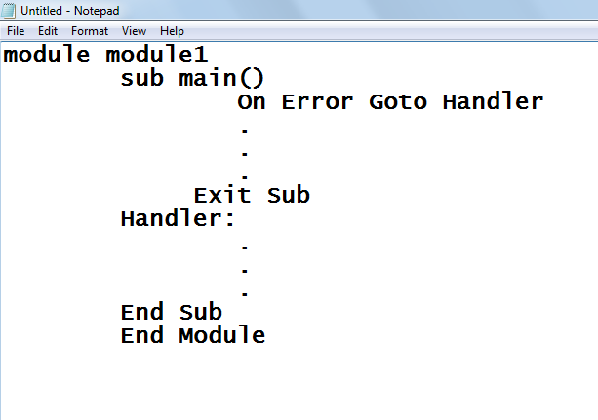
BY LECTURER SURAJ PANDEY CCT COLLEGE

Slide 38
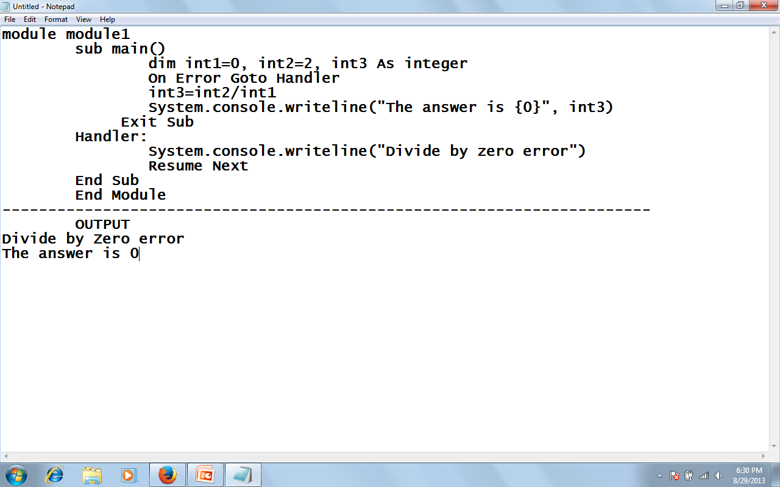
BY LECTURER SURAJ PANDEY CCT COLLEGE

Slide 39
Structured Exception Handling
Structured exception handling tests specific pieces of the code and, as exceptions occur, adapts your exception-handling code to the circumstances that caused the exception. It is significantly faster in large applications than unstructured exception handling and allows more flexible response to errors as well as greater application reliability.
The Try...Catch...Finally control structure is fundamental to structured exception handling. It tests a piece of code, filters exceptions created by the execution of that code, and reacts differently based on the type of thrown exception.
BY LECTURER SURAJ PANDEY CCT COLLEGE

Slide 40
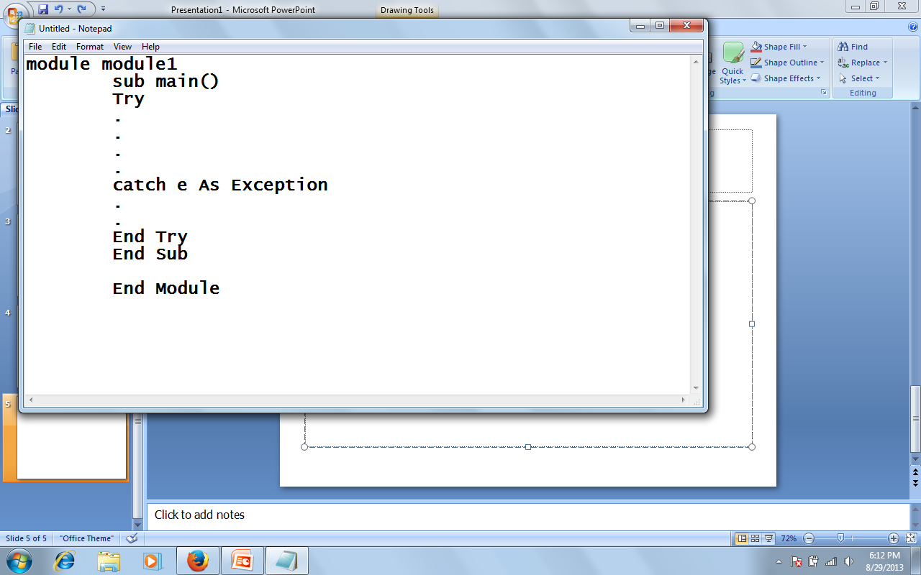
BY LECTURER SURAJ PANDEY CCT COLLEGE

Slide 41
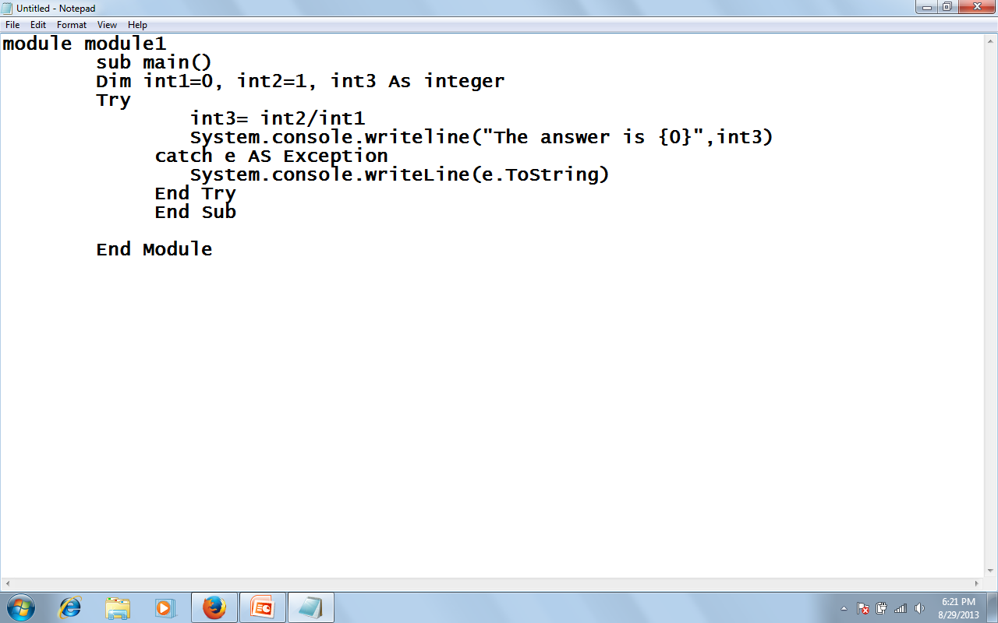
BY LECTURER SURAJ PANDEY CCT COLLEGE

Slide 42
Output:
System.OverFlowException: Arithmetic operation resulted in an overflow.
BY LECTURER SURAJ PANDEY CCT COLLEGE

Slide 43
Raising an Exception Intentionally
There are cases in programs where you might want to create an exception because, although no visual basic trappable exception has occurred, some situation may have occurred that’s incompatible with your program’s logic. You can create an exception intentionally raising an exception, with the visual basic Err object’s Raise method, which is declared this way internally in VB.NET:
Raise(ByVal Number As Integer, Optional ByVal Source As Object= Nothing, Optional ByVal Description As object= Nothing, optional ByVal HelpFile As object= Nothing Optional ByVal HelpContext As Object=Nothing)
BY LECTURER SURAJ PANDEY CCT COLLEGE

Slide 44
Here are the arguments for the Raise method:
Number --- Long integer that identifies the nature of the exception
Source --- String expression naming the object or application that generated the exception, use the form project.class
Description --- String expression describing the exception
Helpfile --- The path to the help file in which help on this exception can be found
Helpcontext --- A context ID identifying a topic within helpfile that provides help for the exception.
BY LECTURER SURAJ PANDEY CCT COLLEGE

Slide 45
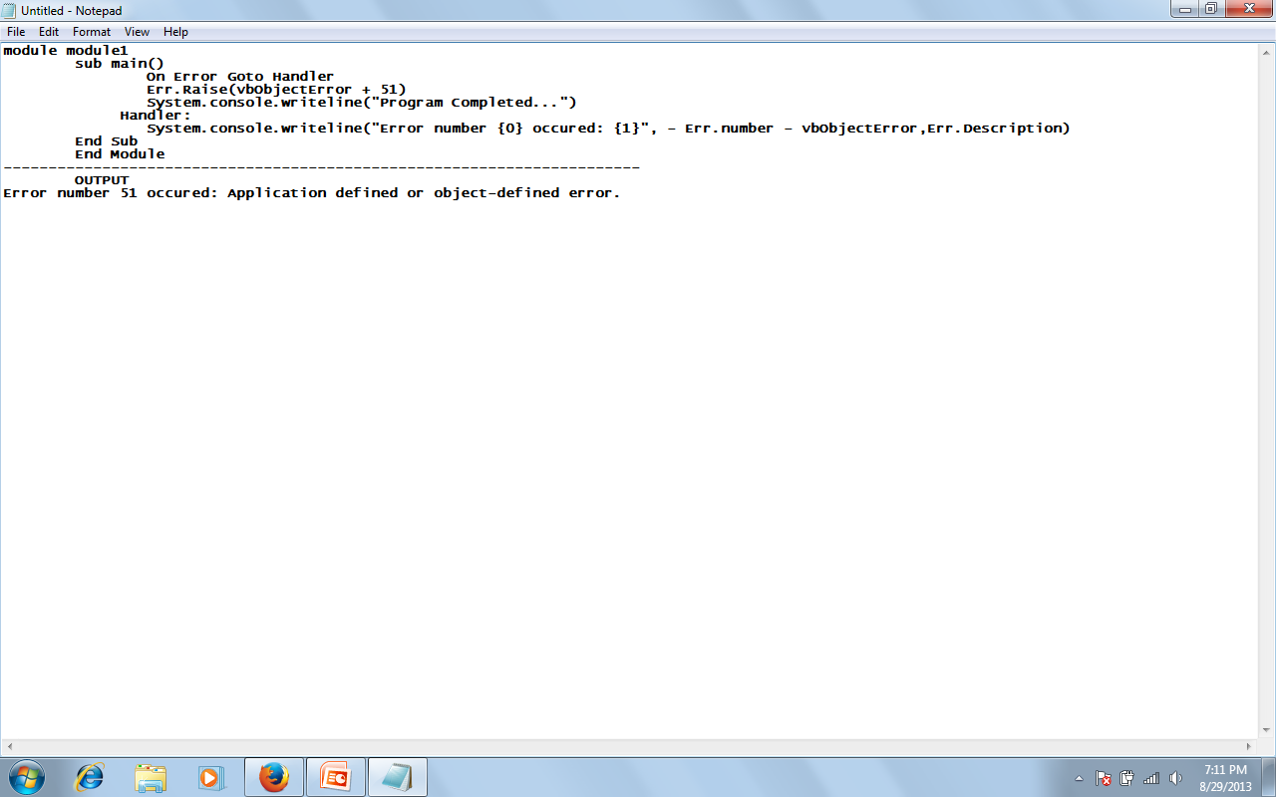
Example, here lets generate our own exception, exception number 51:
BY LECTURER SURAJ PANDEY CCT COLLEGE

Slide 46
Exception filtering in the catch block
When you’re handling exceptions you usually want to handle different types of exceptions differently, according to the nature of the exception that occurred. This process is called filtering.
There are actually two ways to filter exception with catch blocks. First you can filter on specific classes of exceptions, which means you have to prepare for the various exceptions you want to handle.
Exceptions are based on the visual basic exception class (which, like all other objects in visual basic, is based on the object class)
BY LECTURER SURAJ PANDEY CCT COLLEGE

Slide 47
To track down what class such an exception corresponds to, you could take a look at the visual basic documentation for the exception class, which lists the class derived from it:
System.Object System.ApplicationException
      System.IO.IsolatedStorage.IsolatedStorageException
      System.Runtime.Remoting.MetadataServices.SUDSGeneratorException
      System.Runtime.Remoting.MetadataServices.SUDSParserException
      System.SystemException
      System.Windows.Forms.AxHost.InvalidActiveXStateException
BY LECTURER SURAJ PANDEY CCT COLLEGE

Slide 48
The derived class itself has many derived classes, the overflowException class, which is based on the ArithmeticException class, which is based on the SystemException class, which is based on the Exception class:
System.Object
System.Exception
System.SystemException
System.ArithmeticException
System.OverflowException
BY LECTURER SURAJ PANDEY CCT COLLEGE

Slide 49
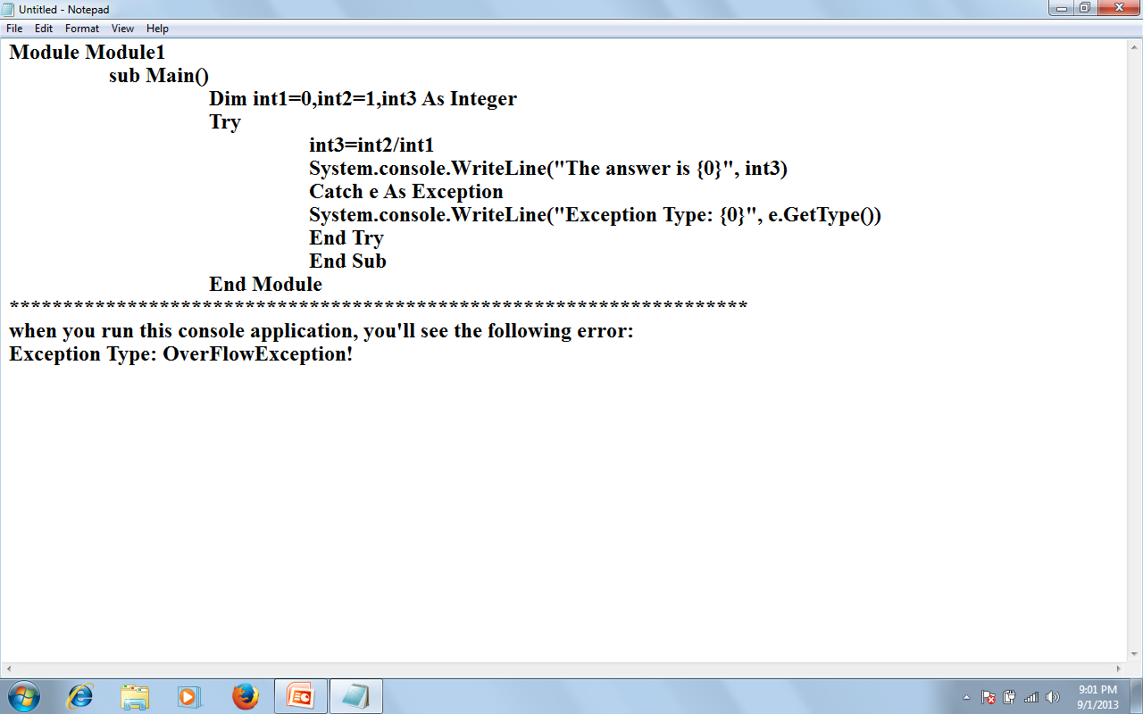
BY LECTURER SURAJ PANDEY CCT COLLEGE

Slide 50
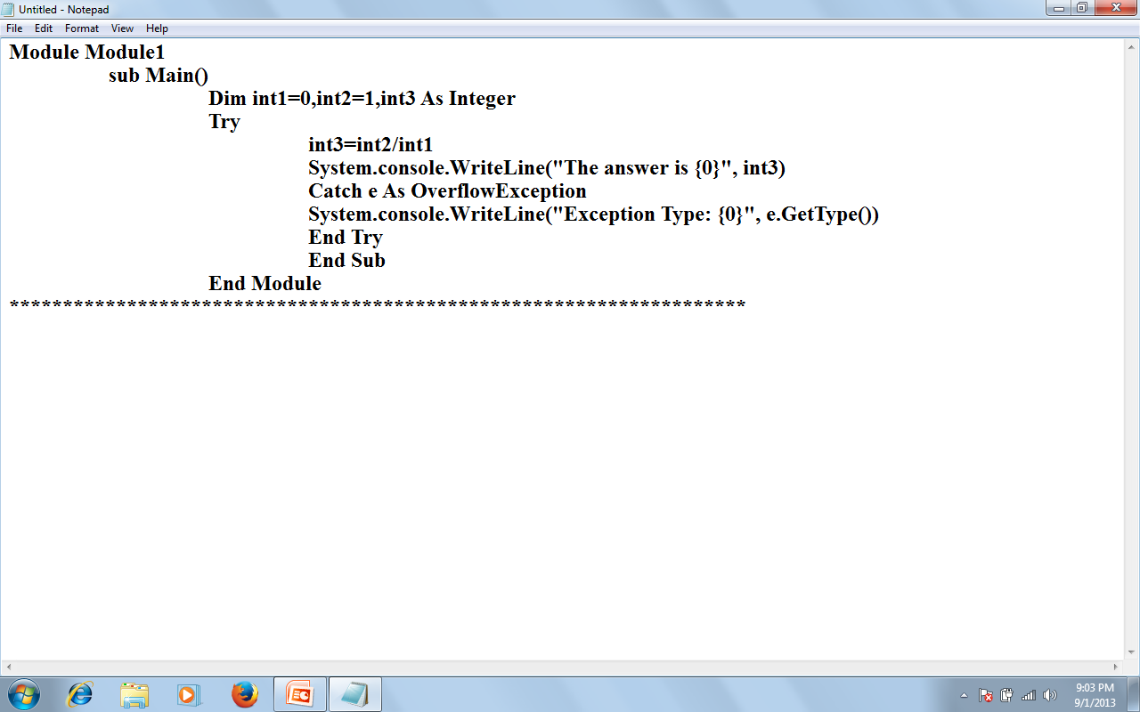
:Arithmetic overflow!”
BY LECTURER SURAJ PANDEY CCT COLLEGE

Slide 51
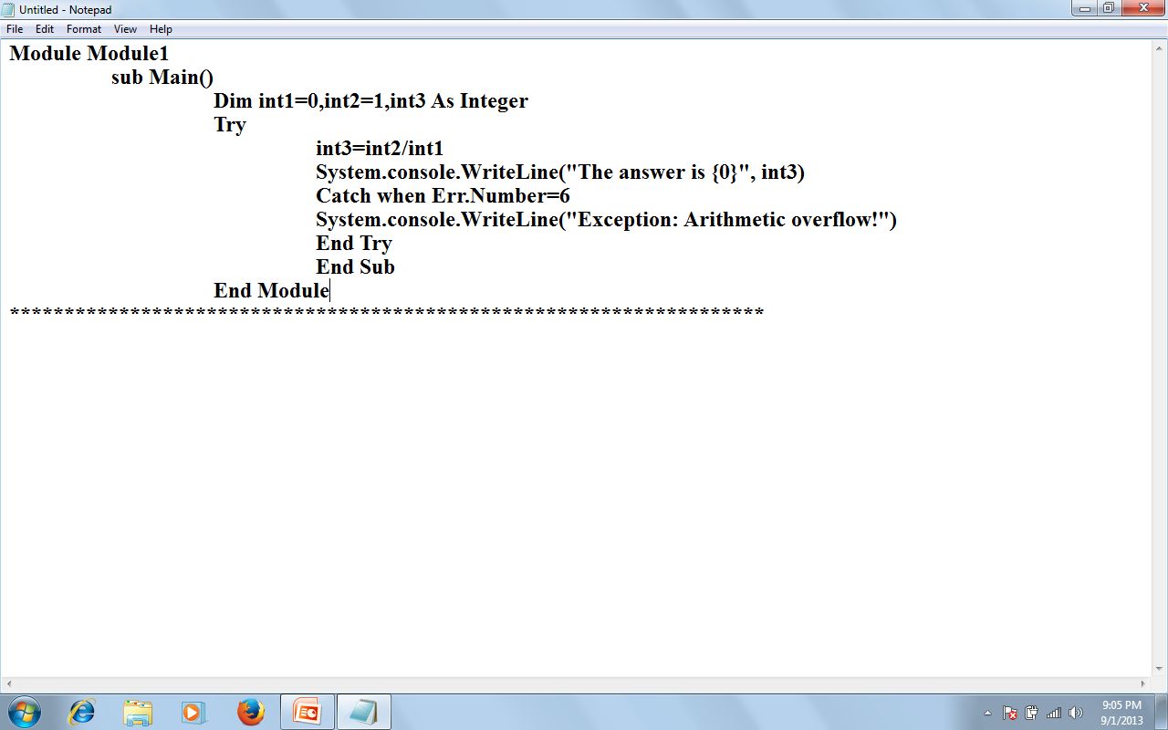
BY LECTURER SURAJ PANDEY CCT COLLEGE

Slide 52
USING MULTIPLE CATCH STATEMENTS
You also can use multiple catch statements when you filter exceptions. Here’s an example that specifically handles overflow, invalid argument, and argument out of range exceptions:
BY LECTURER SURAJ PANDEY CCT COLLEGE

Slide 53
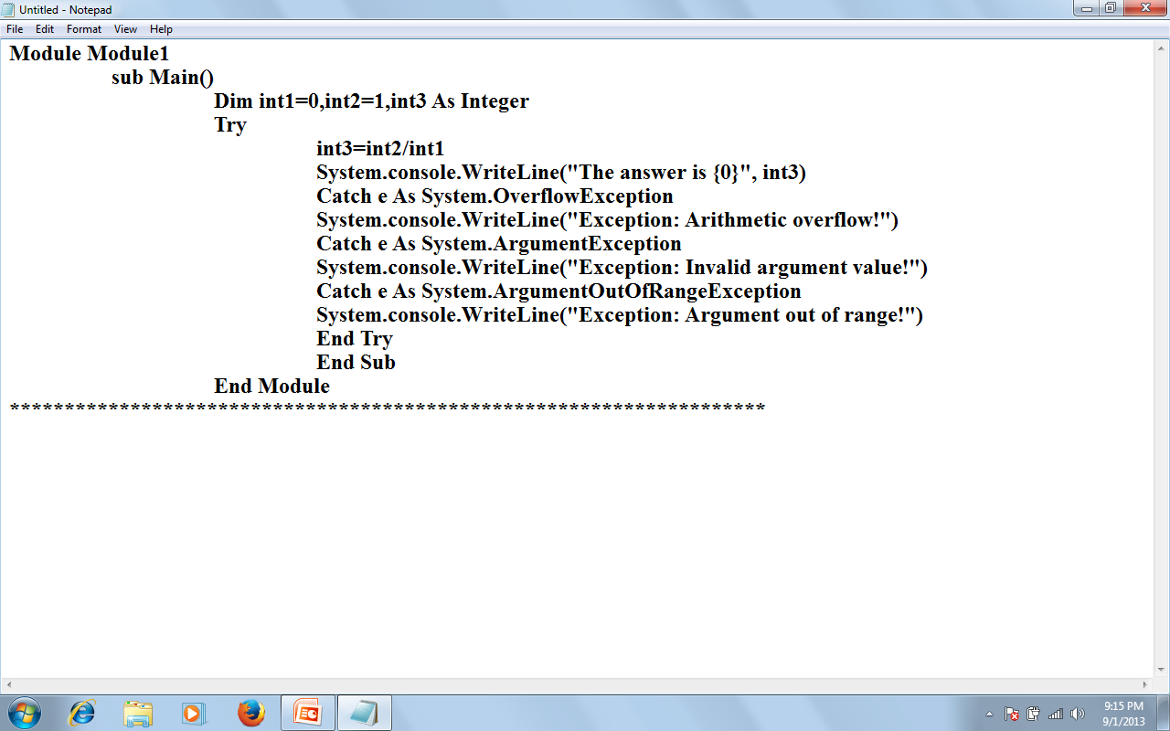
BY LECTURER SURAJ PANDEY CCT COLLEGE

Slide 54
If you want to add a general exception handler to catch any exceptions not filtered, you can add a catch block for the Exception class at the end of the other Catch blocks:
BY LECTURER SURAJ PANDEY CCT COLLEGE

Slide 55
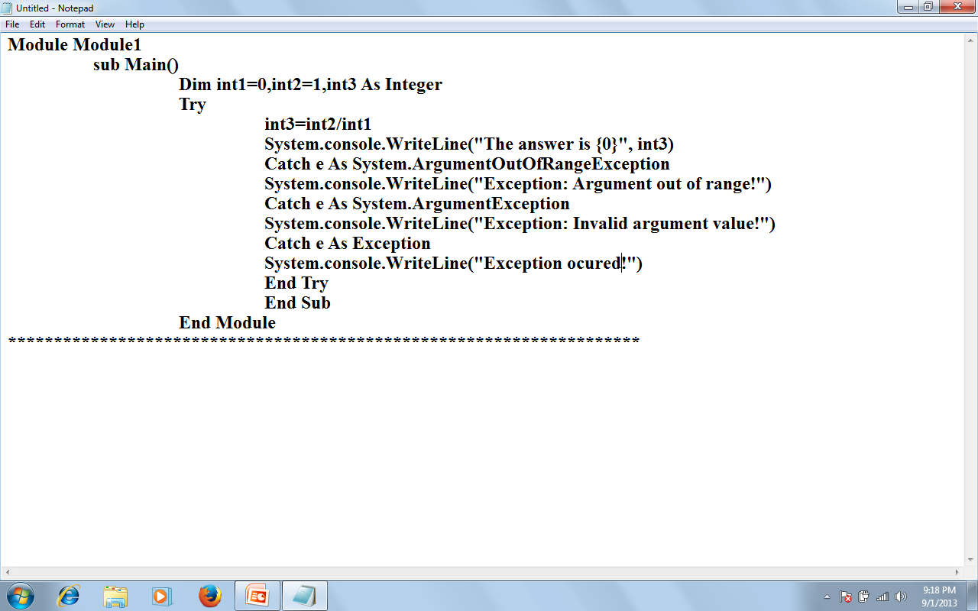
BY LECTURER SURAJ PANDEY CCT COLLEGE

Slide 56
Use Finally
The code in the Finally block, if there is one, is always executed in a Try…. Catch…..Finally statement, even if there was no exception, and even if you execute an Exit Try statement. This allows you to deallocate resources and so on. Here’s an example with a Finally block.
BY LECTURER SURAJ PANDEY CCT COLLEGE

Slide 57
Module Module1
Sub main()
Dim int1=0, int2=1, int3 As Integer
Try
int3=int2/int1
System.console.writeline(“The answer is {0}”, int3)
Catch e As System.OverflowException
System.console.WriteLine(“Exception: Arithmetic Overflow!”)
Catch e As System.ArgumentException
System.console.WriteLine(“Exception: Invalid argument value!”)
Catch e As System.ArgumentOutofRangeException
System.console.WriteLine(“Exception: Argument out of range!”)
Finally
System.console.WriteLine(“Execution of sensitive code” & “is complete” )
End Try
End Sub
End Module
BY LECTURER SURAJ PANDEY CCT COLLEGE

Slide 58
Exception: Arithmetic overflow!
Execution of sensitive code is complete
BY LECTURER SURAJ PANDEY CCT COLLEGE

Slide 59
Throwing an Exception
We can throw an exception using the Throw statement, and we can also rethrow a caught exception using the Throw statement. Here’s an example where we can explicitly throw an overflow exception:
Module Modul1
Sub Main()
Try
Throw New OverflowException()
Catch e As Exception
System.console.writeline(e.message)
End Try
End Sub
BY LECTURER SURAJ PANDEY CCT COLLEGE

Slide 60
Throwing a Custom Exception
We can customize the exception we throw by creating a new exception object based on the ApplicationException object. Here’s an example where we creating a new ApplicationException object with the text “This is a new exception”, and then throwing and catching that exception:
BY LECTURER SURAJ PANDEY CCT COLLEGE

Slide 61
Module Module1
Sub Main()
Try
Throw New ApplicationException(“This is a new exception”)
Catch e As Exception
System.console.WriteLine(e.Message)
End Try
End Sub
End Module
BY LECTURER SURAJ PANDEY CCT COLLEGE

Slide 62
This is a new exception
BY LECTURER SURAJ PANDEY CCT COLLEGE

