Slide 1
The VB.net Graphics and File operation

Slide 2
Introduction to Graphics Handling
The graphics handling in Visual Basic .NET is based on GDI+ (GDI stands for Graphics Device Interface). A graphics device interface such as GDI+ allows you to display graphics on a screen- or a printer without having to handle the details of a specific display device.

Slide 3
Drawing and filling different types of graphics
Drawing Line:
To draw a line across a form, there are two things that you need to define—its coordinates and its color. As noted above, the X and Y coordinates are expressed in pixels. For a line, there are two sets of coordinates—the starting location followed by the ending location.
Just as you would use a pen to draw a line on a piece of paper, Visual Basic uses a Pen object to draw on the form. The Pen object defines the appearance of the line—in this case, the color. In the following procedure, you will draw horizontal, vertical, and diagonal lines on a form.

Slide 4
To draw lines
On the File menu, choose New Project.
On the Template pane, in the New Project dialog box, click Windows Application.
In the Name box, type Lines and then click OK.
A new Windows Forms project opens.
Double-click the form to open the Code Editor, and then select Paint from the Events drop-down list.
In the Form1_Paint event handler, add the following code.

Slide 5
' Draw a 400 pixel black line 25 pixels from the top of the form.
e.Graphics.DrawLine(Pens.Black, 0, 25, 400, 25)
' Draw a 500 pixel red line 100 pixels from the left of the form.
e.Graphics.DrawLine(Pens.Red, 100, 0, 100, 500)
' Draw a diagonal blue line from the upper left to the lower right.
e.Graphics.DrawLine(Pens.Blue, 0, 0, Me.Width, Me.Height)

Slide 6
Drawing simple shapes
Drawing a shape is similar to drawing a line—you need to define the coordinates and the color with which to draw. Where a line took coordinates defining a starting and ending point, a shape such as a square or rectangle takes coordinates describing its upper-left corner, width, and height.
Circles and ovals (also known as ellipses) do not have upper-left corners, so instead the coordinates describe the upper-left corners of their bounding rectangles—an imaginary rectangle of the same width and height of the circle or oval.

Slide 7
To draw shapes
On the File menu, choose New Project.
On the Templates pane, in the New Project dialog box, select Windows Application.
In the Name box, type Shapes and then click OK.
A new Windows Forms project opens.
Double-click the form to open the Code Editor, and then select Paint from the Events drop-down list.
In the Form1_Paint event handler, add the following code.

Slide 8
' Draw a 200 by 150 pixel green rectangle. e.Graphics.DrawRectangle(Pens.Green, 10, 10, 200, 150)
' Draw a blue square e.Graphics.DrawRectangle(Pens.Blue, 30, 30, 150, 150)
' Draw a 150 pixel diameter red circle. e.Graphics.DrawEllipse(Pens.Red, 0, 0, 150, 150)
' Draw a 250 by 125 pixel yellow oval. e.Graphics.DrawEllipse(Pens.Yellow, 20, 20, 250, 125)

Slide 9
Drawing filled shapes
So far, the shapes that you have drawn are just outlines. To draw shapes with solid colors, you need to use one of the fill methods such as FillRectangle or FillEllipse. The fill methods use a Brush object, another type of graphics object that can paint.
When filling a shape with a different color, you will need to define coordinates that are smaller than the shape; otherwise the border will be covered. For example, to fill a square with the coordinates 0, 0, 150, 150 you would specify a fill with the coordinates 1, 1, 149, 149, accounting for the one pixel thickness of the line.

Slide 10
Drawing text
To draw text on a form or control, you use the DrawString graphics method. Like the other draw methods, DrawString takes a Brush object that determines the color, and coordinates that specify where to draw the text—in this case, the X and Y coordinates of the upper-left corner of the bounding rectangle for the text.
The DrawString method also has two additional arguments—the string that you want to draw, and the font that determines what the text looks like. In order to specify the font, you must first create a Font object, and then use that object as an argument to the DrawString method.

Slide 11
To draw text
On the File menu, choose New Project.
In the New Project dialog box, in the Templates pane, click Windows Application.
In the Name box, type DrawText and then click OK.
A new Windows Forms project opens.
Double-click the form to open the Code Editor, and then select Paint from the Events dropdown list.
In the Form1_Paint event handler, add the following code.

Slide 12
Private Sub Form1_Paint(ByVal sender As Object, ByVal e As System.Windows.Forms.PaintEventArgs) Handles Me.Paint
Dim aFont As New System.Drawing.Font("Arial", 22, FontStyle.Bold)
e.Graphics.DrawString("Graphics are fun!", aFont, Brushes.Black, 20, 10)

Slide 13
Drawing rotated text
In order to draw text at an angle, you need to use another type of graphics method called a transform. There are several types of transforms available for different graphics effects; in this case, you will use the RotateTransform method.
The RotateTransform method takes a single argument, the angle at which to rotate the text. The transformation is performed on the line of code following the RotateTransform method; you could also use it to rotate shapes or lines drawn using the other draw methods.

Slide 14
' Rotate the text 45 degrees. e.Graphics.RotateTransform(45) e.Graphics.DrawString("And exciting too!", aFont, Brushes.Red, _ 100, 0)

Slide 15
Displaying an image on a form
To display an image on a form or control, use the DrawImage graphics method. The DrawImage method takes a bitmap image as an argument, along with the X and Y coordinates defining the upper-left corner of the image.

Slide 16
To display a rotated image
On the File menu, choose New Project.
On the Templates pane, in the New Project dialog box, click Windows Application.
In the Name box, type DrawImage and then click OK.
A new Windows Forms project opens.
In Solution Explorer, double-click the My Project node to open the Project Designer.
In the Project Designer, click the Resources tab, select Add Resource, and then select Add Existing File.
In the Add existing file to resources dialog box, browse to any image file and select it, and then click Open.
In Solution Explorer, select the Form1 node, and then on the View menu, select Code to open the Code Editor.
In the Code Editor, select Paint from the Events drop-down list.
In the Form1_Paint event handler, add the following code.

Slide 17
Private Sub Form1_Paint(ByVal sender As Object, ByVal e As System.Windows.Forms.PaintEventArgs) Handles Me.Paint
e.Graphics.RotateTransform(45)
e.Graphics.DrawImage(My.Resources.Tulips, 50, 0)
End Sub

Slide 18
File handling
Reading from and writing to text files
How to VB.NET Files operations
File class is using for the File operations in VB.NET. We can create , delete , copy etc. operations do with File class.
How to create a File ?
In order to create a new File , we can call Create method in the File class.
Syntax : File.Create(FilePath)
FilePath : The name of the new File Object
File.Create("c:\testFile.txt")

Slide 19
How to check a File exist or not ?
Before we creating a File object , we usually check that File exist or not. For that we are using the Exists method in the File class.
Syntax : File.Exists(FilePath) as Boolean

Slide 20
FilePath : The name of the File
Boolean : Returns true or false , if File exist it Returns true else Returns false
VB.NET : File.Exists("c:\testFile.txt")

Slide 21
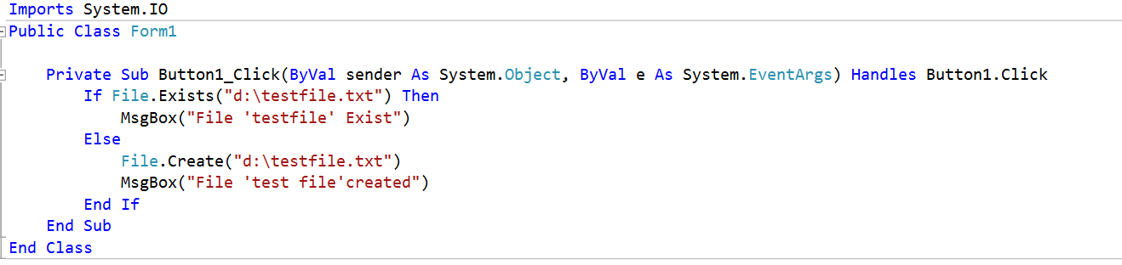

Slide 22
How to Copy a File ?
If we want the Copy of the File Object we can use the Copy method in File class.
sourceFileName : The source file we want to move.
destFileName : The destinations file name.
VB.NET : File.Copy("c:\testFile.txt", "c:\testDir\testFile.txt")

Slide 23
How to delete a File Object ?
When we want to delete a File Object we can use the Delete methods in the File class.
DirPath : The File Object you want to delete.
VB.NET : File.Delete("c:\testDir\testFile.txt")
The following VB.NET source code shows these operations :

Slide 24
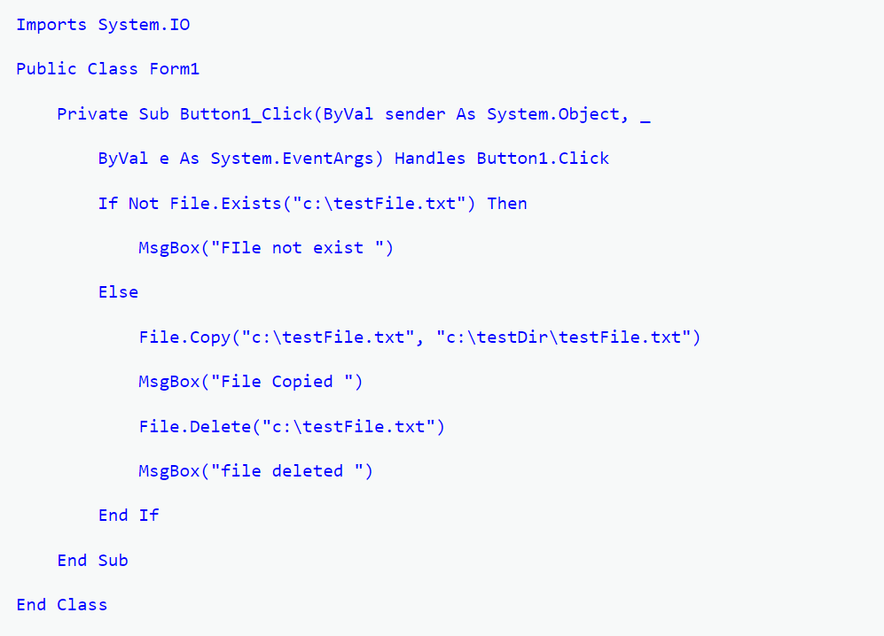

Slide 25
How to VB.NET FileStream operations
The FileStream Class represents a File in the Computer.FileStream allows to move data to and from the stream as arrays of bytes. We operate File using FileMode in FileStream Class
Some of FileModes as Follows :
FileMode.Append : Open and append to a file , if the file does not exist , it create a new file
FileMode.Create : Create a new file , if the file exist it will append to it
FileMode.CreateNew : Create a new File , if the file exist , it throws exception
FileMode.Open : Open an existing file
How to create a file using VB.NET FileStream ?

Slide 26
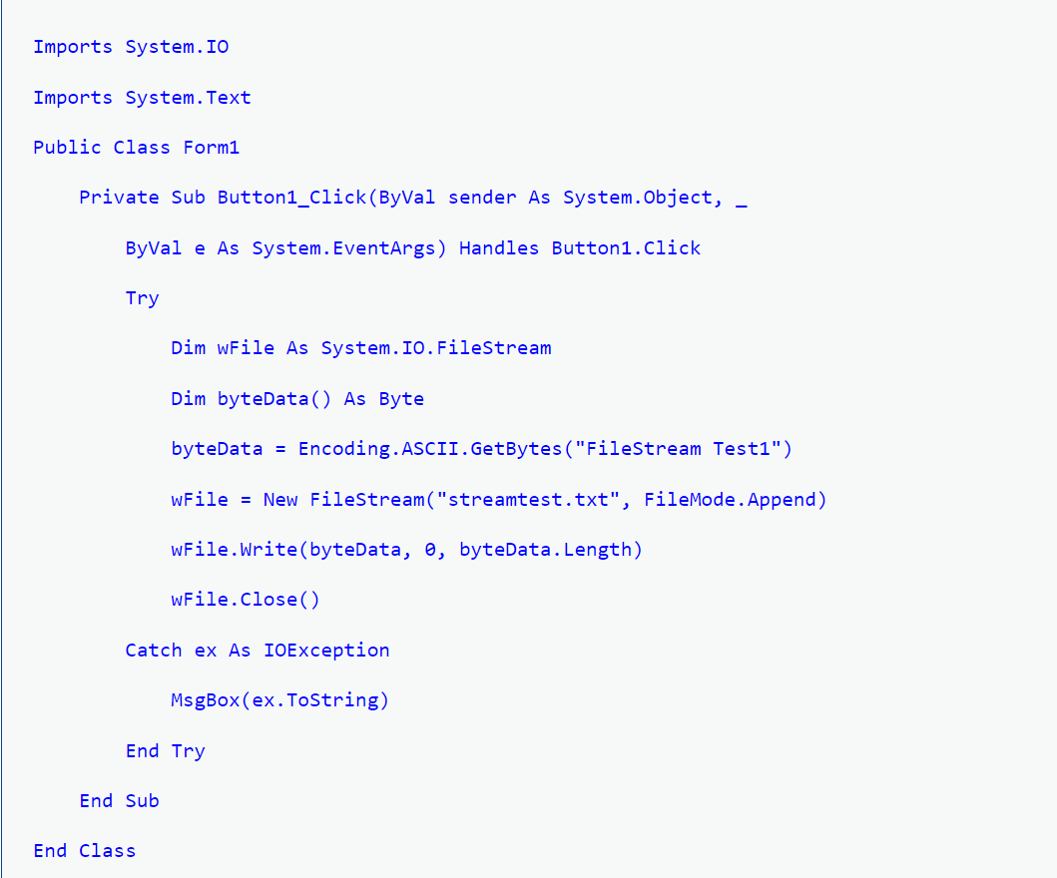

Slide 27
How to VB.NET Simple TextReader
Textreader and TextWriter are the another way to read and write file respectively, even though these are not stream classes. TheStreamReader and StreamWriter classes are derived fromTextReader and TextWriter classes respectively. The following program using TextReader , Read the entire content of the file into a String

Slide 28
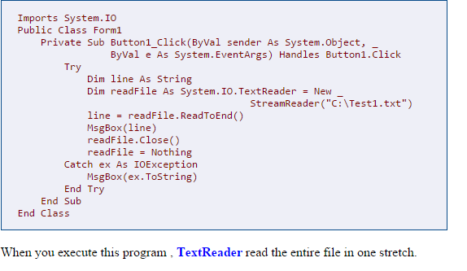

Slide 29
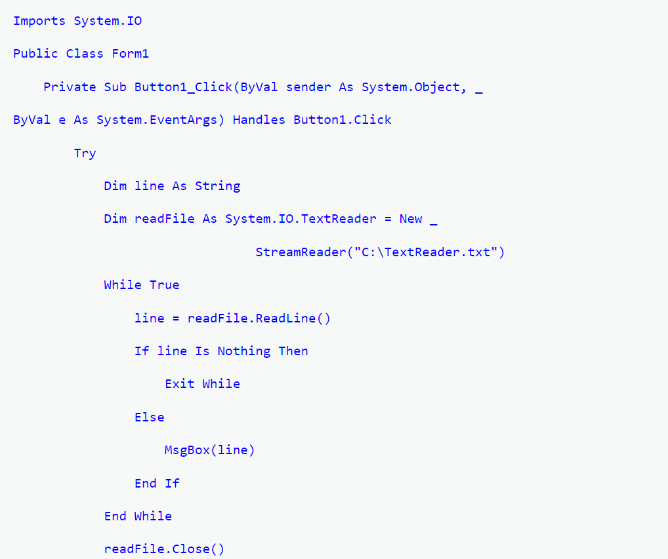

Slide 30
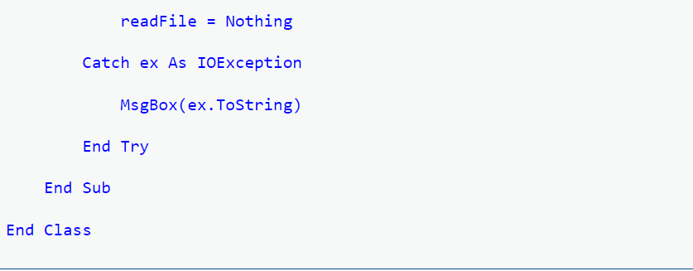

Slide 31
When you execute this program the TextReader read the file line by line.

Slide 32
How to VB.NET TextWriter
Textreader and TextWriter are the another way to read and write file respectively, even though these are not stream classes. TheStreamReader and StreamWriter classes are derived fromTextReader and TextWriter classes respectively. The following sample source showing how write in a file using TextWriter .

Slide 33
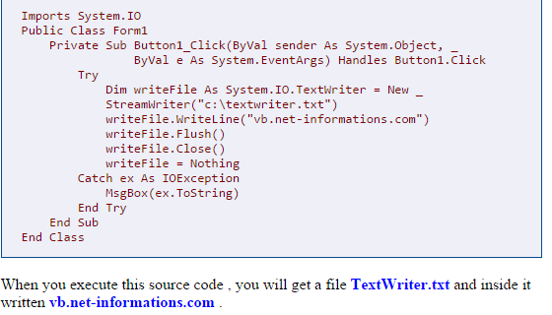

Slide 34
How to VB.NET BinaryReader
BinaryReader Object works at lower level of Streams.BinaryReader is used for read premitive types as binary values in a specific encoding stream. Binaryreader Object works with Stream Objects that provide access to the underlying bytes. For creating a BinaryReader Object , you have to first create a FileStream Object and then pass BinaryReader to the constructor method .
Dim readStream As FileStream
readStream = New FileStream("c:\testBinary.dat", FileMode.Open)
Dim readBinary As New BinaryReader(readStream)
The main advantages of Binary information is that stores files as Binary format is the best practice of space utilization.

Slide 35
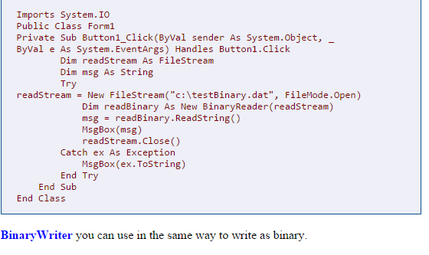

Slide 36
How to VB.NET BinaryWriter
The BinaryWriter Object works at lower level of Streams.BinaryWriter is used for write premitive types as binary values in a specific encoding stream. BinaryWriter Object works with Stream Objects that provide access to the underlying bytes. For creating a BinaryWriter Object , you have to first create a FileStream Object and then pass BinaryWriter to the constructor method .
Dim writeStream As FileStream
writeStream = New FileStream("c:\testBinary.dat", FileMode.Create)
Dim writeBinay As New BinaryWriter(writeStream)
The main advantages of Binary information is that it is not easily human readable and stores files as Binary format is the best practice of space utilization.

Slide 37
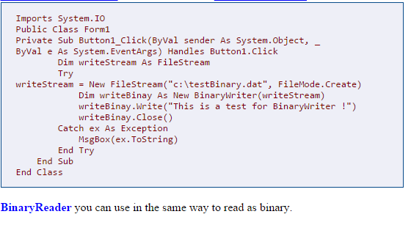

Slide 38
The StreamReader and StreamWriter classes are used for reading from and writing data to text files. These classes inherit from the abstract base class Stream, which supports reading and writing bytes into a file stream.

Slide 39
The streamReader class
The StreamReader class also inherits from the abstract base class TextReader that represents a reader for reading series of characters. The following table describes some of the commonly used methods of the StreamReader class:

Slide 40
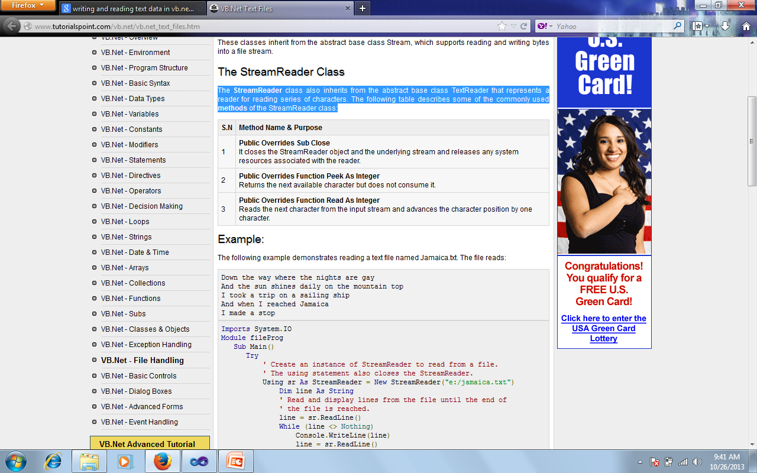

Slide 41
Handling text: The stream Reader and Stream writer classes

Slide 42
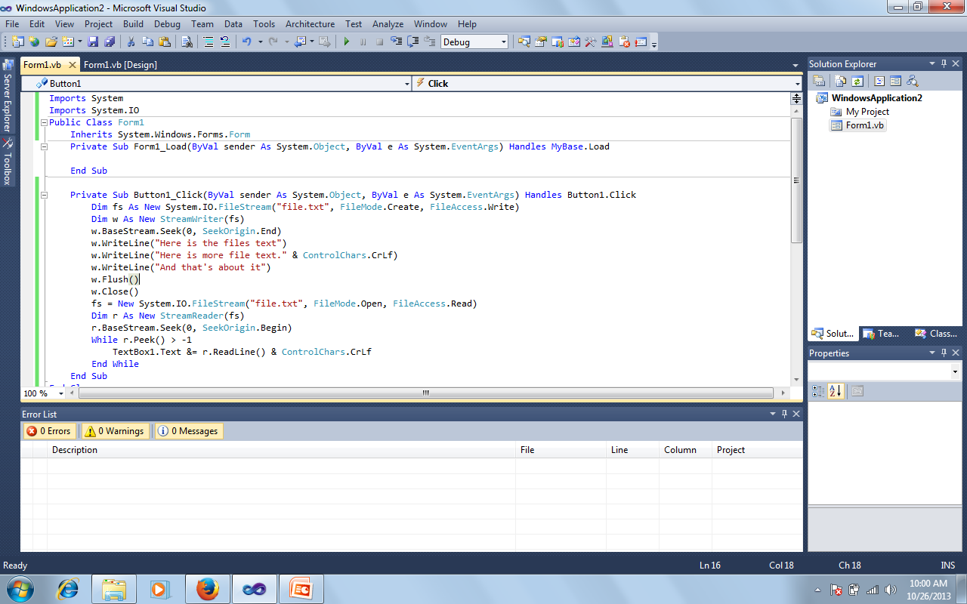

Slide 43
Reading and writing binary data
The BinaryReader and BinaryWriter both read and write data as binary (that is, in the raw 0’s and 1s that your data is actually stored as in your computer) rather then text.
For example you can use the BinaryWriter class’s Write method to send binary data to a file. To read it back in. you can use the BinaryReader class’s Read method.

Slide 44
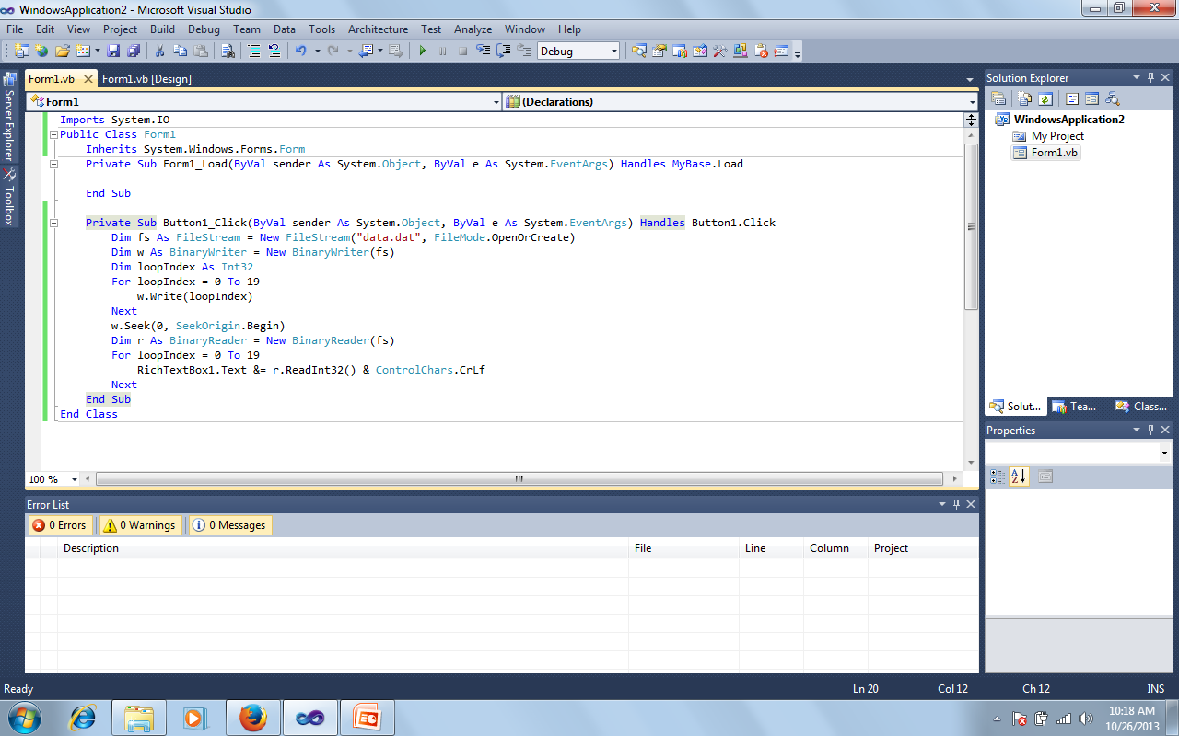

Slide 45
The Peek method takes a peek at the incoming text characters. It's looking ahead one character at a time. If it doesn't see any more characters, it will return a value of minus 1. This will signify the end of the text file. Our loop checks for this minus 1, and bails out when Peek has this value.

