Slide 1
Vb.net object oriented programming
LEcturer Suraj Pandey CCT college

Slide 2
Object-oriented programming (OOP) is a programming language model organized around objects rather than "actions" and data rather than logic. Historically, a program has been viewed as a logical procedure that takes input data, processes it, and produces output data.
LEcturer Suraj Pandey CCT college

Slide 3
OOP
For a programming language to be a true OOP language, the language must meet the following criteria:
Abstraction—Abstraction manages the complexities of a business problem by allowing you to identify a set of objects involved with that business problem.
Encapsulation—Encapsulation hides the internal implementation of an abstraction within the particular object.
Polymorphism—Polymorphism provides for multiple implementations of the same method. For example, different objects can have a Save method, each of which perform different processing.
LEcturer Suraj Pandey CCT college

Slide 4
Inheritance—The excitement of Visual Basic .NET lies in inheritance. Visual Basic 5 introduced the concept of interface inheritance, which allows you to reuse the interface of a class, but not its implementation. Visual Basic .NET provides for true implementation inheritance whereby you can reuse the implementation of a class.
LEcturer Suraj Pandey CCT college

Slide 5
The first step in OOP is to identify all the objects the programmer wants to manipulate and how they relate to each other, an exercise often known as data modeling. Once an object has been identified, it is generalized as a class of objects. Each distinct logic sequence is known as a method. Objects communicate with well-defined interfaces called messages.
LEcturer Suraj Pandey CCT college

Slide 6
Namespace, Classes and object
A Namespace
In VB.NET, classes and other data structures for a specific purpose are grouped together to form a namespace. You can use the classes in a namespace, by simply importing the namespace. The Imports keyword is used to import a namespace to your project. .NET framework provides a rich set of built in classes, grouped together to various namespaces. we are using the System namespace. Import the System namespace (already available in .NET).
Imports System
LEcturer Suraj Pandey CCT college

Slide 7
A Class
a Class is a definition of a real life object. For example, Human is a class for representing all human beings. Dog is a class to represent all Dogs. Classes can contain functions too. Animals is a namespace. Namespace Animals Dog is a class in the namespace Animals:
Class Dog
Bark is a function in this Class:
LEcturer Suraj Pandey CCT college

Slide 8
Function Bark()
Console.Writeline ("Dog is barking")
End Function End Class End Namespace
LEcturer Suraj Pandey CCT college

Slide 9
A class definition starts with the keyword Class followed by the class name; and the class body, ended by the End Class statement. Following is the general form of a class definition:
[ <attributelist> ] [ accessmodifier ] [ Shadows ] [ MustInherit | NotInheritable ] [ Partial ] _ Class name [ ( Of typelist ) ] [ Inherits classname ] [ Implements interfacenames ] [ statements ] End Class
LEcturer Suraj Pandey CCT college

Slide 10
The following example demonstrates a Box class, with three data members, length, breadth and height:
LEcturer Suraj Pandey CCT college

Slide 11
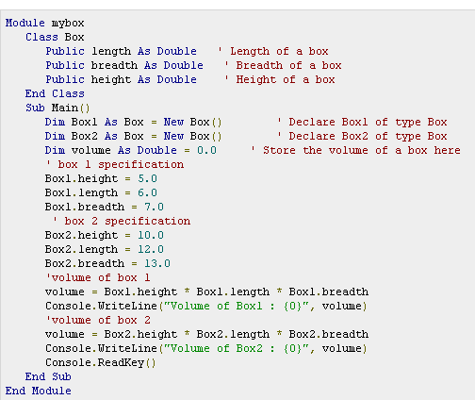
LEcturer Suraj Pandey CCT college

Slide 12
output
Volume of Box1 : 210
Volume of Box2 : 1560
LEcturer Suraj Pandey CCT college

Slide 13
An Object
An object is an instance of a Class.
LEcturer Suraj Pandey CCT college

Slide 14
Classes: Blueprints for Objects
Classes are symbolic representations of objects; classes describe the properties, fields, methods, and events that form objects in the same way that blueprints describe the items that form buildings. Just as a blueprint can be used to create multiple buildings, a single class can be used to create as many objects as necessary. Just as a blueprint defines which parts of a building are accessible to people who use the building, so too can classes control user access to object items through encapsulation.
LEcturer Suraj Pandey CCT college

Slide 15
What is classes and object
The terms class and object are sometimes used interchangeably, but in fact, classes describe the structure of objects, while objects are usable instances of classes. Each instance is an exact yet distinct copy of its class. Because an object is an instance of a class, the act of creating an object is called instantiation.
Using the blueprint analogy, a class is a blueprint, and an object is a building made from that blueprint. Usually, changing the data in one object does not change the data in any other object. (The exception is shared members, class members declared with the Shared modifier, which exist independently of specific instances of a class.)
LEcturer Suraj Pandey CCT college

Slide 16
Differences between classes and modules
The main difference between classes and modules is that classes can be instantiated as objects while standard modules cannot. Because there is only one copy of a standard module's data, when one part of your program changes a public variable in a standard module, any other part of the program gets the same value if it then reads that variable. In contrast, object data exists separately for each instantiated object. Another difference is that unlike standard modules, classes can implement interfaces.
LEcturer Suraj Pandey CCT college

Slide 17
Creating constructor and Destructor
A class constructor is a special member Sub of a class that is executed whenever we create new objects of that class. A constructor has the name New and it does not have any return type.
To create a constructor for a class, create a procedure named Sub New anywhere in the class definition. To create a parameterized constructor, specify the names and data types of arguments to Sub New just as you would specify arguments for any other procedure.
Following program explains the concept of constructor:
LEcturer Suraj Pandey CCT college

Slide 18
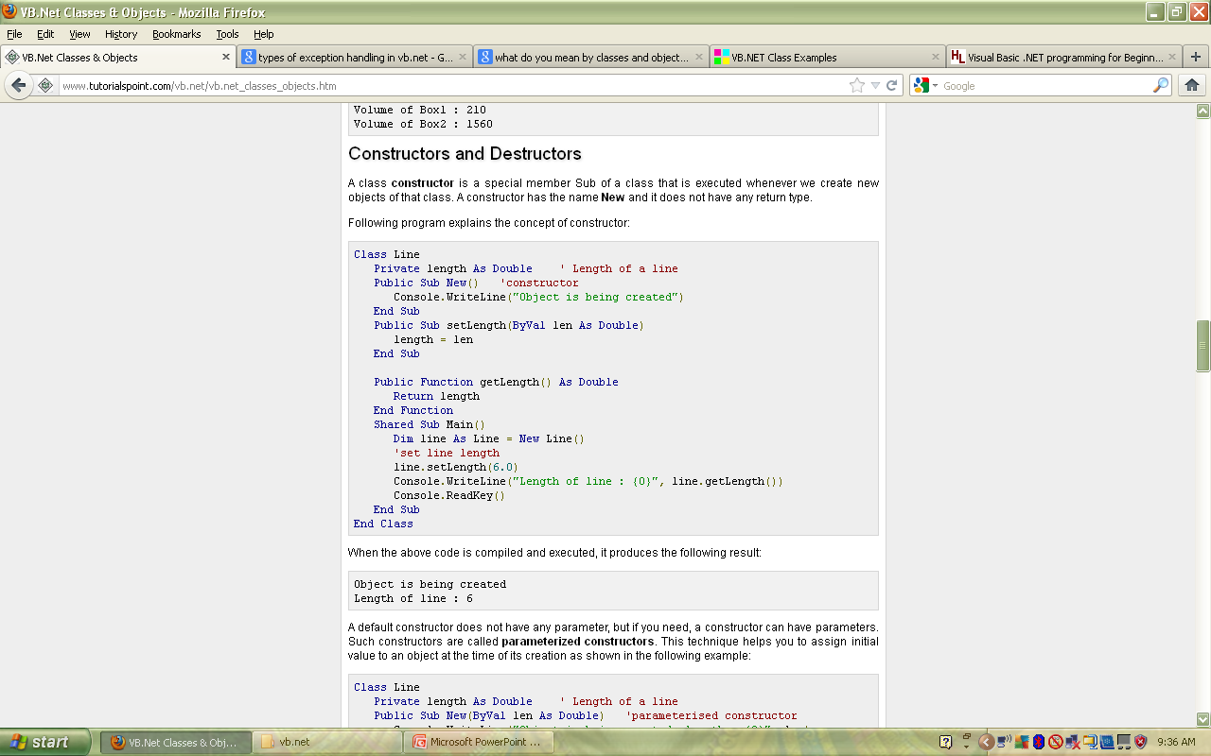
LEcturer Suraj Pandey CCT college

Slide 19
When the above code is compiled and executed, it produces the following result:
Object is being created
Length of line : 6
LEcturer Suraj Pandey CCT college

Slide 20
Parameterized Constructor
A default constructor does not have any parameter but if you need a constructor can have parameters. Such constructors are called parameterized constructors. This technique helps you to assign initial value to an object at the time of its creation as shown in the following example:
LEcturer Suraj Pandey CCT college

Slide 21
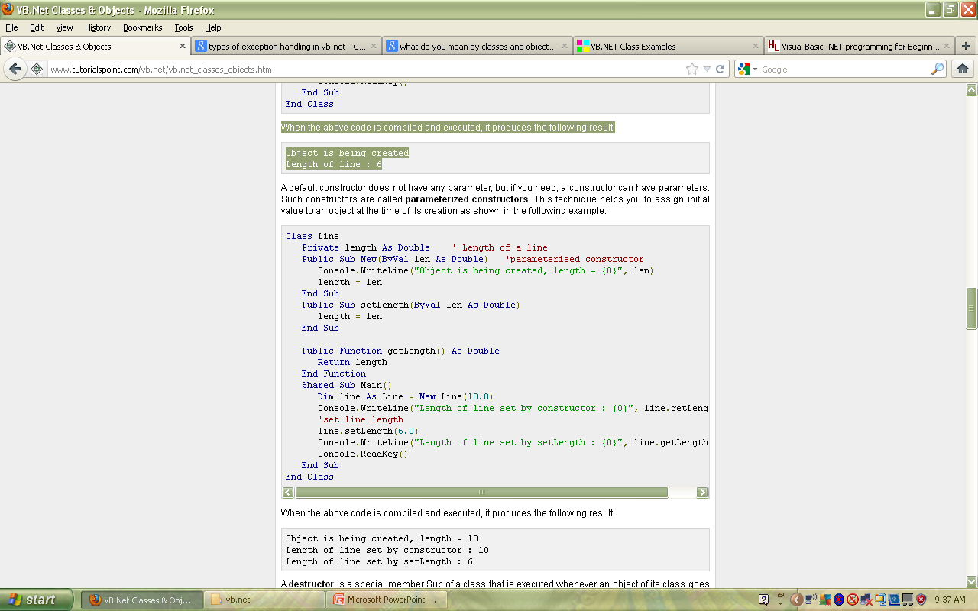
LEcturer Suraj Pandey CCT college

Slide 22
When the above code is compiled and executed, it produces the following result:
Object is being created, length = 10
Length of line set by constructor : 10
Length of line set by setLength : 6
LEcturer Suraj Pandey CCT college

Slide 23
Destructor
A Destructor is a special function which is called automatically when a class is destroyed. In VB.NET, you should use Finalize() routine to create Destructors.
A destructor is a special member Sub of a class that is executed whenever an object of its class goes out of scope.
A destructor has the name Finalize and it can neither return a value nor can it take any parameters. Destructor can be very useful for releasing resources before coming out of the program like closing files, releasing memories etc.
Destructors cannot be inherited or overloaded.
PROF Suraj Pandey CCT college

Slide 24
The default constructor
Public Sub New()
Console.Writeline ("Dog is Created With Age Zero")
Age=0
End Sub
PROF Suraj Pandey CCT college

Slide 25
The parameterized constructor
Public Sub New(val as Integer)
Console.Writeline ("Dog is Created With Age " + Convert.ToString(val))
Age=val
End Sub
PROF Suraj Pandey CCT college

Slide 26
Following example explains the concept of destructor:
LEcturer Suraj Pandey CCT college

Slide 27
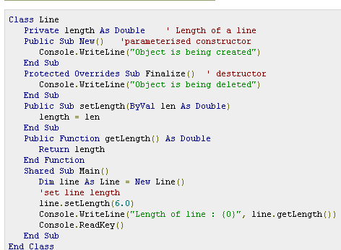
LEcturer Suraj Pandey CCT college

Slide 28
When the above code is compiled and executed, it produces the following result:
Object is being created
Length of line : 6
Object is being deleted
LEcturer Suraj Pandey CCT college

Slide 29
Inheritance
One of the most important concepts in object-oriented programming is that of inheritance. Inheritance allows us to define a class in terms of another class which makes it easier to create and maintain an application. This also provides an opportunity to reuse the code functionality and fast implementation time.
When creating a class, instead of writing completely new data members and member functions, the programmer can designate that the new class should inherit the members of an existing class. This existing class is called the base class, and the new class is referred to as the derived class.
LEcturer Suraj Pandey CCT college

Slide 30
Base & Derived Classes:
A class can be derived from more than one class or interface, which means that it can inherit data and functions from multiple base classes or interfaces.
The syntax used in VB.Net for creating derived classes is as follows:
LEcturer Suraj Pandey CCT college

Slide 31
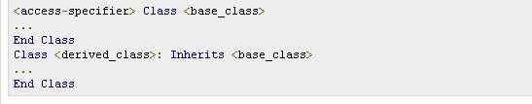
LEcturer Suraj Pandey CCT college

Slide 32
What Is Inheritance?
Inheritance specifies an “is-a-kind-of” relationship
Multiple classes share the same attributes and operations, allowing efficient code reuse
Examples:
  A customer “is a kind of” person
  An employee “is a kind of” person
Base Class
Person
Derived Classes
Customer
Employee

Slide 33
What Is Inheritance?
Derived Class Inherits from a Base Class
Properties, Methods, Data Members, Events, and Event Handlers Can Be Inherited (Dependent on Scope)
Keywords
  Inherits – inherits from a base class
  NotInheritable – cannot be inherited from
  MustInherit – instances of the class cannot be created; must be inherited from as a base class
  Protected – member scope that allows use only by deriving classes

Slide 34
Overriding and Overloading
Derived Class Can Override an Inherited Property or Method
  Overridable – can be overridden
  MustOverride – must be overridden in derived class
  Overrides – replaces method from inherited class
  NotOverridable – cannot be overridden (default)
Use Overload Keyword to Overload Inherited Property or Method

Slide 35
Inheritance Example
Public Class BaseClass
Public Overridable Sub OverrideMethod( )
MsgBox("Base OverrideMethod")
End Sub
Public Sub Other( )
MsgBox("Base Other method – not overridable")
End Sub
End Class
Public Class DerivedClass
Inherits BaseClass
Public Overrides Sub OverrideMethod( )
MsgBox("Derived OverrideMethod")
End Sub
End Class
Dim x As DerivedClass = New DerivedClass( )
x.Other 'Displays "Base Other method – not overridable"
x.OverrideMethod 'Displays "Derived OverrideMethod"

Slide 36
Shadowing
Shadowed members are used to locally replace a member that has broader scope. Any type can shadow any other type. For example, you can declare a property that shadows an inherited method with the same name. Shadowed members cannot be inherited.
LEcturer Suraj Pandey CCT college

Slide 37
Shadowing
Hides Base Class Members, Even If Overloaded
Class aBase
Public Sub M1( ) 'Non-overridable by default
...
End Sub
End Class
Class aShadowed
Inherits aBase
Public Shadows Sub M1(ByVal i As Integer)
'Clients can only see this method
...
End Sub
End Class
Dim x As New aShadowed( )
x.M1( ) 'Generates an error
x.M1(20) 'No error

Slide 38
Using the MyBase Keyword
Refers to the Immediate Base Class
Can Only Access Public, Protected, or Friend Members of Base Class
Is Not a Real Object (Cannot Be Stored in a Variable)
Public Class DerivedClass
Inherits BaseClass
Public Overrides Sub OverrideMethod( )
MsgBox("Derived OverrideMethod")
MyBase.OverrideMethod( )
End Sub
End Class

Slide 39
Using the MyClass Keyword
Ensures Base Class Gets Called, Not Derived Class
Public Class BaseClass
Public Overridable Sub OverrideMethod( )
MsgBox("Base OverrideMethod")
End Sub
Public Sub Other( )
MyClass.OverrideMethod( ) 'Will call above method
OverrideMethod( ) 'Will call derived method
End Sub
End Class
Dim x As DerivedClass = New DerivedClass( )
x.Other( )

Slide 40
What is overloading
Overloading is basically when you have more than one method with the same name but a different number of or different types of parameters. The application then determines which one to call based on the parameters used. Showing the 'Overloads' keyword is optional as long as all of the methods either use it or don't use it.
LEcturer Suraj Pandey CCT college

Slide 41
'will work
Public Sub Testing()
'code here
End Sub
Public Sub Testing(ByVal Filename As String)
'code here
End Sub
'this will also work
Public Overloads Sub Testing()
'code here
End Sub
Public Overloads Sub Testing(ByVal Filename As String)
'code here
End Sub
'but this will not because only one method uses the Overloads keyword
Public Sub Testing()
'code here
End Sub
Public [b]Overloads[/b] Sub Testing(ByVal Filename As String)
'code here
End Sub
LEcturer Suraj Pandey CCT college

Slide 42
What is Overriding Method?
Methods with the same name and the same argument list as the base class
Derived class (subclass) will use the new method rather than the method in the base class
To override a method
  Declare the original method with the Overridable keyword
  Declare the new method with the Overrides keyword
6- <number>

Slide 43
'base class
Public Class BaseClass
Public Overridable Sub Testing()
Msgbox("Shown from the Base")
End Sub
End Class
'derived class
Public Class DerivedClass
Inherits BaseClass
Public Overrides Sub Testing()
Msgbox("Shown from the Derived")
End Sub
End Class
'then in an app
Dim bc as New BaseClass()
bc.Testing()
Dim dc as New DerivedClass()
dc.Testing()
LEcturer Suraj Pandey CCT college

Slide 44
Overloading vs. Overriding
Don't confuse the concepts of overloading and overriding
Overloading deals with multiple methods in the same class with the same name but different signatures
Overriding deals with two methods, one in a parent class and one in a child class, that have the same signature

Slide 45
Overriding
LEcturer Suraj Pandey CCT college

Slide 46
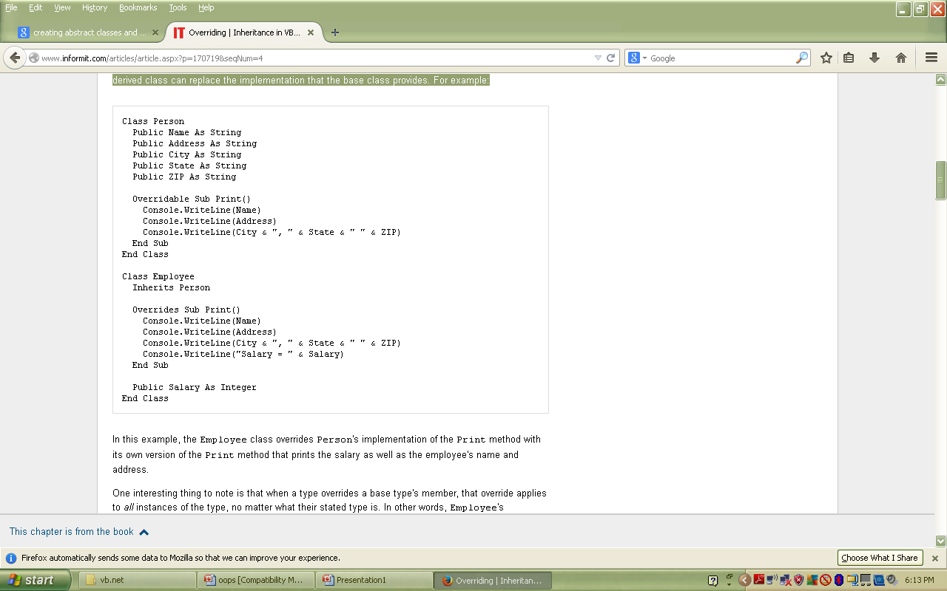
LEcturer Suraj Pandey CCT college

Slide 47
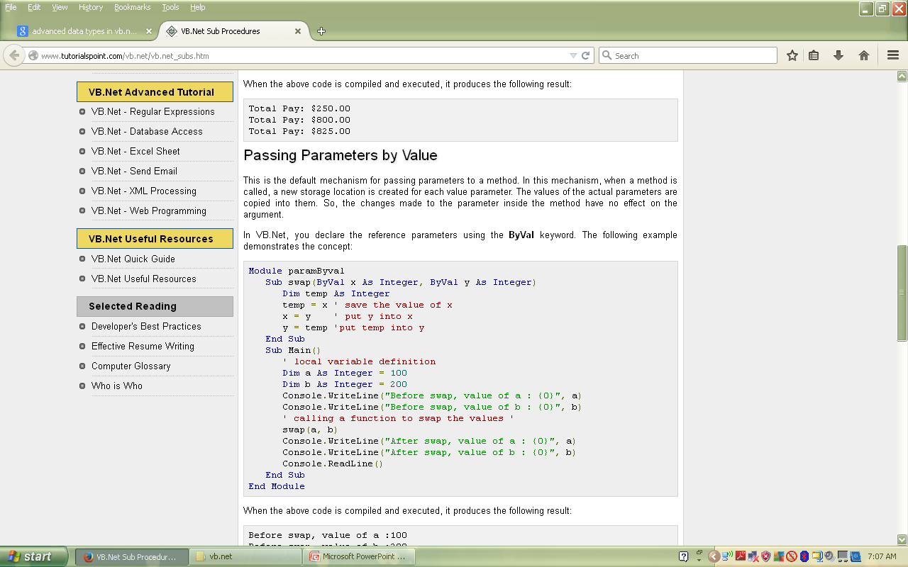
LEcturer Suraj Pandey CCT college

Slide 48
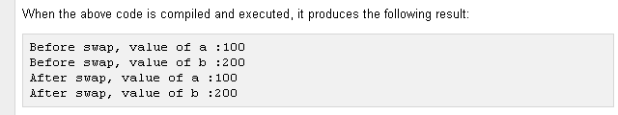
LEcturer Suraj Pandey CCT college

