Slide 1
Array and String
By Lecturer Suraj Pandey CCT College

Slide 2
Arrays
An array stores a fixed-size sequential collection of elements of the same type. An array is used to store a collection of data, but it is often more useful to think of an array as a collection of variables of the same type.
All arrays consist of contiguous memory locations. The lowest address corresponds to the first element and the highest address to the last element.
By Lecturer Suraj Pandey CCT College

Slide 3
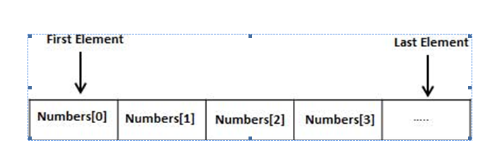
By Lecturer Suraj Pandey CCT College

Slide 4
Creating Arrays in VB.Net
To declare an array in VB.Net, you use the Dim statement. For example,
Dim intData(30) ' an array of 31 elements
Dim strData(20) As String ' an array of 21 strings
Dim twoDarray(10, 20) As Integer 'a two dimensional array of integers
Dim ranges(10, 100) 'a two dimensional array
You can also initialize the array elements while declaring the array. For example,
Dim intData() As Integer = {12, 16, 20, 24, 28, 32}
Dim names() As String = {"Karthik", "Sandhya", _
"Shivangi", "Ashwitha", "Somnath"}
Dim miscData() As Object = {"Hello World", 12d, 16ui, "A"c}
By Lecturer Suraj Pandey CCT College

Slide 5
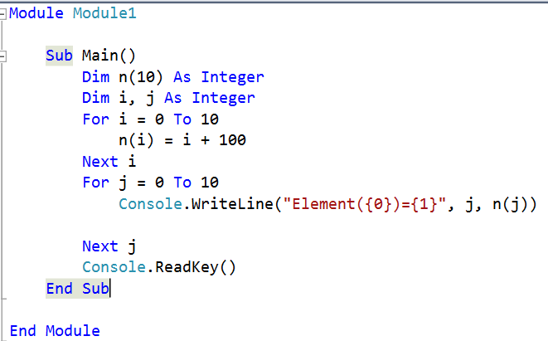
By Lecturer Suraj Pandey CCT College

Slide 6
When the above code is compiled and executed, it produces the following result:
Element(0) = 100
Element(1) = 101
Element(2) = 102
Element(3) = 103
Element(4) = 104
Element(5) = 105
Element(6) = 106
Element(7) = 107
Element(8) = 108
Element(9) = 109
Element(10) = 110
By Lecturer Suraj Pandey CCT College

Slide 7
Dynamic Arrays
Dynamic arrays are arrays that can be dimensioned and re-dimensioned as par the need of the program. You can declare a dynamic array using the ReDim statement.
Syntax for ReDim statement:
ReDim [Preserve] arrayname(subscripts)
Where,
The Preserve keyword helps to preserve the data in an existing array, when you resize it.
arrayname is the name of the array to re-dimension.
subscripts specifies the new dimension.
By Lecturer Suraj Pandey CCT College

Slide 8
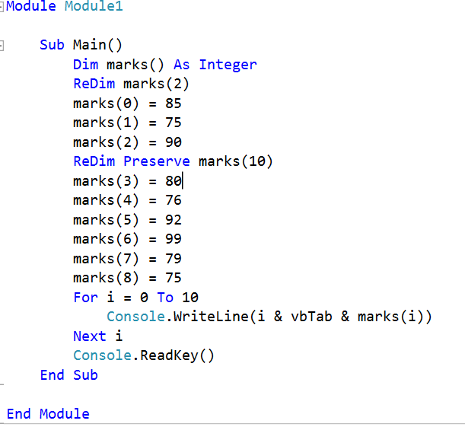
By Lecturer Suraj Pandey CCT College

Slide 9
When the above code is compiled and executed, it produces the following result:
0 85
1 75
2 90
3 80
4 76
5 92
6 99
7 79
8 75
9 0
10 0
By Lecturer Suraj Pandey CCT College

Slide 10
Multi-Dimensional Arrays
VB.Net allows multidimensional arrays. Multidimensional arrays are also called rectangular arrays.
You can declare a 2-dimensional array of strings as:
Dim twoDStringArray(10, 20) As String
or, a 3-dimensional array of Integer variables:
Dim threeDIntArray(10, 10, 10) As Integer
The following program demonstrates creating and using a 2-dimensional array:
By Lecturer Suraj Pandey CCT College

Slide 11
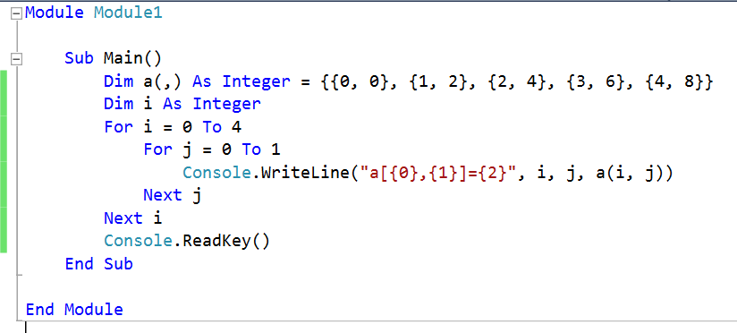
By Lecturer Suraj Pandey CCT College

Slide 12
When the above code is compiled and executed, it produces the following result:
a[0,0]: 0
a[0,1]: 0
a[1,0]: 1
a[1,1]: 2
a[2,0]: 2
a[2,1]: 4
a[3,0]: 3
a[3,1]: 6
a[4,0]: 4
a[4,1]: 8
By Lecturer Suraj Pandey CCT College

Slide 13
Jagged Array
A Jagged array is an array of arrays. The follwoing code shows declaring a jagged array named scores of Integers:
Dim scores As Integer()() = New Integer(5)(){}
The following example illustrates using a jagged array:
By Lecturer Suraj Pandey CCT College

Slide 14
Module arrayApl
Sub Main()
'a jagged array of 5 array of integers
Dim a As Integer()() = New Integer(4)() {}
a(0) = New Integer() {0, 0}
a(1) = New Integer() {1, 2}
a(2) = New Integer() {2, 4}
a(3) = New Integer() {3, 6}
a(4) = New Integer() {4, 8}
Dim i, j As Integer
' output each array element's value
For i = 0 To 4
For j = 0 To 1
Console.WriteLine("a[{0},{1}] = {2}", i, j, a(i)(j))
Next j
Next i
Console.ReadKey()
End Sub
End Module
By Lecturer Suraj Pandey CCT College

Slide 15
When the above code is compiled and executed, it produces the following result:
a[0][0]: 0
a[0][1]: 0
a[1][0]: 1
a[1][1]: 2
a[2][0]: 2
a[2][1]: 4
a[3][0]: 3
a[3][1]: 6
a[4][0]: 4
a[4][1]: 8
By Lecturer Suraj Pandey CCT College

Slide 16
Example
The following program demonstrates use of some of the methods of the Array class:
Module arrayApl
Sub Main()
Dim list As Integer() = {34, 72, 13, 44, 25, 30, 10}
Dim temp As Integer() = list
Dim i As Integer
Console.Write("Original Array: ")
For Each i In list
Console.Write("{0} ", i)
Next i
Console.WriteLine()
' reverse the array
Array.Reverse(temp)
Console.Write("Reversed Array: ")
For Each i In temp
Console.Write("{0} ", i)
By Lecturer Suraj Pandey CCT College

Slide 17
Next i
Console.WriteLine()
'sort the array
Array.Sort(list)
Console.Write("Sorted Array: ")
For Each i In list
Console.Write("{0} ", i)
Next i
Console.WriteLine()
Console.ReadKey()
End Sub
End Module
By Lecturer Suraj Pandey CCT College

Slide 18
When the above code is compiled and executed, it produces the following result:
Original Array: 34 72 13 44 25 30 10
Reversed Array: 10 30 25 44 13 72 34
Sorted Array: 10 13 25 30 34 44 72
By Lecturer Suraj Pandey CCT College

Slide 19
VB.Net - Strings
In VB.Net, you can use strings as array of characters, however, more common practice is to use the String keyword to declare a string variable. The string keyword is an alias for the System.String class.
Creating a String Object
You can create string object using one of the following methods:
By assigning a string literal to a String variable
By using a String class constructor
By using the string concatenation operator (+)
By retrieving a property or calling a method that returns a string
By calling a formatting method to convert a value or object to its string representation
By Lecturer Suraj Pandey CCT College

Slide 20
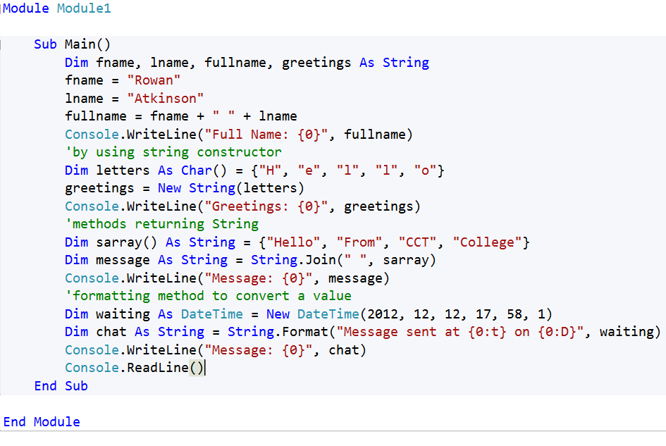
By Lecturer Suraj Pandey CCT College

Slide 21
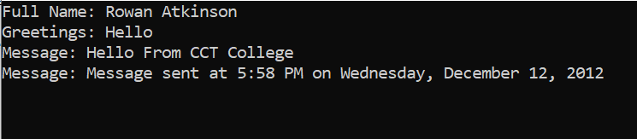
By Lecturer Suraj Pandey CCT College

Slide 22
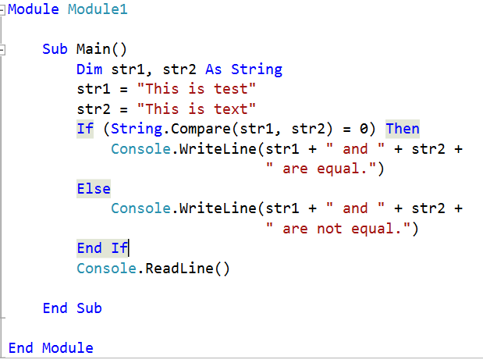
Examples:
The following example demonstrates some of the methods mentioned above:
Comparing Strings:
By Lecturer Suraj Pandey CCT College

Slide 23
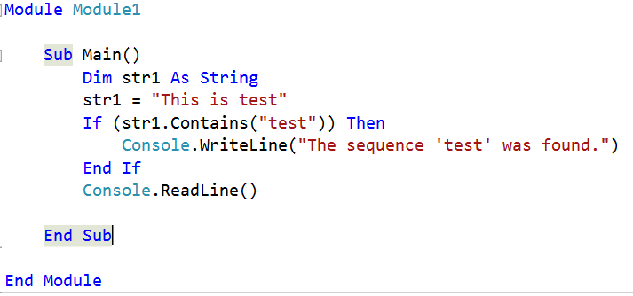
String Contains String:
When the above code is compiled and executed, it produces the following result:
The sequence 'test' was found.
By Lecturer Suraj Pandey CCT College

Slide 24
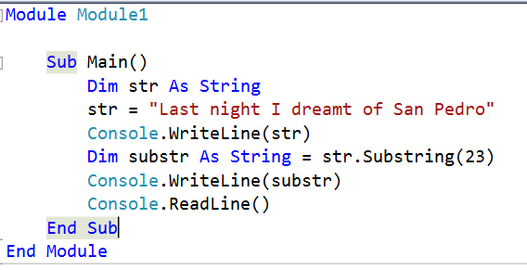
Getting a Substring:
When the above code is compiled and executed, it produces the following result:
Last night I dreamt of San Pedro
San Pedro.
By Lecturer Suraj Pandey CCT College

Slide 25
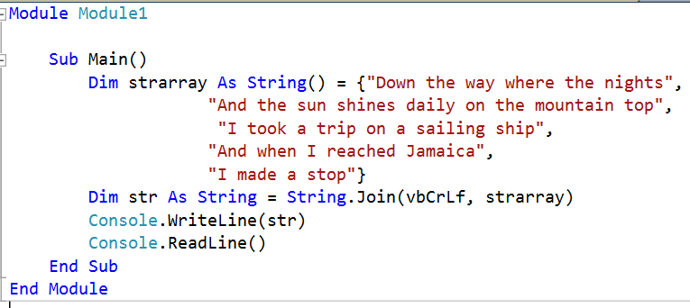
Joining Strings:
When the above code is compiled and executed, it produces the following result:
Down the way where the nights are gay
And the sun shines daily on the mountain top
I took a trip on a sailing ship
And when I reached Jamaica
I made a stop
By Lecturer Suraj Pandey CCT College

Slide 26
Module strings
Sub Main()
Dim fname, lname, fullname, greetings As String
fname = “cct"
lname = “college"
fullname = fname + " " + lname
Console.WriteLine("Full Name: {0}", fullname)
'by using string constructor
Dim letters As Char() = {"H", "e", "l", "l", "o"}
greetings = New String(letters)
Console.WriteLine("Greetings: {0}", greetings)
'methods returning String
Dim sarray() As String = {"Hello", "From", “ctc", "College"}
Dim message As String = String.Join(" ", sarray)
Console.WriteLine("Message: {0}", message)
'formatting method to convert a value
Dim waiting As DateTime = New DateTime(2016, 9, 4, 16, 20, 1)
Dim chat As String = String.Format("Message sent at {0:t} on {0:D}", waiting)
Console.WriteLine("Message: {0}", chat)
Console.ReadLine()
End Sub
End Module
Output: Full Name: cct college Greetings: Hello Message: Hello From ctc College Message: Message sent at 4:20 PM on Sunday, September 4, 2016

Slide 27
Properties of the String Class: The String class has the following two properties:
1. Chars: Gets the Char object at a specified position in the current String object.
2. Length: Gets the number of characters in the current String object.
Methods of the String Class: The String class has numerous methods that help us in working with the string objects. The following table provides some of the most commonly used methods:

Slide 28
Examples: The following example demonstrates some of the methods mentioned above:
1. Comparing Strings:
Module Strings
Sub Main()
Dim FirstString(30) As String
Dim SecondString(30) As String
Dim result As Integer
Console.WriteLine("Enter First String: ")
FirstString(30) = Console.ReadLine() Console.WriteLine("Enter Second String: ")
SecondString(30) = Console.ReadLine()
result = String.Compare(FirstString(30), SecondString(30)) Console.WriteLine("Comparison Result: " & result) Console.ReadKey()
End Sub
End Module

Slide 29
Output:
Enter First String: Ram
Enter Second String: Shyam
Comparison Result: -1

Slide 30
2. String Contains String: Module strings
Sub Main()
Dim str1 As String str1 = "This is test"
If (str1.Contains("test")) Then Console.WriteLine("The sequence 'test' was found.") End If
Console.ReadLine()
End Sub
End Module
Output: The sequence 'test' was found.
3. Getting a Substring:
Module strings
Sub Main()
Dim str As String
str = "Last night I dreamt of San Pedro" Console.WriteLine(str)
Dim substr As String = str.Substring(23) Console.WriteLine(substr) Console.ReadLine()
End Sub
End Module
Output: Last night I dreamt of San Pedro San Pedro

Slide 31
4. Joining Strings:
Module strings
Sub Main()
Dim strarray As String() = {"Down the way where the nights are gay", "And the sun shines daily on the mountain top", "I took a trip on a sailing ship", "And when I reached Jamaica", "I made a stop"}
Dim str As String = String.Join(vbCrLf, strarray)
Console.WriteLine(str) Console.ReadLine()
End Sub
End Module
Output: Down the way where the nights are gay And the sun shines daily on the mountain top I took a trip on a sailing ship And when I reached Jamaica I made a stop
5. String To Upper Case:
Module Strings
Sub Main()
Dim mystring(25) As String Console.WriteLine("Enter Your String: ") mystring(25) = Console.ReadLine() mystring(25) = UCase(mystring(25)) Console.WriteLine("Your string in UpperCase: " & mystring(25)) Console.ReadKey()
End Sub
End Module
Output: Enter Your String: pokhara
Your string in UpperCase: POKHARA

Slide 32
6. String to Lower Case: Module Strings
Sub Main()
Dim mystring(25) As String Console.WriteLine("Enter Your String: ")
mystring(25) = Console.ReadLine() mystring(25) = LCase(mystring(25)) Console.WriteLine("Your string in LowerCase: " & mystring(25)) Console.ReadKey()
End Sub
End Module
Output: Enter Your String:
POKHARA
Your string in UpperCase: pokhara
7. String Clone:
Module Strings
Sub Main()
Dim mystring As String = "Pokhara"
Dim temp(25) As String temp(25) = mystring.Clone() Console.WriteLine("Your Clone string: " & temp(25)) Console.ReadKey()
End Sub
End Module
Output: Your Clone string: Pokhara

