Slide 1
VARIABLE

Slide 2
USING VB. NET VARIABLES AND DATA TYPES
A variable: named memory location that can contain data
All variables have:
  Data type – kind of data the variable can contain
  Name – An identifier the programmer creates to refer to the variable
  Value – Every variable refers to a memory location that contains data. This value can be specified by the programmer
LECTURER Suraj Pandey CCT College

Slide 3
SO WHAT IS VARIABLE
A variable is nothing but a name given to a storage area that our programs can manipulate. Each variable in VB.Net has a specific type, which determines the size and layout of the variable's memory; the range of values that can be stored within that memory; and the set of operations that can be applied to the variable.
LECTURER Suraj Pandey CCT College

Slide 4
The basic value types provided in VB.Net can be categorized as:
Type
Example
Integral types
Byte, Short, Integer, Long and Char
Floating point types
Single and Double
Decimal types
Decimal
Boolean types
True or False values, as assigned
Date types
Date
LECTURER Suraj Pandey CCT College

Slide 5
VARIABLE DECLARATION IN VB.NET
The Dim statement is used for variable declaration and storage allocation for one or more variables. The Dim statement is used at module, class, structure, procedure or block level.
LECTURER Suraj Pandey CCT College

Slide 6
DECLARING AND INITIALIZING VARIABLES
To declare a VB .NET variable, write:
  Keyword “Dim”
  Name to be used for identifier
  Keyword “As”
  Data type
Example:
  ' declare a variable
  Dim i As Integer
LECTURER Suraj Pandey CCT College

Slide 7
Module variablesNdataypes
Sub Main()
Dim a As Short
Dim b As Integer
Dim c As Double
a = 10
b = 20
c = a + b
Console.WriteLine("a = {0}, b = {1}, c = {2}", a, b,c)
Console.ReadLine()
End Sub
End Module
LECTURER Suraj Pandey CCT College

Slide 8
Accepting Values from User
The Console class in the System namespace provides a function ReadLine for accepting input from the user and store it into a variable. For example,
Dim message As String
message = Console.ReadLine
The following example demonstrates it:
LECTURER Suraj Pandey CCT College

Slide 9
Module variablesNdataypes
Sub Main()
Dim message As String
Console.Write("Enter message: ")
message = Console.ReadLine
Console.WriteLine()
Console.WriteLine("Your Message: {0}", message)
Console.ReadLine()
End Sub
End Module
LECTURER Suraj Pandey CCT College

Slide 10
SCOPE OF VARIABLE:
When you declare a variable within a procedure, only code within that procedure can read or change the value of that variable: Its scope is local to that procedure. Sometimes, however, you want to use a variable with a broader scope, one whose value is available to all procedures within the same module, or even to all the procedures in all modules.
The scope and duration of a variable is determined by the keywords Dim, Redim, Static, Public or Private.

Slide 11
In Visual Basic.Net 4 basic types of scope are present:
1. Block Scope
2. Procedural Scope
3. Module Scope
4. Namespace Scope(Public Scope)

Slide 12
BLOCK SCOPE
If variables are declared inside the block of statement then those declare variables are cannot be kept out. Because it consist of number of statements
For example
Do and Loop
b. For [Each] and Next
c. If and End If
d. Select and End Select
e. Try and End Try
f. While and End While
g. With and End With

Slide 13
PROCEDURE SCOPE(LOCAL SCOPE)
If variables are declared inside the procedure then this scope is called procedure scope. Variables which are declare inside this scope is used only in this procedure scope. Variables outside this procedure is cannot be used.
Program 1: Printing Sum of Even from 1 to 100

Slide 14
Public Class Form1
Private Sub Button1_Click(ByVal sender As System.Object, ByVal e As System.EventArgs) Handles Button1.Click
Dim i As Integer
Dim sum As Integer
For i = 0 To 100 Step 2
sum = sum + i
Next
MsgBox("Sum of All Even No = " & sum)
End Sub
End Class
in this example SUM is on the both procedural scope

Slide 15
MODULE SCOPE
In this scope variables are declared inside the module. We can declare variable using DIM and PRIVATE statement below the public class form. The variable which are declare inside this scope can be used in every module of program. This scope is called Module scope.
Program 2: Module Scope

Slide 16
Public Class Form1
Dim x As Integer
Sub Exp1()
Dim y As Integer
x = 10
y = 20
MsgBox(y)
End Sub
Sub Exp2()
Dim y As String
y = "VB.NET"
MsgBox(y)
MsgBox(x)
End Sub
Sub Exp3()
MsgBox(x)
End Sub
End Class
In this example x module is scope of variable because of this it can be used in three sub procedures Exp1, Exp2 Exp3

Slide 17
NAMESPACE SCOPE
In this scope variable can be used in whole of the project. To declare variable in this scope public statement in code window below public form is written. In this instead of DIM/Private we use Public to declare a varibale
Program 3: Public Module- in this program two form is use:

Slide 18
Public Class Form1
Public x As Integer
Private Sub Button1_Click(ByVal sender As System.Object, ByVal e As System.EventArgs) Handles Button1.Click
x = 100
Form2.Show()
End Sub
End Class

Slide 19
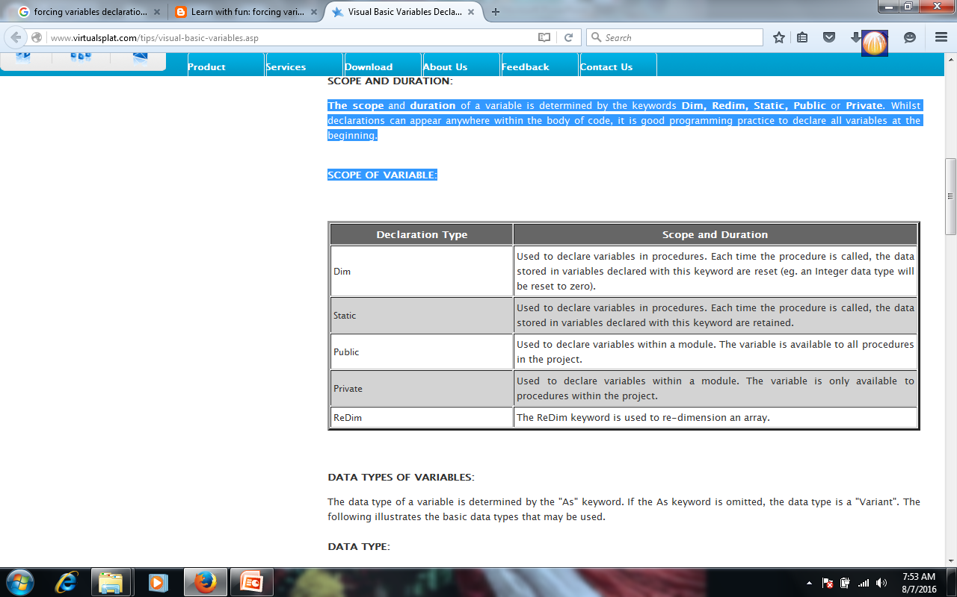

Slide 20
LIFETIME OF A VARIABLE
variables lifetime is the time during which a variable retains its value. The values in module-level and public variables are preserved as long as the database is open (unless you reinitialize your code).
However, local variables declared with the Dim keyword exist only while the procedure in which they are declared is running. Usually, when a procedure has finished, the values of its local variables are discarded and the memory used by the local variables is reclaimed.
The next time the procedure is run, all of its local variables are reinitialized.
However, you can make Visual Basic preserve the value of a local variable by making the variable static.

Slide 21
FORCING VARIABLE DECLARATION IN VB.NET
In Visual Basic 6 there is no need to declare variables because in visual basic 6 there is a default setting . Due to default setting in VB.Net we need to declare a variable. If we don’t declare variable then it will generate error. In order to change the default behavior in Visual Basic we need to go to the statement in code window and change the setting.

Slide 22
Option Explicit statement ensures whether the compiler requires all variables to be explicitly declared or not before it use in the program.
Option Explicit [On Off]
The Option Explicit has two modes. On and Off mode. If Option Explicit mode in ON , you have to declare all the variable before you use it in the program . If not , it will generate a compile-time error whenever a variable that has not been declared is encountered .
If the Option Explicit mode is OFF , Vb.Net automatically create a variable whenever it sees a variable without proper declaration.
By default the Option Explicit is On

Slide 23
By default the Option Explicit is On
With the Option Explicit On , you can reduce the possible errors that result from misspelled variable names. Because in Option Explicit On mode you have to declare each variable in the program for storing data.
Take a look at the following programs, it will give you a clear picture of Option Explicit.
The following program is a normal vb.net program , so the default mode of Option Explicit On is using. The default is Option Explicit On , so we do not need to put it in the source code.

Slide 24
Public Class Form1
Private Sub Button1_Click(ByVal sender As System.Object, _ ByVal e As System.EventArgs) Handles Button1.Click
Dim someVariable As String
someVariable = "Option Explicit ON" MsgBox(someVariable)
End Sub
End Class

Slide 25
DECLARING AND INITIALIZING VARIABLES
After declaring a variable’s name and data type, we can proceed to assign values to them.
  Dim height As integer
  height=170
  Dim temperature As Double
  tmperature=36.9
LECTURER Suraj Pandey CCT College

Slide 26
VB.Net - Data Types
Data types refer to an extensive system used for declaring variables or functions of different types. The type of a variable determines how much space it occupies in storage and how the bit pattern stored is interpreted
VB.Net provides a wide range of data types. The following table shows all the data types available:

Slide 27
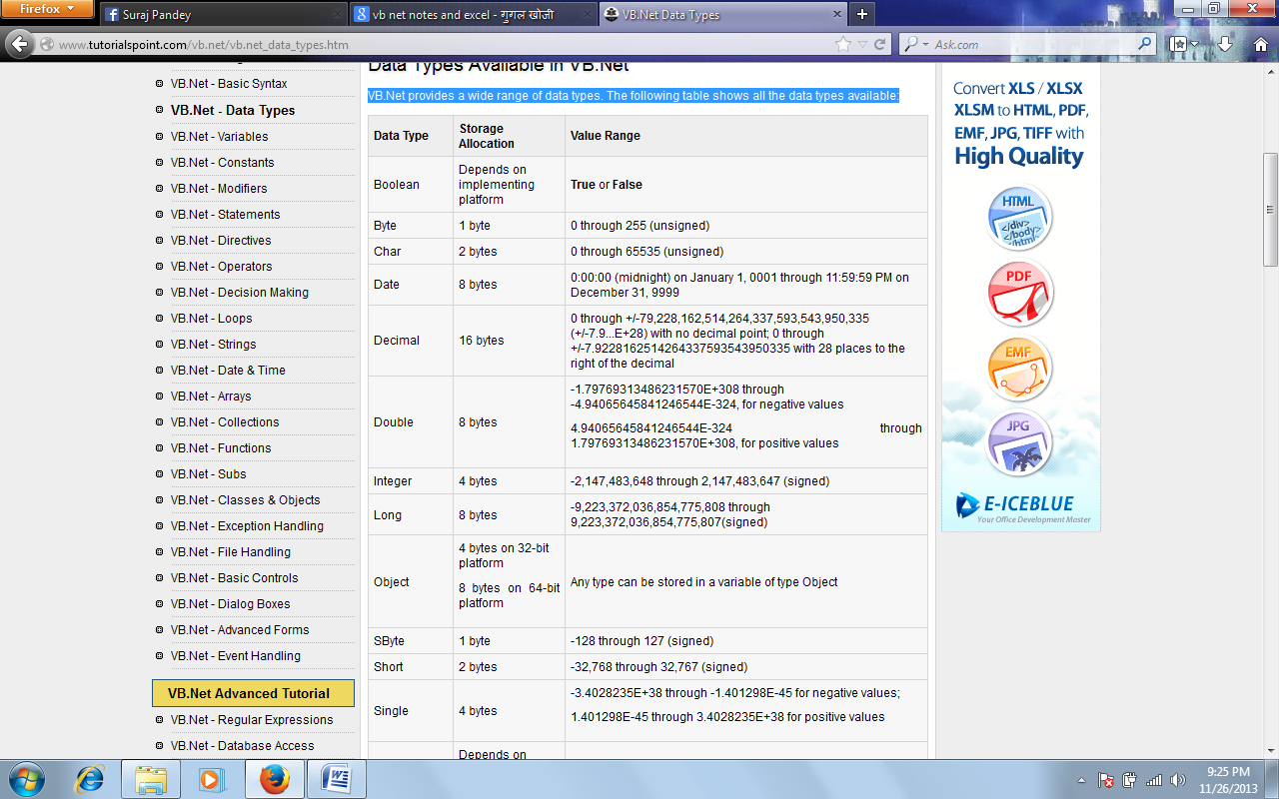

Slide 28
DATA TYPE CONVERSION

Slide 29
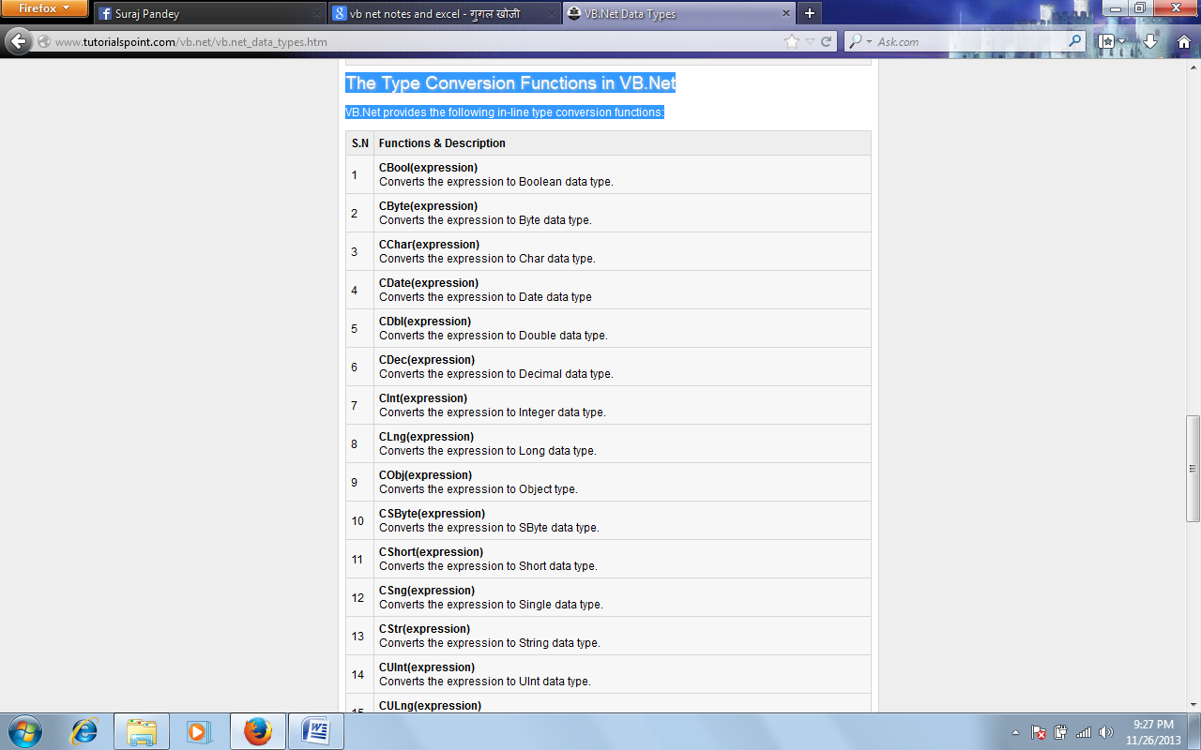

Slide 30
Example:
The following example demonstrates some of these functions:
Module DataTypes
Sub Main()
Dim n As Integer
Dim da As Date
Dim bl As Boolean = True
n = 1234567
da = Today
Console.WriteLine(bl)
Console.WriteLine(CSByte(bl))
Console.WriteLine(CStr(bl))
Console.WriteLine(CStr(da))
Console.WriteLine(CChar(CChar(CStr(n))))
Console.WriteLine(CChar(CStr(da)))
Console.ReadKey()
End Sub
End Module

Slide 31
VB.Net - Constants and Enumerations
The constants refer to fixed values that the program may not alter during its execution. These fixed values are also called literals.
Constants can be of any of the basic data types like an integer constant, a floating constant, a character constant, or a string literal. There are also enumeration constants as well.
An enumeration is a set of named integer constants.
Declaring Constants
In VB.Net, constants are declared using the Const statement.

Slide 32
The syntax for the Const statement is:
constantname [ As datatype ] = initializer
constantname: specifies the name of the constant
datatype: specifies the data type of the constant
initializer: specifies the value assigned to the constant

Slide 33
For example,
' The following statements declare constants.
Const maxval As Long = 4999
Public Const message As String = "HELLO"
Private Const piValue As Double = 3.1415

Slide 34
Example
The following example demonstrates declaration and use of a constant value:
Module constantsNenum
Sub Main()
Const PI = 3.14149
Dim radius, area As Single
radius = 7
area = PI * radius * radius
Console.WriteLine("Area = " & Str(area))
Console.ReadKey()
End Sub
End Module
When the above code is compiled and executed, it produces the following result:
Area = 153.933

Slide 35
Declaring Enumerations
An enumerated type is declared using the Enum statement. The Enum statement declares an enumeration and defines the values of its members. The Enum statement can be used at the module, class, structure, procedure, or block level.
Enum enumerationname [ As datatype ]
memberlist
End Enum
Where,
name: specifies the name of the member. Required.
initializer: value assigned to the enumeration member. Optional.

Slide 36
For example,
Enum Colors
red = 1
orange = 2
yellow = 3
green = 4
azure = 5
blue = 6
violet = 7
End Enum

Slide 37
Example
The following example demonstrates declaration and use of the Enum variable Colors:
Module constantsNenum
Enum Colors
red = 1
orange = 2
yellow = 3
green = 4
azure = 5
blue = 6
violet = 7
End Enum
Sub Main()
Console.WriteLine("The Color Red is : " & Colors.red)
Console.WriteLine("The Color Yellow is : " & Colors.yellow)
Console.WriteLine("The Color Blue is : " & Colors.blue)
Console.WriteLine("The Color Green is : " & Colors.green)
Console.ReadKey()
End Sub
End Module

Slide 38
When the above code is compiled and executed, it produces the following result:
The Color Red is: 1
The Color Yellow is: 3
The Color Blue is: 6
The Color Green is: 4

Slide 39
VB.Net - Statements
A statement is a complete instruction in Visual Basic programs. It may contain keywords, operators, variables, literal values, constants and expressions.
Statements could be categorized as:
Declaration statements - these are the statements where you name a variable, constant, or procedure, and can also specify a data type.
Executable statements - these are the statements, which initiate actions. These statements can call a method or function, loop or branch through blocks of code or assign values or expression to a variable or constant. In the last case, it is called an Assignment statement.
Declaration Statements
The declaration statements are used to name and define procedures, variables, properties, arrays, and constants. When you declare a programming element, you can also define its data type, access level, and scope.

Slide 40
S.N
Statements and Description
1 Dim Statement
Declares and allocates storage space for one or more variables.
2 Const Statement
Declares and defines one or more constants.
3 Enum Statement
Declares an enumeration and defines the values of its members.
4 Class Statement
Declares the name of a class and introduces the definition of the variables, properties, events, and procedures that the class comprises.
Example
1 Dim number As Integer
Dim quantity As Integer = 100
Dim message As String = "Hello!"
2 Const maximum As Long = 1000
Const naturalLogBase As Object
= CDec(2.7182818284)
3 Enum CoffeeMugSize
Jumbo
ExtraLarge
Large
Medium
Small
End Enum
4 Class Box
Public length As Double
Public breadth As Double
Public height As Double
End Class

Slide 41
5 Structure Statement
Declares the name of a structure and introduces the definition of the variables, properties, events, and procedures that the structure comprises.
6 Module Statement
Declares the name of a module and introduces the definition of the variables, properties, events, and procedures that the module comprises.
5 Structure Box
Public length As Double
Public breadth As Double
Public height As Double
End Structure
6 Public Module myModule
Sub Main()
Dim user As String =
InputBox("What is your name?")
MsgBox("User name is" & user)
End Sub
End Module

Slide 42
Executable Statements
An executable statement performs an action. Statements calling a procedure, branching to another place in the code, looping through several statements, or evaluating an expression are executable statements. An assignment statement is a special case of an executable statement.
Example
The following example demonstrates a decision making statement:

Slide 43
Module decisions
Sub Main()
'local variable definition '
Dim a As Integer = 10
' check the boolean condition using if statement '
If (a < 20) Then
' if condition is true then print the following '
Console.WriteLine("a is less than 20")
End If
Console.WriteLine("value of a is : {0}", a)
Console.ReadLine()
End Sub
End Module
When the above code is compiled and executed, it produces the following result:
a is less than 20;
value of a is : 10

Slide 44
VB.Net - Operators
An operator is a symbol that tells the compiler to perform specific mathematical or logical manipulations. VB.Net is rich in built-in operators and provides following types of commonly used operators:
Arithmetic Operators
Comparison Operators
Logical/Bitwise Operators
Assignment Operators

Slide 45
Arithmetic Operators
Following table shows all the arithmetic operators supported by VB.Net. Assume variable A holds 2 and variable B holds 7, then:

Slide 46
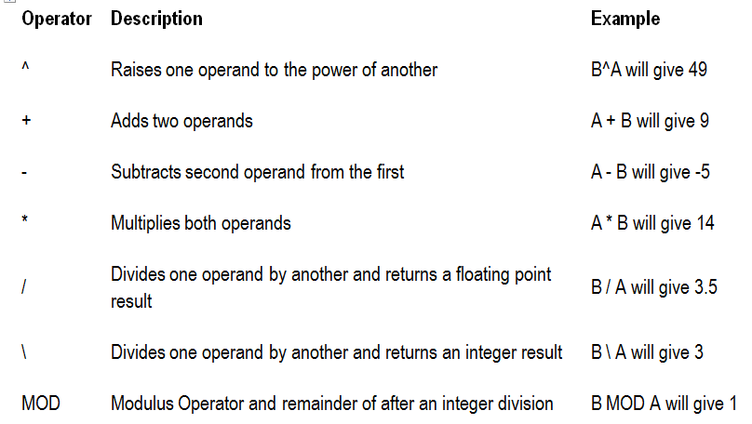

Slide 47
Comparison Operators
Following table shows all the comparison operators supported by VB.Net. Assume variable A holds 10 and variable B holds 20, then:

Slide 48
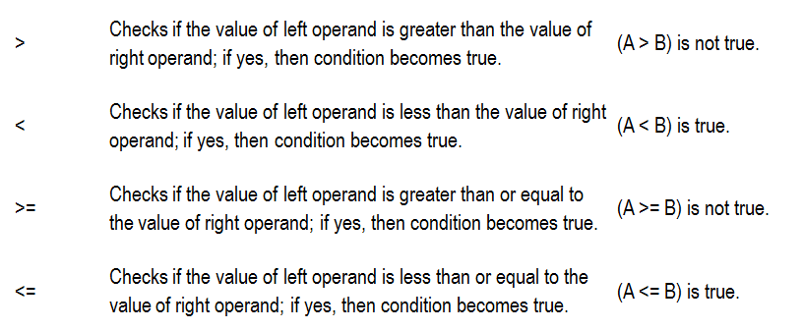

Slide 49
Logical/Bitwise Operators
Following table shows all the logical operators supported by VB.Net. Assume variable A holds Boolean value True and variable B holds Boolean value False, then:
Examples:
1 And
It is the logical as well as bitwise AND operator. If both the operands are true, then condition becomes true. This operator does not perform short-circuiting, i.e., it evaluates both the expressions.
(A And B) is False.
2 Or
It is the logical as well as bitwise OR operator. If any of the two operands is true, then condition becomes true. This operator does not perform short-circuiting, i.e., it evaluates both the expressions.
(A Or B) is True.
3 Not
It is the logical as well as bitwise NOT operator. Use to reverses the logical state of its operand. If a condition is true, then Logical NOT operator will make false.
Not(A And B) is True.

Slide 50
4 IsFalse
It determines whether an expression is False.
5 IsTrue
It determines whether an expression is True.

Slide 51
Assignment Operators
There are following assignment operators supported by VB.Net:
1 =
Simple assignment operator, Assigns values from right side operands to left side operand
C = A + B will assign value of A + B into C
2 +=
Add AND assignment operator, It adds right operand to the left operand and assigns the result to left operand
C += A is equivalent to C = C + A
3 -=
Subtract AND assignment operator, It subtracts right operand from the left operand and assigns the result to left operand
C -= A is equivalent to C = C - A
4 *=
Multiply AND assignment operator, It multiplies right operand with the left operand and assigns the result to left operand
C *= A is equivalent to C = C * A

