Slide 1


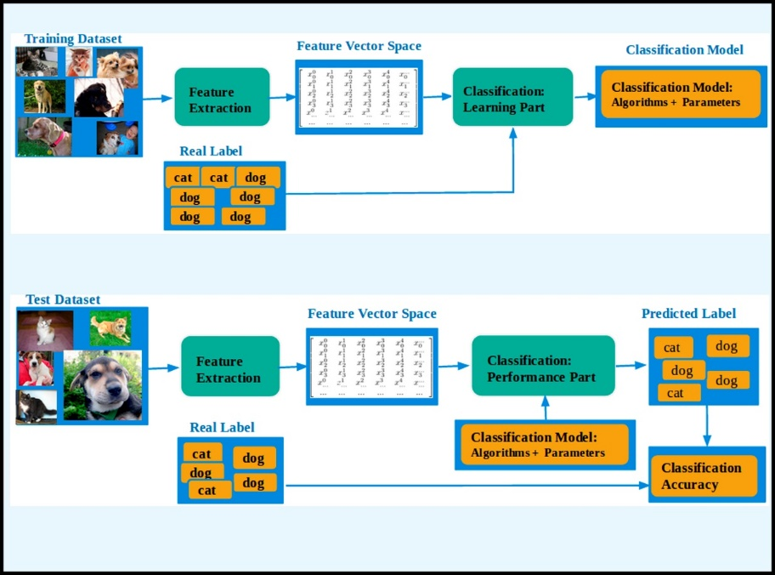





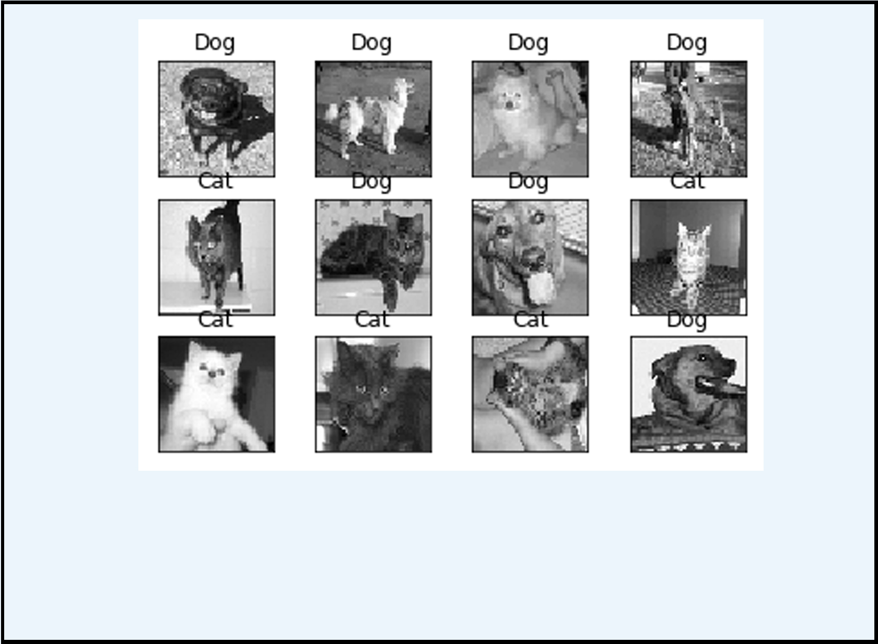



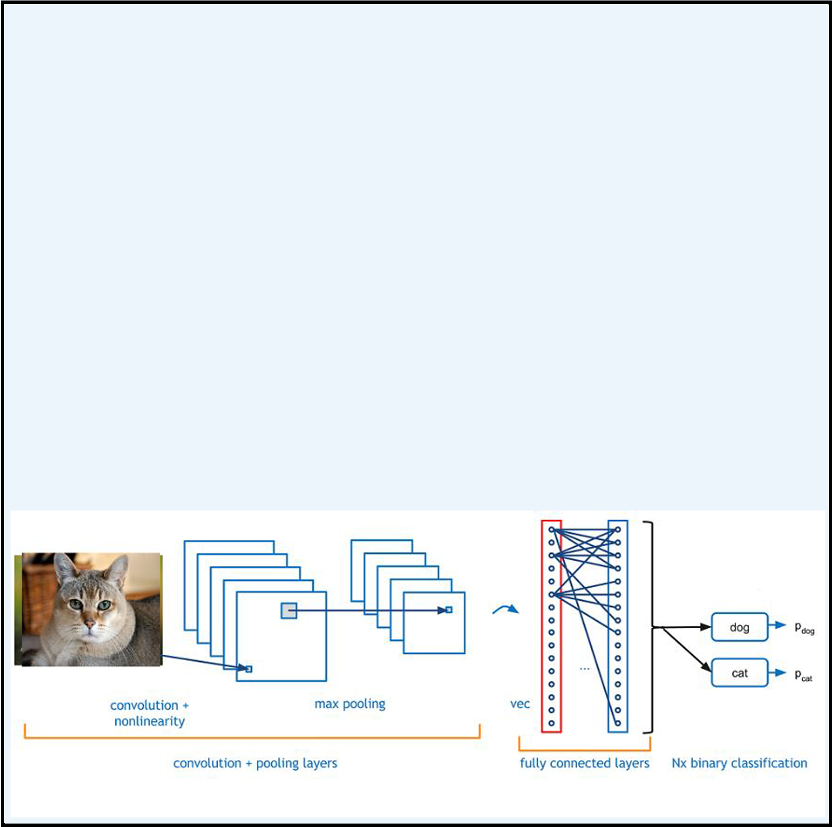

ANIMAL CLASSIFICATION USING CONVOLUTIONAL NEURAL NETWORK
(DEPARTMENT OF COMPUTER SCIENCE AND ENGINEERING, BIT MESRA, JAIPUR CAMPUS)
PRANAV KUMAR
ROHAN SARDANA
SURAJ PANKER
CSE - V
INTRODUCTION
WORKING
This project aims to classify the input image as either a dog or a cat image. The image input which you give to the system will be analysed and the predicted result will be given as output.
Machine learning algorithm (Convolutional Neural Networks) is used to classify the image.
The model thus implemented can be extended to a mobile device or any website as per the developers need.
Fig. : Architecture for Learning Task
OBJECTIVE
Fig. : Architecture for Performance Task
To distinguish between cat and dog present in the photos given as input.
FEATURES
This code can directly be integrated with your current project or can be extended as a mobile application or a site.
To extend the project to classify diﬀerent entities, all you need to do is find the suitable dataset, change the dataset accordingly and train the model.
BLOCK DIAGRAM
Preprocessing
Building the Network
RESULT
Training
Using the Network
DESCRIPTION
A convolutional neural network (CNN) is a type of artificial neural network used in image recognition and processing that is specifically designed to process pixel data.
CNNs are powerful image processing, artificial intelligence (AI) that use deep learning to perform both generative and descriptive tasks, often using machine vison that includes image and video recognition, along with recommender systems and natural language processing (NLP).
The above image is obtained classifying 11 out of 12 images correct.
So, Accuracy comes out to be: 11/12=0.9167.
CONCLUSION
This project gives a general idea of how image classification can be done eﬀiciently. The scope of the project can be extended to various industries where there is a huge scope for automation, by just altering the dataset.
REFERENCES
https://www.kaggle.com/c/dogs-vs-cats/data
https://www.geeksforgeeks.org/project-idea-cat-vs-dog-image-classifier-using-cnn-implemented-using-keras/

