Slide 1

Vivekanand Education Society’s Institute Of Technology
Department Of Information Technology
DSA mini Project
A.Y. 2025-26
Title: Data Structures & Algorithms
Domain: Data Structures & Algorithms
Member:Suraj Prakash
Mentor Name: Kajal Jewani

Slide 2
Content
Introduction to the Project
Problem Statement
Scope of the Project
Requirements of the System (Hardware, Software)
Code and Video
Data Structure & Concepts Used
Algorithm Explanation
Time and Space Complexity
Conclusion
References (in IEEE Format)

Slide 3

Introduction to Project
Built using javascript, css and bfs
Built with React to demonstrate a practical application
of the Breadth-First Search (BFS) algorithm
Inspired by the Arcade Original
Focuses on DSA implementatio

Slide 4
Problem Statement
Main Goal: To create a Pac-Man game with intelligent ghost AI, not just enemies that move randomly.
The Challenge: To program the ghosts to efficiently hunt the player by always finding the shortest possible path through the maze.
The Solution: To use a classic computer science algorithm (Breadth-First Search) as the "brain" for the ghosts' movement.
r Rates

Slide 5
Scope of The Project
A complete, single-level Pac-Man game.
A player-controlled Pac-Man using keyboard inputs.
Three intelligent ghosts that use the BFS algorithm to
chase the player.
A full game loop, including scoring, lives, win/loss panels,
and a pause feature.
A high score system that saves to the browser.

Slide 6
Objectives of the project
Apply a Pathfinding Algorithm: To implement Breadth-First
Search (BFS) to create intelligent ghost AI.
Build a Complete Game: To develop a full, playable
Pac-Man game with all essential features.
Gain React Experience: To build the project using the React.js library to manage the game's state and user interface.

Slide 7
Requirements of the system (Hardware, software)
Hardware: Any standard PC/Laptop
(2 GB RAM minimum)
Software: To build or modify the project, Node.js and npm are required.
OS: Windows/Linux/Mac
Web Browser: An up-to-date version of a web browser like Google Chrome, Mozilla Firefox, or Microsoft Edge.

Slide 8
Data Structures & Concepts Used
Array for making Map
Array (as 2D Grid) :-
The entire game map is represented by a single array. Numbers define walls (1), dots (2), and paths (0).

Slide 9
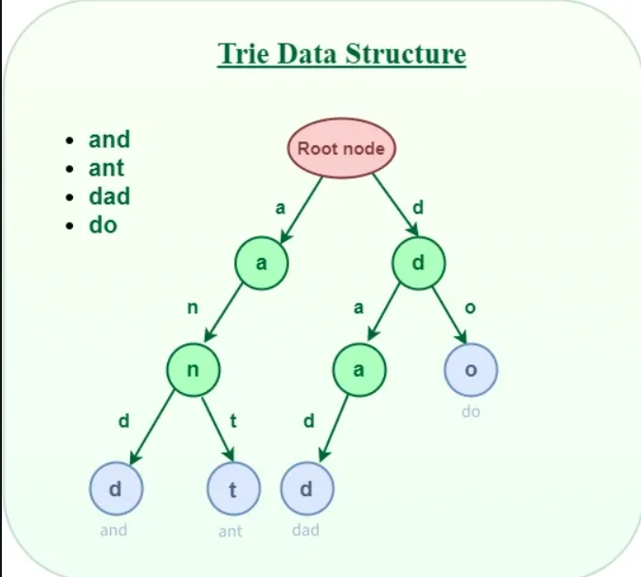
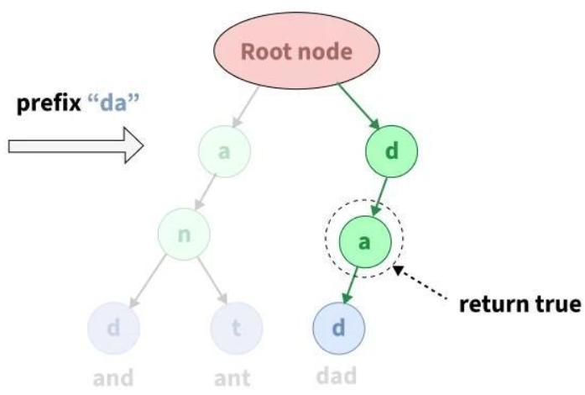
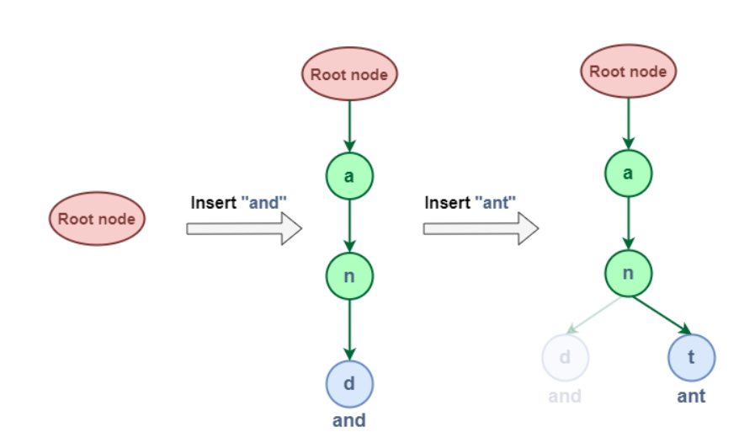
Data Structure Info
Searching using Prefix Time Complexity O(n):
Insert Time Complexity O(n):

Slide 10
Algorithm Explanation
Insert: Add each contact character by character into Trie
Search: Traverse Trie according to prefix characters
Suggest: Recursively list all words below prefix node
Output: Print matching contacts in console
Fallback: If no match, print “No Suggestions”

Slide 11
Time & Space Complexity
Insertion: O(L) per word (L = word length)
Search Prefix: O(P) (P = prefix length)
Suggestion Listing: O(N) for N words below prefix
Space: O(26 * total characters) for Trie nodes
Efficient compared to linear search O(N*L)

Slide 12
CODE
All links below are clickable
Trie.c
Trie.h
Project.c
Libraries used were cJSON

Slide 13
Conclusion
Implemented efficient contact search system in C
Used Trie Data Structure for fast prefix search
Demonstrated DSA application in real-world problem
Simple console interface but effective logic
Provides a foundation for larger applications

Slide 14
References
Trie Data Structure (GeekforGeeks): https://www.geeksforgeeks.org/dsa/trie-insert-and-search/
Agnihotri, A. (2025, April 28). cJSON - JSON file write/read/modify in C. GeeksforGeeks. Retrieved October 7, 2025, from https://www.geeksforgeeks.org/c/cjson-json-file-write-read-modify-in-c/
GeeksforGeeks. (2025, September 1). Trie | (insert and search). GeeksforGeeks. Retrieved October 7, 2025, from https://www.geeksforgeeks.org/dsa/trie-insert-and-search/

