Slide 1
Semester Loading

Slide 2


Hello!
I am Suraj Raj
Data Engineer
You can find me on Linkedin at: @surajraj90

Slide 3
Table Of Contents
Initial Expectations
Input Data
Tools & Technologies
How to Run?
Output Excel
Future Enhancements
Limitations

Slide 4
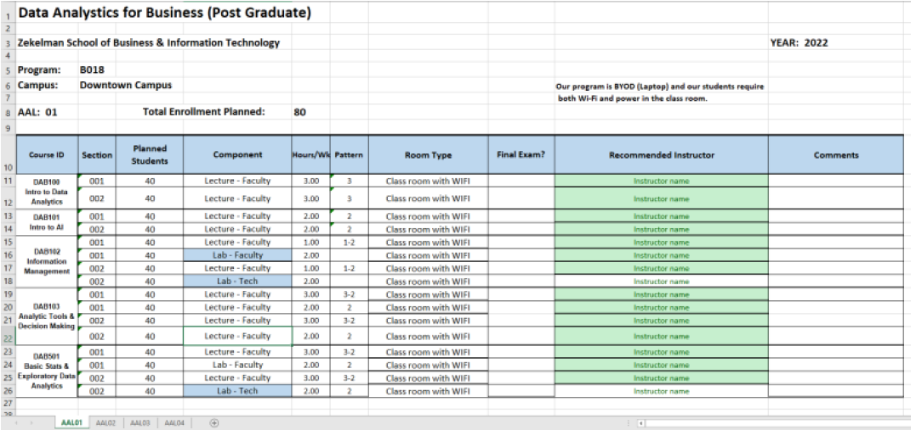
Initial Expectations
An excel output as formatted below

Slide 5
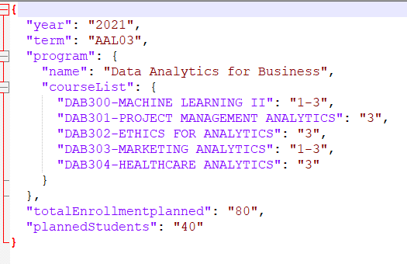
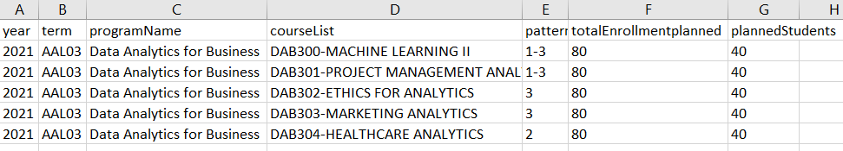
Input Data
JSON
EXCEL

Slide 6
Tools And Technologies Used & Required On Host Machine
Python >=3.6
Pandas
Xlsxwriter
Excel or Json Input
Windows Shell Script

Slide 7
How To Run?
First, you must successfully setup your environment as mentioned in last slide.
Second, you need to fill the input template(Excel or Json)
Run the Shell Script as shown below to get output.

Slide 8
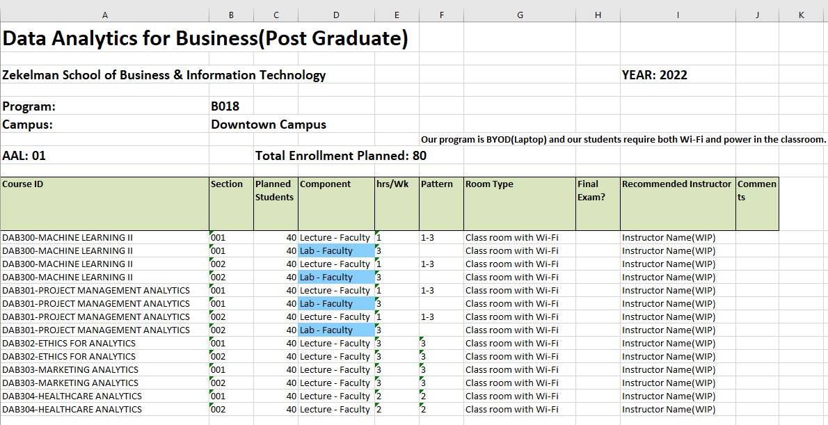
Output Or Target Excel
An excel output as below after running Shell Command

Slide 9
Future Enhancements
User Interface to upload file(Excel, Json) or manually type on UI.
Enhance the solution to run for all the combinations of courses/subjects/semesters/years
Usage of MySQL or other databases options to store static data and past records.
If possible, make this solution available on CLOUD.(Best Solution)

Slide 10
Limitations
No User Interface currently.

Slide 11
Thank You

