Slide 1

Thyroid Detection with Machine Learning

Slide 2
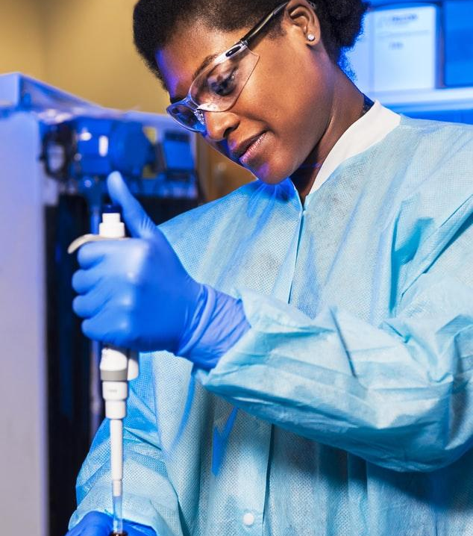
Hello!
I am Suraj Raj

Slide 3
Agenda
About Project
What are we trying to achieve?
Column Correlation
Architecture
Tools & Technologies
Machine Learning algorithms used
Final Product
Future Improvements
References

Slide 4
About Project
Thyroid Detection with Machine Learning.
There are multiple blood tests a person must undergo for the detection of Thyroid and from the combination of all these test results, doctor can judge whether a person has thyroid or not.
Initial understanding
Read multiple papers published. We have seen that in the papers already published, they have used multiple algorithms, but they have not achieved the accuracy greater than 96%. Also, there is no mechanism that anyone can use their research publicly.
Dataset used
UCI ML Repository(Link provided in the end)

Slide 5
About Project(Dataset)
Main features from dataset that we have used:
Thyroid Stimulating Hormone (TSH)
Thyroxine (TT4)
Triiodothyronine (T3)
Free T4 Index (FTI)
Thyroxine Utilization Rates (T4U)
Target Variable
Thyroid Positive, or
Thyroid Negative
These are the blood test results those are having highest correlation with the target variable. We can include the gender feature here but the difference in the accuracy is very negligible, so we have removed that.
There are around 3000 records on which this algorithm is trained and tested.

Slide 6
What are we trying to achieve?
Accuracy of greater than 96%.
A web portal where anyone can come and check the thyroid result by just putting details of blood tests.
Learning the use of technology in healthcare.

Slide 7
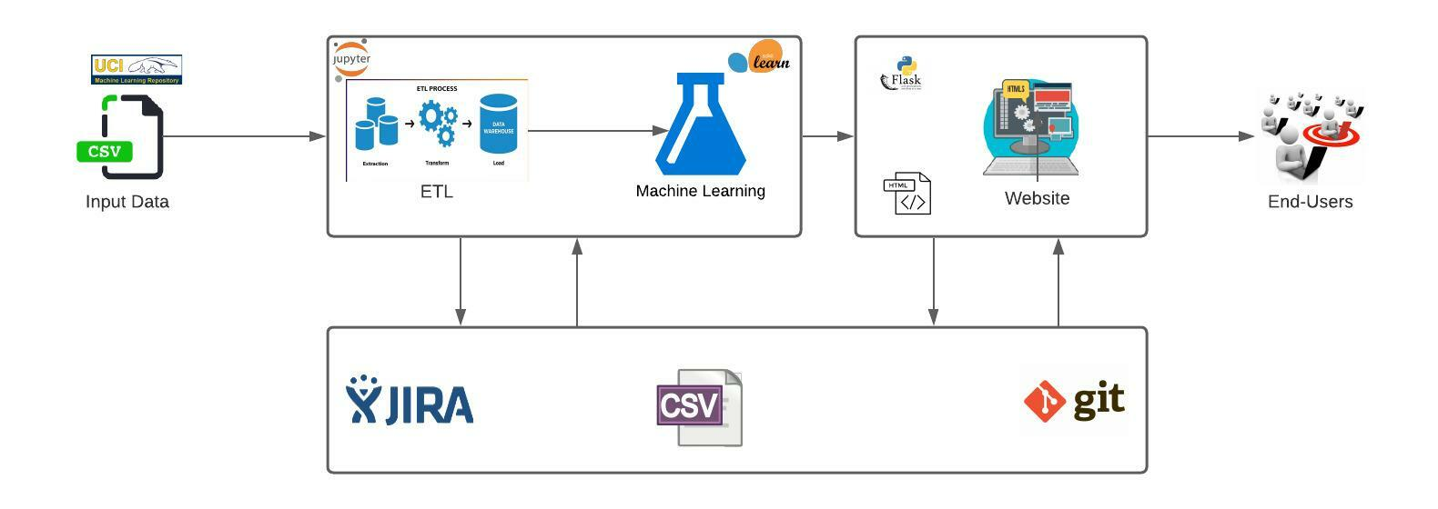
Architecture

Slide 8
About Project(Timelines)
 | Wk1 | Wk2 | Wk3 | Wk4 | Wk5 | Wk6 | Wk7 | Wk8 | Wk9 | Wk10 | Wk11 | Wk12 | Wk13 | Wk14
Initial Analysis |  | ◆
Dataset finding |  |  |  | ◆
Tools/Technologies setup & Data Cleaning |  |  |  |  |  | ◆
Exploratory Data Analysis |  |  |  |  |  |  |  | ◆
Data Visualization |  |  |  |  |  |  |  |  | ◆
Machine Leaning Model Building |  |  |  |  |  |  |  |  |  |  |  | ◆
User Interface |  |  |  |  |  |  |  |  |  |  |  |  | ◆
Testing |  |  |  |  |  |  |  |  |  |  |  |  |  | ◆
*Note:- Timelines are tentative

Slide 9
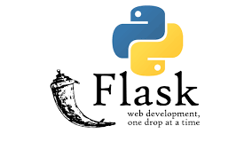

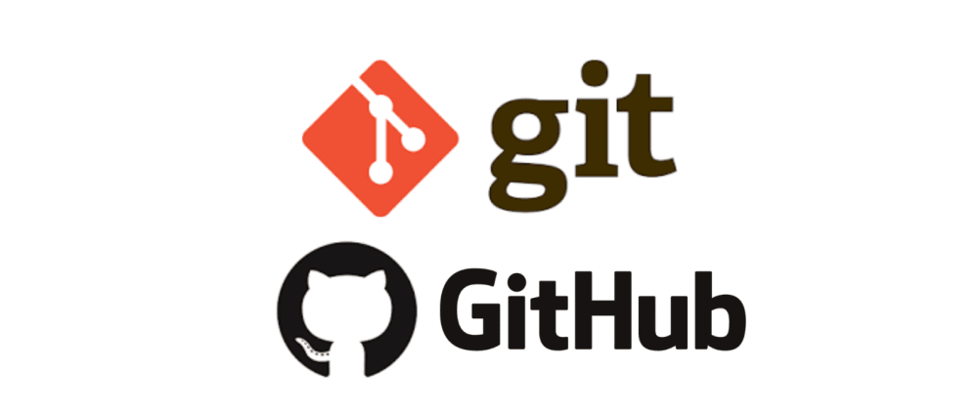
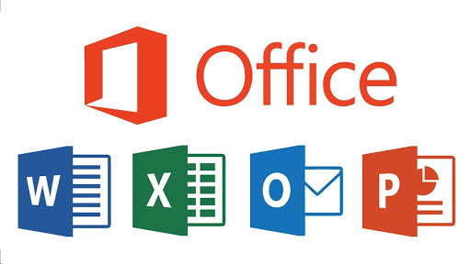


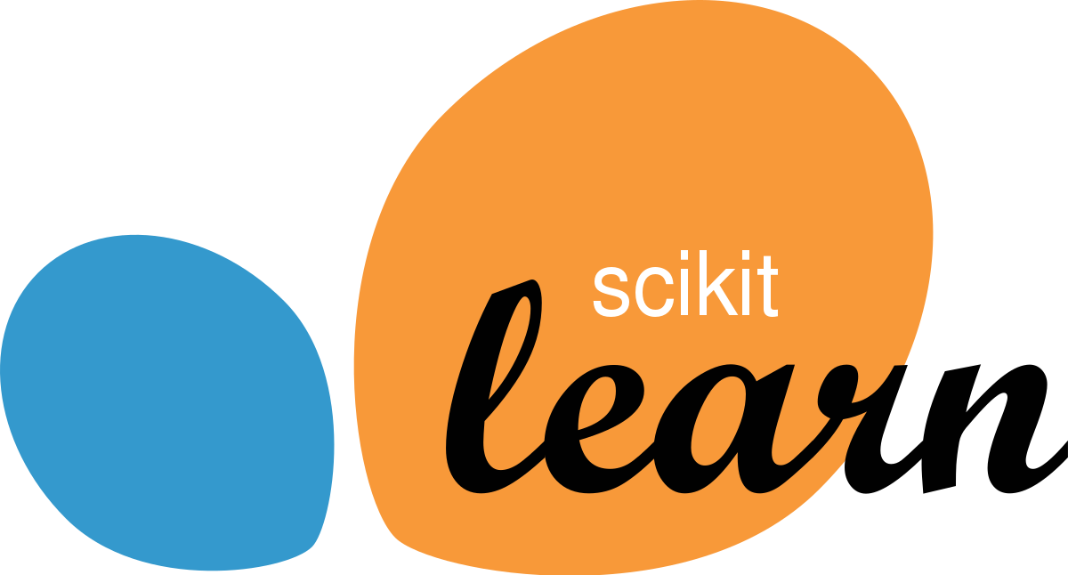
Tools and Technologies used.
Python
Jupyter Notebooks
Pycharm & Flask for User Interface
Jira Board
Git & Github
Scikit-learn for ML models
MS Office

Slide 10
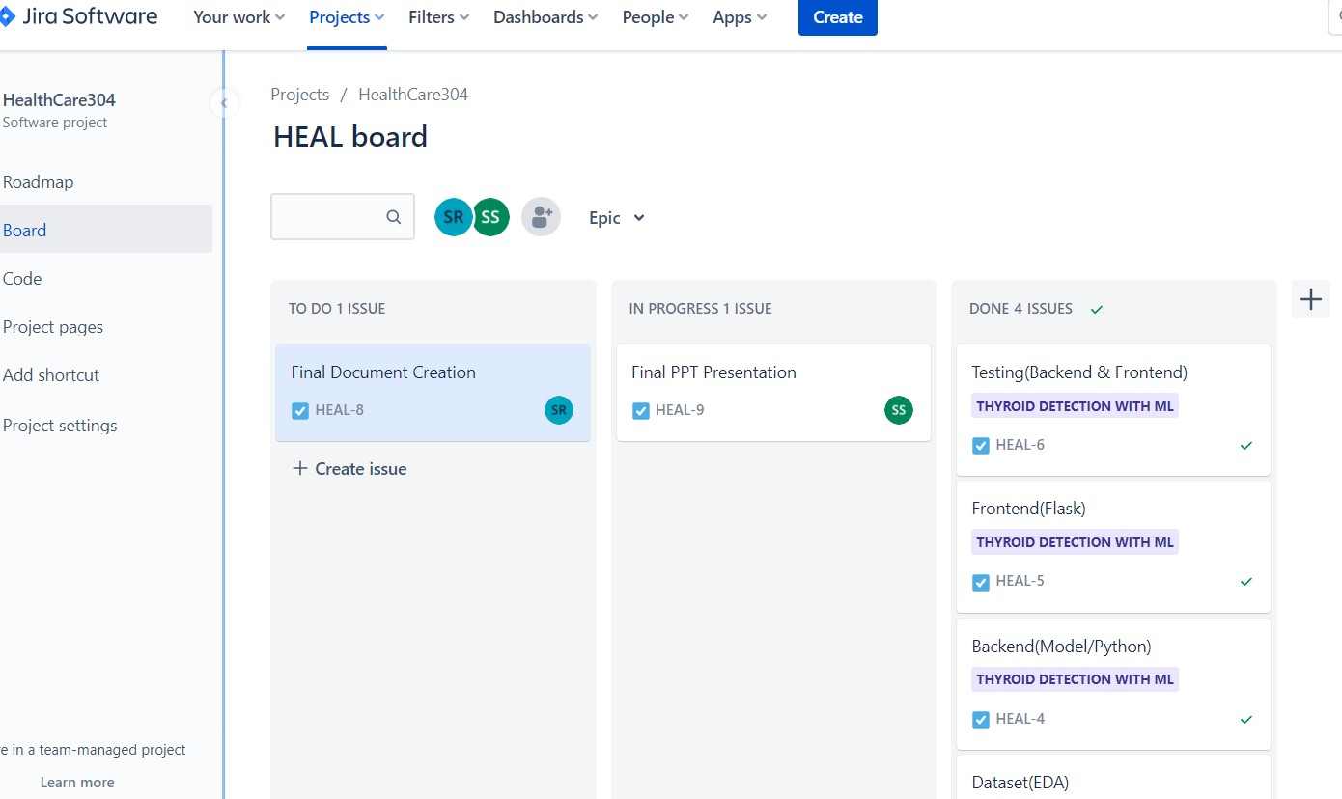
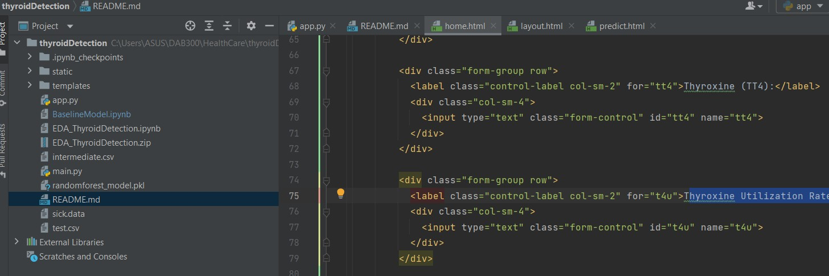
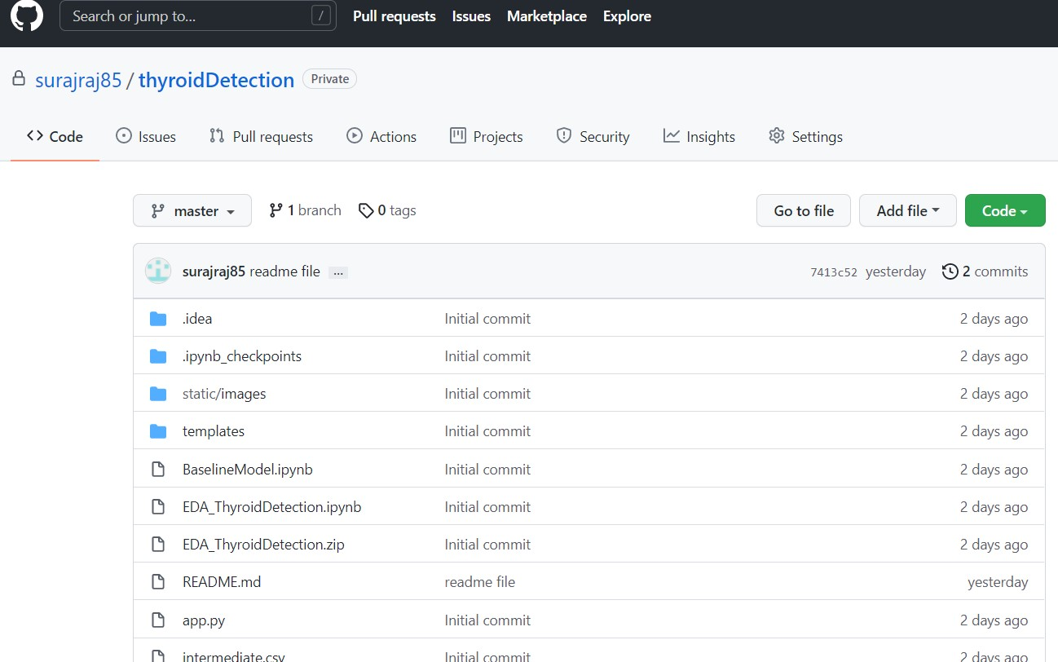
Tools and Technologies used

Slide 11
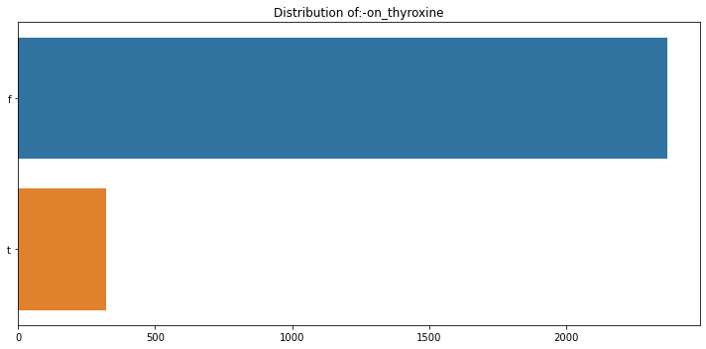
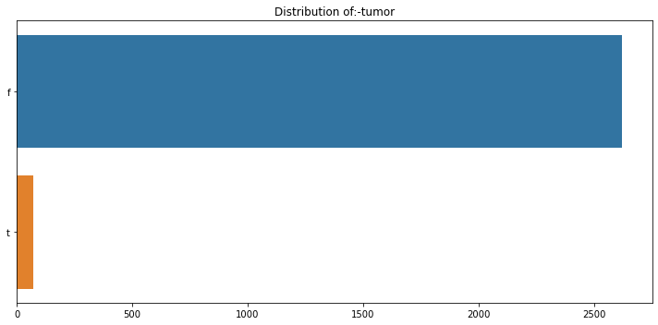
EDA (Distribution)

Slide 12
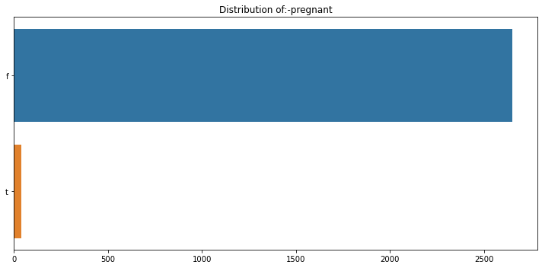
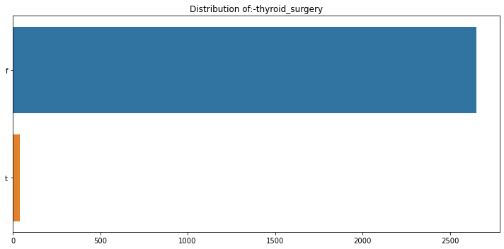
EDA (Distribution)

Slide 13
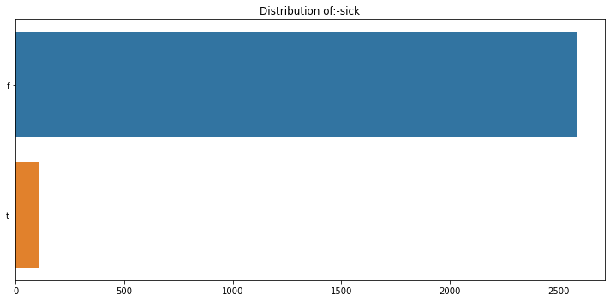
EDA (Distribution of Target)

Slide 14
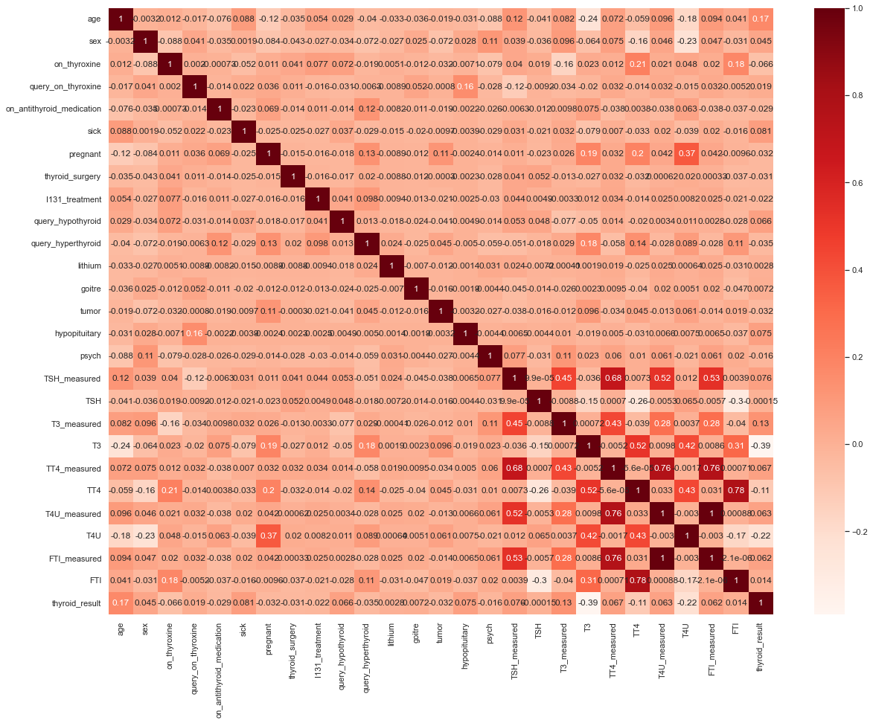
Correlation Matrix

Slide 15
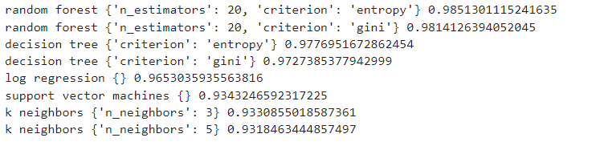
Machine Learning Algorithms used
Logistic Regression
Decision Tree Classifier
Random Forest Classifier
KNN Classifier
Support Vector Machine
Neural Networks

Slide 16
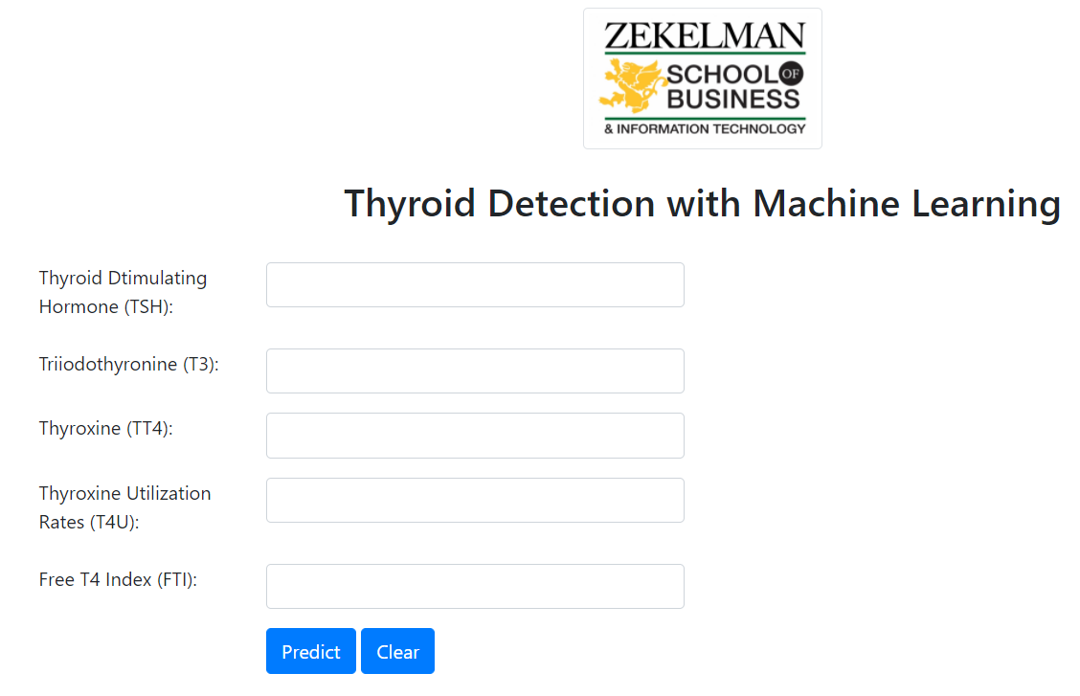
Final Product(Landing Page)

Slide 17
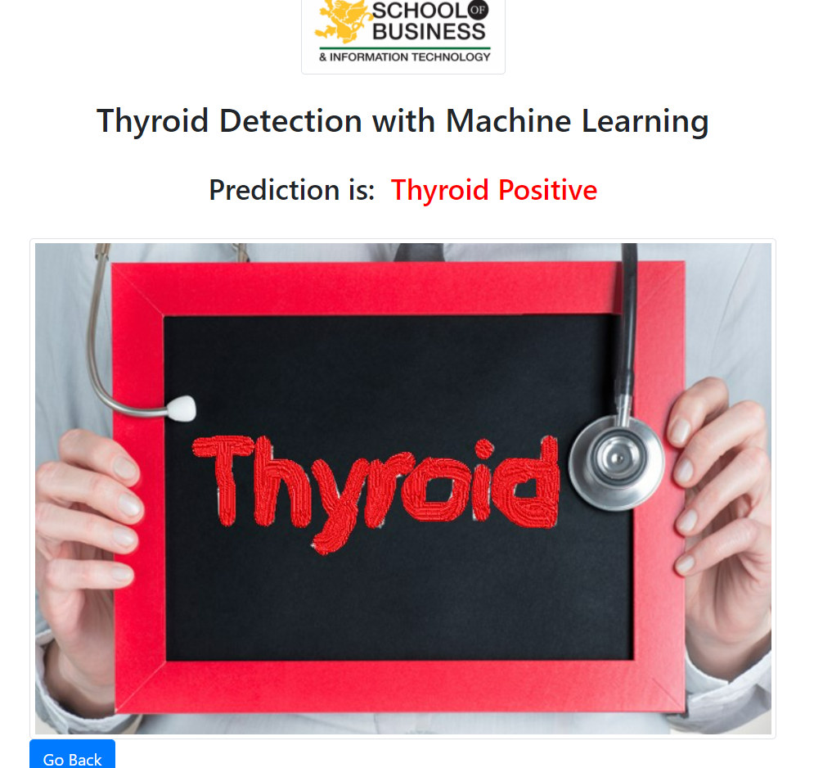
Final Product(Thyroid +ve)

Slide 18
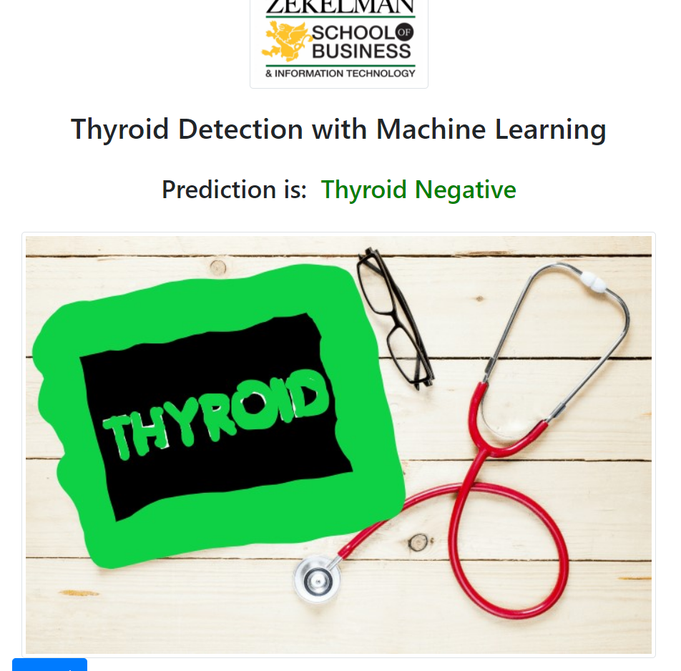
Final Product(Thyroid -ve)

Slide 19
Future Improvements
Running algorithms on large dataset.
Improving the UI components and adding checks to control the values.

Slide 20
References
https://archive.ics.uci.edu/ml/datasets/thyroid+disease
https://scikit-learn.org/stable/
Medium-MultiAlgo

Slide 21
THANK YOU

