Slide 1

Department Of Information technology
Course:- Software Engineering Modeling ﻿ & Design
Title : Hostel Mess Management System
Roll No. | PRN No. | Name
26 | 0124UITM1026 | Giri Aryan Ganesh
34 | 0124UITM1034 | Rajput Suraj Sandeepsigh
43 | 0124UITF1043 | Walke Apeksha Sandip
44 | 0124UITF1044 | Khoje Sarika Dadasaheb
Guided By :
Prof P.G.Thakre
Notes:
1

Slide 2
Introduction & Objectives
In many hospitals, management is still handled manually, which leads to issues such as inaccurate patient records, delays in service, improper billing, and difficulty in handling a large number of patients.
Our system aims to overcome these problems by providing a digital platform for managing patient registration, appointment scheduling, treatment records, and payment processing.
Objectives
To automate hospital management processes
To reduce paperwork
To provide an easy appointment booking system
To maintain patient and billing records
To improve overall management efficiency
Prerequisite Course: Computer Organization and Architecture, Operating System and Administration, Data Structures
Notes:
2

Slide 3
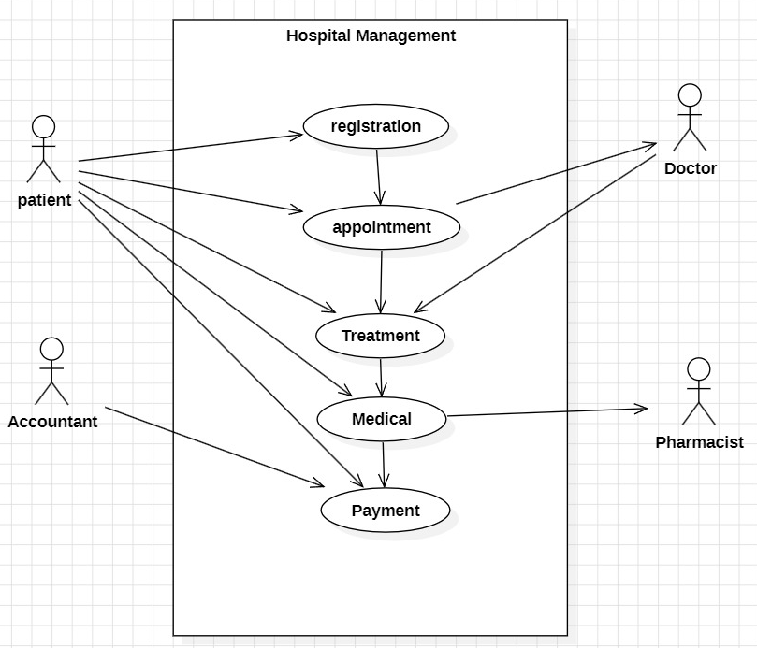
Use Case Diagram
Definition
A Use Case Diagram is a UML diagram that shows how different users (actors) interact with a system to perform specific tasks (use cases).
Main Elements
Actor: User of the system (Patient, Doctor, Pharmacist, Accountant)
Use Case: Function of system (Registatrion, Appointment, Treatment, Medical, Payment)
System Boundary: Defines system scope
Association: Connection between actor & use case
Common Notations
👤 Stick figure → Actor
⭕ Oval → Use Case
▭ Rectangle → System Boundary
─ Line → Association
Notes:
3

Slide 4
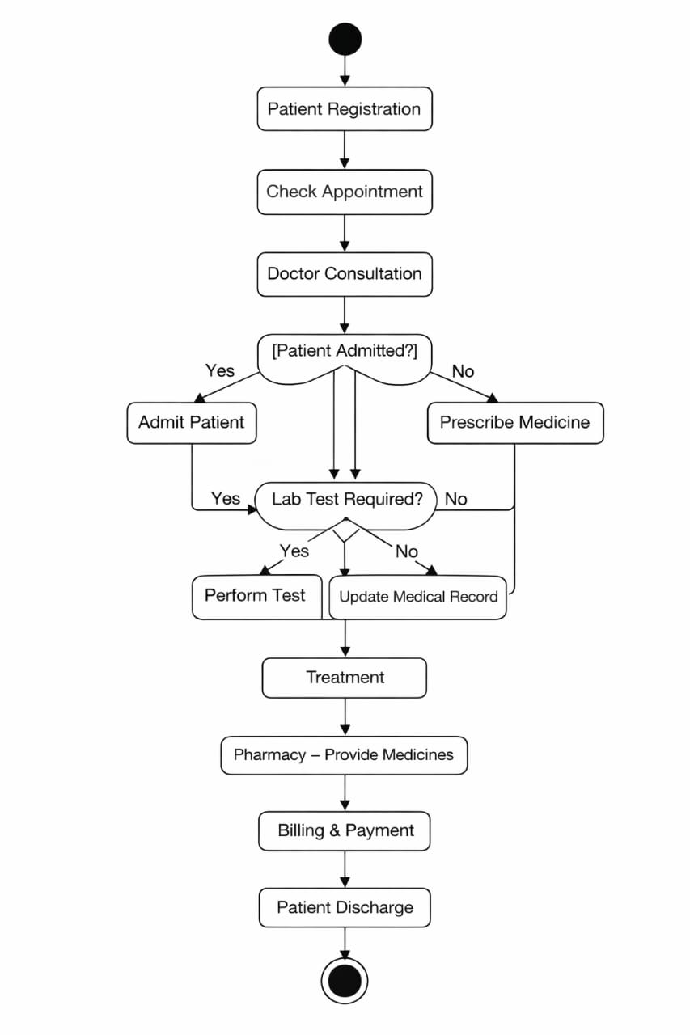
Activity Diagram
Definition
An Activity Diagram shows the flow of actions or processes in a system from start to end.
Main Elements
Activity (task)
Decision (condition)
Start & End
Flow (sequence of steps)
Common Notations
● Filled Circle → Start
◎ Circle with border → End
▭ Rectangle → Activity
◇ Diamond → Decision
➝ Arrow → Flow
Prerequisite Course: Computer Organization and Architecture, Operating System and Administration, Data Structures
Notes:
4

Slide 5
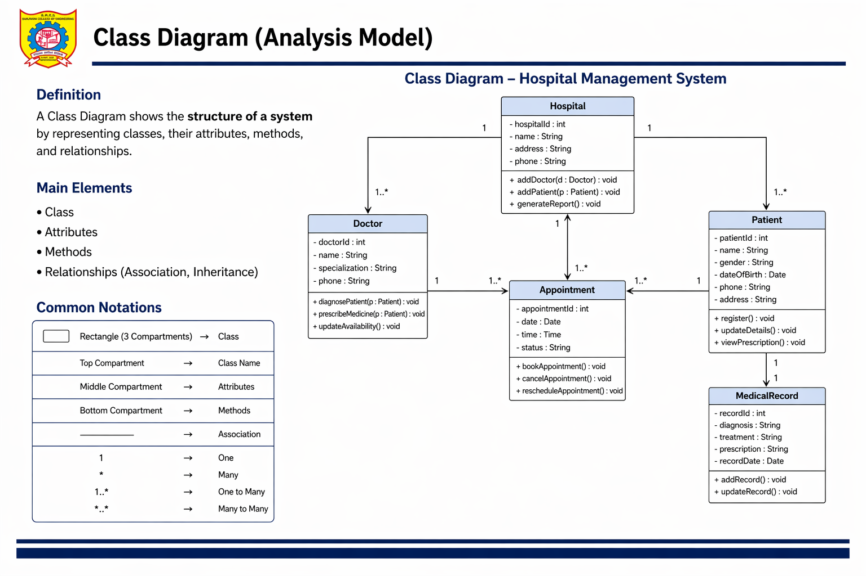
Class Diagram (Analysis Model)
Notes:
5

Slide 6
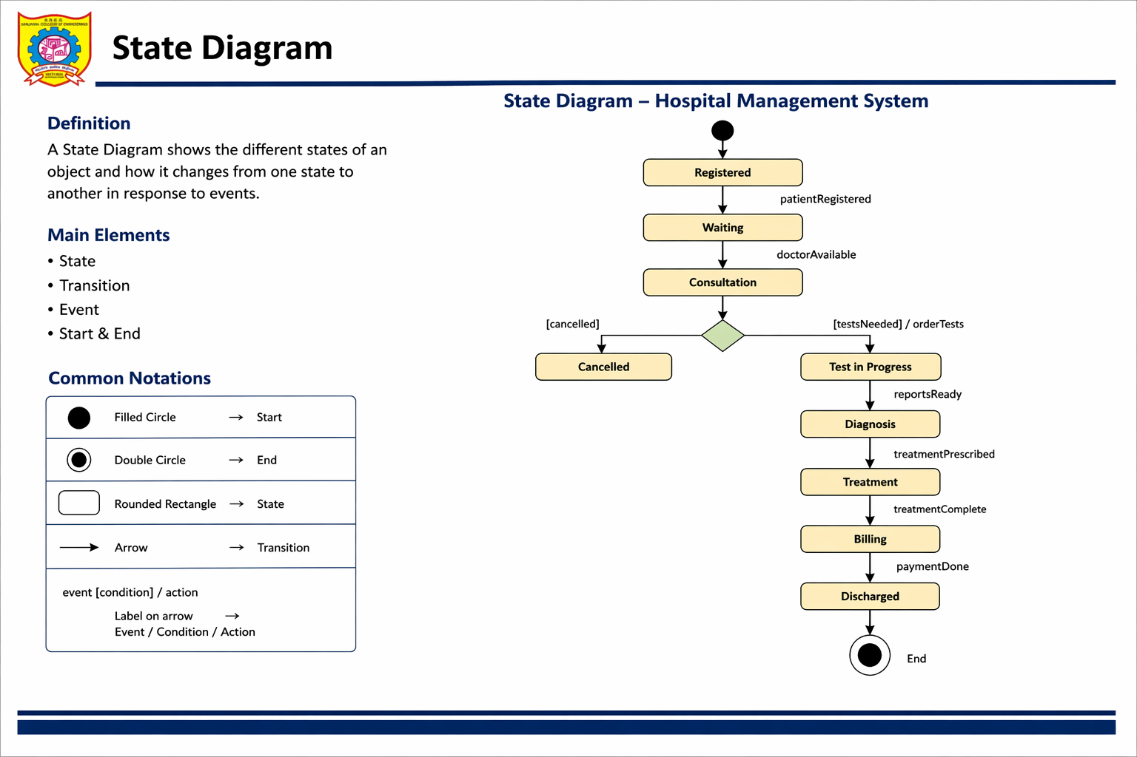
State Diagram
Notes:
6

Slide 7
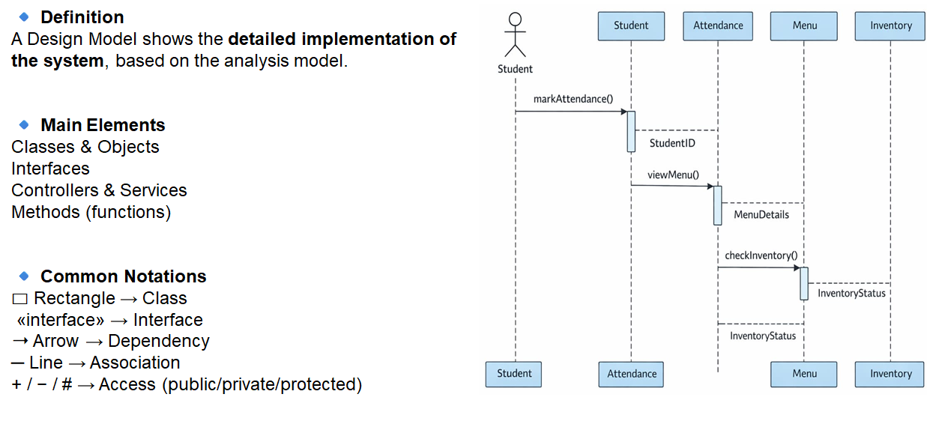
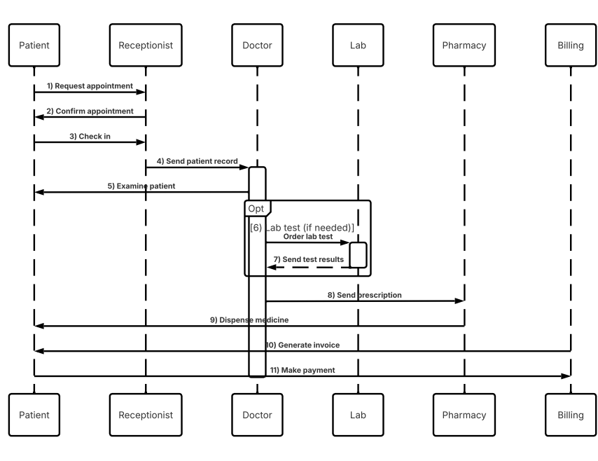
Sequence Diagram

Slide 8
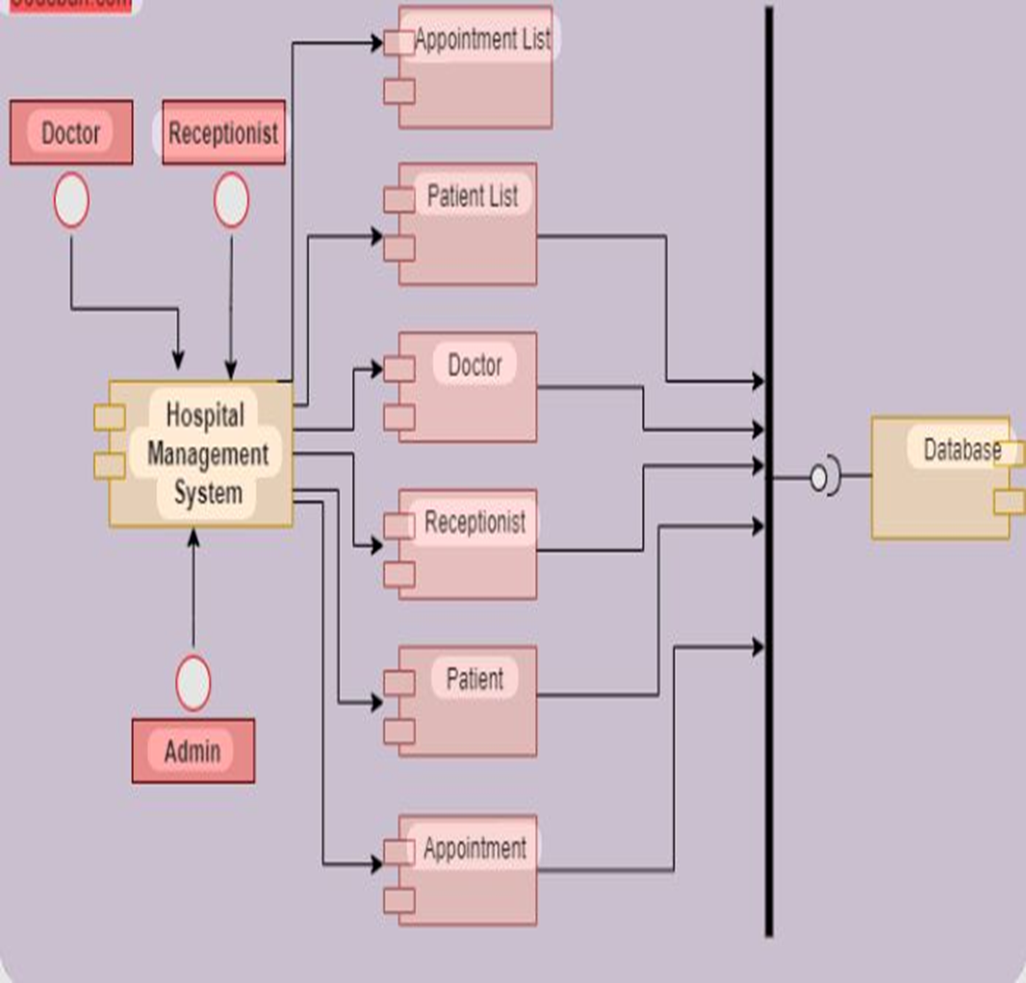
Component Diagram
Definition
A Component Diagram shows the structure of a system by representing its components and their relationships.
Main Elements
Components
Interfaces
Dependencies
Common Notations
▭ Rectangle with tabs → Component
◯ Lollipop → Provided Interface
⊂ Socket → Required Interface
➝ Arrow → Dependency
Notes:
8

Slide 9
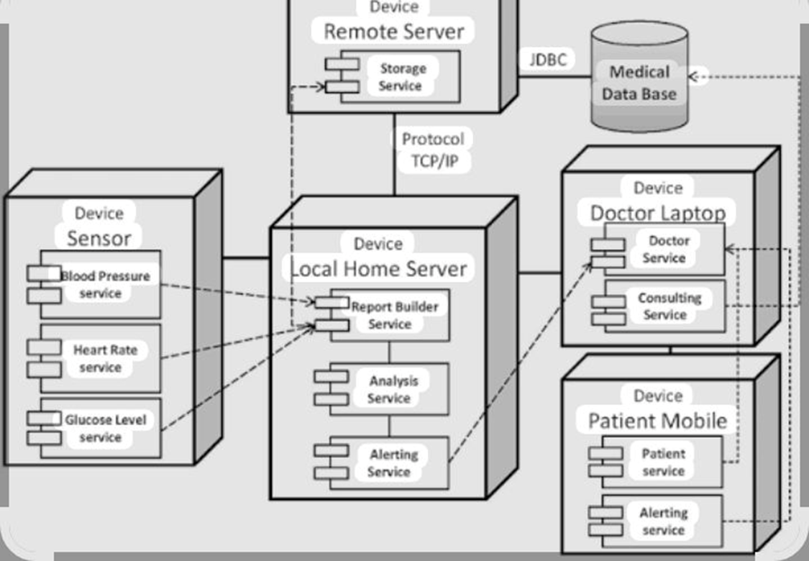
Deployment Diagram
Definition
A Deployment Diagram shows the physical arrangement of hardware and software in a system.
Main Elements
Nodes (devices/servers)
Artifacts (software)
Communication paths
Common Notations
▭ 3D Box → Node
📦 Rectangle → Artifact
➝ Line → Communication Link
«device» / «server» → Node type
Notes:
9

Slide 10
Conclusion & References
The Hospital Management System provides a smart and efficient solution for managing hospital activities.
Automates patient registration, appointments, billing, and records
Reduces manual errors and paperwork
Improves transparency and coordination between departments
Enhances overall experience for patients and hospital staff
References
UML Diagrams – Software Engineering Notes
Software Engineering
UML Distilled
Draw.io (diagrams.net) tool
Classroom notes & study material
Notes:
10

Slide 11
Thank
You
Notes:
11

