Slide 1
LANDER PROTOTYPE
MINI PROJECT
SURAJ RAO B
SREESHA Y M
NISHCHITH JAIN S

Slide 2
OBJECTIVE
To design an autonomous landing vehicle which has the capability to land safely on a flat surface by auto rpm control and hovering based on the data from the height sensor.

Slide 3
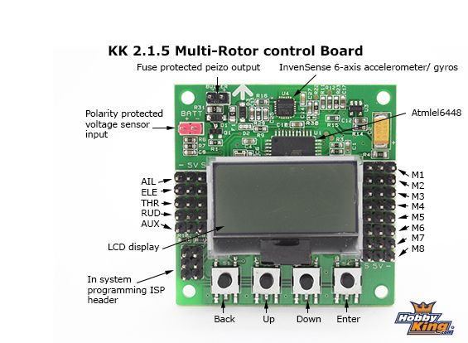
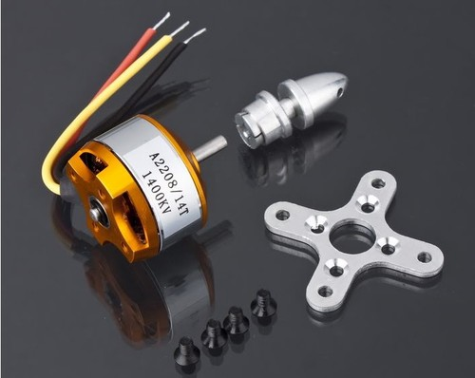
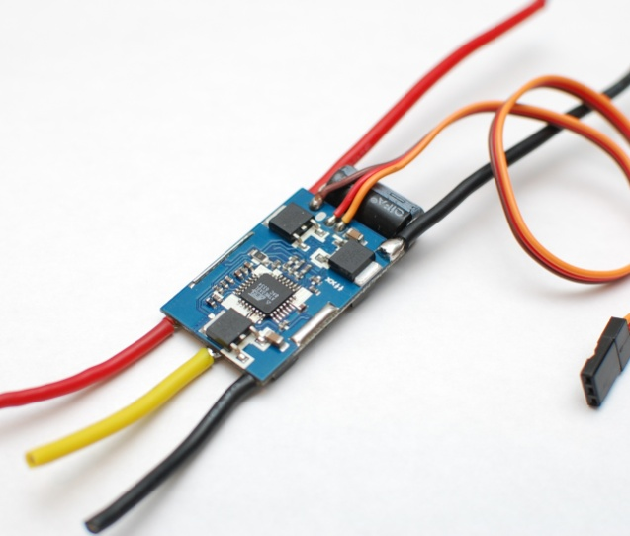
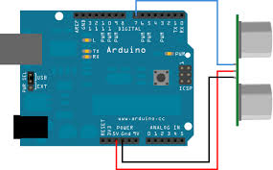
COMPONENTS
KK 2.1 Flight controller board
Arduino Uno
Ultrasonic distance sensor
ESC (Electronic Speed Controller)
Brushless DC motors

Slide 4
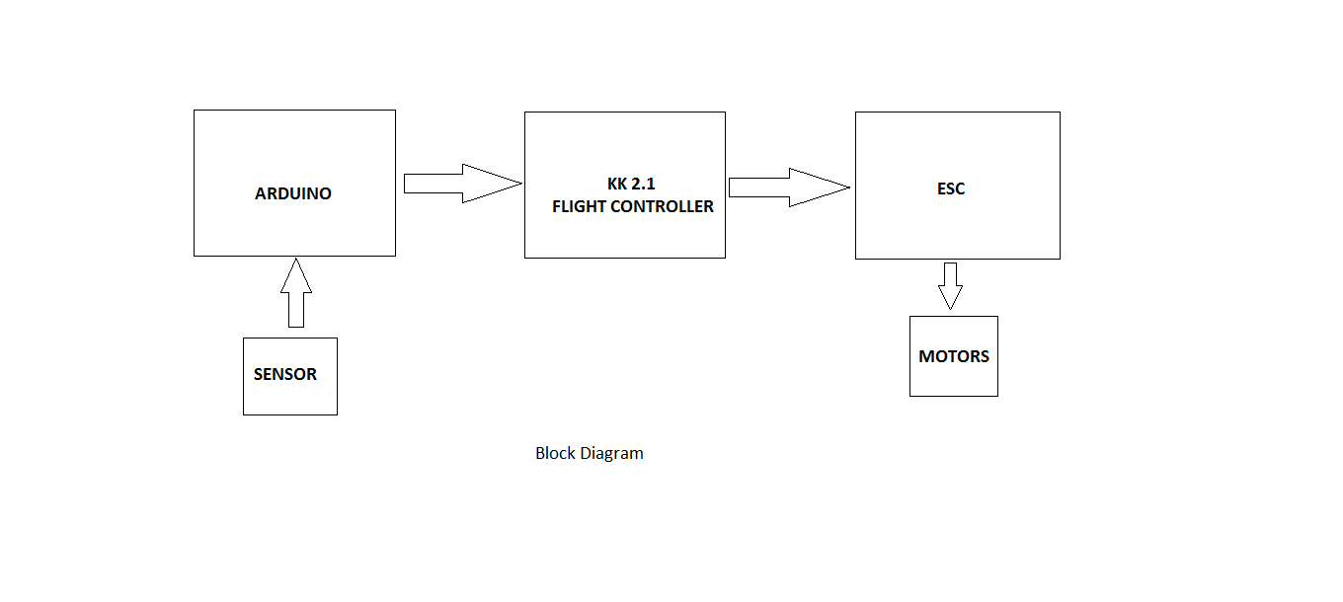
BLOCK DIAGRAM

Slide 5
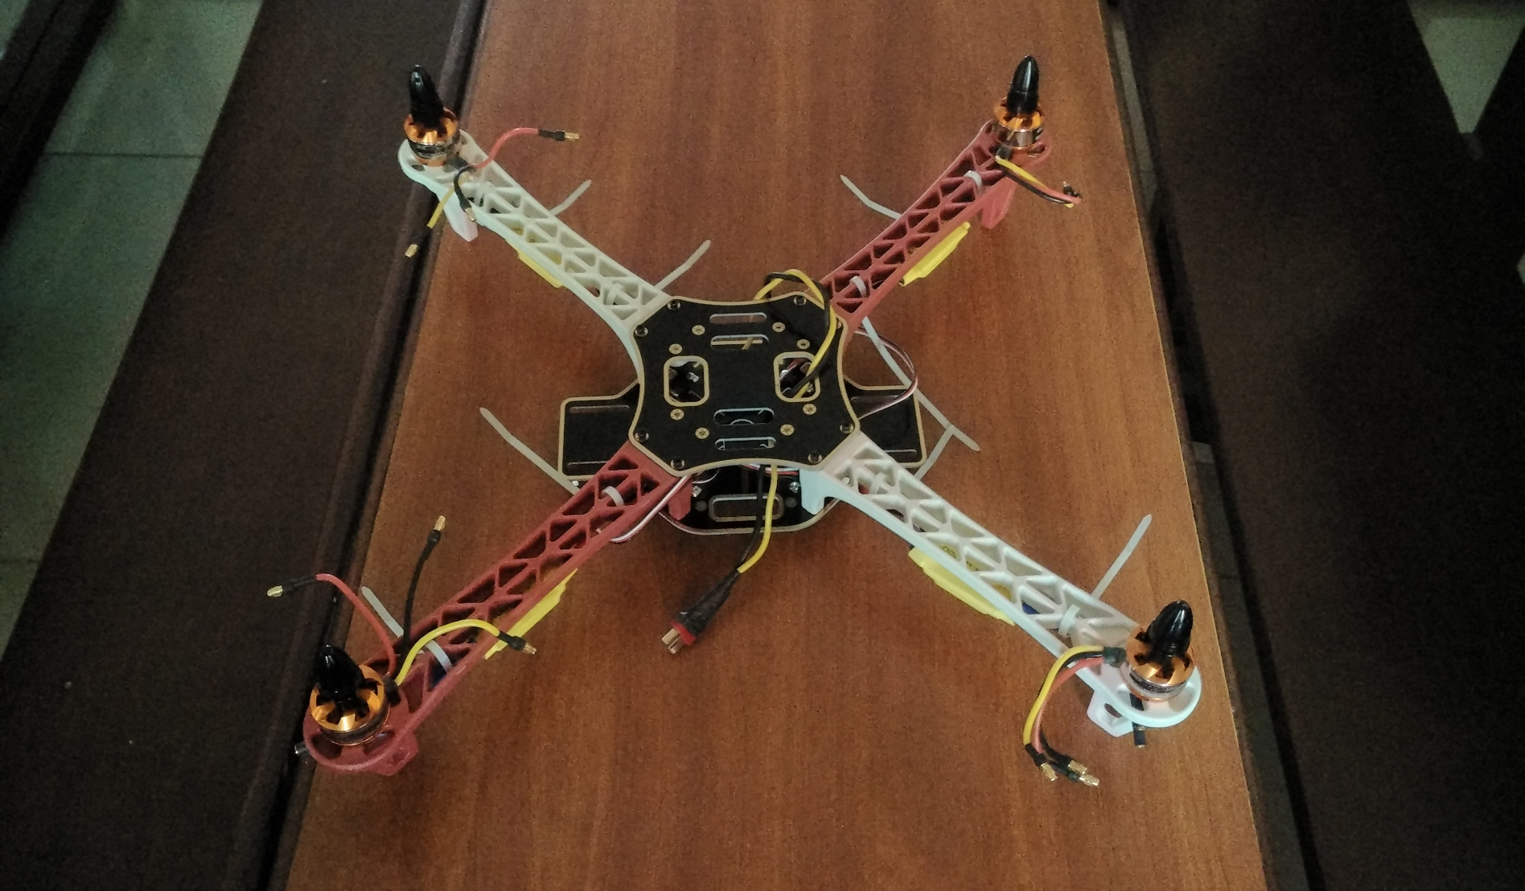
ASSEMBLY OF THE COMPONENTS

Slide 6
WORKING
Distance sensor is interfaced to Arduino board through which the height of the system above the landing surface is determined.
Based on this data suitable values are passed to the KK 2.1 flight controller board.
Flight controller board has its output pins connected to ESC which are further connected to the motors.
Based on the various signals sent to the KK 2.1 board, rpm of the motors are controlled.

Slide 7
SENDING VALUES TO KK 2.1 BOARD
KK 2.1 is interfaced with Arduino by connecting receiver pins to the PWM pins of Arduino.
Servo library in the Arduino is used to send the values to the KK 2.1 board.
The distance of the system above the required surface is determined using the sensor.
Based on this data, various PWM values are sent to the KK 2.1 using the conds() function.
These values are received by the throttle, rudder, elevator, aileron and according to these values signals are sent to the ESCs to control the speed of the brushless motors.

Slide 8
ADVANTAGES
This technique can be used as a part of safe landing in drone ambulances.
It can be used to land on remote places which are difficult to reach by humans.
It can be used to land on the specified locations to deliver goods which will reduce the use of manpower as well as save time.

Slide 9
DISADVANTAGES
The sensor which we have used has a range of only 2 meters.
Accuracy of the landing site is less.
Discharging time of the battery is very fast.

Slide 10
FURTHER DEVELOPMENTS
Sensor with a better range can be used for better performance.
Landing site can be precisely found by using a GPS module.

Slide 11
THE END
THANK YOU

