Slide 1

MINI PROJECT PRESENTATION
Multi-Agent Research System
A Multi-Agent AI Orchestration System for Automated Desk Research
Submitted by: Suraj Singh Rawat
University Roll No: 2400951530054 | Class: TT-C (AI & ML)
Department of Computer Science & Engineering MGM's College of Engineering & Technology, Noida · 2026-27

Slide 2
MOTIVATION
The Problem: Desk Research Is Slow and Manual
• Preparing a briefing on an unfamiliar topic follows a fixed sequence: find credible sources, read them, condense them into prose, judge if it is complete.
• That sequence takes 2-4 hours per topic for a human analyst.
• Output quality varies widely with the individual analyst's skill and diligence.
• Capacity scales only by hiring more people — cost rises in direct proportion to volume.
– Because the sequence is predictable, it is a strong candidate for automation.
Multi-Agent Research System · Suraj Singh Rawat
2

Slide 3
OBJECTIVES
Design Goals — Agreed and Numeric
• Perform the whole desk-research sequence with no human intervention.
• Speed — produce a complete report within 60 seconds.
• Cost — substantially below the commercial LLM endpoint then in use.
• Scale — serve at least 10 simultaneous users without degradation.
• Gain practical experience of the engineering around ML work: automated testing, benchmarking and deployment — not model development in isolation.
Success is demonstrated by measurement, not asserted in prose.
Multi-Agent Research System · Suraj Singh Rawat
3

Slide 4
BACKGROUND
Techniques and Tools Studied
• Large Language Models — stateless; everything the model must consider has to be in the prompt. Instruction phrasing that fixes output shape beats phrasing that asks for quality.
• The Multi-Agent Pattern — split a task into single-purpose stages with declared inputs/outputs, instead of one opaque prompt.
• LangChain — templated prompts, provider abstraction, output parsing, retry behaviour.
• Web retrieval & extraction — Tavily / DuckDuckGo for discovery, BeautifulSoup4 for stripping markup down to body text.
• Streamlit — renders a Python script as a web app; simple UI, no second language or build step.
Multi-Agent Research System · Suraj Singh Rawat
4

Slide 5
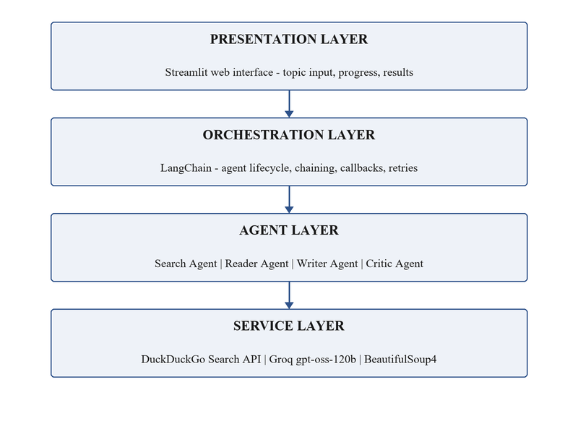
DESIGN
System Architecture — Four Layers
Presentation → Orchestration → Agents → Services. No layer reaches past its neighbour, so a change in one (e.g. swapping the model provider) does not propagate.
Multi-Agent Research System · Suraj Singh Rawat
5

Slide 6
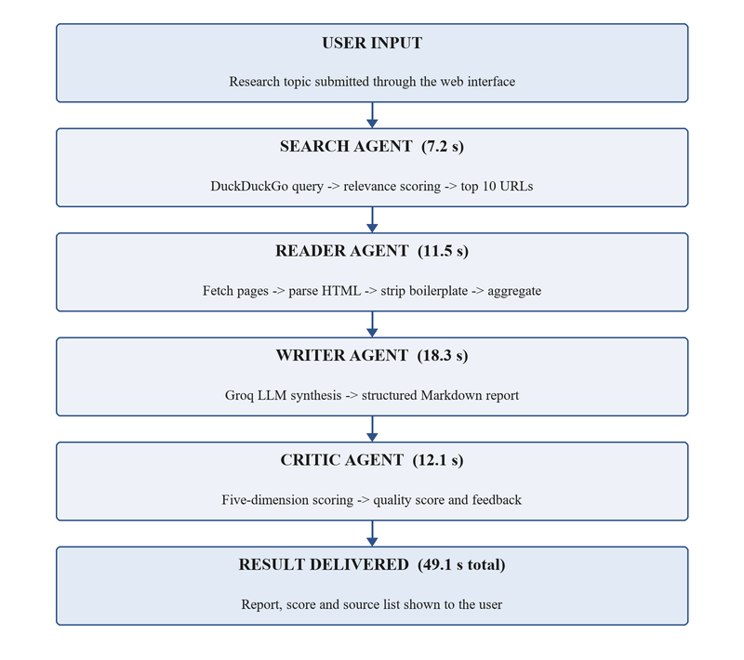
DESIGN
The Four-Agent Sequential Pipeline
Fixed order: reading needs sources, writing needs material, evaluation needs a report. Measured mean end-to-end: 49.1 s against a 60 s ceiling.
Multi-Agent Research System · Suraj Singh Rawat
6

Slide 7
DESIGN
What Each Agent Does
Agent | Receives | Returns
Search | Topic string | Up to 10 sources, each with URL, title, snippet, relevance score
Reader | Ranked sources | Aggregated body text + counts of successful / failed retrievals
Writer | Aggregated text + topic | Report in Markdown, six fixed sections
Critic | Report + topic | Score 0-10, five sub-scores, written strengths & weaknesses
Each agent has a declared contract — so each can be timed, tested and fixed on its own, and a defect localises to one stage.
Multi-Agent Research System · Suraj Singh Rawat
7

Slide 8
DESIGN
Technology Stack and Rationale
Layer | Technology | Reason for selection
Interface | Streamlit | Simple UI; no second language or build step
Orchestration | LangChain | Prompt templating, output parsing, provider abstraction
Language model | Groq gpt-oss-120b | ~70% cheaper per token; very low latency
Discovery | Tavily / DuckDuckGo | No quota at the volumes involved
Extraction | BeautifulSoup4 | Tolerant of malformed markup; well documented
Config | python-dotenv | Keeps credentials out of the repository
Testing | pytest | Fixtures and parametrisation suit agent testing
Multi-Agent Research System · Suraj Singh Rawat
8

Slide 9
IMPLEMENTATION
Implementation Highlights
• Prompt design — the Writer prompt names six sections with word budgets; stating structure explicitly was the single biggest gain in output consistency.
• Sampling — temperature 0.7 for synthesis (readable prose), 0.3 for the Critic (consistent scoring).
• Reader is built to fail gracefully — a dead URL removes one source, it does not end the request; extractions under 100 words are rejected.
• Error handling — page failure absorbed by Reader; model-endpoint failure retried with exponential backoff (2 s → 32 s); missing credential is terminal.
• Stateless — each request owns its state; no database; any instance can be restarted without data loss.
Multi-Agent Research System · Suraj Singh Rawat
9

Slide 10
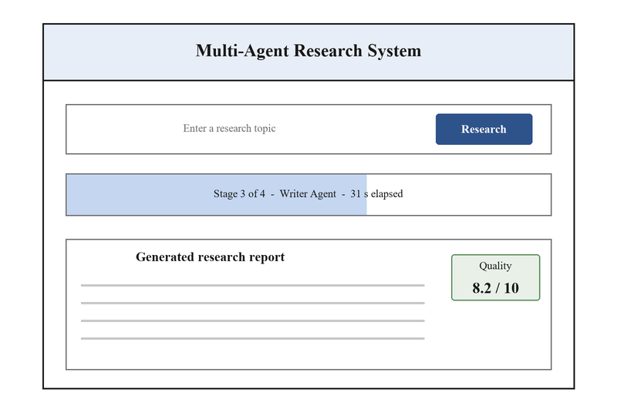
IMPLEMENTATION
User Interface
One text field, a button, a live progress indicator, the rendered report with its quality score and every source listed. All generated content is escaped before rendering.
Multi-Agent Research System · Suraj Singh Rawat
10

Slide 11
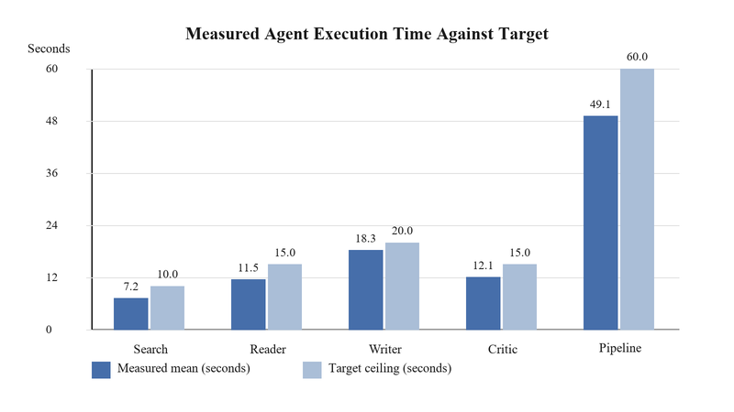
RESULTS
Testing and Performance
• 39 automated tests — unit, integration, end-to-end — all pass.
• Statement coverage: 85% overall (target met).
• Every stage finishes inside its budget.
• Pipeline mean: 49.1 s vs 60 s ceiling; 95th pct 58.1 s.
• 10 concurrent users add only ~1.4 s of latency.
Multi-Agent Research System · Suraj Singh Rawat
11

Slide 12
RESULTS
Cost Evaluation
Item | Commercial endpoint | Groq endpoint
Model charges / month | 5.25 USD | 1.75 USD
Compute instance | 30.00 USD | 30.00 USD
Storage and transfer | 2.00 USD | 2.00 USD
Monthly total | 37.25 USD | 33.75 USD
Cost per report | 0.0373 USD | 0.0338 USD
Model charges fell ~70% (the target). Effect on the total is smaller because the compute instance dominates at 1,000 reports/month — the saving grows as volume rises, since model cost scales with usage and the instance cost does not.
Multi-Agent Research System · Suraj Singh Rawat
12

Slide 13
EVALUATION
Known Limitations
• No fact-checking — the system synthesises what its sources assert; wrong sources produce a confident, well-formed, wrong report.
• The Critic scores craftsmanship, not correctness — it has no ground truth.
• Extraction is heuristic — fails on script-rendered pages, paywalls and non-HTML; typically 1-3 of 10 URLs are lost.
• Pipeline is strictly sequential — it cannot revisit an earlier stage in light of a later one.
• English only; nothing stored, so no report history; Critic Agent coverage is 79% vs the 85% target.
Multi-Agent Research System · Suraj Singh Rawat
13

Slide 14
CONCLUSION
Conclusion and Future Scope
• The system performs the whole desk-research sequence unattended and meets every target: 49.1 s mean, ~70% lower model cost, 10 concurrent users, 39/39 tests.
• The decisive decision was four agents over one model — the gain was diagnosability, not just quality. Nearly every measurement depends on it.
• Future scope:
– Act on the Critic's score — low score triggers a fresh search (line → loop).
– Better extraction via a headless browser or article-extraction library.
– Cache results by topic; add multi-language and PDF support.
Multi-Agent Research System · Suraj Singh Rawat
14

Slide 15
Thank You
Questions & Discussion
Suraj Singh Rawat · Roll No. 2400951530054 · TT-C (AI & ML)

