Slide 1
Industrial Training On OOPs
Trainer Guide
Mr. Kedar Kulkarni Prof. N. M. Mule
Prof. P. D. Sheth

Slide 2
Content
Introduction Of OOPs
Features Of OOPs
Object
Class
Pros And Cons
Conclusion
Certificate of Completion

Slide 3
Introduction
1. What is OOPs ?
OOPs stands for the Object-Oriented Programming system. Programs are treated as a collection of objects in oops. Each object is nothing but an example of a class.
2. Why use OOPs?
OOPs has clarity in programming. It has flexibility and simplicity in solving complex problems. Reuseage of code is easy as the Inheritance concept helps to reduce redundancy of code. Data and code are bound together by encapsulation. OOPs has features for data hiding, so private data can be store and maintain confidentiality. Problems can be divided into different parts making it simple to solve. The concept of polymorphism has flexibility for that a single entity can have multiple forms.

Slide 4
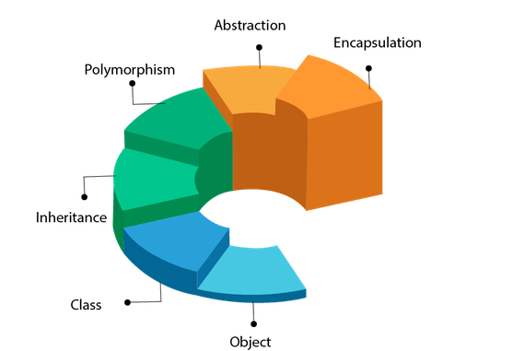
Features of OOPs
Inheritance
Encapsulation
Polymorphism
Abstraction

Slide 5
01
02
03
04
Encapsulation
Inheritance
Restrict access to members of an object
i.e. provide privacy
A class is based on another class and uses data
Polymorphism
Abstraction
polymorphism has flexibility for that a single entity can have multiple forms
shows only essential attributes and hides unnecessary information

Slide 6
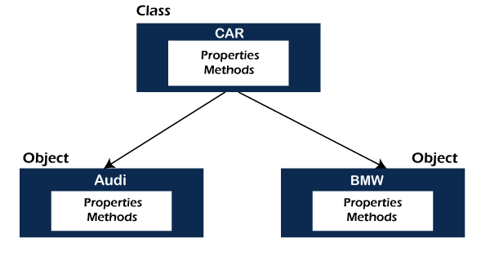
What is Object & Class
Object :
An object is a real-world entity that has attributes, behavior, and properties.
Class :
A class is a blueprint or template of an object. It is a user-defined data type. Inside a class, we define variables, constants, member functions, and other functionality.

Slide 7

Pros And Cons in OOPs
Pros
Cons
Inefficient
It can be too scalable
Cause duplication
Parallel development
The modular classes are often reusable
Coding is easier to maintain

Slide 8
Conclusion
From this training on OOPs I have learned Concepts in C++
I have understood why we need Object-oriented programming, what C++ OOPs are, and the basic concepts of OOPs like polymorphism, inheritance encapsulation, etc
I have also learned about the advantages of C++ OOPs, along with examples of polymorphism and inheritance.

Slide 9
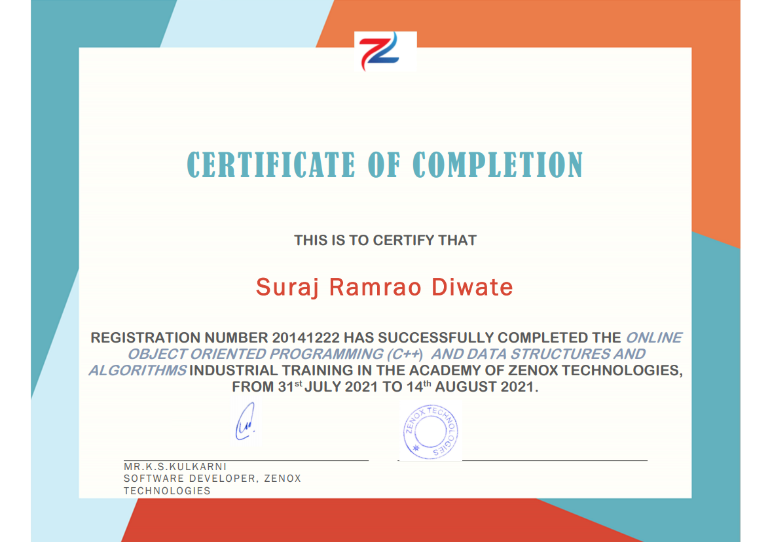

Slide 10

Problem Statement
Library Management System
Project By
Diwate Suraj Ramrao
20141222

Slide 11
Block diagram
Login option
student
librarian
booklist
Search book
Add book
Issue book
booklist
Search book

Slide 12
Source Code Implementation
Source code is in below link
source code of library management system

Slide 13
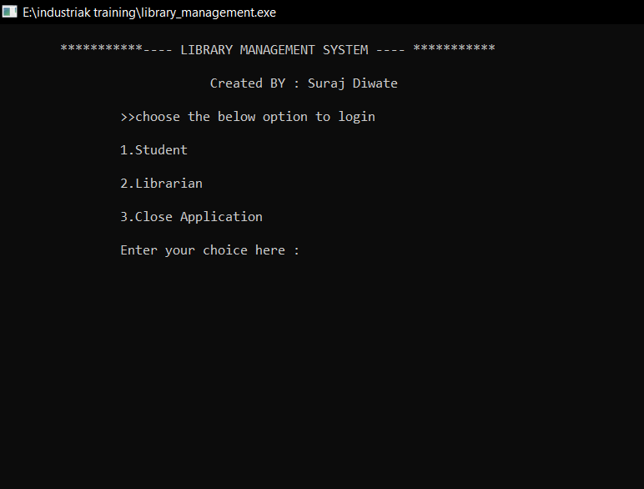
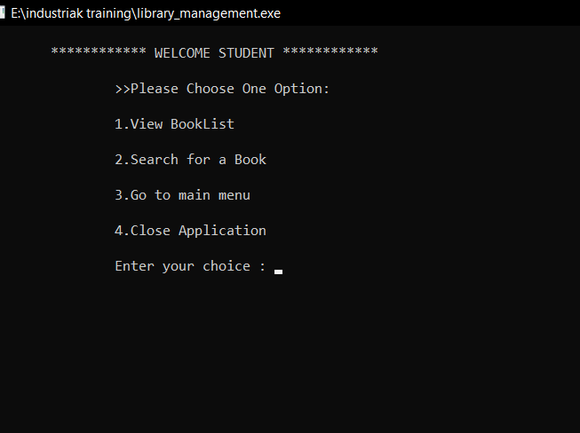
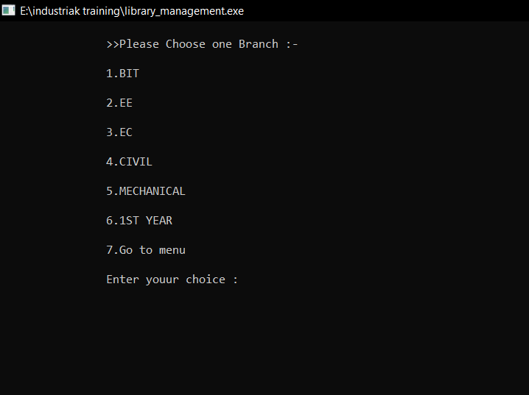
Result
Student section

Slide 14
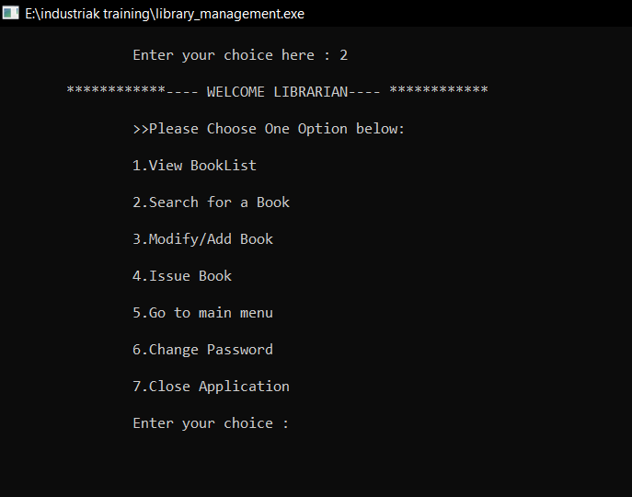
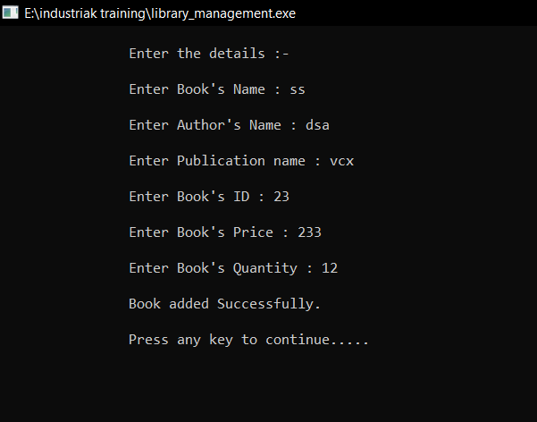
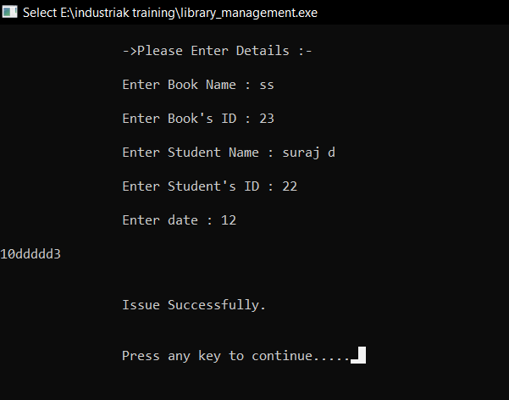
Librarian section

Slide 15
Conclusion

Slide 16
Thank
You !

