Slide 1

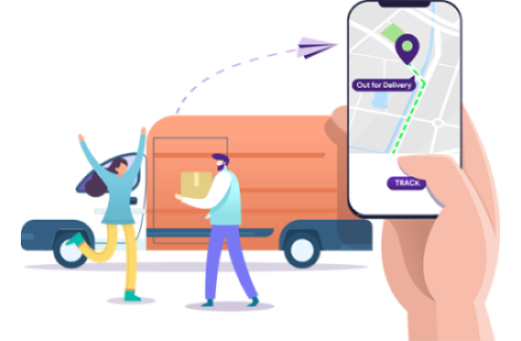

ORDER TRACKING AND GPS ENABLEMENT FOR KESHPRO

Slide 2

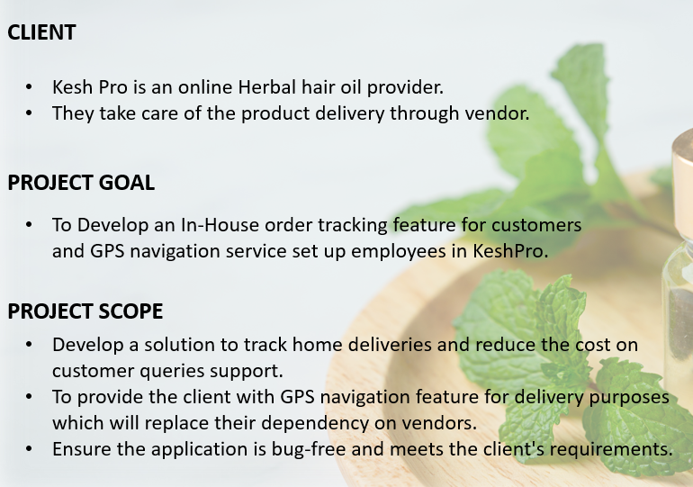
PROJECT SUMMARY

Slide 3
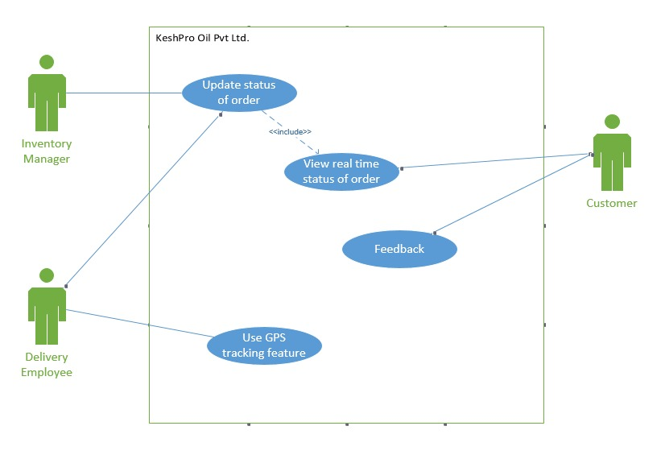
USE CASE DIAGRAM

Slide 4
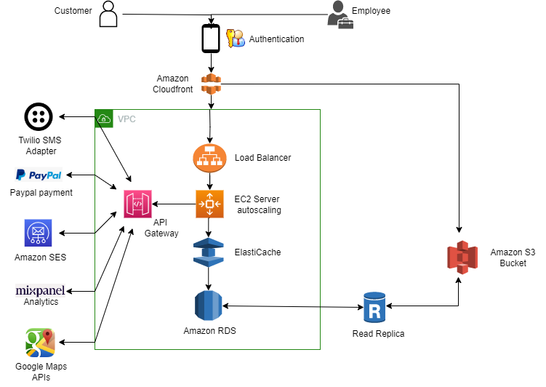
ARCHITECTURE

Slide 5
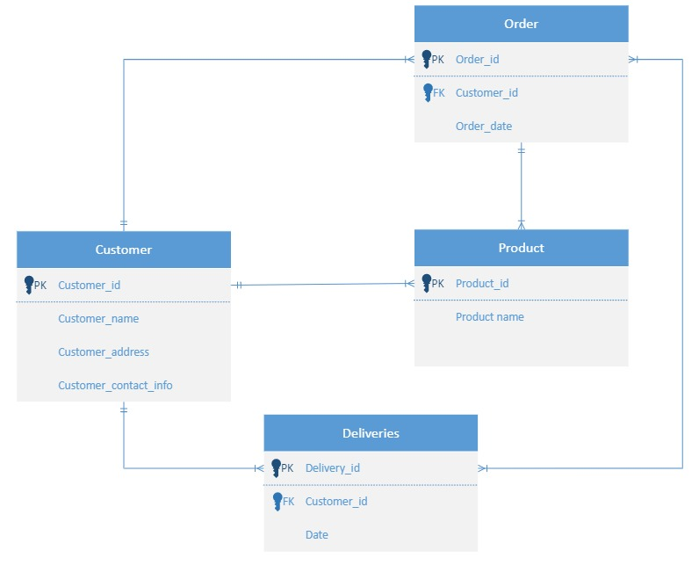
DATA REQUIREMENTS

Slide 6
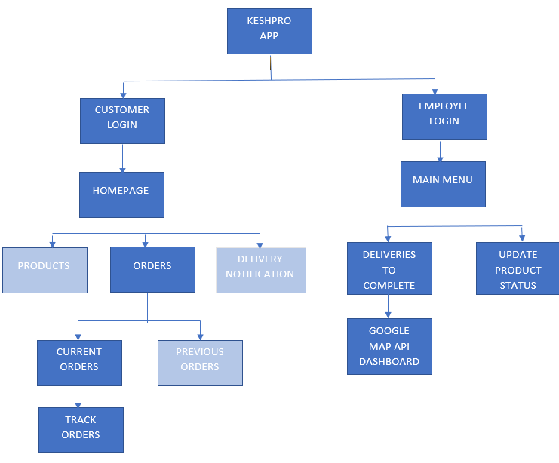
NAVIGATION STRUCTURE

Slide 7

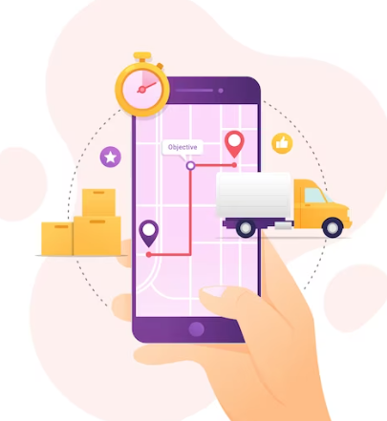

CONCLUSION
BENEFITS
Helped client save money through -
- Real time order tracking relieved burden from customer support service
- GPS navigation enabled client to start their own delivery service.
Order tracking feature helps the client keep better record of inventory.
Added feature will improve customer experience and attract them to use the app.
GPS tracking feature will also help client track the delivery employee’s activities.
LESSONS LEARNED
User requirement specific use case diagram helped client to understand project easily.
Navigation diagram is fundamental in designing the UI prototype of any application.
Prototype design through figma helped client to understand and experience the proposed product.
Data requirements helped us to understand relevant data needed for the development.

Slide 8
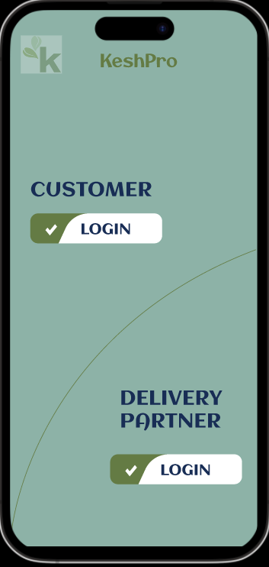
PROTOTYPE
URL: https://tinyurl.com/KeshPro

Slide 9
design

