Slide 1

A Quiz Application on Web Programming
Batch 1
JavaScript
CSS
HTML
Developed by, Suraj Renake

Slide 2
Introduction
Problem Statement:
To develop a responsive web application on Web Programming, using HTML5, CSS3, and JavaScript.
Developing and loading various parts in a single webpage. Here, users will experience an user friendly way of attempting quiz.
The software 'QUIZ' created for a school or college was intended to minimize the time required to administer a quiz, to measure the points, to shortlist the student's name, and thereby to improve the performance. It is planned to replace current manual documentation and correction. The introduction of the method in the enterprise would dramatically minimize time and will also have easily measured markers.

Slide 3
OBJECTIVES OF THE PROJECT:
To develop client-based web pages using HTML5, CSS3, JavaScript.
To create an appropriate platform for best managing of MCQ test
The main objective of ONLINE QUIZ is to efficiently evaluate the candidate through a fully automated system that not only saves lot of time but also gives fast results. For students they give papers according to their convenience and time and there is no need of using extra thing like paper, pen.
Users can see their result after submitting the test.

Slide 4

Technologies used:
HTML:
HTML is a hypertext markup language which provides the basic structure for our project.
We have used the latest version of HTML, i.e. HTML 5
CSS:
Cascading Style Sheet had played a key role in developing our project, in an interactive manner.
In this project, we have also made use of custom annimations

Slide 5
Technologies used:
JavaScript:
JavaScript is completely different from Java. It is used to add behavior to our webpage.
In our project, it’s the game of JavaScript.
We have used it to present the question and options dynamically, in a random order.
Also, in calculating the final result of the quiz, and for many more operations.

Slide 6
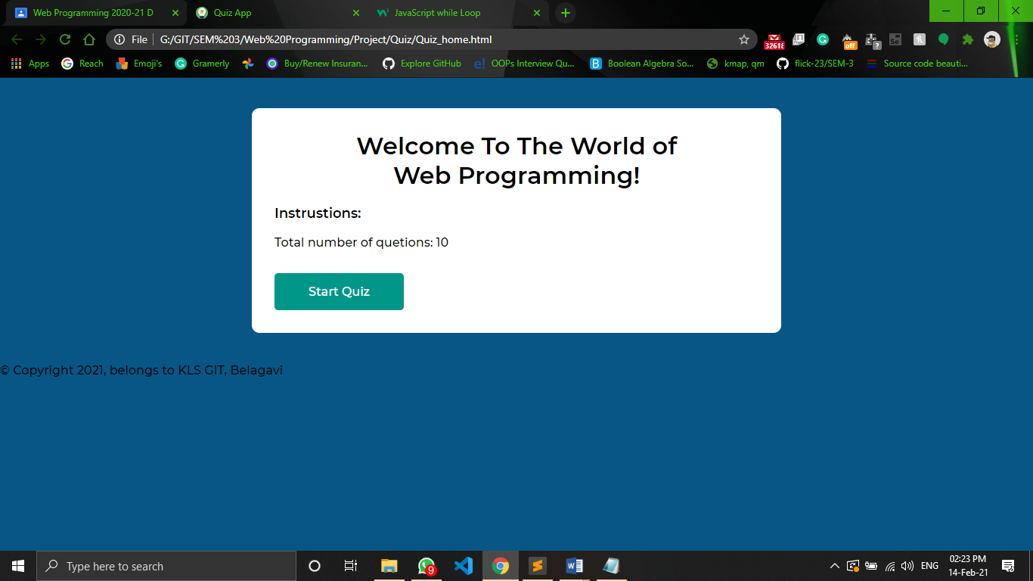
SCREENSHOTS:
fig a. Welcome page and instructions
Notes:
You can safely remove this slide. This slide design was provided by SlideModel.com – You can download more templates, shapes and elements for PowerPoint from http://slidemodel.com

Slide 7
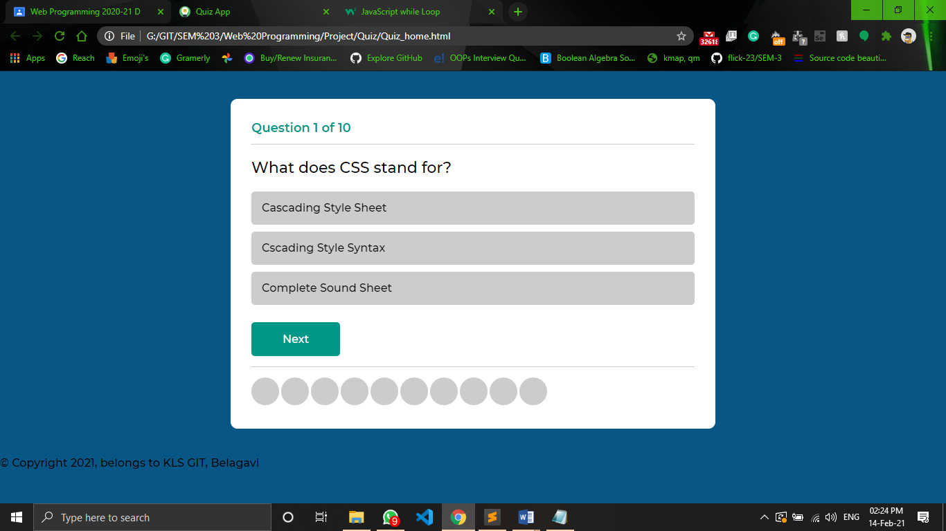
SCREENSHOTS:
fig b. one random questions will be picked by the s/m from the bunch of available questions, with the jumbled options
Notes:
You can safely remove this slide. This slide design was provided by SlideModel.com – You can download more templates, shapes and elements for PowerPoint from http://slidemodel.com

Slide 8
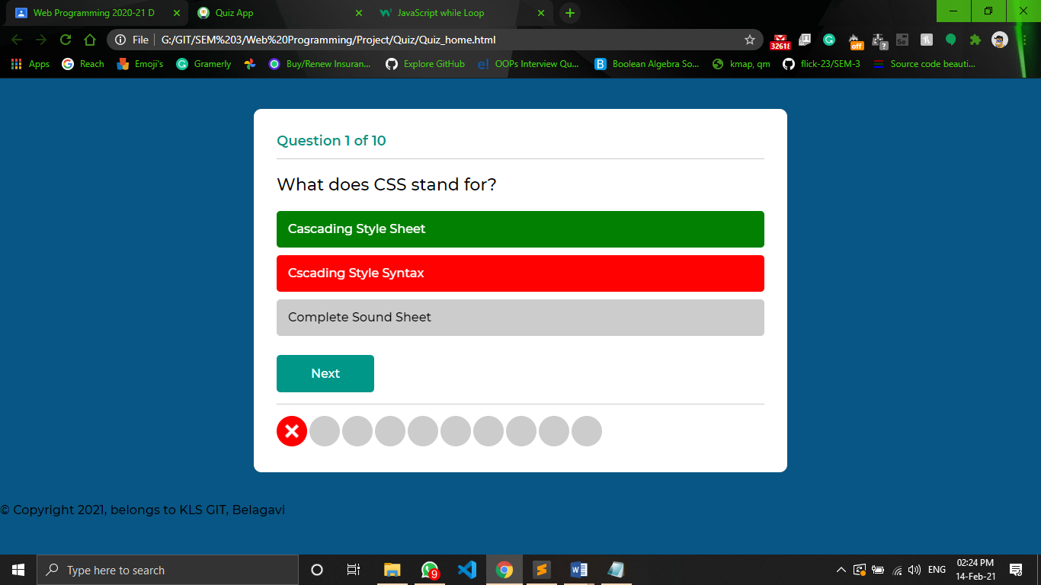
SCREENSHOTS:
fig c. the selected option will be indicated with Green and red, for right and wrong answer respectively
Notes:
You can safely remove this slide. This slide design was provided by SlideModel.com – You can download more templates, shapes and elements for PowerPoint from http://slidemodel.com

Slide 9
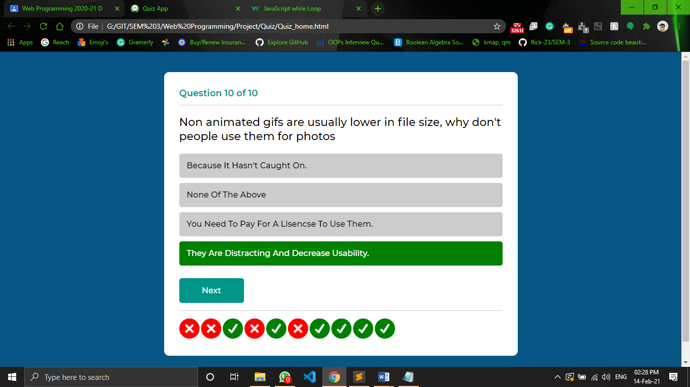
SCREENSHOTS:
fig a. Welcome page and instructions
Notes:
You can safely remove this slide. This slide design was provided by SlideModel.com – You can download more templates, shapes and elements for PowerPoint from http://slidemodel.com

Slide 10
SCREENSHOTS:
fig d. an option indicated with green for right selected option
Notes:
You can safely remove this slide. This slide design was provided by SlideModel.com – You can download more templates, shapes and elements for PowerPoint from http://slidemodel.com

Slide 11
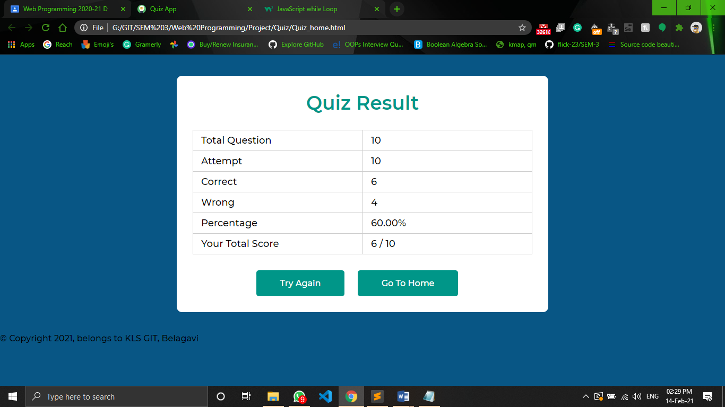
SCREENSHOTS:
fig e. eventually, the final result is displayed
Notes:
You can safely remove this slide. This slide design was provided by SlideModel.com – You can download more templates, shapes and elements for PowerPoint from http://slidemodel.com

Slide 12



References:
Jennifer Niederst Robbins, Learning Web Design: A Beginner’s Guide to HTML, CSS, JavaScript, and Web Graphics, O'reilly, 4th Edition,2012
https://stackoverflow.com
https://www.w3schools.com
YouTube tutorials

