Slide 1
Introduction to Programming
with Python
Suraj Vagoli (suraj.v@inforcecomputing.com)
Intern at Inforce Computing Pvt Ltd,
M.tech(Embedded Systems) Student of VIT,Vellore.
Notes:
07/17/19

Slide 2
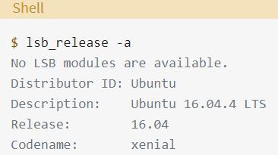
How To Install Python 3 and Set Up a Programming Environment on an Ubuntu
Depending on the version of the Ubuntu distribution you run, the Python install instructions vary. You can determine your local Ubuntu version by running the following command:

Slide 3
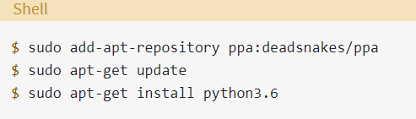
How To Install Python 3 and Set Up a Programming Environment on an Ubuntu
Depending on the version number you see under Release in the console output, follow the instructions below:
Ubuntu 17.10, Ubuntu 18.04 (and above) come with Python 3.6 by default. You should be able to invoke it with the command python3.
Ubuntu 16.10 and 17.04 do not come with Python 3.6 by default, but it is in the Universe repository. You should be able to install it with the following commands:
You can then invoke it with the command python3.6.

Slide 4
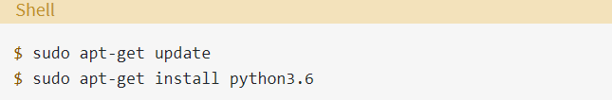
How To Install Python 3 and Set Up a Programming Environment on an Ubuntu
If you are using Ubuntu 14.04 or 16.04, Python 3.6 is not in the Universe repository, and you need to get it from a Personal Package Archive (PPA). For example, to install Python from the “deadsnakes” PPA, do the following:
As above, invoke with the command python3.6.

Slide 5
Setting up Python 3
To make sure that our versions are up-to-date, let’s update and upgrade the system with apt-get:
$ sudo apt-get update
$ sudo apt-get -y upgrade (The -y flag will confirm that we are agreeing for all items to be installed)
$ python3 –V
Output: Python 3.5.2
To manage software packages for Python, let’s install pip:
  $ sudo apt-get install -y python3-pip
  $ pip3 install numpy (NumPy for scientific computing)

Slide 6
How to run Python programs
Open Editor using following command
$ gedit filename.py ( Write code → Save file → exit from editor)
Run python code
  $ python filename.py

Slide 7

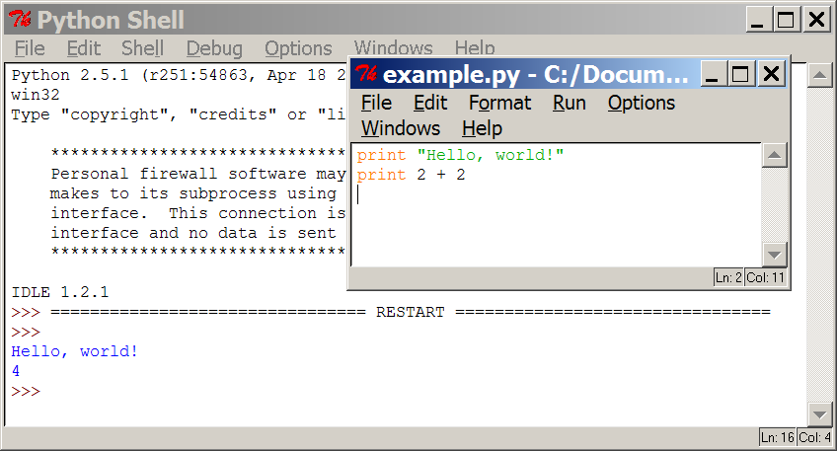
Programming basics
code or source code: The sequence of instructions in a program.
syntax: The set of legal structures and commands that can be used in a particular programming language.
output: The messages printed to the user by a program.
console: The text box onto which output is printed.
  Some source code editors pop up the console as an external window, and others contain their own console window.
Notes:
07/17/19

Slide 8
What is Python
Python is a high-level programming language which is:
  Interpreted: Python is processed at runtime by the interpreter. (Next Slide)
  Interactive: You can use a Python prompt and interact with the interpreter directly to write your programs.
  Object-Oriented: Python supports Object-Oriented technique of programming.
  Beginner’s Language:Python is a great language for the beginner-level programmers and supports the development of a wide range of applications.

Slide 9
Interpreters vs Compilers
The first thing that is important to understand about Python is that it is an interpreted language.
There are two sorts of programming languages: interpreted ones and compiled ones. A compiled language is what you are probably used to if you have done any programming in the past.
The process for a compiled language is as follows:
Create source file using text edit→
Use compiler to syntax check and convert source file into binary →
Use linker to turn binary files into executable format→
Run the resulting executable format file in the operating system.

Slide 10



Compiling and interpreting
Many languages require you to compile (translate) your program into a form that the machine understands.
Python is instead directly interpreted into machine instructions.
compile
execute
source code
Hello.java
byte code
Hello.class
output
interpret
source code
Hello.py
output

Slide 11
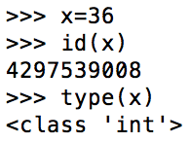
Python Features
Easy to learn, easy to read and easy to maintain.
Portable:It can run on various hardware platforms and has the same interface on all platforms.
Extendable: You can add low-level modules to the Python interpreter.
Scalable: Python provides a good structure and support for large programs.
Python has support for an interactive mode of testing and debugging.
Python has a broad standard library cross-platform.
Everything in Python is an object: variables,functions, even code.Every object has an ID, a type, and a value.

Slide 12
Expressions
expression: A data value or set of operations to compute a value.
  Examples: 1 + 4 * 3
  42
Arithmetic operators we will use:
  + - * / addition, subtraction/negation, multiplication, division
  % modulus, a.k.a. remainder
  ** exponentiation
precedence: Order in which operations are computed.
  * / % ** have a higher precedence than + -
  1 + 3 * 4 is 13
  Parentheses can be used to force a certain order of evaluation.
  (1 + 3) * 4 is 16

Slide 13
More Features
Python provides interfaces to all major commercial databases.
Python supports functional and structured programming methods as well as OOP.
Python provides very high-level dynamic data types and supports dynamic type checking.
Python supports GUI applications
Python supports automatic garbage collection.
Python can be easily integrated with C, C++, and Java.

Slide 14
Real numbers
Python can also manipulate real numbers.
  Examples: 6.022 -15.9997 42.0 2.143e17
The operators + - * / % ** ( ) all work for real numbers.
  The / produces an exact answer: 15.0 / 2.0 is 7.5
  The same rules of precedence also apply to real numbers:
  Evaluate ( ) before * / % before + -
When integers and reals are mixed, the result is a real number.
  Example: 1 / 2.0 is 0.5
  The conversion occurs on a per-operator basis.
  7 / 3 * 1.2 + 3 / 2
  2 * 1.2 + 3 / 2
  2.4 + 3 / 2
  2.4 + 1
  3.4
Notes:
07/17/19

Slide 15
Math commands
Python has useful commands for performing calculations.
To use many of these commands, you must write the following at the top of your Python program:
  from math import *
Command name | Description
abs(value) | absolute value
ceil(value) | rounds up
cos(value) | cosine, in radians
floor(value) | rounds down
log(value) | logarithm, base e
log10(value) | logarithm, base 10
max(value1, value2) | larger of two values
min(value1, value2) | smaller of two values
round(value) | nearest whole number
sin(value) | sine, in radians
sqrt(value) | square root
Constant | Description
e | 2.7182818...
pi | 3.1415926...
Notes:
07/17/19

Slide 16
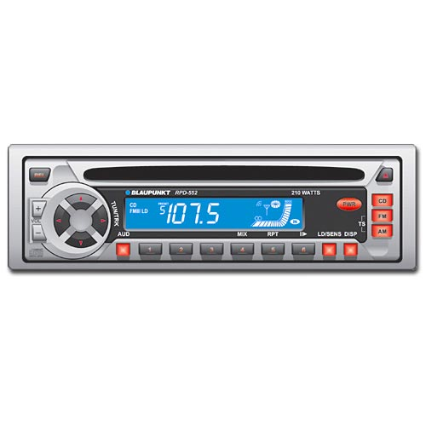
Variables
variable: A named piece of memory that can store a value.
  Usage:
    Compute an expression's result,
    store that result into a variable,
    and use that variable later in the program.
assignment statement: Stores a value into a variable.
  Syntax:
  name = value
  Examples: x = 5
  gpa = 3.14
  x 5 gpa 3.14
  A variable that has been given a value can be used in expressions.
  x + 4 is 9
Exercise: Evaluate the quadratic equation for a given a, b, and c.

Slide 17
print
print : Produces text output on the console.
Syntax:
  print "Message"
  print Expression
  Prints the given text message or expression value on the console, and moves the cursor down to the next line.
  print Item1, Item2, ..., ItemN
  Prints several messages and/or expressions on the same line.
Examples:
  print "Hello, world!"
  age = 45
  print "You have", 65 - age, "years until retirement"
  Output:
  Hello, world!
  You have 20 years until retirement
Notes:
07/17/19

Slide 18
input
input : Reads a number from user input.
  You can assign (store) the result of input into a variable.
  Example:
  age = input("How old are you? ")
  print "Your age is", age
  print "You have", 65 - age, "years until retirement"
  Output:
  How old are you? 53
  Your age is 53
  You have 12 years until retirement
Notes:
07/17/19

Slide 19
Repetition (loops)
and Selection (if/else)
Notes:
07/17/19

Slide 20
The for loop
for loop: Repeats a set of statements over a group of values.
  Syntax:
  for variableName in groupOfValues:
  statements
    We indent the statements to be repeated with tabs or spaces.
    variableName gives a name to each value, so you can refer to it in the statements.
    groupOfValues can be a range of integers, specified with the range function.
  Example:
  for x in range(1, 6):
  print x, "squared is", x * x
  Output:
  1 squared is 1
  2 squared is 4
  3 squared is 9
  4 squared is 16
  5 squared is 25

Slide 21
range
The range function specifies a range of integers:
    range(start, stop) - the integers between start (inclusive)
    and stop (exclusive)
  It can also accept a third value specifying the change between values.
    range(start, stop, step) - the integers between start (inclusive)
    and stop (exclusive) by step
  Example:
  for x in range(5, 0, -1):
  print x
  print “INFORCE!"
  Output:
  5
  4
  3
  2
  1
  INFORCE!

Slide 22
Cumulative loops
Some loops incrementally compute a value that is initialized outside the loop. This is sometimes called a cumulative sum.
  sum = 0
  for i in range(1, 11):
  sum = sum + (i * i)
  print "sum of first 10 squares is", sum
  Output:
  sum of first 10 squares is 385

Slide 23

if
if statement: Executes a group of statements only if a certain condition is true. Otherwise, the statements are skipped.
  Syntax:
  if condition:
  statements
Example:
  gpa = 8.23
  if gpa > 8.0:
  print "Your application is accepted."
Notes:
07/17/19

Slide 24
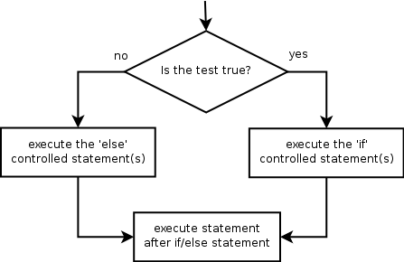

if/else
if/else statement: Executes one block of statements if a certain condition is True, and a second block of statements if it is False.
  Syntax:
  if condition:
  statements
  else:
  statements
Example:
  gpa = 7.5
  if gpa > 8.0:
  print "Welcome to INFORCE COMPUTING!"
  else:
  print "Your application is denied."
Multiple conditions can be chained with elif ("else if"):
  if condition:
  statements
  elif condition:
  statements
  else:
  statements
Notes:
07/17/19

Slide 25
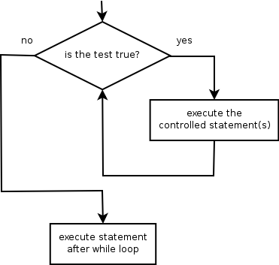
while
while loop: Executes a group of statements as long as a condition is True.
  good for indefinite loops (repeat an unknown number of times)
Syntax:
  while condition:
  statements
Example:
  number = 1
  while number < 200:
  print number,
  number = number * 2
  Output:
  1 2 4 8 16 32 64 128

Slide 26
Logic
Many logical expressions use relational operators:
Logical expressions can be combined with logical operators:
Operator | Meaning | Example | Result
== | equals | 1 + 1 == 2 | True
!= | does not equal | 3.2 != 2.5 | True
< | less than | 10 < 5 | False
> | greater than | 10 > 5 | True
<= | less than or equal to | 126 <= 100 | False
>= | greater than or equal to | 5.0 >= 5.0 | True
Operator | Example | Result
and | 9 != 6 and 2 < 3 | True
or | 2 == 3 or -1 < 5 | True
not | not 7 > 0 | False

Slide 27
Text and File Processing
Notes:
07/17/19

Slide 28
Strings
string: A sequence of text characters in a program.
  Strings start and end with quotation mark " or apostrophe ' characters.
  Examples:
  "hello"
  "This is a string"
  "This, too, is a string. It can be very long!"
A string may not span across multiple lines or contain a " character.
"This is not
a legal String."
"This is not a "legal" String either."
A string can represent characters by preceding them with a backslash.
  \t tab character
  \n new line character
  \" quotation mark character
  \\ backslash character
  Example: "Hello\tthere\nHow are you?"
Notes:
07/17/19

Slide 29
Indexes
Characters in a string are numbered with indexes starting at 0:
  Example:
  name = “I. FORCE"
Accessing an individual character of a string:
  variableName [ index ]
  Example:
  print name, "starts with", name[0]
  Output:
  I. FORCE starts with I
index | 0 | 1 | 2 | 3 | 4 | 5 | 6 | 7
character | I | . |  | F | O | R | C | E
Notes:
07/17/19

Slide 30
String properties
len(string) - number of characters in a string
(including spaces)
str.lower(string) - lowercase version of a string
str.upper(string) - uppercase version of a string
Example:
name = “Inforce Computing"
length = len(name)
big_name = str.upper(name)
print big_name, "has", length, "characters"
Output:
INFORCE COMPUTING has 17 characters

Slide 31
raw_input
raw_input : Reads a string of text from user input.
  Example:
  name = raw_input("What's your company name? ")
  print name, "... Ohh nice!"
  Output:
  What’s your company name? Inforce Computing
  Inforce Computing ... Ohh nice!
Notes:
07/17/19

Slide 32
Text processing
text processing: Examining, editing, formatting text.
  often uses loops that examine the characters of a string one by one
A for loop can examine each character in a string in sequence.
  Example:
  for c in “INFORCE":
  print c
  Output:
  I
  N
  F
  O
  R
  C
  E

Slide 33
Strings and numbers
ord(text) - converts a string into a number.
  Example: ord("a") is 97, ord("b") is 98, ...
  Characters map to numbers using standardized mappings such as ASCII and Unicode.
chr(number) - converts a number into a string.
  Example: chr(99) is "c"

Slide 34
File processing
Many programs handle data, which often comes from files.
Reading the entire contents of a file:
  variableName = open("filename").read()
  Example:
  file_text = open("bankaccount.txt").read()
Notes:
07/17/19

Slide 35
Line-by-line processing
Reading a file line-by-line:
  for line in open("filename").readlines():
  statements
  Example:
  count = 0
  for line in open("bankaccount.txt").readlines():
  count = count + 1
  print "The file contains", count, "lines."

Slide 36
Python useful tools
Notes:
07/17/19

Slide 37
Python useful tools
Python IDEs
  Vim
  Eclipse with PyDev
  Sublime Text
  Emacs
  Komodo Edit
  PyCharm

Slide 38
Python useful tools
Python Web Frameworks
  Django
  Flask
  Pylons
  Pyramid
  TurboGears
  Web2py

Slide 39
Who uses python?
Notes:
07/17/19

Slide 40
Organizations use python
Web Development :Google, Yahoo
Games :Battlefield 2, Crystal Space
Graphics :Walt Disney Feature Animation, Blender 3D
Science :National Weather Service, NASA, Applied Maths
Software Development :Nokia, Red Hat, IBM
Education :University of California-Irvine, SchoolTool
Government :The USA Central Intelligence Agency (CIA)

Slide 41
What's Next?
Notes:
07/17/19

Slide 42
Further programming
What next?
  Arrays, data structures
  Algorithms: searching, sorting, recursion, etc.
  Objects and object-oriented programming
  Graphical user interfaces, event-driven programming

