Slide 1
Secure File Storage Using Hybrid Cryptography Algorithms on Cloud CS 6301.005 Developing and Securing the Cloud Dr. Bhavani Turaisingham
Arjun Hegde
Sravya Kurra
Suraj Raghavendra Vadvadgi
Published in: 2016 International Conference on Wireless Communications, Signal Processing and Networking (WiSPNET)

Slide 2
Cryptographic Algorithms
Fernet(Symmetric encryption)
MultiFernet(same as Fernet with key rotation)
Authenticated encryption with associated data:
1. ChaCha20-Poly1305
2. AES-GCM
3. AES-CCM
For decryption, the reverse process of encryption is used

Slide 3
Methodology
Load the file on the server.
Divide the uploaded file into N parts.
Encrypting all the parts of the file using any one of the selected algorithms (Algorithm is changed with every part in round robin fashion).
The keys for cryptography algorithms is then secured using a different algorithm and the key for this algorithm is provided to the user as public key.
After the above 4 steps you will have a N files which are in encrypted form which are stored on the server and a key which is downloaded as public key for decrypting the file and downloading it.
To restore the file, Load the key on the server.
Decrypt the keys of the algorithms.
Decrypt all the N parts of the file using the same algorithms which were used to encrypt them.
Combine all the N parts to form the original file and provide it to the user for downloading.

Slide 4
Parts of the Project
Back-end Application
application.py (main function that calls all required functions)
encryption.py (encryption algorithms definitions)
decryption.py (decryption algorithm definitions)
divider.py(divides the file into parts)
restore.py(restoring the file for download once key is submitted)
tools.py(file parts management and storage in directory )
2. Web Application
The web application of the project was used for secure storage of file on the cloud.

Slide 5
How to run the project
The project is based on Python 2.7.15 platform running it on any other platform might create some issues.
Step 1: Install Requirements
pip install -r requirements.txt
Step 2: Run the application
python application.py
Step 3: Visit the localhost from your browser
Flask==0.12.2
Werkzeug
Cryptograpy==2.2.2

Slide 6
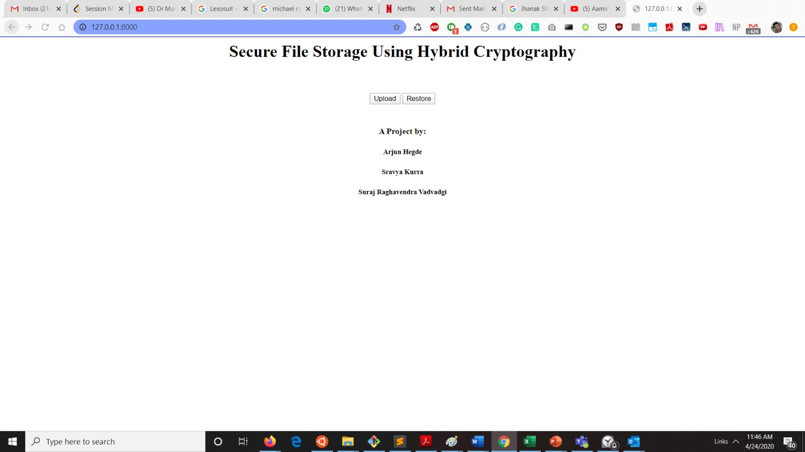
Web Application – GUI to upload the file for secure storage

Slide 7

Choose a file from your system to upload and press submit

Slide 8
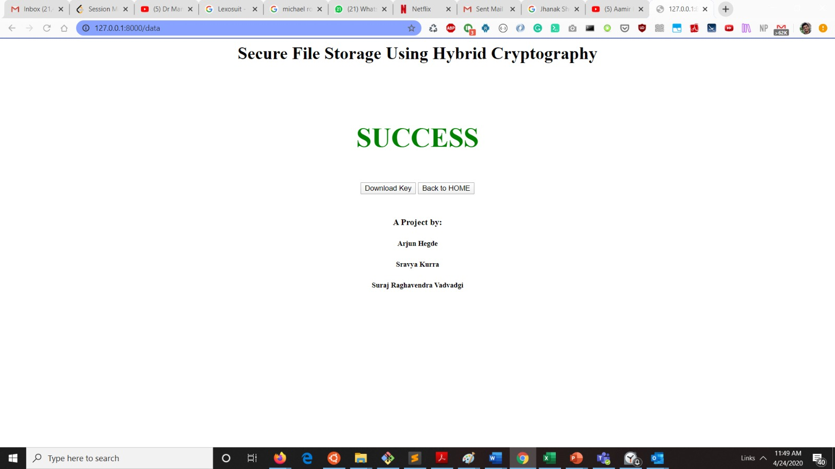
Download the public key here to download the file later

Slide 9
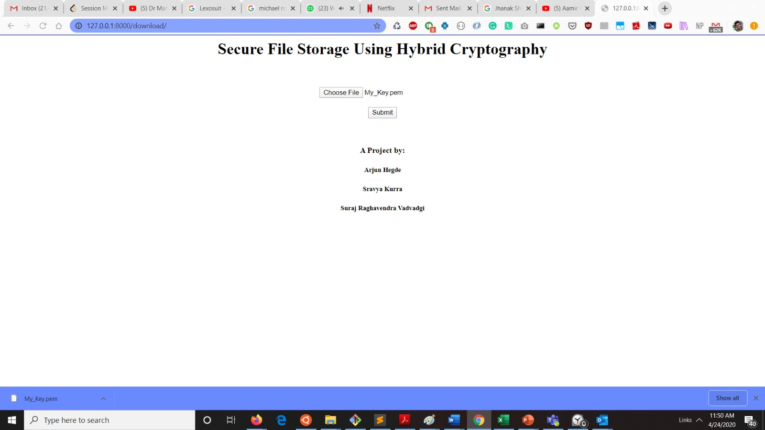
Upload the downloaded key to restore/get the file from cloud storage

Slide 10
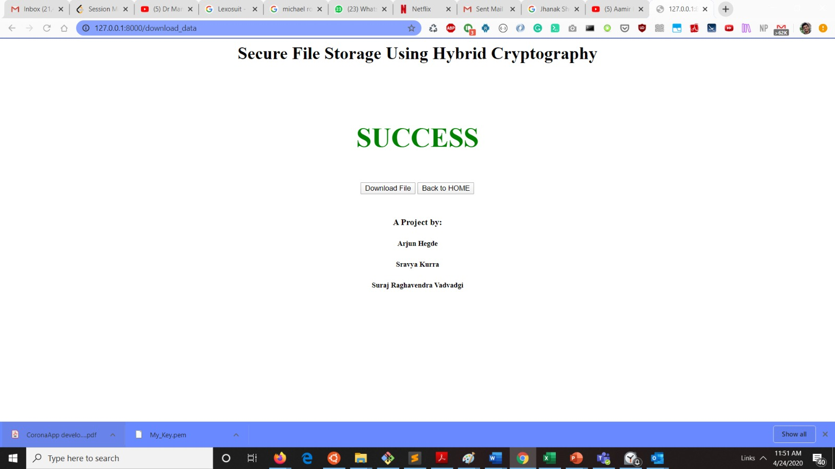
Once you submit the key you will get button to download the file

Slide 11
Conclusion
To store data on cloud we have to face many issues. To provide the solution to these issues there are n number of ways. Cryptography and steganography techniques are more popular now a day's for data security. Use of a single algorithm is not effective for high level security to data in cloud computing. The proposed model efficiently secures the file/data on cloud.

Slide 12
Thank you

