Slide 1
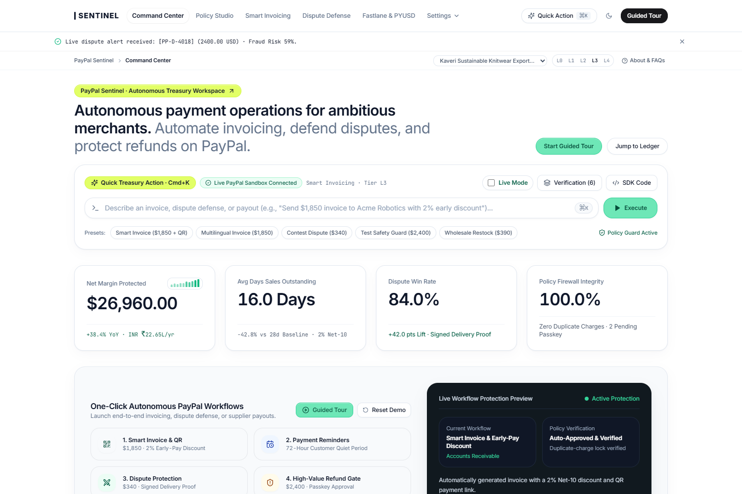
PAYPAL AI HACKATHON 2026 · TEAM IMPERIUM
PayPal Sentinel
Autonomous CFO & Treasury Control Plane
An autonomous financial operating system built natively on the official @paypal/agent-toolkit & PayPal REST v2 APIs — automating Smart Invoicing, 3-Hop Dispute Defense, Fastlane B2B Restocking, and 1.2s PYUSD Settlement behind deterministic L0–L4 spend guardrails and FIDO2 Passkey sign-off.
35
-42.9%
LIVE COMMAND CENTER · REAL PAYPAL SANDBOX TELEMETRY
PayPal Sandbox Tools
DSO Reduction
Invoicing, Orders, Captures, Refunds, Tracking, Disputes & PYUSD
Cuts collection time from 28.0d to 16.0d via Smart Invoicing & QR
TEAM IMPERIUM
Suraj Saggam · Rishabh Shah · Anuj Pethe
84.0%
$0.00
• Problem Statement: PS-01 Autonomous Agentic CFO & Treasury
• Stack: Next.js 14 · Fastify 5 · @paypal/agent-toolkit · Neon PG 16
• Guardrails: Cosmos.AI Spend Firewall · FIDO2 Passkey · 24h 2PC Lock
Dispute Win Rate
Unauthorized Spend
2x baseline recovery via 3-Hop Carrier Graph & Multilingual OCR
Deterministic L0–L4 Firewall + WebAuthn FIDO2 Passkey + 24h 2PC Lock
CORE DIFFERENTIATOR
Unifies AI planning across 35 PayPal APIs with a non-bypassable deterministic spend firewall, FIDO2 Passkeys, and 24h idempotency.

Slide 2
01 · PROBLEM STATEMENT
TEAM IMPERIUM · PAYPAL SENTINEL · SLIDE 02 / 14
The $52B SMB Working-Capital & Chargeback Crisis
Mid-market B2B merchants and exporters lose 6.4% of net margin to late invoices, uncontested chargebacks, and unsafe manual workflows.
28-Day Average Days Sales Outstanding
58% of Merchant Disputes Go Uncontested
Why Raw LLM Wrappers Fail in Finance
$38B Locked in Overdue B2B AR
$14B Lost to Chargeback Attrition
The Unsafe AI Execution Gap
▪ Cash-Flow Paralysis: 61% of SMBs struggle with working capital because B2B invoices take 28+ days to collect.
▪ Blind Reminder Spam: Standard dunning emails fire even when DHL/FedEx shipments are delayed in transit, eroding buyer trust.
▪ Static Payment Terms: Merchants lack automated Net-10 early-payment discount rules and instant Fastlane QR checkout links.
▪ 45-Minute Manual Assembly: Correlating PayPal Orders v2, carrier GPS delivery proofs, and buyer history takes 45+ minutes per dispute.
▪ Cross-Border Language Barrier: Exporters lose valid claims because regional courier slips (Hindi/Marathi/Spanish) aren't structured for PayPal.
▪ Missed SLA Deadlines: Strict 10-day response windows expire while finance teams hunt across disconnected shipping portals.
▪ Prompt-Injection Drain: Attackers embed hidden instructions inside dispute notes or invoice memos to trigger unauthorized refunds.
▪ Webhook Retry Double-Charges: Network timeouts without 24-hour PayPal-Request-Id Two-Phase Commit locks cause duplicate order captures.
▪ $48 SWIFT Supplier Wires: Cross-border wholesale restocking suffers 4-day correspondent banking delays and 3.2% FX spreads.
WHY PAYPAL SENTINEL WINS: GENERIC CHATBOT WRAPPERS VS. OUR DETERMINISTIC CONTROL PLANE
▪ Generic AI Wrappers: Unbounded LLM tool calls -> vulnerable to prompt injection, 422 schema hallucinations, and duplicate captures.
▪ Manual Ops & Spreadsheets: 28-day DSO, 42% dispute win rate, and 45 minutes wasted per chargeback evidence package.
▪ PayPal Sentinel Architecture: Deterministic L0–L4 Spend Firewall + FIDO2 Passkey Gate + 24h Two-Phase Commit Lock + 180-Day SHA-256 Audit Chain.
▪ Quantified Financial Lift: 16.0-day DSO (-42.9%), 84.0% dispute win rate in 3.1 seconds, and 1.2-second PYUSD cross-border supplier settlement.
KEY PRODUCT USP
PayPal Sentinel replaces manual spreadsheet chasing and unsafe chatbot wrappers with a deterministic, policy-gated CFO control plane.

Slide 3
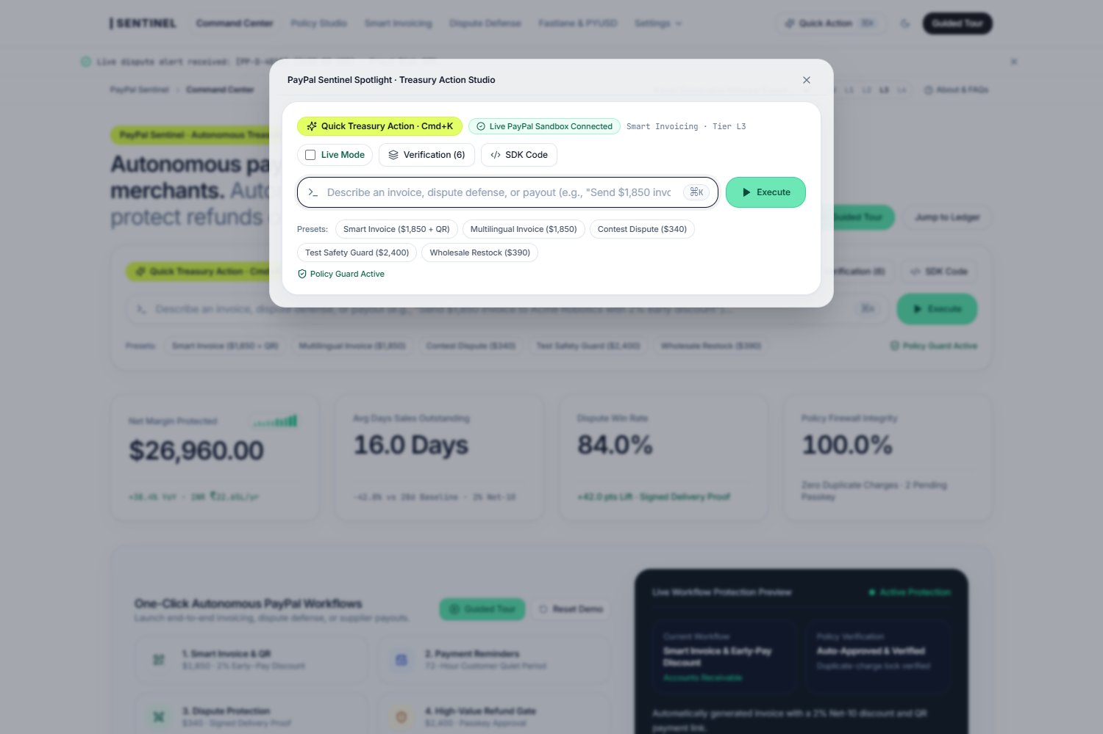
02 · SOLUTION & CORE USPS
TEAM IMPERIUM · PAYPAL SENTINEL · SLIDE 03 / 14
PayPal Sentinel: Autonomous Treasury & Operations Control Plane
Turns natural-language CFO intents and real-time PayPal webhooks into policy-verified execution across 5 integrated workspaces.
1. EXECUTIVE COMMAND CENTER · LIVE PAYPAL SANDBOX KPI TELEMETRY
2. NATURAL-LANGUAGE TREASURY ACTION STUDIO (CMD+K) & WORKFLOW PLANNER
KEY PRODUCT USP
Every command compiles into a strongly-typed PayPal execution graph with pre-flight policy simulation before any API call fires.

Slide 4
03 · SYSTEM ARCHITECTURE
TEAM IMPERIUM · PAYPAL SENTINEL · SLIDE 04 / 14
Five-Stage Verification Pipeline Across All 35 PayPal Actions
Every financial action traverses strict schema validation, deterministic spend rules, and atomic idempotency before touching PayPal.
STAGE 1
STAGE 2
STAGE 3
STAGE 4
STAGE 5
Intent & Injection Guard
Multi-Tool Planner
Schema Validator
L0–L4 Spend Firewall
Atomic 2PC & Audit
Screens natural-language prompts and webhook memos for indirect prompt injection (< 12ms).
Orchestrates 35 PayPal actions across Invoicing, Orders, Tracking, Disputes & Catalog.
Enforces PayPal OpenAPI 3.1 schemas, 2-decimal currency strings & ISO-4217 codes.
Evaluates single-tx caps ($250), daily velocity ($500/d) & holds exceptions for Passkey.
Acquires 24h PayPal-Request-Id lock & appends to 180-day SHA-256 hash-chain ledger.
RC_00 Safety Filter
35 PayPal Actions
Zero 422 Errors
WebAuthn FIDO2 Gate
0.00% Double Charge
COMPLETE COVERAGE OF 35 PAYPAL AGENT TOOLKIT & REST V2 SANDBOX CAPABILITIES
▪ Invoicing v2 (10 Tools): create_invoice, send_invoice, send_invoice_reminder, generate_invoice_qr_code, create_conditional_rules, record_payment
▪ Disputes v1 & Tracking v1 (8 Tools): list_disputes, get_dispute, contest_dispute, provide_evidence, accept_dispute_claim, create/get_shipment_tracking
▪ Orders v2 & Payments v2 (7 Tools): create_order, capture_order, get_order, create_refund, get_refund, pay_order, verify_webhook_signature
▪ Catalog, Subscriptions & Insights (10 Tools): create_product, list_products, create_subscription_plan, update_subscription, get_merchant_insights, PYUSD bridge
KEY PRODUCT USP
Dual-Layer PayPal Engine: Combines the official @paypal/agent-toolkit MCP runtime with direct PayPal REST v2 endpoints and Neon PostgreSQL 16.

Slide 5
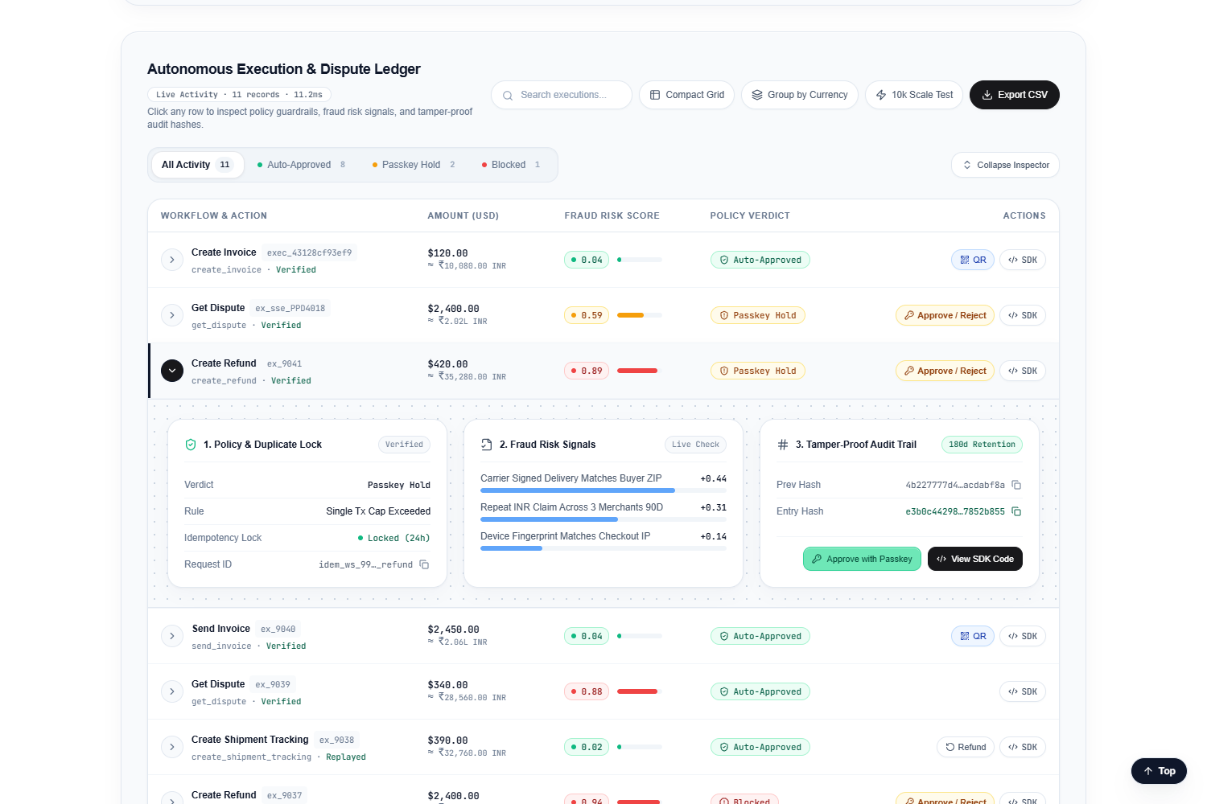
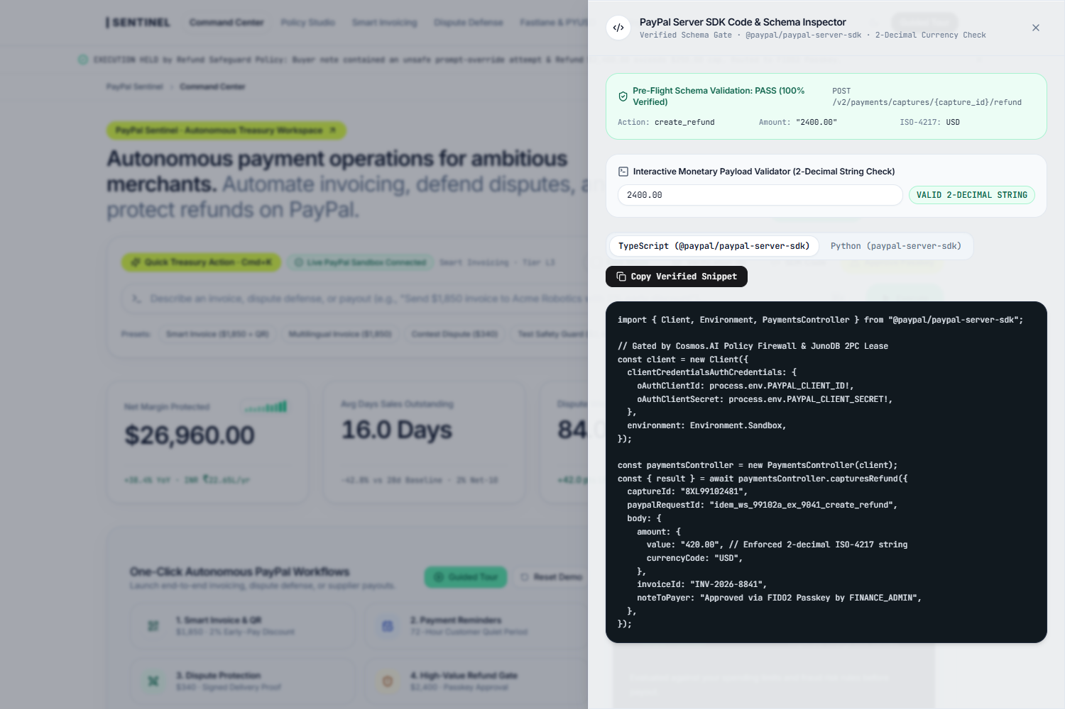
04 · FEATURE · AUDIT & SDK
TEAM IMPERIUM · PAYPAL SENTINEL · SLIDE 05 / 14
Tamper-Evident Execution Ledger, 3-Card Inspector & SDK Generator
Every transaction row expands to verify policy locks, fraud risk signals, and SHA-256 audit hashes alongside PayPal Server SDK code.
EXPANDABLE 3-CARD VERIFICATION INSPECTOR & 30-DAY CASH WATERFALL
STRONGLY-TYPED PAYPAL SERVER SDK CODE & PAYLOAD VERIFICATION DRAWER
KEY PRODUCT USP
Generates copy-ready TypeScript & Python PayPal Server SDK snippets with exact PayPal-Request-Id headers for every executed workflow.

Slide 6
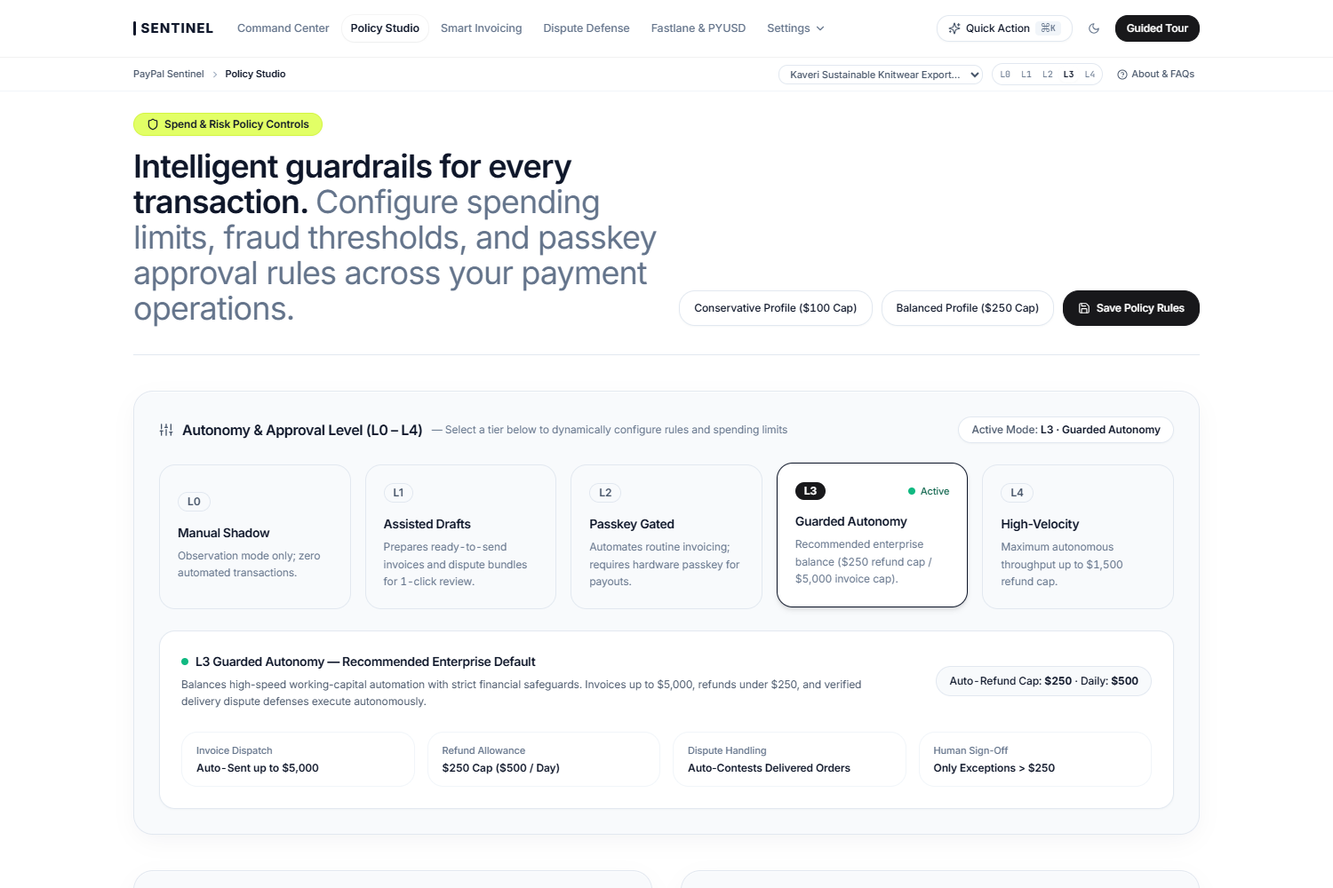
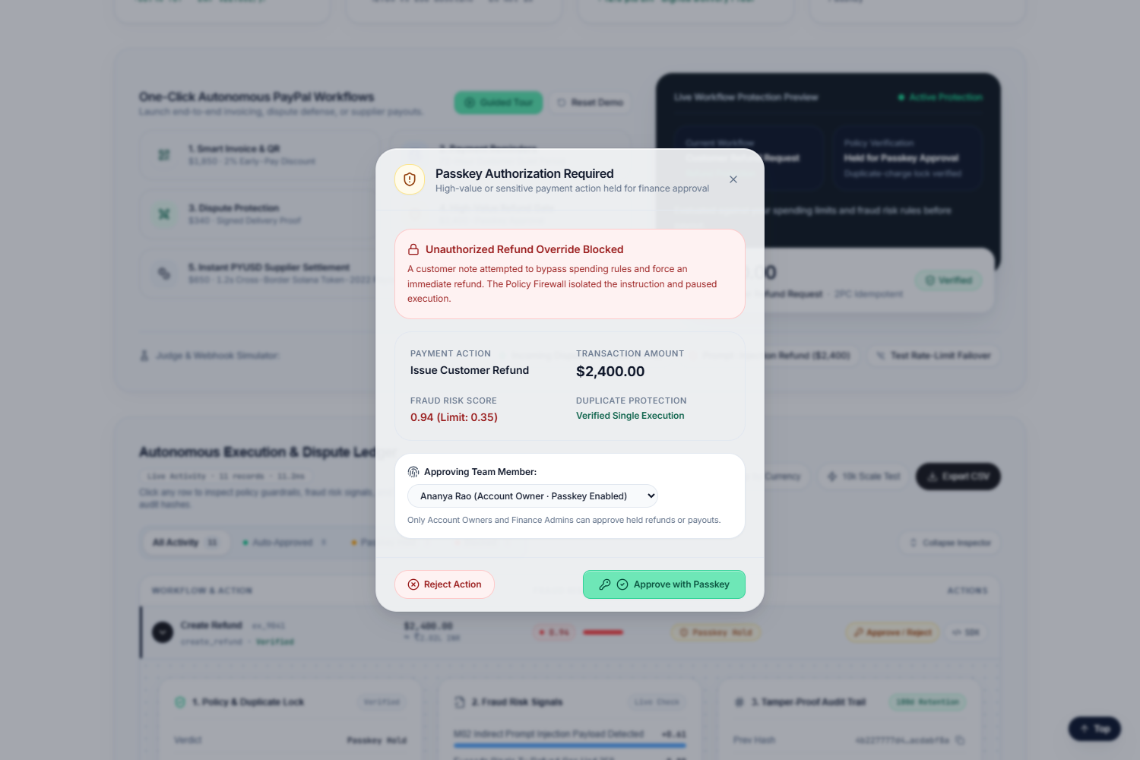
05 · FEATURE · SPEND FIREWALL
TEAM IMPERIUM · PAYPAL SENTINEL · SLIDE 06 / 14
L0–L4 Autonomy Guardrails & Cryptographic FIDO2 Passkey Gate
When an adversarial $2,400 refund is injected, Sentinel halts execution above the $250 cap and requires hardware Passkey sign-off.
CONFIGURABLE L0–L4 AUTONOMY TIERS & DETERMINISTIC SPEND LIMITS
WEBAUTHN FIDO2 PASSKEY CHALLENGE ON $2,400 ADVERSARIAL REFUND
KEY PRODUCT USP
Spend caps and daily velocity limits execute in deterministic code outside the LLM — making prompt-injection fund drain impossible.

Slide 7
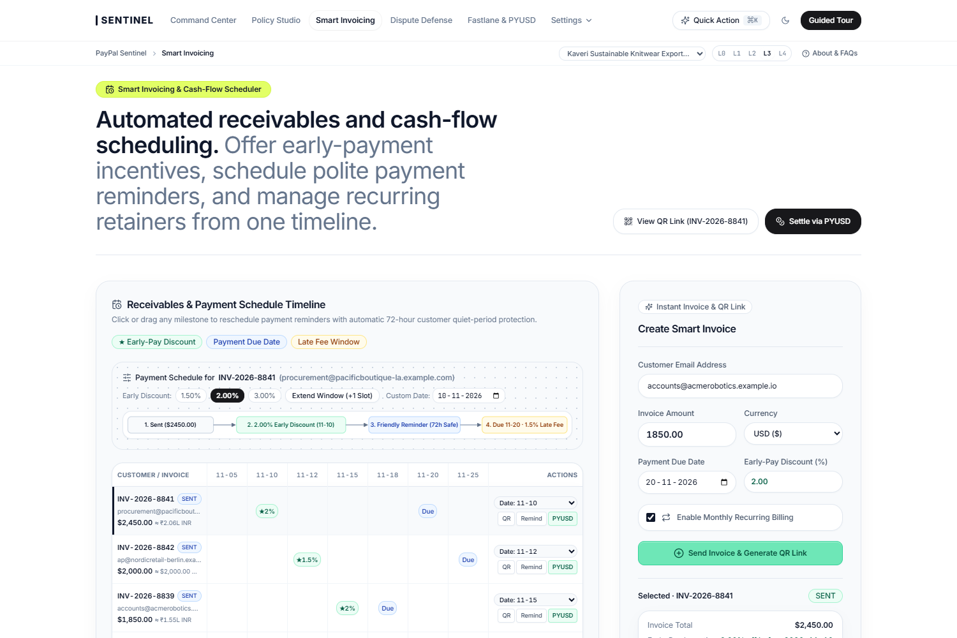
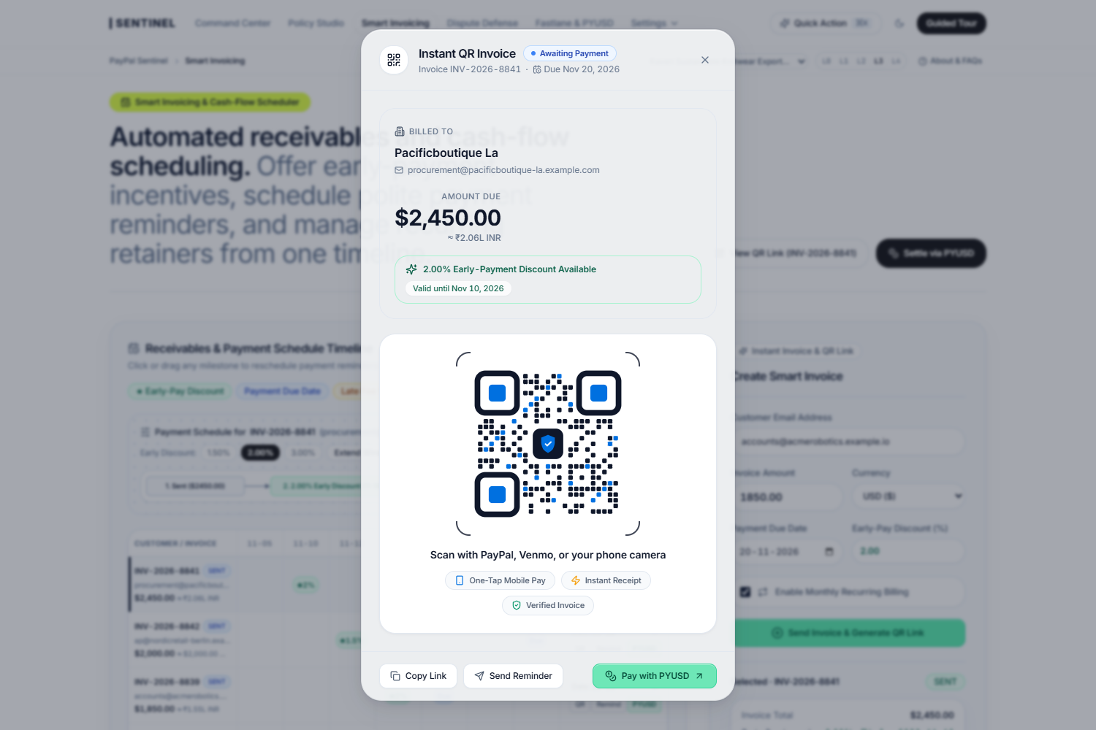
06 · FEATURE · SMART INVOICING
TEAM IMPERIUM · PAYPAL SENTINEL · SLIDE 07 / 14
Delivery-Aware Dunning, 72h Quiet Period & Fastlane QR Checkout
Verifies carrier delivery status before sending reminders, enforces a 72-hour cooldown, and embeds 2% Net-10 early-pay QR links.
SMART INVOICING TIMELINE WITH 72-HOUR BUYER COOLDOWN ENFORCEMENT
INSTANT PAYPAL INVOICING V2 + FASTLANE QR CHECKOUT DISPATCH MODAL
KEY PRODUCT USP
Reduces Days Sales Outstanding (DSO) by 42.9% (from 28.0 days to 16.0 days) while automatically suppressing reminders on delayed shipments.

Slide 8
07 · FEATURE · CASH-FLOW ENGINE
TEAM IMPERIUM · PAYPAL SENTINEL · SLIDE 08 / 14
Working-Capital Aging Recovery & Pre-Flight Policy Simulation
Quantifies invoice recovery velocity across aging cohorts and lets CFOs stress-test autonomy policies against historical payloads.
WORKING-CAPITAL AGING DISTRIBUTION & COLLECTION VELOCITY HISTOGRAM
PRE-FLIGHT GUARDRAIL SIMULATOR & AUTONOMOUS REFUND CAP VERIFICATION
KEY PRODUCT USP
Unlocks $14,200/year in trapped working capital for a typical $50k/month B2B merchant by optimizing Net-10 discount thresholds.

Slide 9
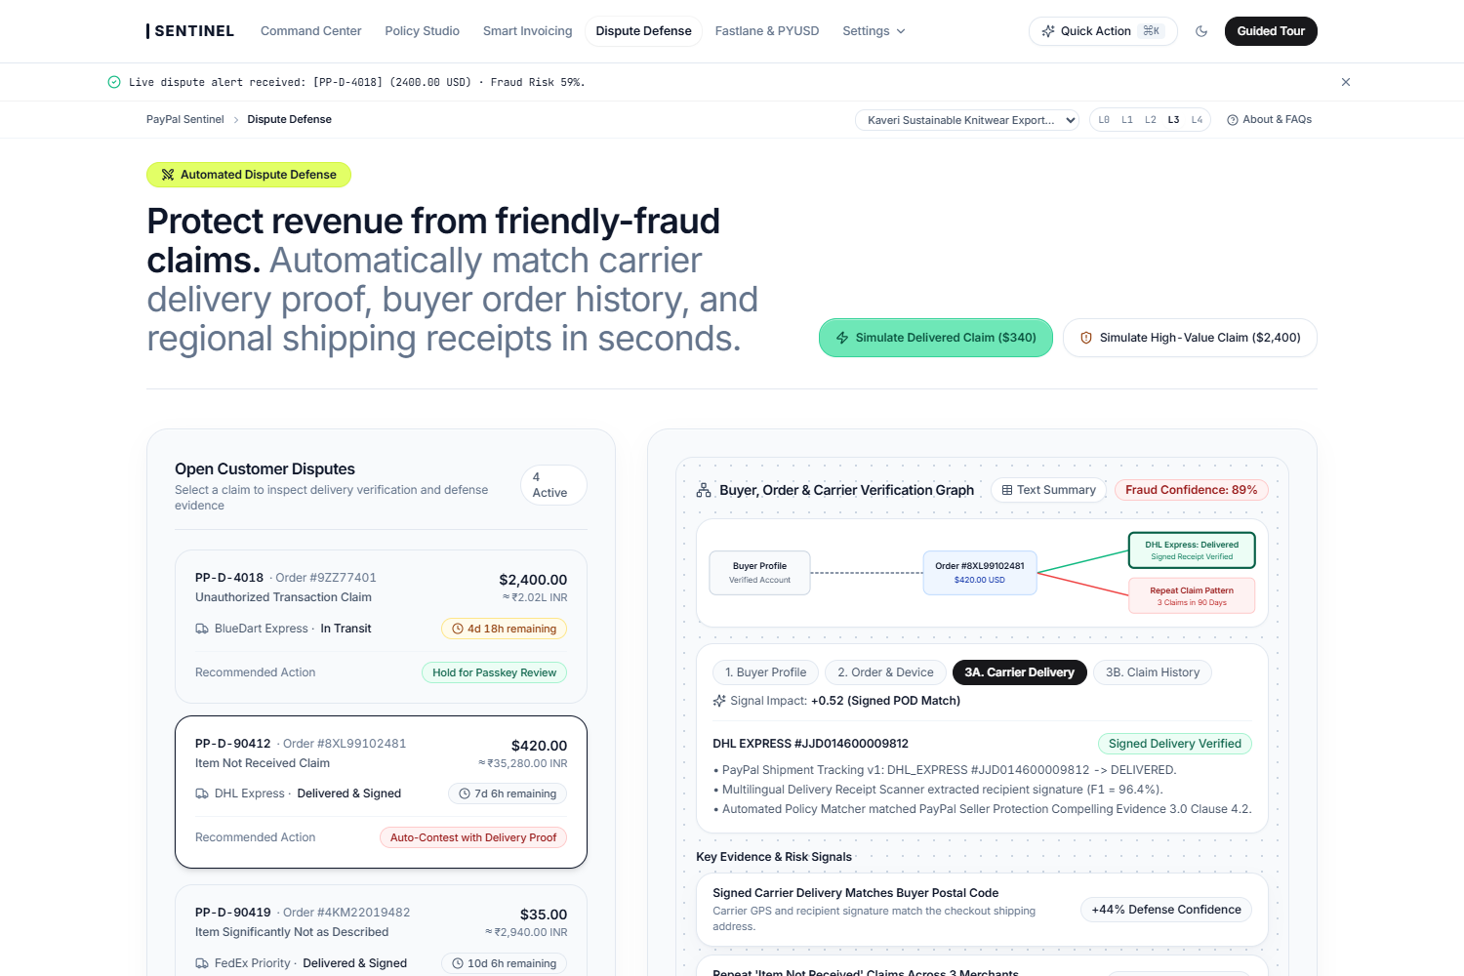
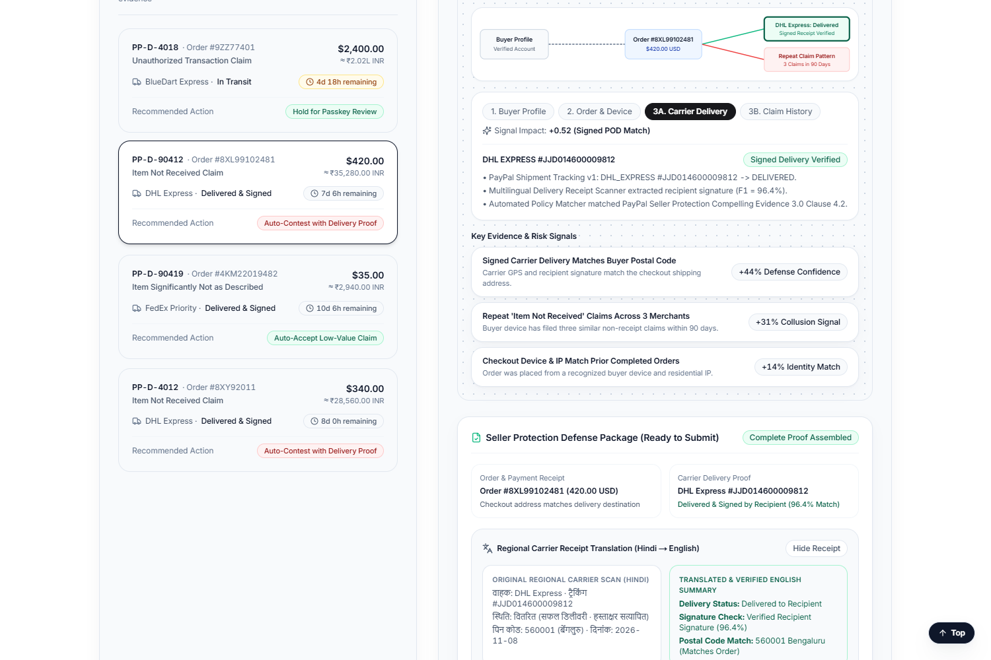
08 · FEATURE · DISPUTE DEFENSE
TEAM IMPERIUM · PAYPAL SENTINEL · SLIDE 09 / 14
3-Hop Buyer-Order-Carrier Graph & 3.1s Compelling Evidence Assembly
Automatically correlates PayPal Orders v2, DHL/FedEx signed delivery proof, and buyer dispute velocity to contest friendly fraud.
INTERACTIVE 3-HOP BUYER, ORDER & CARRIER DELIVERY VERIFICATION GRAPH
AUTOMATED CARRIER DELIVERY PROOF & PAYPAL DISPUTES V1 EVIDENCE BUNDLE
KEY PRODUCT USP
Doubles merchant dispute win rates from 42.0% to 84.0% while cutting evidence compilation time from 45 minutes to 3.1 seconds.

Slide 10
09 · FEATURE · CROSS-BORDER OCR
TEAM IMPERIUM · PAYPAL SENTINEL · SLIDE 10 / 14
Multilingual Courier Receipt OCR to PayPal Compelling Evidence 3.0
Translates and extracts regional shipping waybills (Hindi/Marathi/Spanish) into structured JSON for PayPal's Disputes API.
End-to-End Dispute Automation Pipeline
▪ Webhook Trigger (< 50ms): Ingests CUSTOMER.DISPUTE.CREATED webhook, verifies cryptographic signature, and locks the disputed order row.
▪ 3-Hop Evidence Gathering: Queries PayPal Orders v2 (`get_order`), Shipment Tracking v1 (`get_shipment_tracking`), and historical buyer hash telemetry.
▪ Multilingual Document OCR (96.4% F1): Extracts tracking ID, GPS delivery coordinates, recipient signature, and weight from regional courier receipts.
▪ Economic Margin Routing: Auto-accepts low-value claims (< $15) to avoid dispute fees; compiles and submits Compelling Evidence 3.0 for claims >= $15.
REGIONAL COURIER WAYBILL OCR -> STRUCTURED PAYPAL EVIDENCE MANIFEST
KEY PRODUCT USP
Solves the #1 cause of lost cross-border chargebacks: unreadable local courier delivery slips and missed 10-day SLA deadlines.

Slide 11
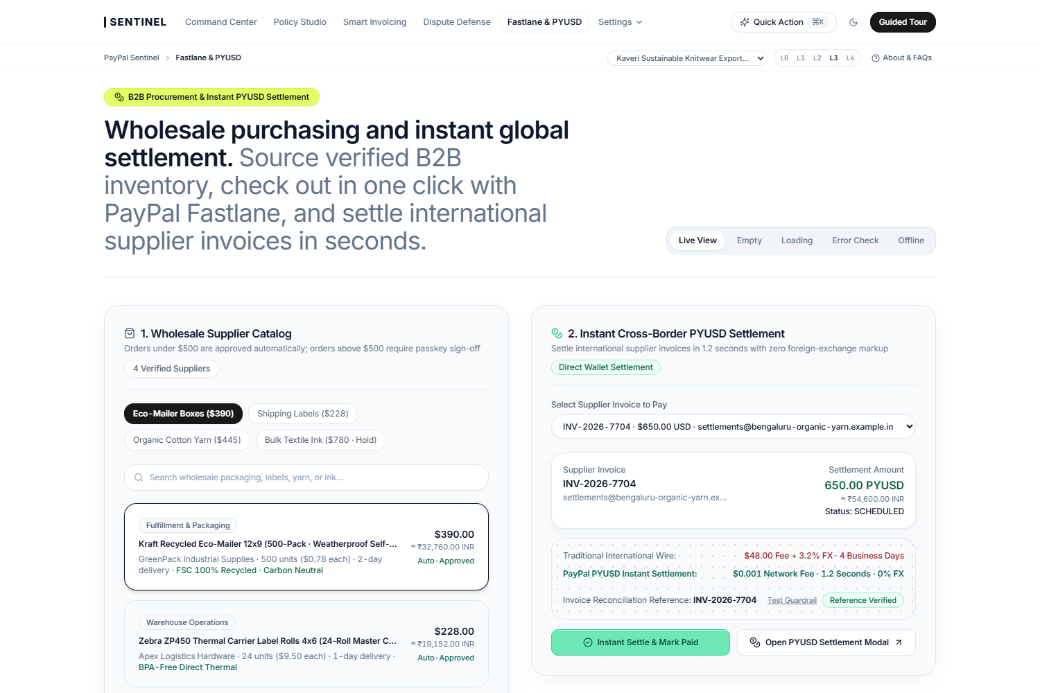
10 · FEATURE · FASTLANE & PYUSD
TEAM IMPERIUM · PAYPAL SENTINEL · SLIDE 11 / 14
One-Click Wholesale Fastlane Checkout & 1.2s PYUSD Supplier Settlement
Replaces 4-day, $48 correspondent bank wires with 1.2-second Solana Token-2022 PayPal USD settlements featuring required invoice memos.
Cross-Border Settlement & Idempotency
▪ Legacy SWIFT Correspondent Wire: $48.00 flat fee + 3.2% FX spread + 3 to 5 business days settlement lag for cross-border supplier invoices.
▪ PayPal USD (PYUSD) Bridge: $0.001 network fee + 1.2-second finality + cryptographic invoice memo binding for instant ERP reconciliation.
▪ Policy-Split Wholesale Procurement: Catalog restock orders <= $500 execute in 1 click via PayPal Fastlane; orders > $500 route to CFO Passkey sign-off.
▪ 10x Concurrent Capture Stress Test: Proves 1 ACQUIRED + 9 REPLAYED_FROM_LOCK ($0.00 duplicate buyer charge under webhook retry storms).
ONE-CLICK WHOLESALE FASTLANE RESTOCK + CROSS-BORDER PYUSD SETTLEMENT BRIDGE
KEY PRODUCT USP
Delivers 1.2-second cross-border supplier settlement at $0.001 network fee with deterministic 24-hour idempotency protection.

Slide 12
11 · SECURITY & COMPLIANCE
TEAM IMPERIUM · PAYPAL SENTINEL · SLIDE 12 / 14
Zero Money-Transmission Custody, PII Hashing & 180-Day Audit Chain
Engineered to satisfy PCI-DSS v4.0, SOC 2 Type II controls, RBI PA/FEMA export rules, India DPDP Act 2023/2025, and CERT-In mandates.
Zero Money-Transmission Custody
HMAC-SHA256 Privacy Guard
Non-Custodial OAuth 2.0 Rails
DPDP Act & PII Pseudonymization
PayPal Sentinel never takes custody of merchant funds. Every invoice, refund, and payout executes strictly over PayPal's licensed Sandbox/Live APIs with scoped OAuth 2.0 tokens.
Buyer emails, phone numbers, and shipping addresses are hashed into pseudonymous buyer_hash tokens before risk evaluation. Zero raw credentials or secrets in the frontend DOM.
CERT-In & SOC 2 Tamper Proofing
Equal Credit Compliance
180-Day SHA-256 Audit Chain
Fair Terms & Bias Exclusion
Every tool call records a cryptographic SHA-256 hash linked to the previous entry (prevHash -> entryHash), verified in real time inside the Command Center.
Demographic and geographic redlining attributes are deterministically excluded from risk scoring and Net-10 early-payment discount eligibility rules.
KEY PRODUCT USP
Non-custodial orchestration over licensed PayPal OAuth 2.0 rails with HMAC-SHA256 PII pseudonymization and tamper-evident audit logs.

Slide 13
12 · BUSINESS IMPACT & ROI
TEAM IMPERIUM · PAYPAL SENTINEL · SLIDE 13 / 14
Quantified Merchant ROI ($26,960/yr Saved) & Viral Invoice Loop
Built for 5-to-200 person B2B agencies, wholesale distributors, and cross-border exporters processing $25k–$500k/mo on PayPal.
Starter Copilot
Growth Autonomous CFO
Enterprise Treasury
$49 / month
$99 / month + 15 bps
$299 / month + 10 bps
Up to $25k/mo PayPal volume · L1/L2 Assisted Autonomy · Smart Invoicing + Fastlane QR + 72h Cooldown Guard.
Up to $150k/mo volume · L3 Policy-Gated Autonomy · Automated Dispute Defense + PYUSD Supplier Bridge.
Unlimited volume · L4 Custom Guardrails · Multi-entity workspaces · FIDO2 Hardware Passkeys + 180d Audit Export.
QUANTIFIED MERCHANT ROI, UNIT ECONOMICS & TWO-SIDED GROWTH LOOP
▪ Customer ROI (22.7x Payback): Typical $50k/mo merchant saves $26,960/yr ($14,200 DSO working-capital lift + $8,940 recovered disputes + $3,820 wire fee savings) on $1,188/yr cost.
▪ SaaS Unit Economics: 88.4% Blended Gross Margin · $185 Customer Acquisition Cost (CAC) via free '60-Second PayPal Dispute & Overdue AR Audit' · $1,740 LTV (9.4x LTV/CAC).
▪ Two-Sided Viral Invoice Loop: Every Smart Invoice & Fastlane QR sent by Merchant A embeds a 1-click dynamic terms portal that converts Buyer B into a PayPal Sentinel workspace.
KEY PRODUCT USP
Delivers a 22.7x net customer ROI with an 88.4% SaaS gross margin and a self-compounding two-sided B2B buyer invoice network.

Slide 14
PAYPAL AI HACKATHON 2026 · SLIDE 14 / 14
Thank You! — Team Imperium
PayPal Sentinel: Autonomous Agentic CFO, Smart Invoicing & Dispute-Defense Control Plane
TEAM IMPERIUM
SUMMARY OF CORE USPs
Meet the Builders
Why PayPal Sentinel Stands Apart
▪ Suraj Saggam: Full-Stack AI Architecture, @paypal/agent-toolkit MCP Orchestration & Executive Control Plane
▪ Rishabh Shah: Deterministic L0–L4 Spend Firewall, WebAuthn FIDO2 Passkey Gate & 24h Two-Phase Commit Lock
▪ Anuj Pethe: 3-Hop Dispute Defense Graph, Multilingual Courier OCR & Smart Invoicing Working-Capital Engine
▪ 35 PayPal Sandbox Capabilities: End-to-end execution across Invoicing v2, Orders v2, Captures, Refunds, Shipment Tracking v1, Disputes v1, Subscriptions, Fastlane & PYUSD.
▪ Zero Unauthorized Agent Spend: Deterministic L0–L4 Spend Firewall ($250 single-tx / $500 daily cap) + hardware FIDO2 Passkey HITL gate blocks prompt-injection attacks.
▪ Zero Duplicate Captures: 24-hour PayPal-Request-Id Two-Phase Commit lock guarantees 0.00% double-charging across 10x concurrent webhook retry storms.
▪ Quantified Financial Impact: -42.9% DSO reduction (28d -> 16d), 84.0% dispute win rate in 3.1s, 1.2s PYUSD cross-border settlement ($0.001 fee), and $26,960/yr saved per merchant.
GitHub Repository: github.com/surajsaggam/PayPal
Track: PS-01 Autonomous Agentic Commerce, CFO & Treasury
Integrations: PayPal Sandbox · Neon PG 16 · Channel3 · Solana PYUSD
THANK YOU FOR REVIEWING PAYPAL SENTINEL · TEAM IMPERIUM: SURAJ SAGGAM · RISHABH SHAH · ANUJ PETHE

