Slide 1

Uncovering Patterns and Insights in Employee Turnover
Attrition:
DAI06
Suraj Sathish

Slide 2

Agenda
Introduction
Dataset
Patterns and Insights
Strengths and Limitations
Recommendations

Slide 3

Introduction
High attrition rates can be detrimental to an organization.
Effectively managing attrition helps organizations retain top talent, enhance employee satisfaction, and build a strong employer brand

Slide 4
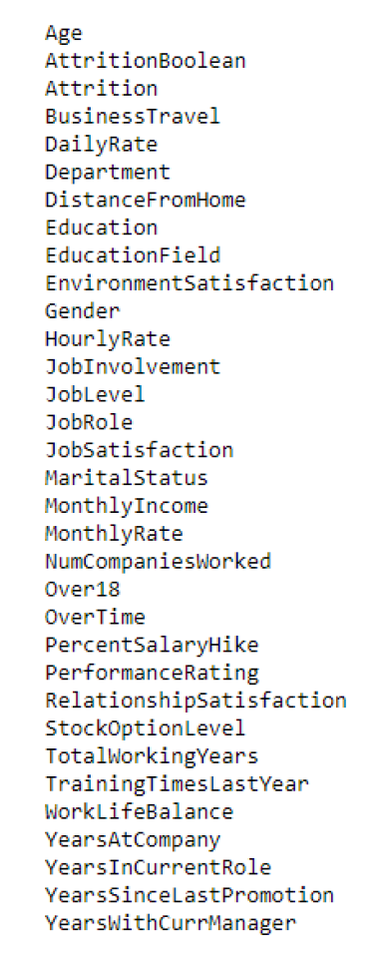
Dataset
IBM HR Analytics Dataset
Data from 1470 employees with 33 key features
Numerical and Categorical variables
Provides insights into attrition status of employees

Slide 5

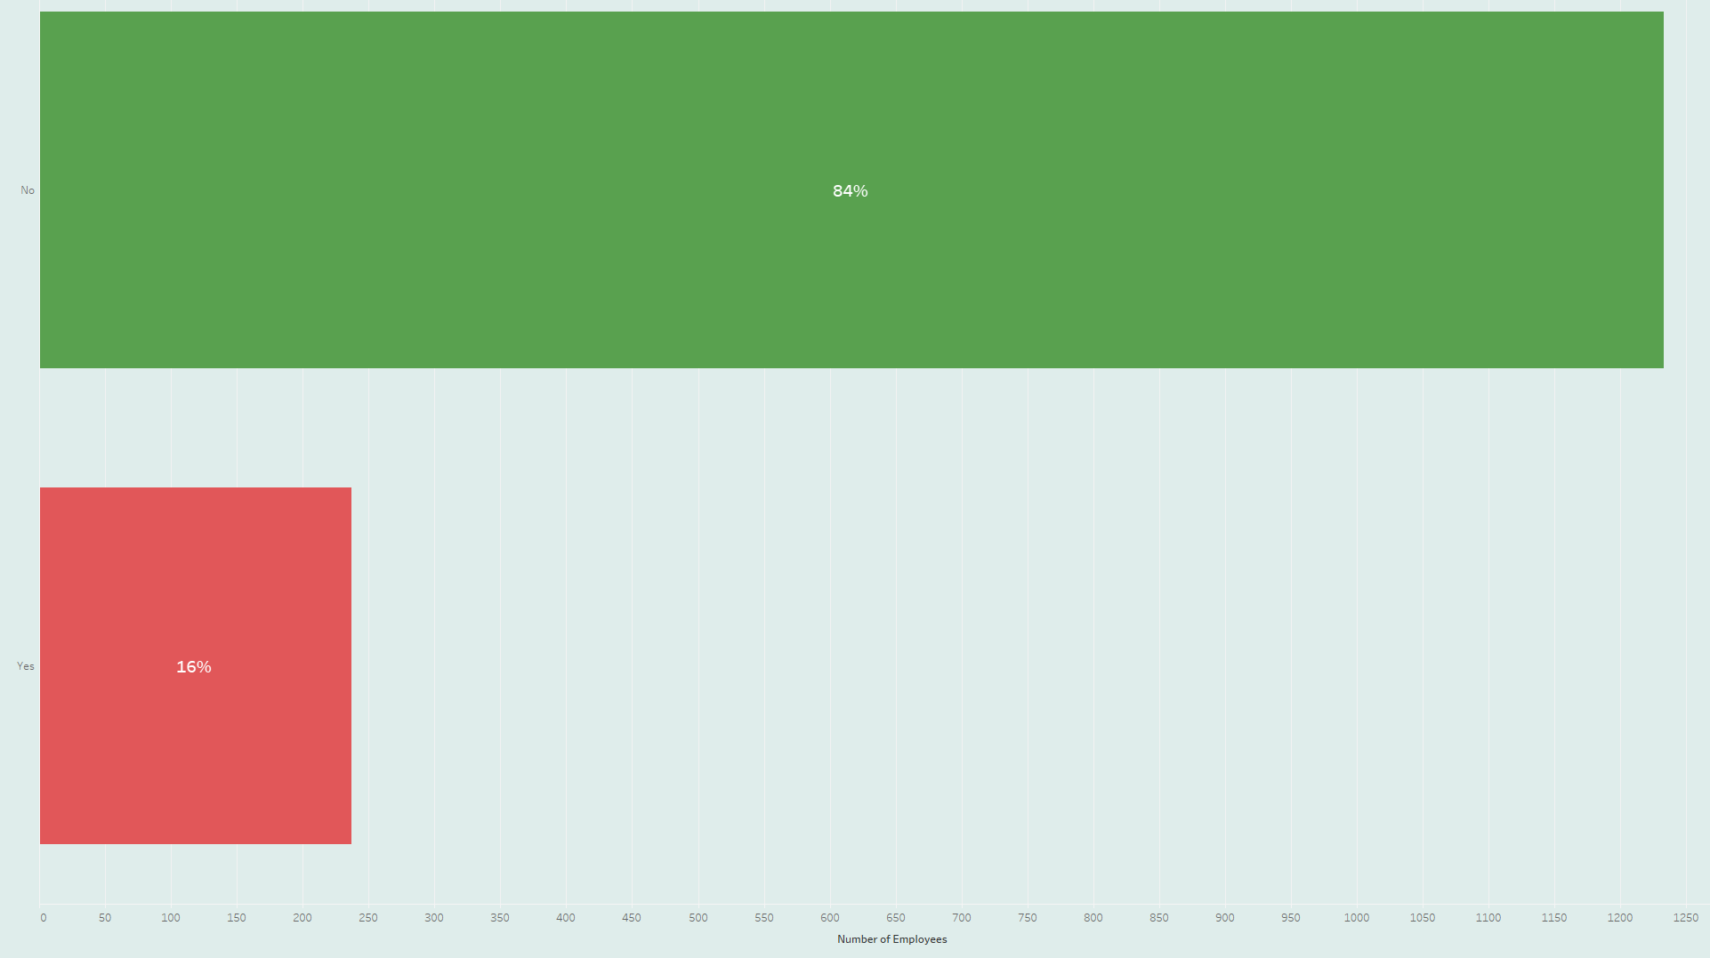
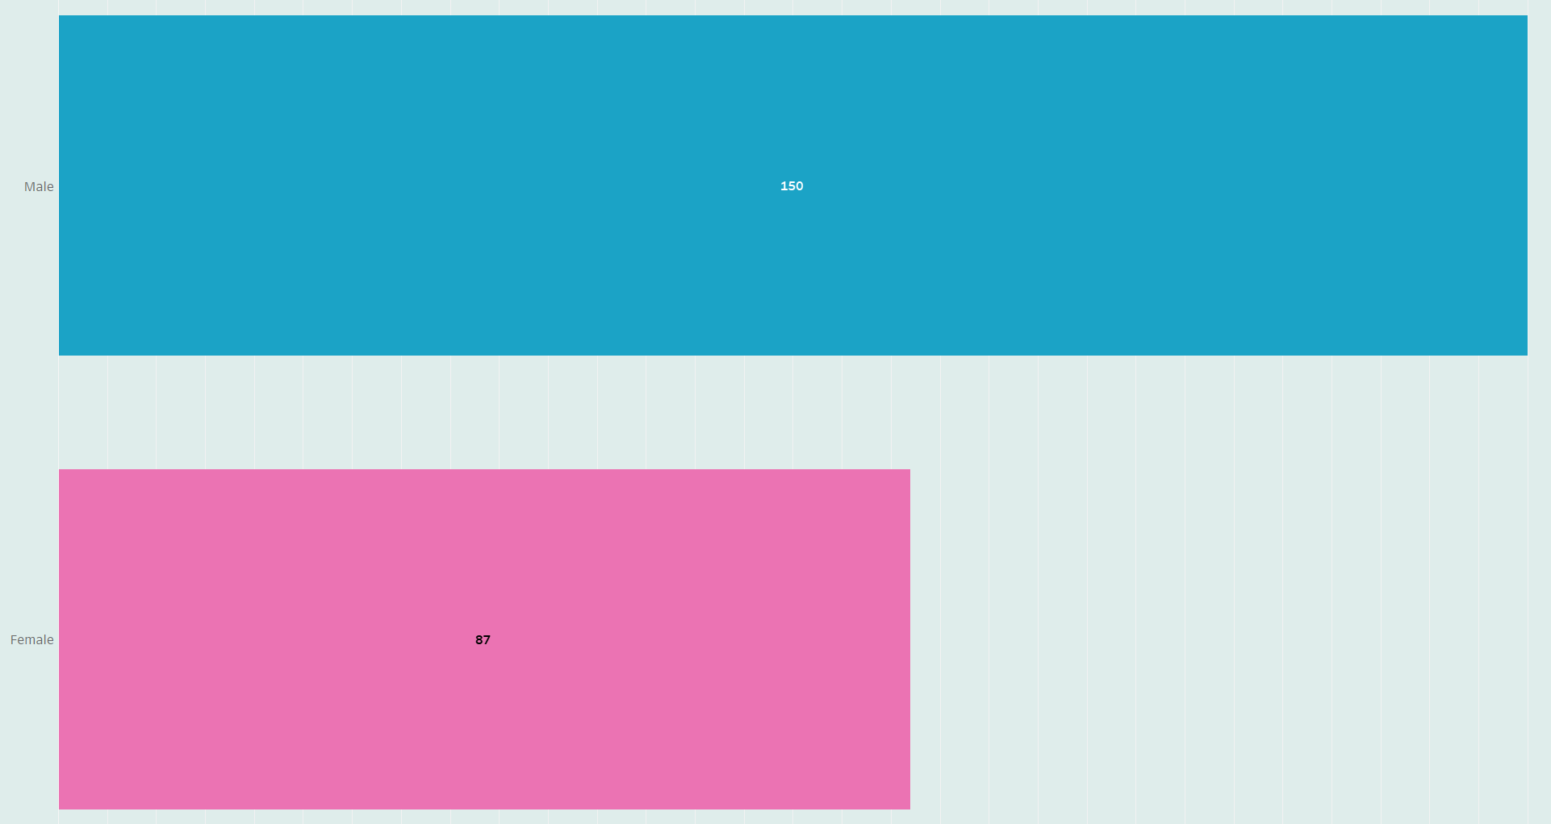




Patterns and Insights – Attrition Rates
84% Retained
16% Attrition rate

Slide 6
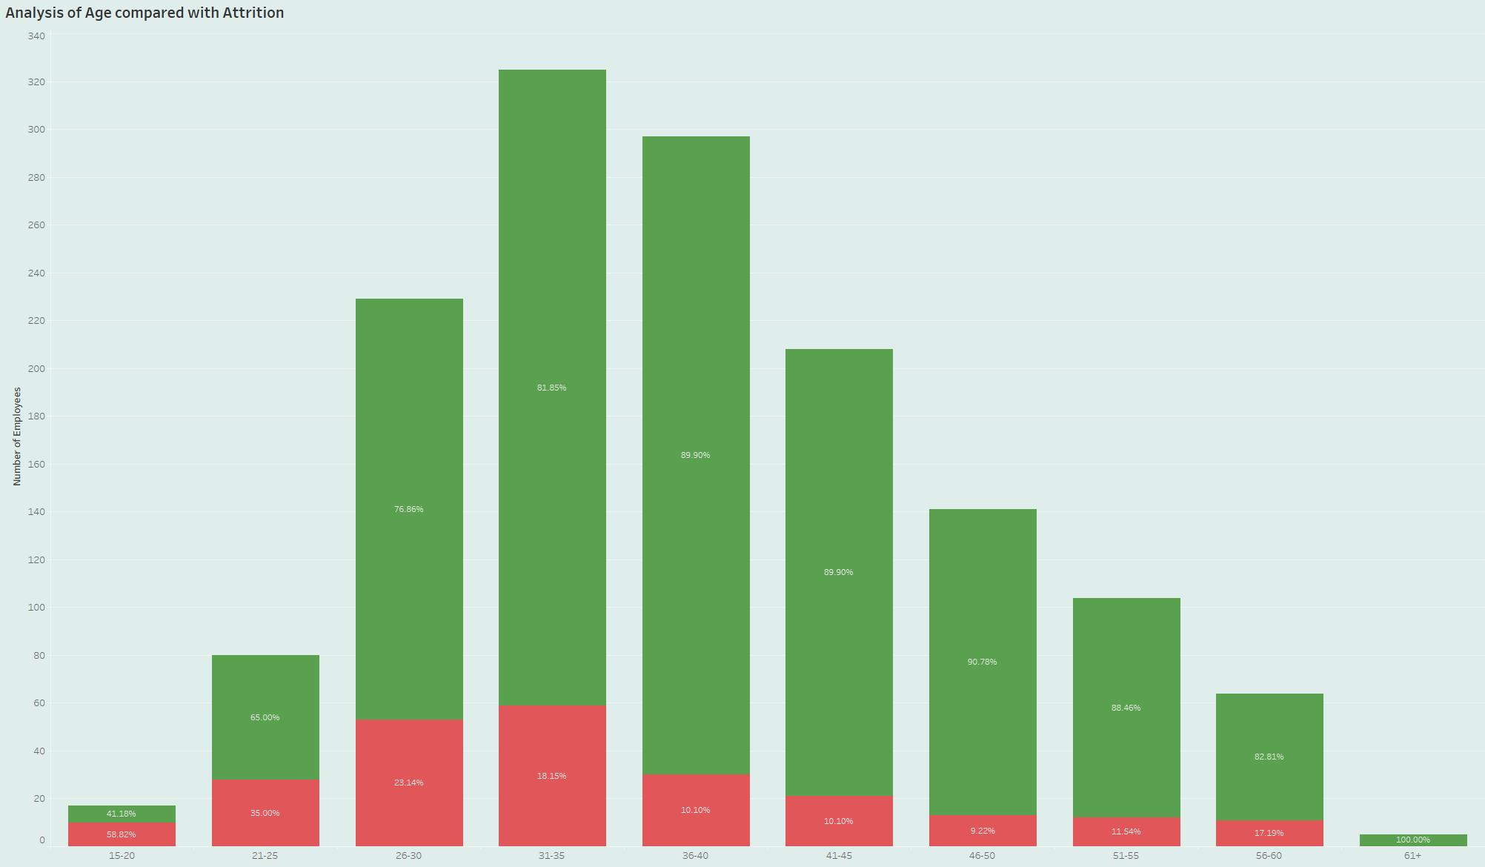
Patterns and Insights – Age Groups
Employee age spanning from 18 – 60
Highest observed attrition rates among 25–35-year-olds
As age increases, attrition rates, gradually decrease

Slide 7
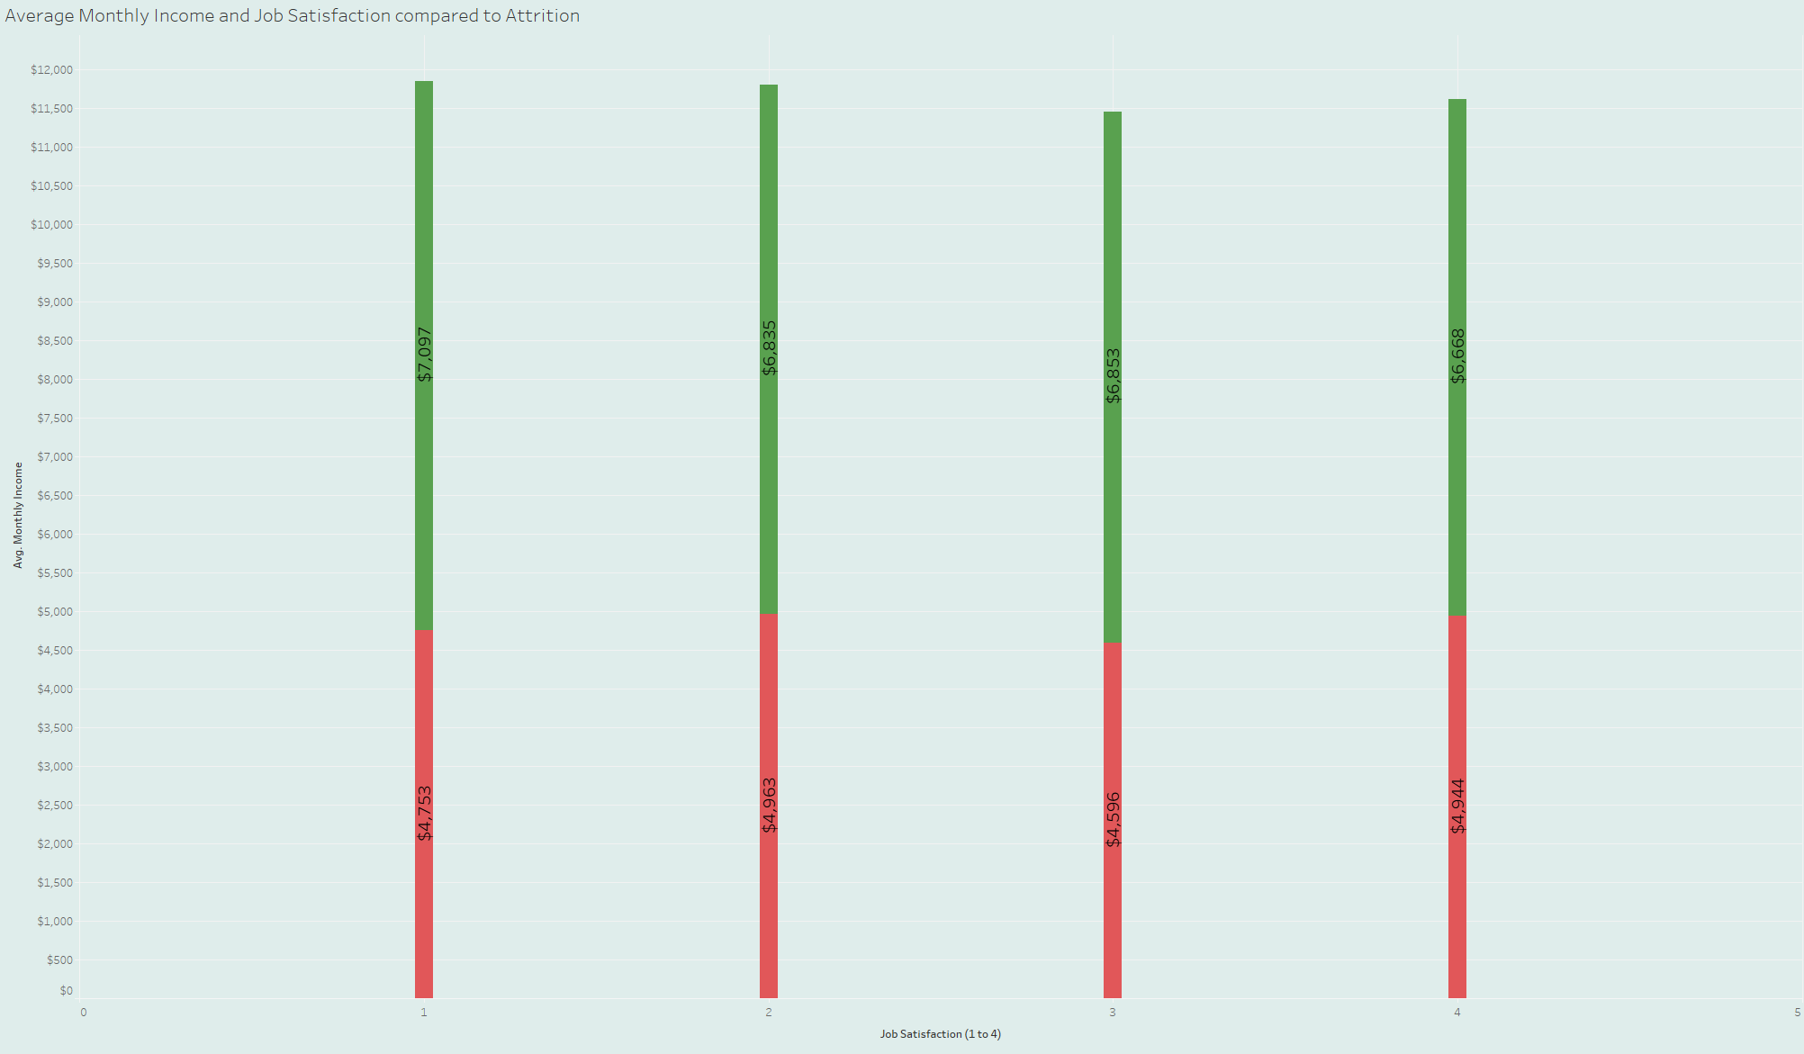
Patterns and Insights – Job Satisfaction
Job satisfaction is measured on a scale of 1 to 4 with 1 indicating low satisfaction and 4 indicating high satisfaction

Slide 8
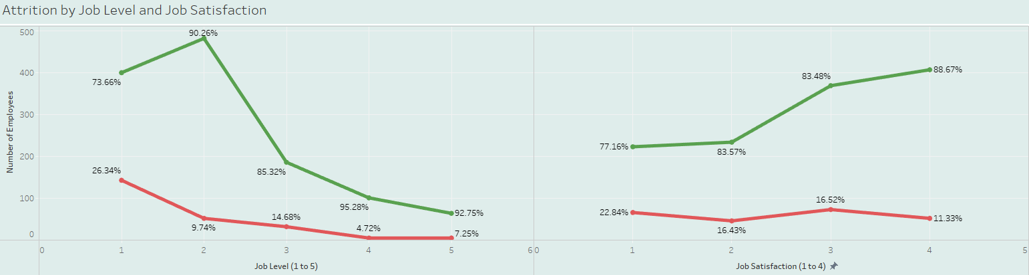
Patterns and Insights – Job Level/Satisfaction

Slide 9
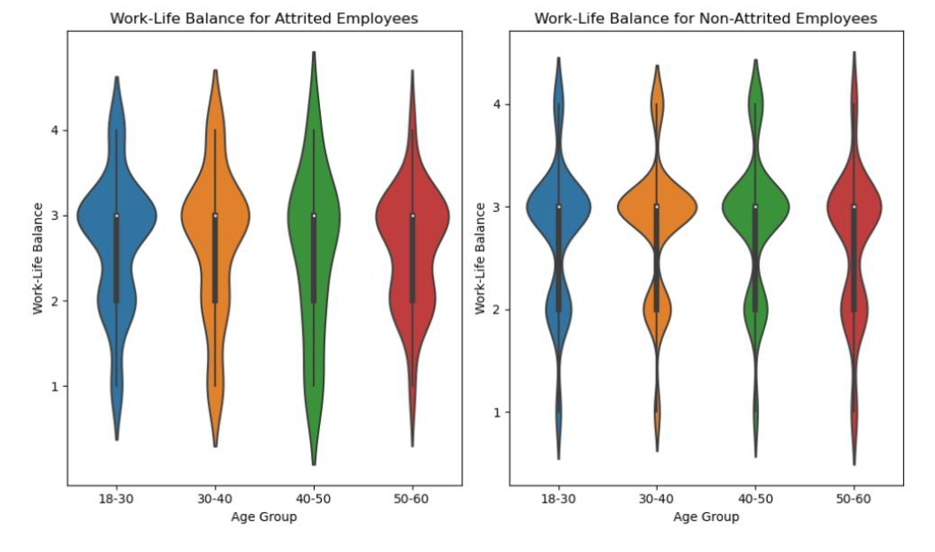
Patterns and Insights – Work-Life Balance
Work-Life Balance is classified on a scale of 1 to 4 with 1 being low satisfaction and 4 being high satisfaction
Higher proportion of attrited employees report dissatisfaction in their work-life dynamics

Slide 10


Strengths and Limitations
Relevant and specific dataset for attrition
Comprehensive variables
Good sample size and clean data
Lack of external factors
Unknown timeframe
Potential Bias

Slide 11



Recommendations
Work-Life Balance
Flexible hours, remote work options, or other benefits
Career Development and Growth
Mentorship programs, training initiatives, and defined career paths
Enhance Job Satisfaction
Positive work environment and recognition

