Slide 1
FPE - Format Preserving Encryption
- Suraj Hardade

Slide 2
What Is FPE?
Format Preserving Encryption is - as the name says - an encryption in which the format of the encrypted data is maintained.
When a plaintext is encrypted with FPE, the ciphertext then has the
same format again and has same length.
Ex.
1. CCN – Credit Card Number : Consist of 16 digits decimal numerals.
2. SSN - Social Security Number : Consist of 9 digits decimal numerals.

Slide 3
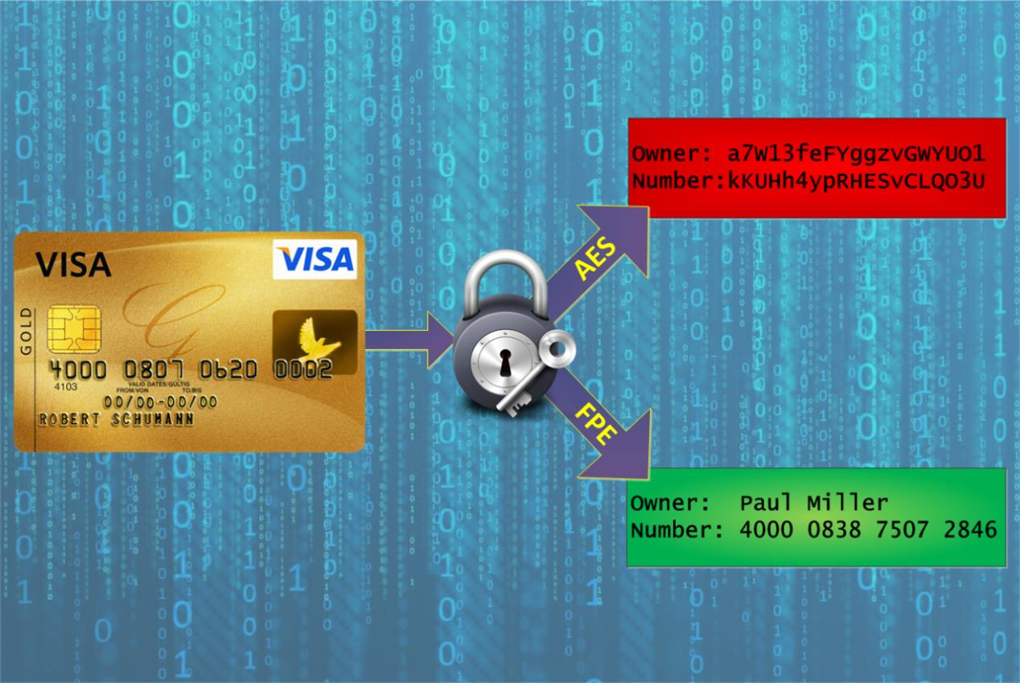
Ex : CCN

Slide 4
Modes Of FPE :
1. FF1 : - Format-preserving, Feistel-based encryption mode
- Flexibility in the length of the tweak
- Round count is ten
- supports a greater range of lengths for the protected, formatted data
2. FF3 : - Format-preserving, Feistel-based encryption mode
- Tweak length is fixed.
- Round count is eight
- Greater throughput

Slide 5
Feistel Structure :
- FF1 and FF3 based on Feistel Structure
- A framework for constructing an encryption mode
- Consists of several iterations called rounds
- Consists of three steps:
1. The data is split into two parts
2. keyed function, called the round function, is applied to one part of the data in order to modify the other part of the data
3. The roles of the two parts are swapped for the next round

Slide 6
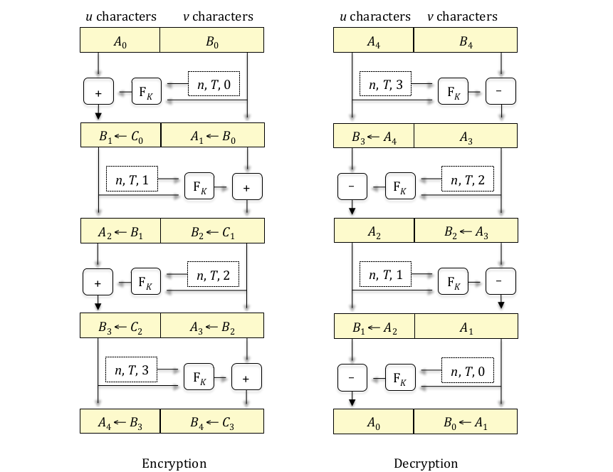
Feistel Structure :

Slide 7
Definitions :
1. Alphabet : - finite set of two or more symbols.
Ex. alphabet of lower-case English letters :
2. Base : - number of characters in a given alphabet.
- base is denoted by radix
Ex. alphabet of base ten numerals:
{0,1,2,3,4,5,6,7,8,9}
radix=10
3. Numeral :- For a given base, a nonnegative integer less than the base
Ex.alphabet of base ten numerals:
{0,1,2,3,4,5,6,7,8,9}
{a, b, c, d, e, f, g, h, i, j, k, l, m, n, o, p, q, r, s, t, u, v, w, x, y, z}

Slide 8
Definitions :
4. Numeral String:- For a given base, a finite, ordered sequence of numerals for the base.
Ex.alphabet of base ten numerals:
{0,1,2,3,4,5,6,7,8,9}
Numeral string : {0,1,2,…,radix-1}
5. Byte : - String of eight bits
6. Byte String : - Bit string whose length is a multiple of eight bits
- concatenation of a finite sequence of bytes
7. Tweak : - Input parameter to the encryption and decryption functions
- Not need to be kept secret
- Tweaks are Byte String (FF1 & FF3)

Slide 9
Parameters :
Parameters requirements for FF1 Algo :
1. radix : radix ∈ [2 .. 2^16 ]
2. minlen & maxlen: 2 <= minlen <= maxlen < (2^32)
3. Twaek : - Byte^≤maxlen where maxlen = 2^32 − 1
4. Keys : - {0,1}^128 : 128-bit AES keys
5. Addition : 1 : Blockwise Addition
6. method : 2 : alternating feistel
7. split (n) : floor_div : ⎣n/2⎦ n : No. Of characters in input string
8. rnds (n) : 10 : number of rounds
9. CIPH : AES-based round function

Slide 10
FF1 Encrypt Algorithm:
1. Prerequisites : - Designated cipher function, CIPH , of an approved 128-bit block cipher
- Key, K, for the block cipher
- Base, radix
- Range of supported message lengths, [minlen .. maxlen]
- Maximum byte length for tweaks, maxTlen
2. Input : - Numeral string, X, in base radix of length n, such that n ∈ [minlen .. maxlen]
- Tweak T, a byte string of byte length t, such that
t ∈ [0 .. maxTlen]
3. Output : - Numeral string, Y, such that LEN (Y) = n

Slide 11
FF1 Encrypt Algorithm:
Steps:
1. u = ⎣n/2⎦; v = n – u u : Half of total length of I/p
v : Remaining length of I/p
Floor function : - denoted by ⌊x⌋
- greatest integer that does not exceed x
Ex. ⌊2.1⌋ = 2;
⌊4⌋ = 4
2. A = X [1 .. u]; B = X [u + 1 .. n] A : Half numreals of I/p
B : Remaining numerals
Give substring of numerals from 1 to u
Ex. X=56789 - Numeral string
X[1..3]=567

Slide 12
FF1 Encrypt Algorithm:
3. b = ⎡ ⎡v ⋅ LOG (radix)⎤/8⎤ b : value needed in Step 6.i
ceiling function : - denoted by ⎡x⎤
- least integer that is not less than x
Ex. ⎡2.1⎤ = 3;
⎡4⎤ = 4
LOG(radix) : base 2 logarithm of x
Ex. LOG(10) = 3.32... radix=10
LOG(36)= 1.556.. radix=36
4. d = 4 ⎡b/4⎤ + 4 d : value needed in Step 6.iii
5. P = [1]¹ || [2]¹ || [1]¹ || [radix]³ || [10]¹ || [u mod 256]¹ || [n]⁴ || [t]⁴
- 16 bytes string
|| : Represent concatenation operation

Slide 13
FF1 Encrypt Algorithm:
5. P ← [vers]¹ || [method]¹ || [addition]¹ || [radix]³ || [rnds(n)]¹ || [split(n)]¹ || [n]⁴ || [t]⁴
6. For i from 0 to 9: - As total rounds=10
6.i. Q = T || [0]^{(−t−b−1) mod 16} || [i]¹ || [ NUM(radix)(B)]^{b}
[x]^{s} : representation of x as a string of s bytes
Ex. [1]⁴=[0,0,0,1]
NUM(radix) (X) : converts numerial string X represents in base radix
Algorithm : NUM(radix) (X):
-Prerequisite: - Base,radix.
-Input : - Numeral string, X
-Output : Number, x
Steps: 1. Let x = 0
2. For i from 1 to LEN (X), let x = x ⋅ radix + X [i]
3. Return x

Slide 14
FF1 Encrypt Algorithm:
6.ii : R = PRF (P || Q)
6.iii : Let S be the first d bytes of the following string of ⎡d/16⎤blocks:
R ||CIPH(k)(R⊕[1]¹⁶ )||CIPH(k)(R⊕[2]¹⁶ )...CIPH(k)(R⊕[⎡d/16⎤-1]¹⁶ )
CIPH(k) - Designated cipher function
- Ex. AES(k)
6.iv : y = NUM(S)
NUM(x) : integer that a bit string x represents
ex. NUM(10000000) = 128
6.v : If i is even, let m = u; else, let m = v
6.vi : c = (NUM(radix)(A)+y)mod radix^{m}
- used to keep length is same as A numeral substring

Slide 15
FF1 Encrypt Algorithm:
6.vii : C = STR^{m}_{(radix)}(c)
STR^{m}_{(radix)}(x): representation of x as a string of m numerals in base radix
ex. STR⁴₍₁₂₎(556) : 0 3 10 7
6.viii : A = B
6.ix : B = C
7. Return A || B

Slide 16
Test Vectors:
Test Vector 1:
PT is <0123456789>
Radix = 10
Input (length = 10): "0123456789"
No Tweak
Key is 2B 7E 15 16 28 AE D2 A6 AB F7 15 88 09 CF 4F 3C
Intermediate values:
X is 0 1 2 3 4 5 6 7 8 9 - numeral string
Tweak is <empty>
Step1 : u = ⎣n/2⎦; v = n – u
u is 5, v is 5
Step2: A = X [1 .. u]; B = X [u + 1 .. n]
A is 0 1 2 3 4 - A numeral string
B is 5 6 7 8 9 - B numeral string

Slide 17
Test Vectors:
Test Vector 1:
Intermediate values:
Step3: b = ⎡ ⎡v ⋅ LOG (radix)⎤/8⎤
LOG(10)=3.32=4 - ceil division
v.4=ceil_div(20/8)=ceil_div(2.5)=3
b is 3
Step4: d = 4 ⎡b/4⎤ + 4
d is 8
Step5: P = [1]¹ || [2]¹ || [1]¹ || [radix]³ || [10]¹ || [u mod 256]¹ || [n]⁴ || [t]⁴
[radix]³ = [10]³ =[0,0,10] -Represented in byte string upto 3 bytes
[n]⁴ =[10]⁴ =[0,0,0,10]
[t]⁴ = [0]⁴ =[0,0,0,0] - length of tweak ‘t’ is zero
P is [ 1, 2, 1, 0, 0, 10, 10, 5, 0, 0, 0, 10, 0, 0, 0, 0 ] - after concating all values
- it should be 16 bytes
Round #0:
Step6.i : Q = T || [0]^{(−t−b−1) mod 16} || [i]¹ || [ NUM_{(radix)}(B)]^{b}
T is empty - if present we need to convert each digit/char to its ascii

Slide 18
Test Vectors:
Test Vector 1:
Intermediate values:
Round #0:
Step6.i : Q = T || [0]^{(−t−b−1) mod 16} || [i]¹ || [ NUM_{(radix)}(B)]^{b}
T is empty - if present we need to convert each digit/char to its ascii
- 2nd block is to padd 0’s into Q : (-0-3-1)%16=12 : [0]¹²
- i represent round count
[ NUM_{(radix)}(B)]^{b}= [ NUM₍₁₀₎(B)]³ - convert numeral string to integer
NUM₍₁₀₎(5,6,7,8,9)=[56789]³ = [0,221,213] -conversion to byte string
Q is [ 0, 0, 0, 0, 0, 0, 0, 0, 0, 0, 0, 0, 0, 0, 221,213 ]
round
Step6.ii: R = PRF (P || Q)
R is [ 195, 184, 41, 161, 232, 100, 43, 120, 204, 41,148, 123, 59, 147, 219, 99 ]
Step6.iii: S is c3b829a1e8642b78 - first d bytes of 6.iii step

Slide 19
Test Vectors:
Test Vector 1:
Intermediate values:
Round #0:
Step6.iv: y = NUM (S)
y is 14103068008476060536
Step6.v: m is 5
Step6.vi : c = ( NUM_{(radix)}(A)+y) mod radix^{m}
c is 61770
Step6.vii: C = STR^{m} _{radix} (c)
C is 61770
Step6.viii: A is 5 6 7 8 9
Step6.ix: B is 6 1 7 7 0
This loop will continue till it completes 10 rounds after that A and B concatenate and returned.

