Slide 1

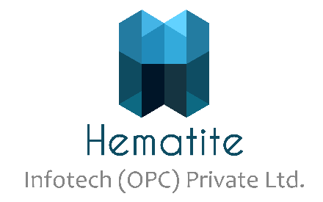
Kubernetes - Basics
CDAC
1

Slide 2
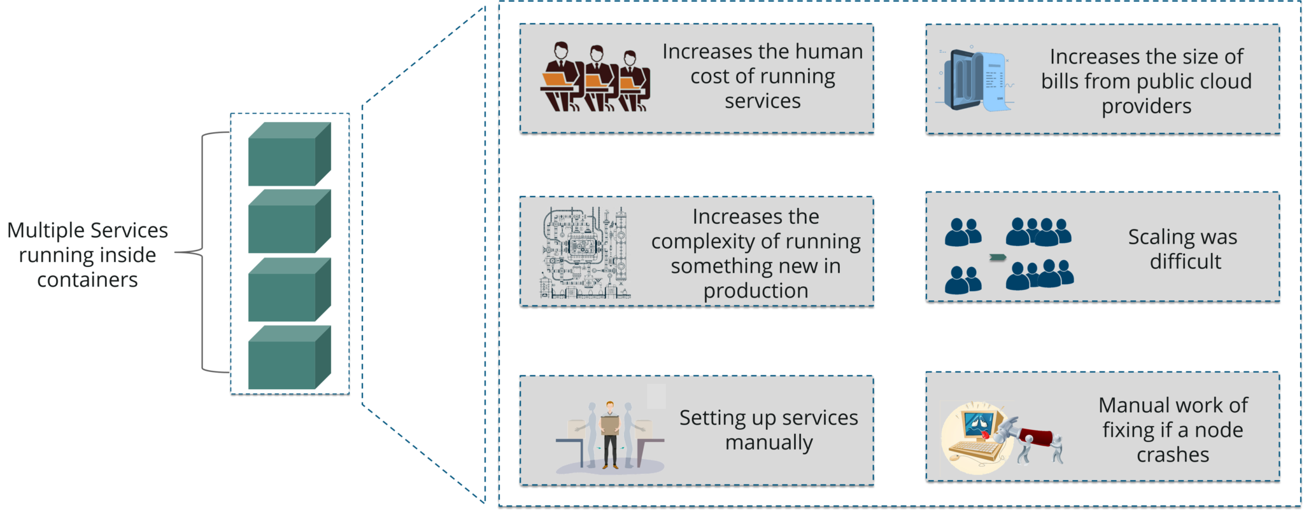
Kubernetes Tutorial: Challenges Without Container Orchestration

Slide 3
Kubernetes Tutorial: Challenges Without Container Orchestration
As you can see in the above diagram when multiple services run inside containers, you may want to scale these containers. In large scale industries, this is really tough to do. That’s because it would increase the cost to maintain services, and the complexity to run them side by side.
Now, to avoid setting up services manually & overcome the challenges, something big was needed. This is where Container Orchestration Engine comes into the picture.
This engine, lets us organize multiple containers, in such a way that all the underlying machines are launched, containers are healthy and distributed in a clustered environment. In today’s world, there are mainly two such engines: Kubernetes & Docker Swarm.

Slide 4
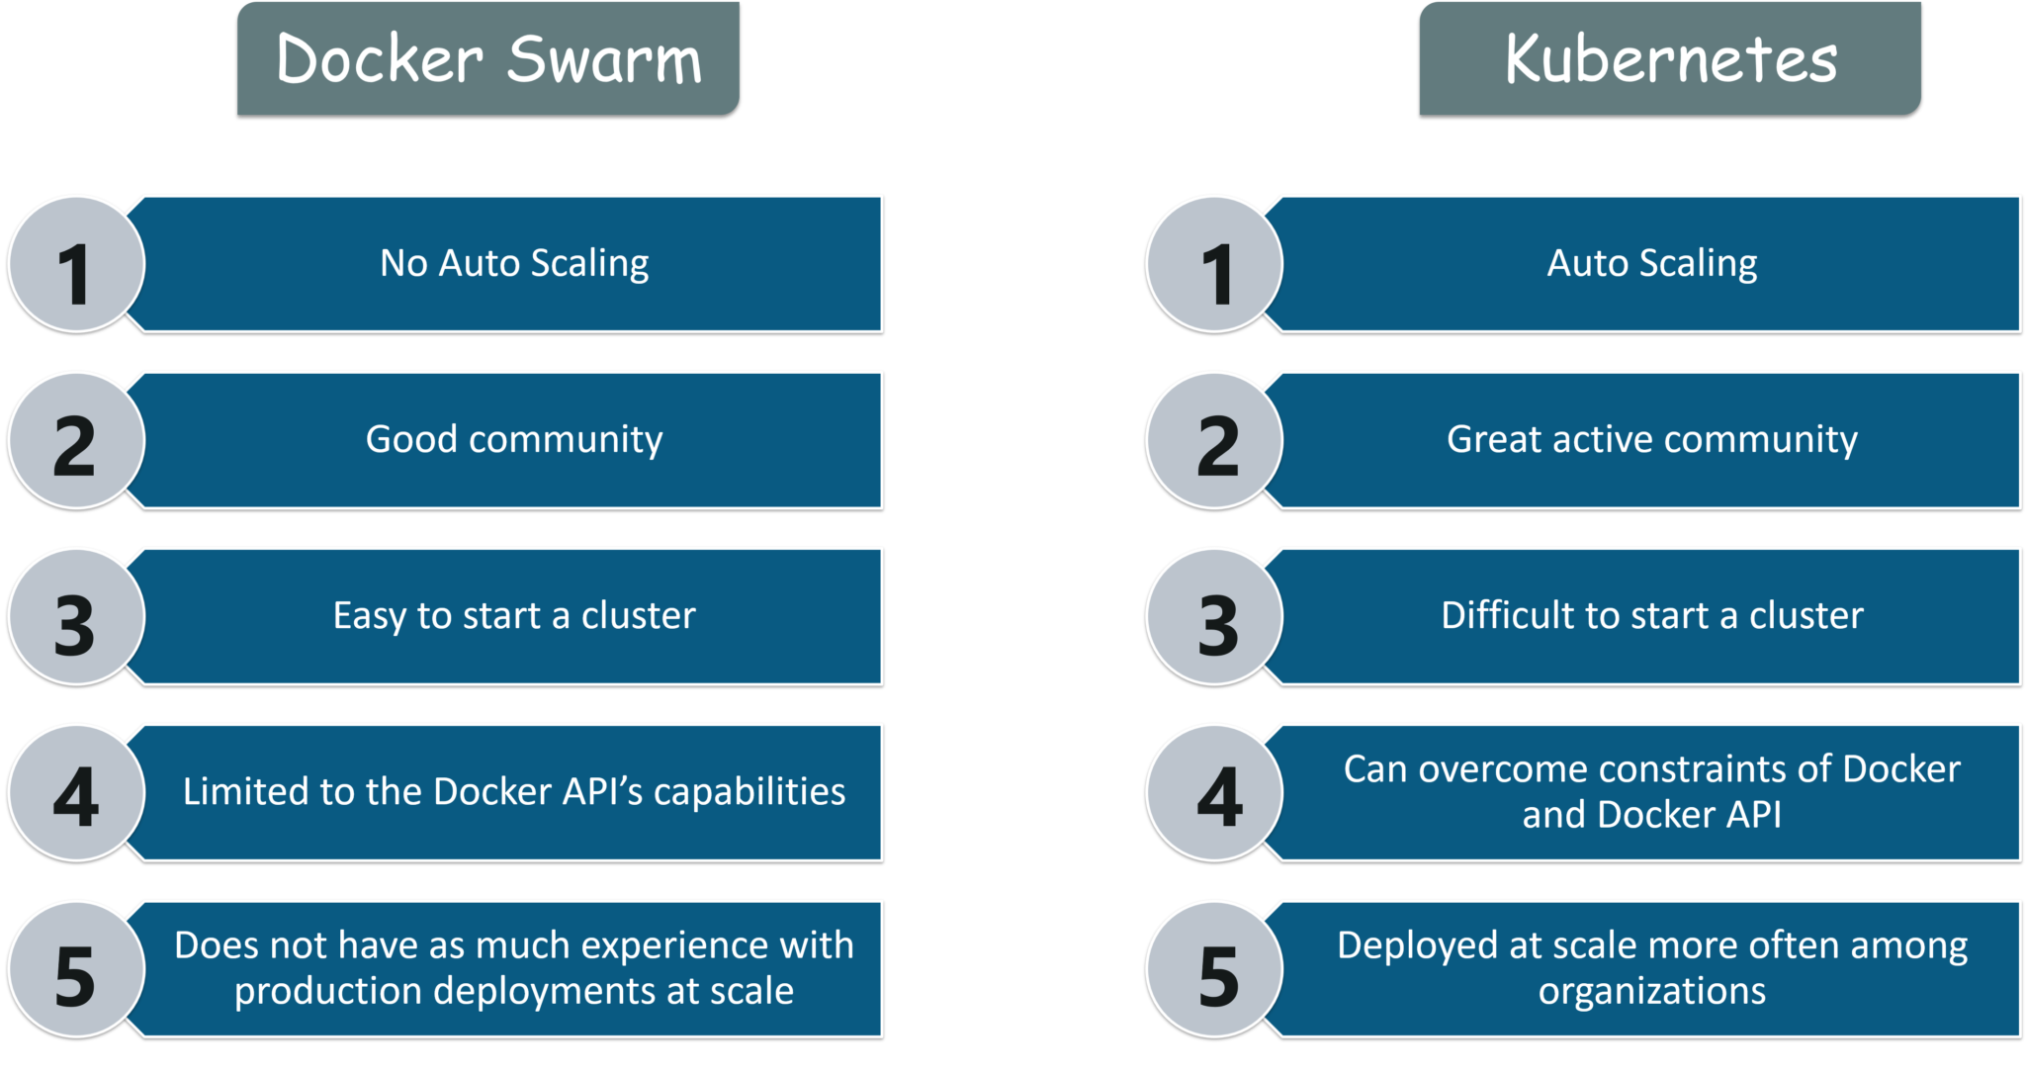
Kubernetes Tutorial: Kubernetes vs Docker Swarm
Kubernetes and Docker Swarm are leading container orchestration tools in today’s market. So before using them in prod, you should know what exactly they are and how they work.

Slide 5
Difference Kubernetes and Docker Swarm
Features | Kubernetes | Docker Swarm
Installation & Cluster Configuration | Installation is complicated; but once setup, the cluster is very strong | Installation is very simple; but cluster is not very strong
GUI | GUI is the Kubernetes Dashboard | There is no GUI
Scalability | Highly scalable & scales fast | Highly scalable & scales 5x faster than Kubernetes
Auto-Scaling | Kubernetes can do auto-scaling | Docker Swarm cannot do auto-scaling
Load Balancing | Manual intervention needed for load balancing traffic between different containers in different Pods | Docker Swarm does auto load balancing of traffic between containers in the cluster
Rolling Updates & Rollbacks | Can deploy Rolling updates & does automatic Rollbacks | Can deploy Rolling updates, but not automatic Rollbacks
Data Volumes | Can share storage volumes only with other containers in same Pod | Can share storage volumes with any other container
Logging & Monitoring | In-built tools for logging & monitoring | 3rd party tools like ELK should be used for logging &

Slide 6
What is Kubernetes
Kubernetes is an open-source system that handles the work of scheduling containers onto a compute cluster and manages the workloads to ensure they run as the user intends. Being the Google’s brainchild, it offers excellent community and works brilliantly with all the cloud providers to become a multi-container management solution.

Slide 7
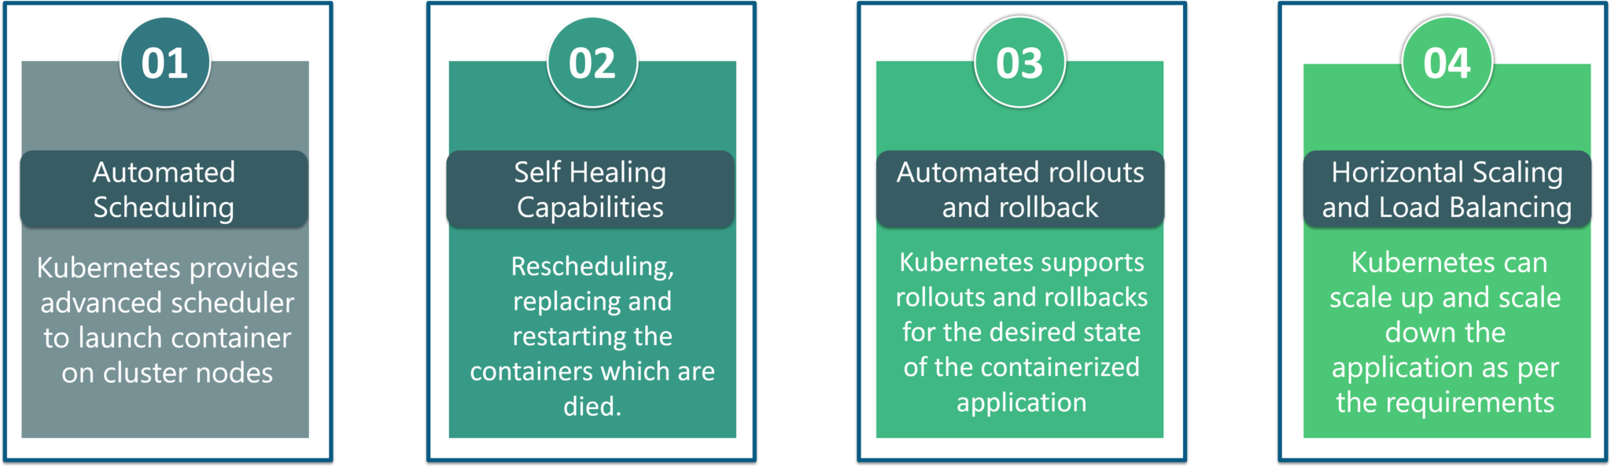
Kubernetes Features
Automated Scheduling: Kubernetes provides advanced scheduler to launch container on cluster nodes based on their resource requirements and other constraints, while not sacrificing availability.
Self Healing Capabilities: Kubernetes allows to replaces and reschedules containers when nodes die. It also kills containers that don’t respond to user-defined health check and doesn’t advertise them to clients until they are ready to serve.
Automated rollouts & rollback: Kubernetes rolls out changes to the application or its configuration while monitoring application health to ensure it doesn’t kill all your instances at the same time. If something goes wrong, with Kubernetes you can rollback the change.
Horizontal Scaling & Load Balancing: Kubernetes can scale up and scale down the application as per the requirements with a simple command, using a UI, or automatically based on CPU usage.

Slide 8
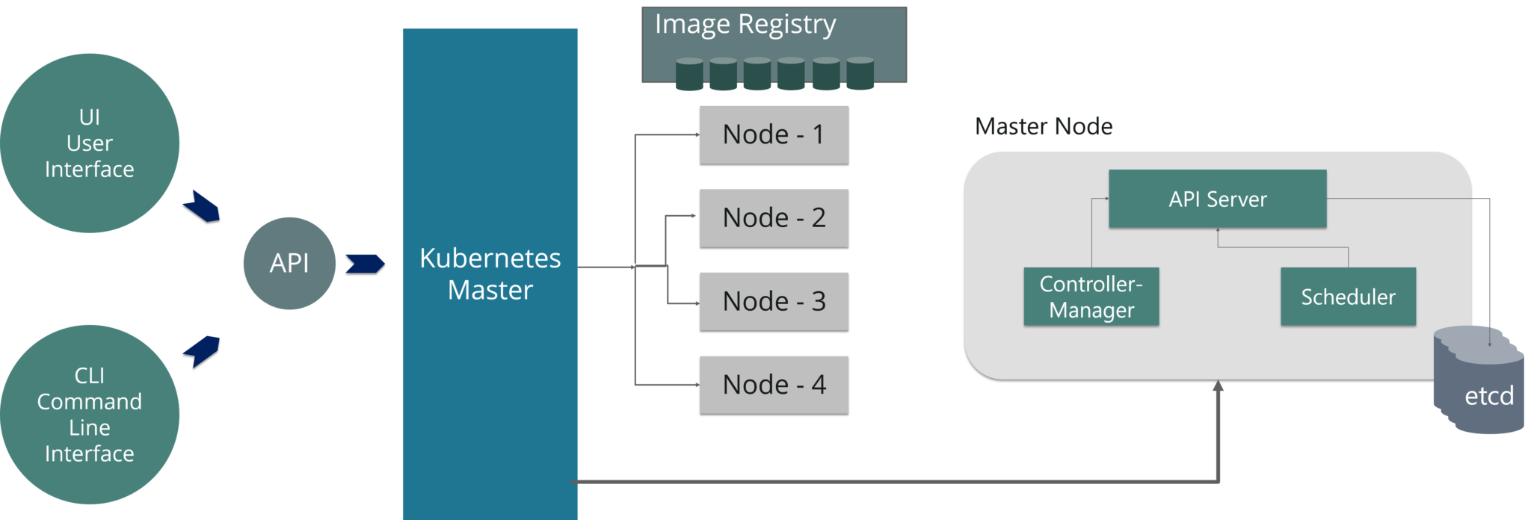
Kubernetes Architecture

Slide 9
Kubernetes Architechture
Kubernetes Architecture has the following main components:
Master nodes
Worker/Slave nodes
Master Node
The master node is responsible for the management of Kubernetes cluster. It is mainly the entry point for all administrative tasks. There can be more than one master node in the cluster to check for fault tolerance
As you can see in the diagram, the master node has various components like API Server, Controller Manager, Scheduler and ETCD.
API Server: The API server is the entry point for all the REST commands used to control the cluster.
Controller Manager: Is a daemon that regulates the Kubernetes cluster, and manages different non-terminating control loops.
Scheduler: The scheduler schedules the tasks to slave nodes. It stores the resource usage information for each slave node.
ETCD: ETCD is a simple, distributed, consistent key-value store. It’s mainly used for shared configuration and service discovery.

Slide 10
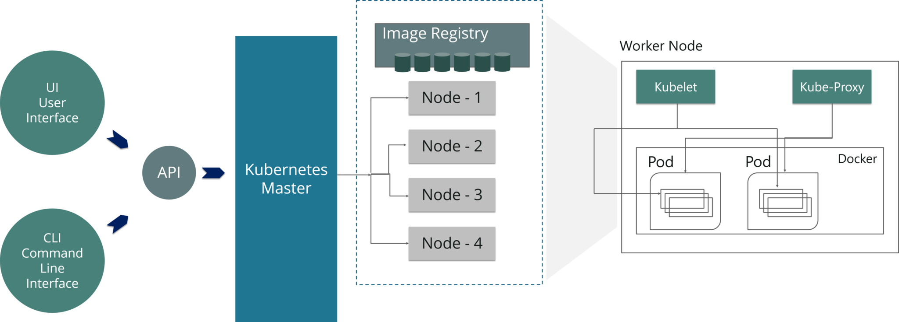
Kubernetes Architecture
Worker/Slave nodes
Worker nodes contain all the necessary services to manage the networking between the containers, communicate with the master node, and assign resources to the scheduled containers.
As you can see in the above diagram, the worker node has various components like Docker Container, Kubelet, Kube-proxy, and Pods.
Docker Container: Docker runs on each of the worker nodes, and runs the configured pods
Kubelet: Kubelet gets the configuration of a Pod from the API server and ensures that the described containers are up and running.
Kube-proxy: Kube-proxy acts as a network proxy and a load balancer for a service on a single worker node
Pods: A pod is one or more containers that logically run together on nodes.

Slide 11
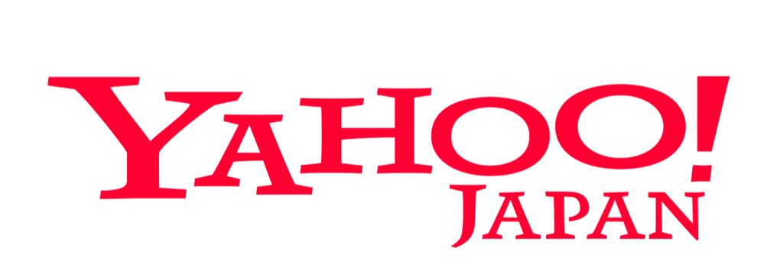
Kubernetes Case Study
Yahoo! JAPAN is a web services provider headquartered in Sunnyvale, California. As the company aimed to virtualize the hardware, company started using OpenStack in 2012. Their internal environment changed very quickly. However, due to the progress of cloud and container technology, the company wanted the capability to launch services on various platforms.
Problem: How to create images for all required platforms from one application code, and deploy those images onto each platform?
For your better understanding, refer to the below image. When the code is changed at the code registry, then bare metal images, Docker containers, and VM images are created by continuous integration tools, pushed into the image registry, and then deployed to each infrastructure platform.

Slide 12
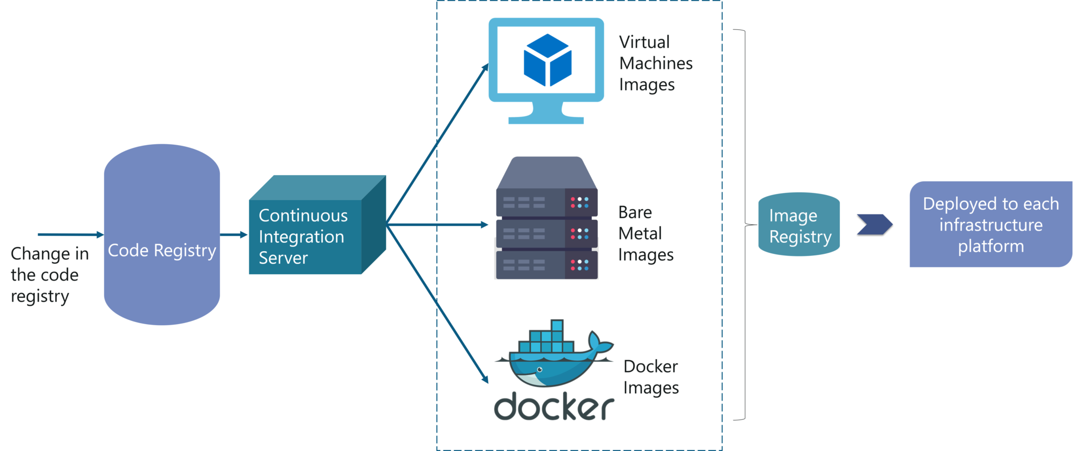
Kubernetes Case Study Contd…

Slide 13
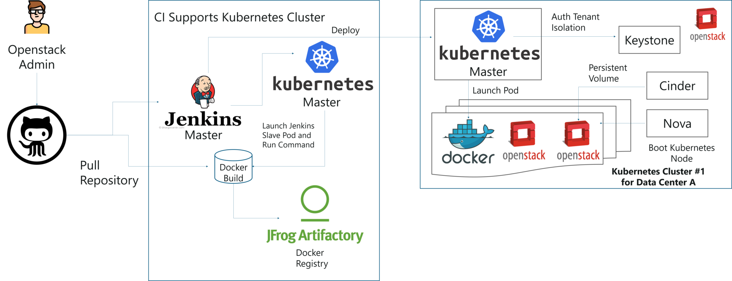
Kubernetes Case Study - Solution
When you have a number of clusters, then it becomes hard to manage them right?
So, they just wanted to create a simple, base OpenStack cluster to provide the basic functionality needed for Kubernetes and make the OpenStack environment easier to manage.
By the combination of Image creation workflow and Kubernetes, they built the below toolchain which makes it easy from code push to deployment.
This kind of toolchain made sure that all factors for production deployment such as multi-tenancy, authentication, storage, networking, service discovery were considered.
That’s how folks, Yahoo! JAPAN built an automation toolchain for “one-click” code deployment to Kubernetes running on OpenStack, with help from Google and Solinea.

Slide 14




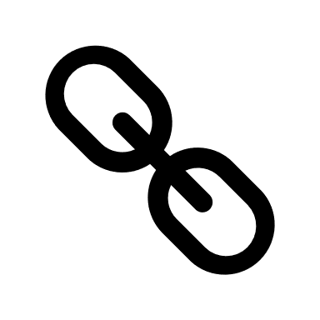
Thank You
Parag Joshi
+91 98233 17863
Parag.joshi@hematitecorp.com
www.hematitecorp.com
14

