Slide 1
RestAPI-2
Krishna Aryal

Slide 2
RestAPI-2
Select All
Search Based on ID
Create New
Update Based on ID
Delete Based on ID

Slide 3
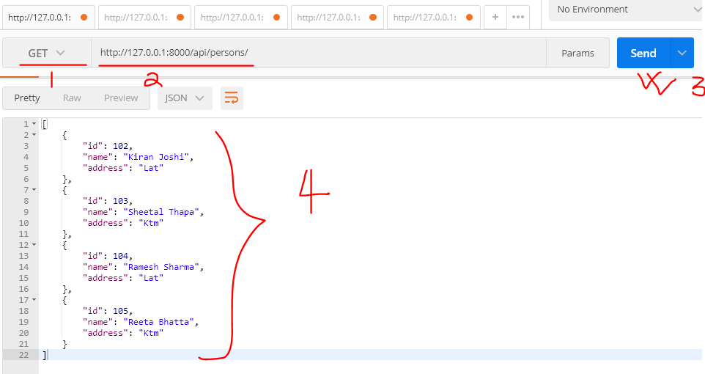
Select All

Slide 4
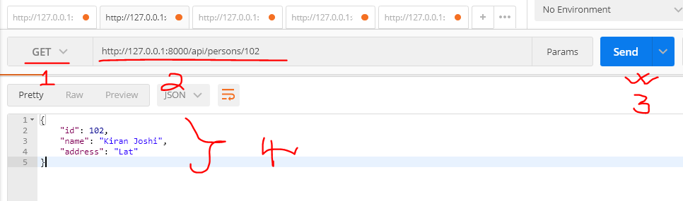
Search Based on ID

Slide 5
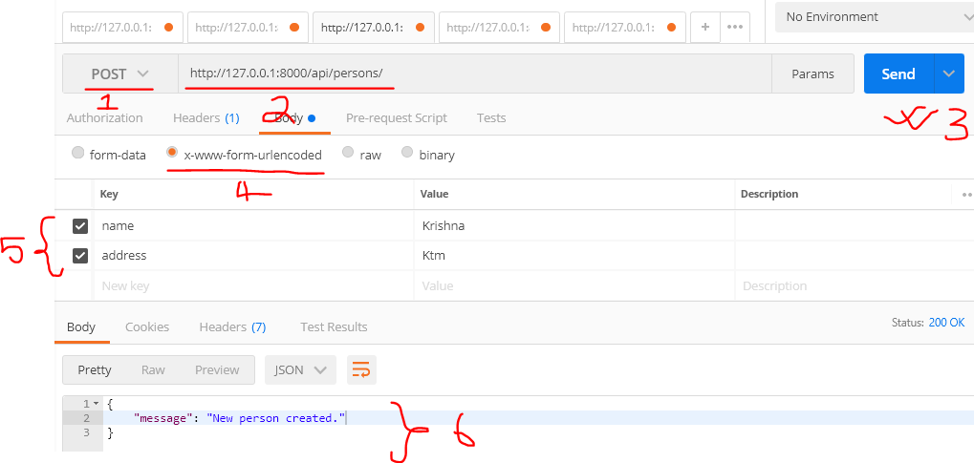
Create New

Slide 6
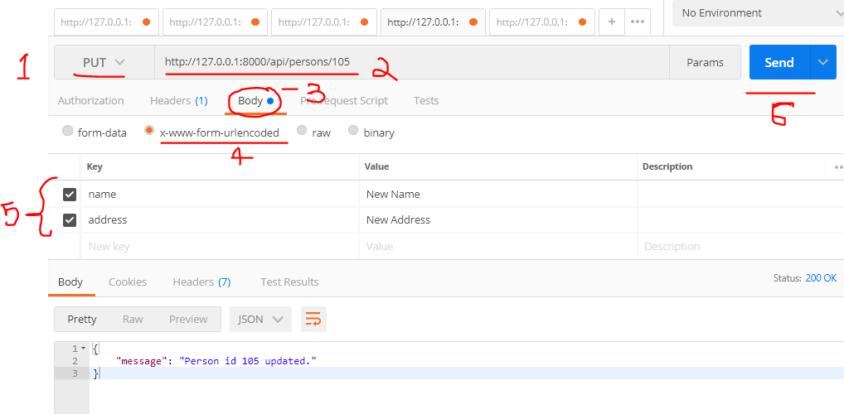
Update Based on ID

Slide 7
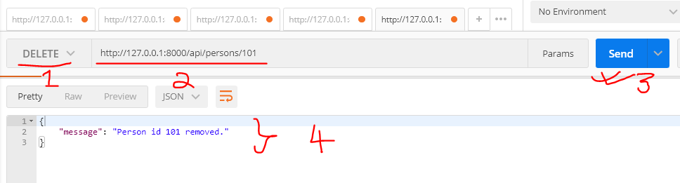
Delete Based on ID

