Slide 1
NodeJS-1
Krishna Aryal

Slide 2
Table of Contents
Introduction
Features
Advantages
Applications
Download and Installation
Hello world

Slide 3
Introduction
Open-source and cross-platform runtime environment for executing JavaScript code outside a browser.
Building back-end services like APIs like Web App or Mobile App.
Used in production by Paypal, Uber, Netflix, Walmart etc

Slide 4
Features
It’s easy to get started and can be used for prototyping and agile development
It provides fast and highly scalable services
It uses JavaScript everywhere, so it’s easy for a JavaScript programmer to build back-end services using Node.js
Source code cleaner and consistent.
Large ecosystem for open source library.
It has Asynchronous or Non-blocking nature.

Slide 5
Advantages
Easy Scalability
Real-time web apps
Fast Suite
Easy to learn and code
Advantage of Caching
Data Streaming
Hosting
Corporate Support

Slide 6
Applications
Real-Time Chats,
Complex Single-Page applications,
Real-time collaboration tools,
Streaming apps
JSON APIs based application

Slide 7
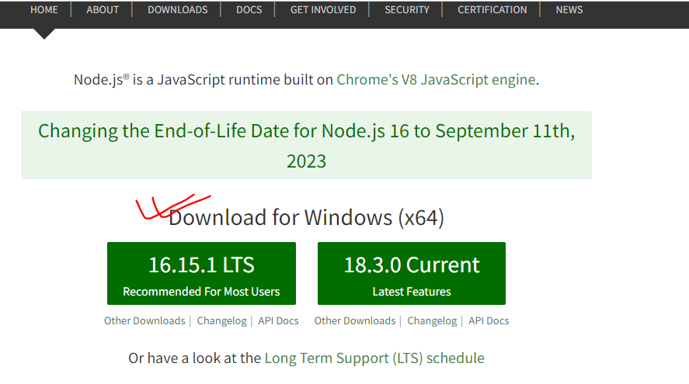
Download and Installation
https://nodejs.org/en/

Slide 8
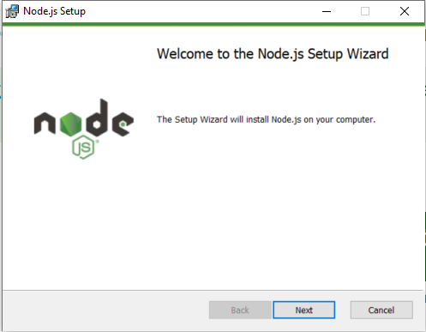
Installation

Slide 9
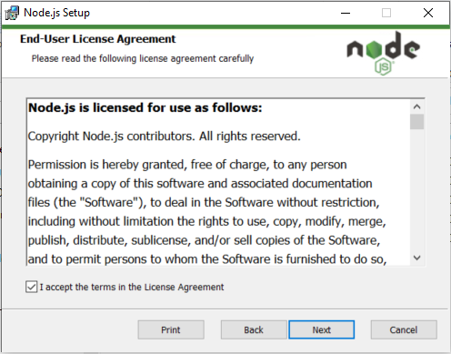
Installation

Slide 10
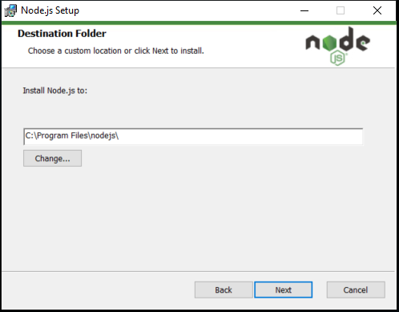
Installation

Slide 11
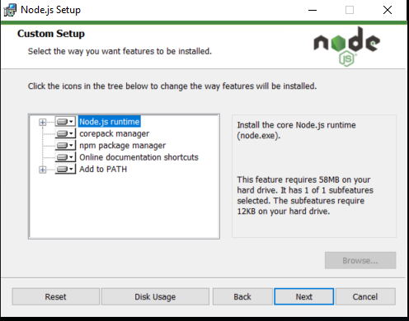
Installation

Slide 12
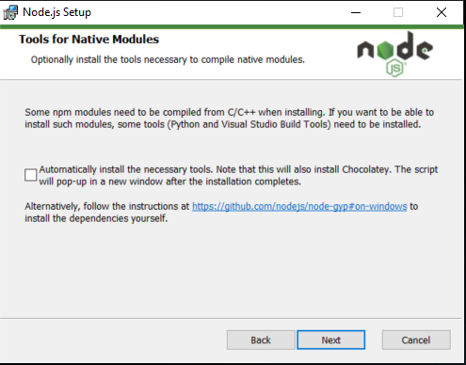
Installation

Slide 13
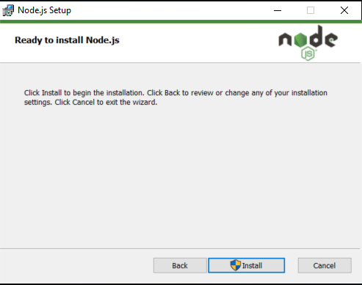
Installation

Slide 14
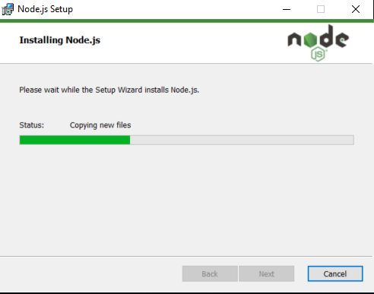
Installation

Slide 15
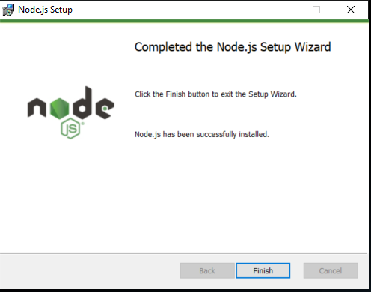
Installation

Slide 16
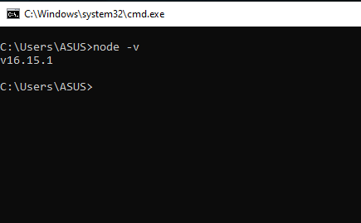
Installation

Slide 17
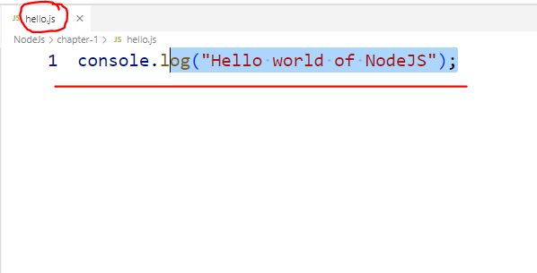

Hello World

