Slide 1
NodeJS
Krishna Aryal

Slide 2
Table of Contents
Asynchronous & Synchronous
Call-Stack

Slide 3
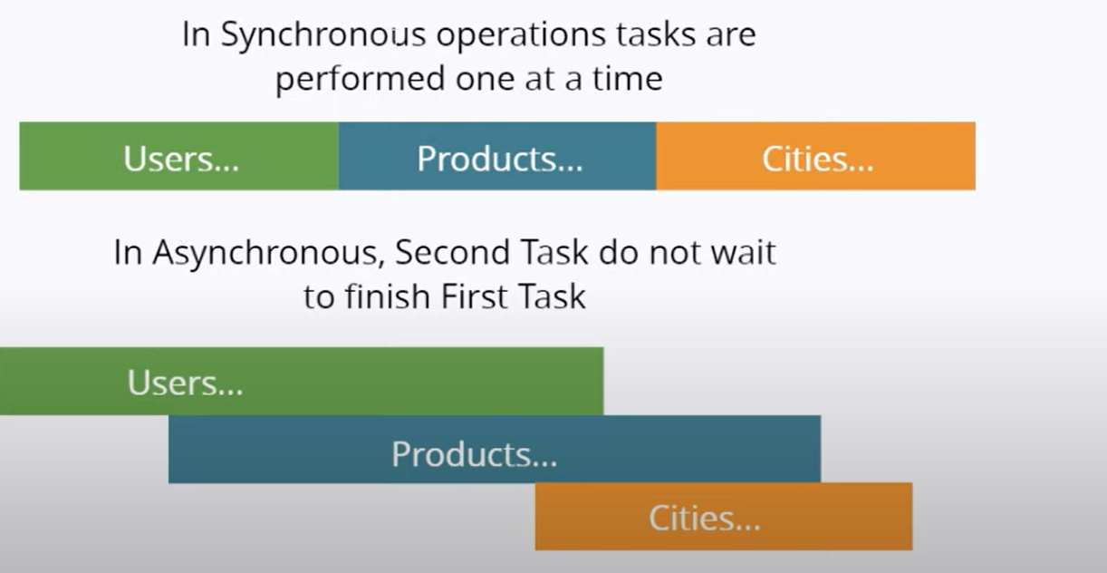
Asynchronous & Synchronous
PHP
JavaScript, NodeJS

Slide 4
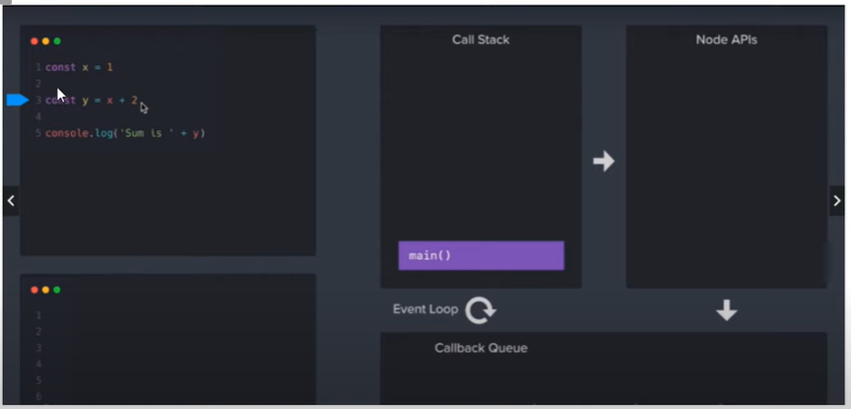
Call Stack, NodeAPI, CallBack Queue

Slide 5
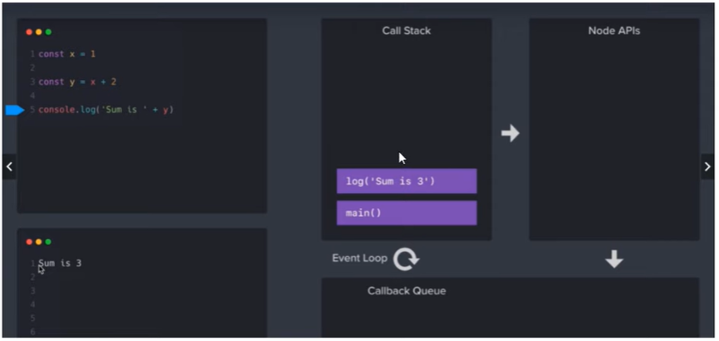
Call Stack, NodeAPI, CallBack Queue

Slide 6
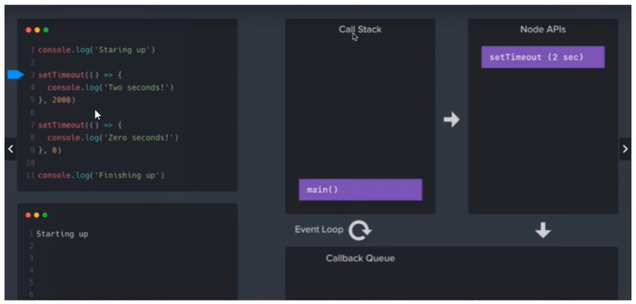
Call Stack, NodeAPI, CallBack Queue

Slide 7
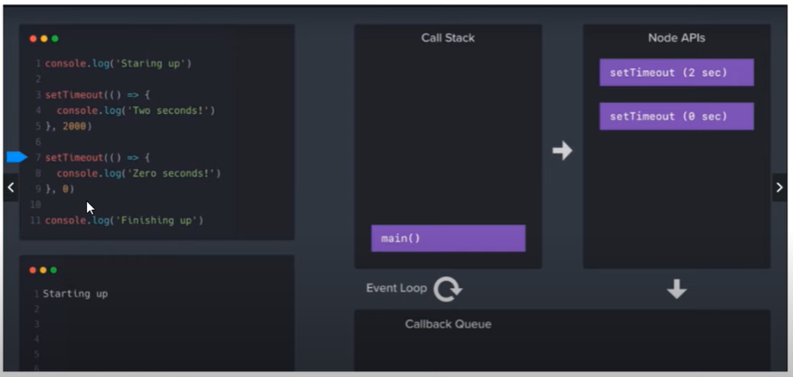
Call Stack, NodeAPI, CallBack Queue

