Slide 1
ExpressJS
Krishna Aryal

Slide 2
Table of Contents
Introduction, Installation & Configuration
Hello world
Create an application
Routing
Controller
Bable

Slide 3
1. Introduction, Installation and Configuration
Open source web application framework developed by Node.js foundation
Create static, dynamic, and hybrid web and mobile applications framework
Popular (fast, easy, robust)
Routing
Middleware
REST API

Slide 4
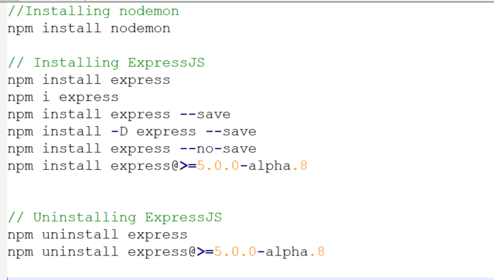
1. Introduction, Installation and Configuration

Slide 5
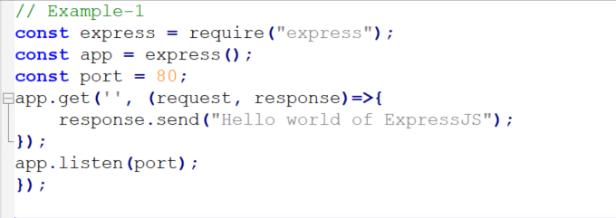
2. Hello World

Slide 6
2. Hello World
express()
The express() function is a top-level function exported by the express module.
const app = express()
The app returned by express() is in fact a JavaScript function, designed to be passed to Node’s HTTP servers as a callback to handle requests.
This makes it easy to provide both HTTP and HTTPS versions of your app with the same code base, as the app does not inherit from these.

Slide 7
2. Hello World
app.listen()
It binds and listens for connections on the specified host and port. If port is omitted or is 0, the operating system will assign an arbitrary unused port, which is useful for cases like automated tasks.
const app = express()
The app returned by express() is in fact a JavaScript function, designed to be passed to Node’s HTTP servers as a callback to handle requests.
This makes it easy to provide both HTTP and HTTPS versions of your app with the same code base, as the app does not inherit from these.

Slide 8
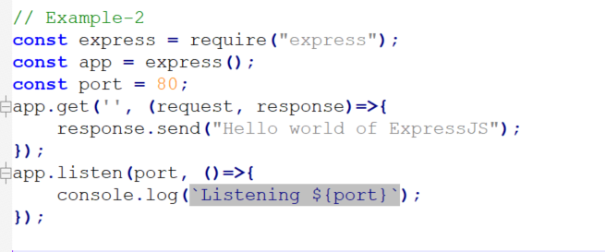
2. Hello World

Slide 9
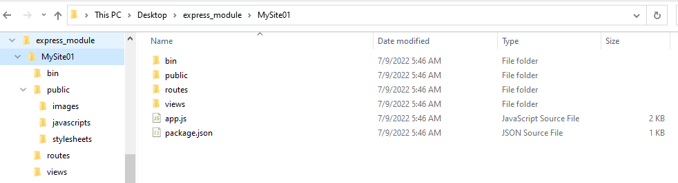
3. Create an Application
Use the application generator tool, express-generator, to quickly create an application skeleton.

Slide 10
4. ROUTE
Introduction
Syntax
Methods
Route parameter

Slide 11
Introduction
Routing refers to determining how an application responds to a client request to a particular endpoint, which is a URI (path) and a specific HTTP request method (GET, POST and others)
Each route can have one or mode callback functions, which are executed when the route is matched.
Syntax
app.method(path, callback)
app.method(path, [Callback-1, Callback-2, …., Callback-N])
app.method(path, [Callback-1, Callback-2, …., Callback-N], callback)

Slide 12
Introduction
app is an instance of express
method is an HTTP request method must be in lowercase
path is a path on the server (url-pattern)
callback is the function executed when the route is matched.

Slide 13
Routing methods
methods
GET – Retrieve Data
POST - Create/Insert
PUT - Full Record Update
PATCH - Partial Record Update
DELETE - Delete Data
ALL – Any HTTP Request Method

Slide 14
Routing methods
path
app.all(path, [Callback1, Callback2, …., CallbackN], callback)
This method is like the standard app.method() methods, except it matches all HTTP verbs.
This method is useful for mapping “global” logic for specific path prefixes or arbitrary matches.

Slide 15
Route parameter
Route parameters are named URL segments that are used to capture the values specified at their position in the URL.
The captured values are populated in the req.params object, with the name of the route parameter specified in the path as their respective keys.
The name of route parameters must be made up of “A-Za-z0-9”
Examples
/student/:id
/student/:id/:name
/student/:is/and/:name

Slide 16
Controller
Controllers can group related request handling logic separately. Instead of defining all of your request handling logic as callback in route or route fines, you may wish to organize this behavior using controller modules.

Slide 17
References
https://www.youtube.com/watch?v=5RrhT280GXg&list=PLbGui_ZYuhigerSlDF_v1t1mM2iGomXnq&index=5

