Slide 1
MangoDB
Krishna Aryal

Slide 2
Table of Contents
Introduction
Download
Installation & Configuration

Slide 3
Introduction
MangoDB is a document database designed for ease of development and scaling. It is one of the most powerful NoSQL system and database system. Being a NoSQL means that it does not use the usual rows and columns. This database uses a document storage format called BSON which is binary style JSON documents.
Example (BSON Format)
{
_id:ObjectId(“9bac56jdes”),
name: “Raj”,
address: “Ktm”,
}

Slide 4
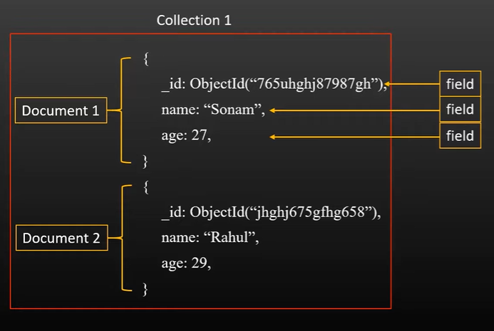
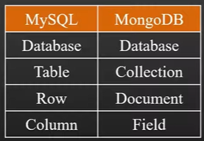
Introduction

Slide 5
Introduction

Slide 6
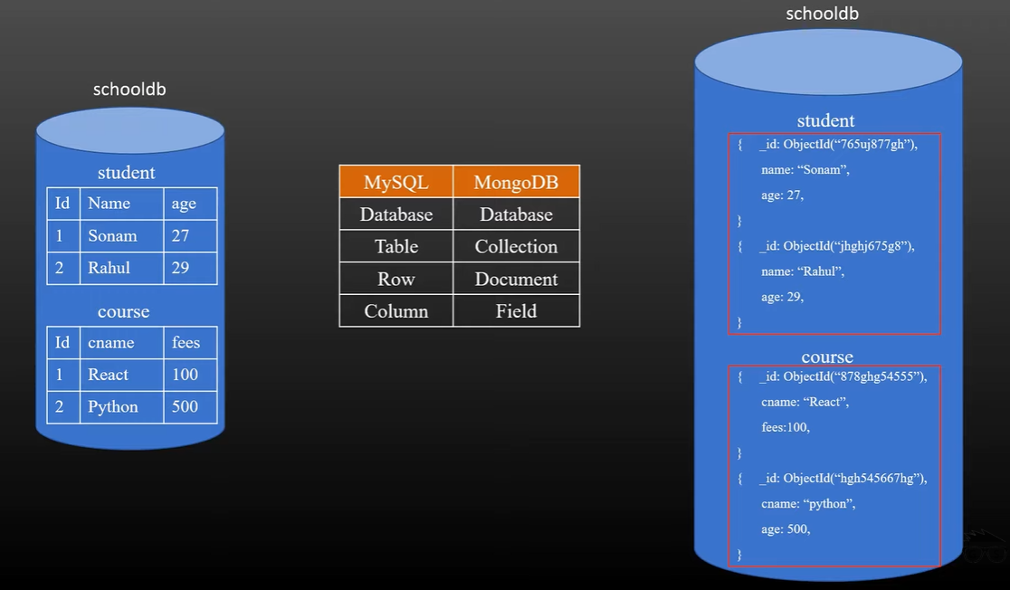
Introduction

Slide 7
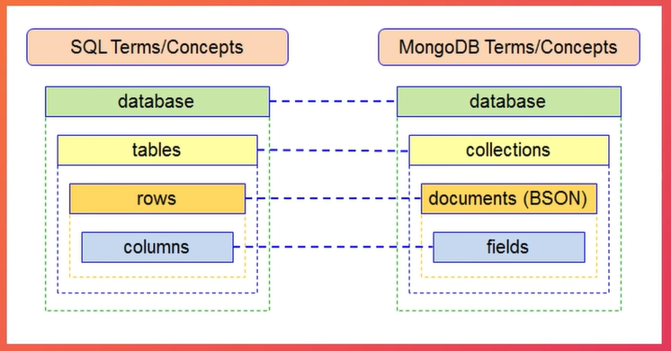
Basic Terms

Slide 8
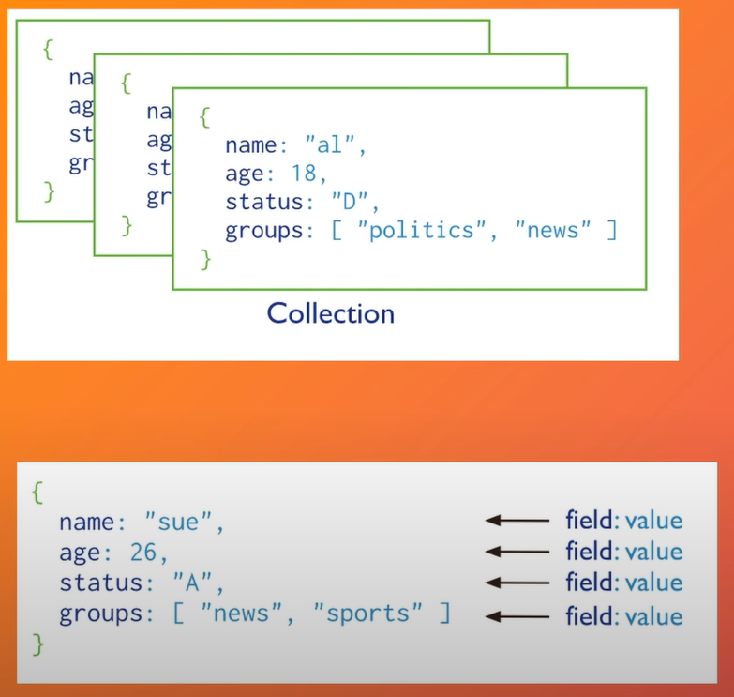
Basic Terms

Slide 9
Basic Terms

Slide 10
Basic Terms
Database
Database hold one or more collections.
Collection
Collection stores documents in a collections. Collections are analogous to tables in relational databases.
Document
A document is a set of key-value pairs. The documents in a single collection do not need to have the same set of fields and the data type for a field can differ across documents within a collection.

Slide 11
Basic Terms
Database
Database hold one or more collections.
Collection
Collection stores documents in a collections. Collections are analogous to tables in relational databases.
Document
A document is a set of key-value pairs. The documents in a single collection do not need to have the same set of fields and the data type for a field can differ across documents within a collection.

Slide 12
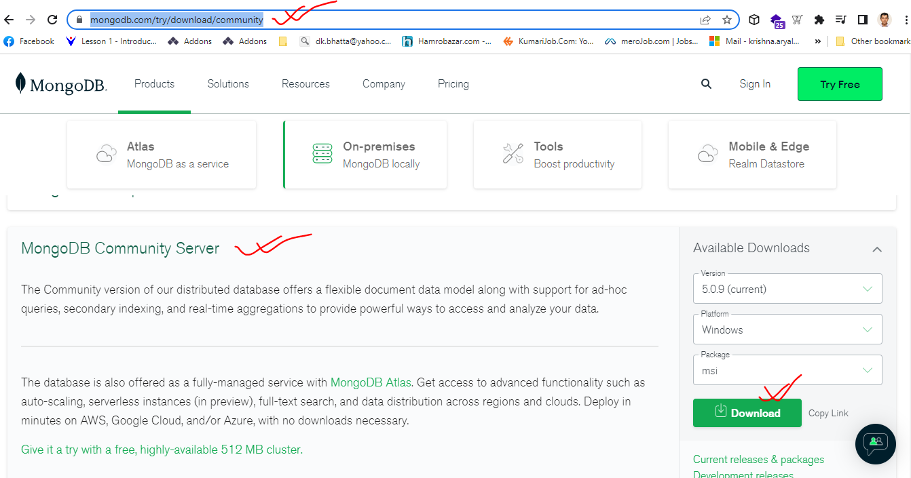
Download MangoDB
https://www.mongodb.com/try/download/community

Slide 13
Download MangoDB
https://www.mongodb.com/try/download/community

Slide 14
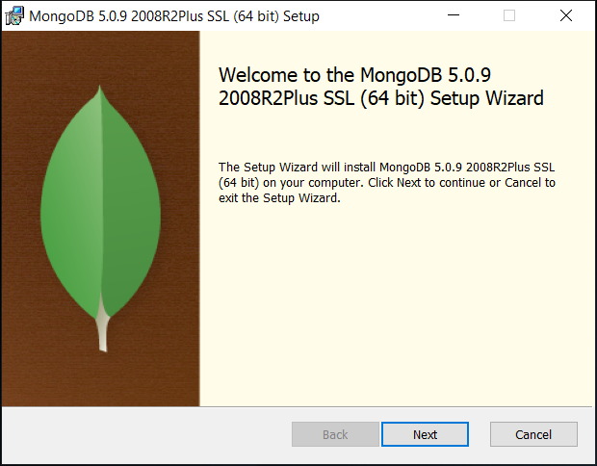
Installing MangoDB

Slide 15
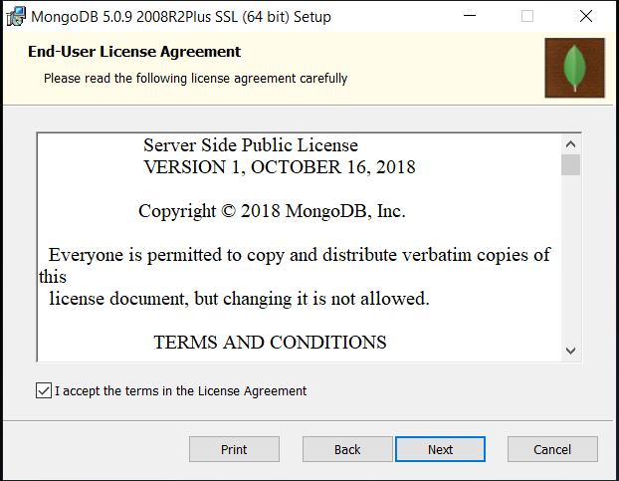
Installing MangoDB

Slide 16
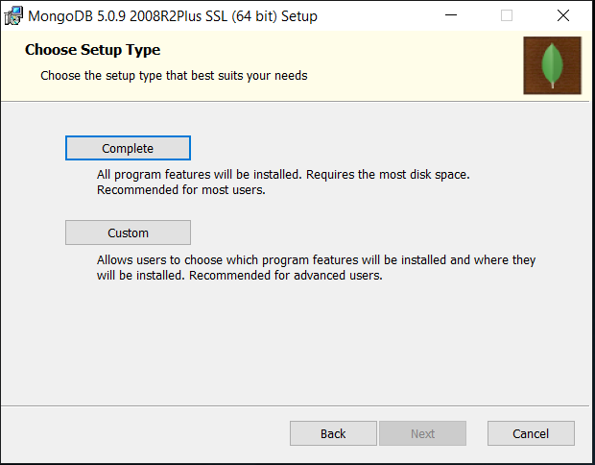
Installing MangoDB

Slide 17
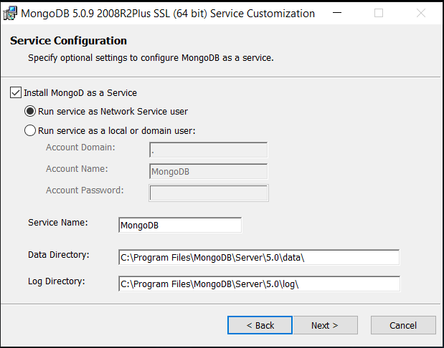
Installing MangoDB

Slide 18
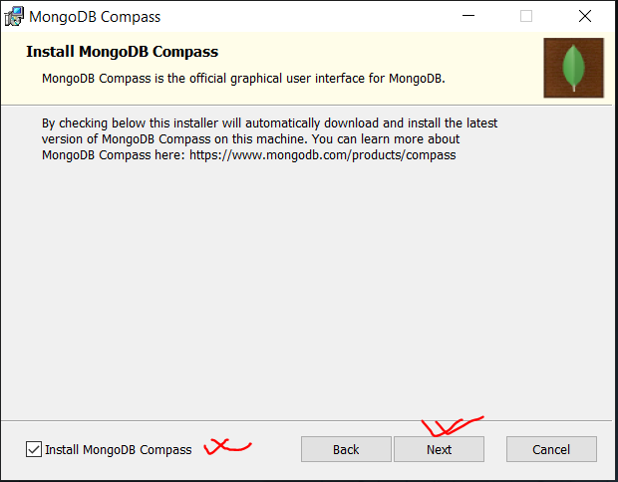
Installing MangoDB

Slide 19
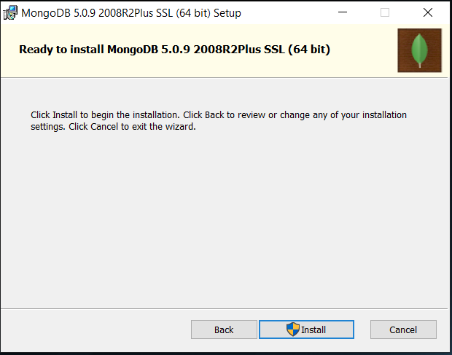
Installing MangoDB

Slide 20
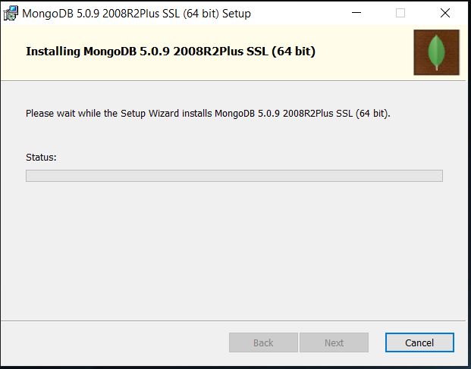
Installing MangoDB

Slide 21
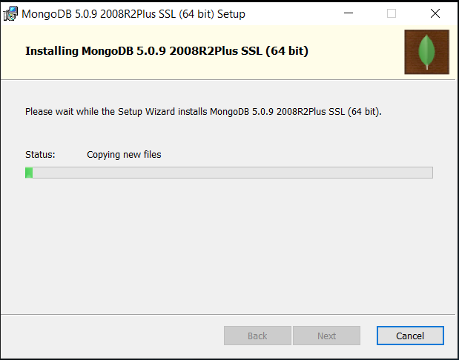
Installing MangoDB

Slide 22
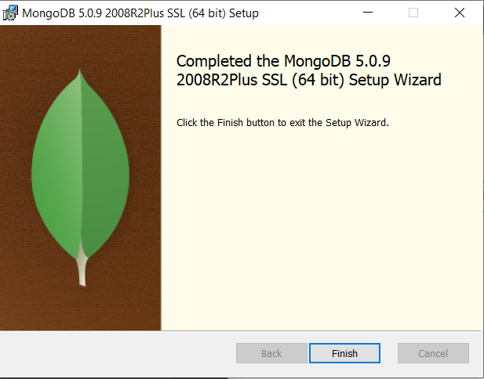
Installing MangoDB

Slide 23
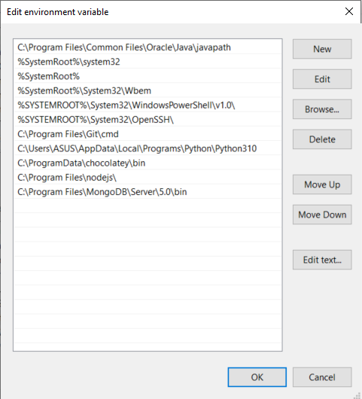
Setting Path

Slide 24
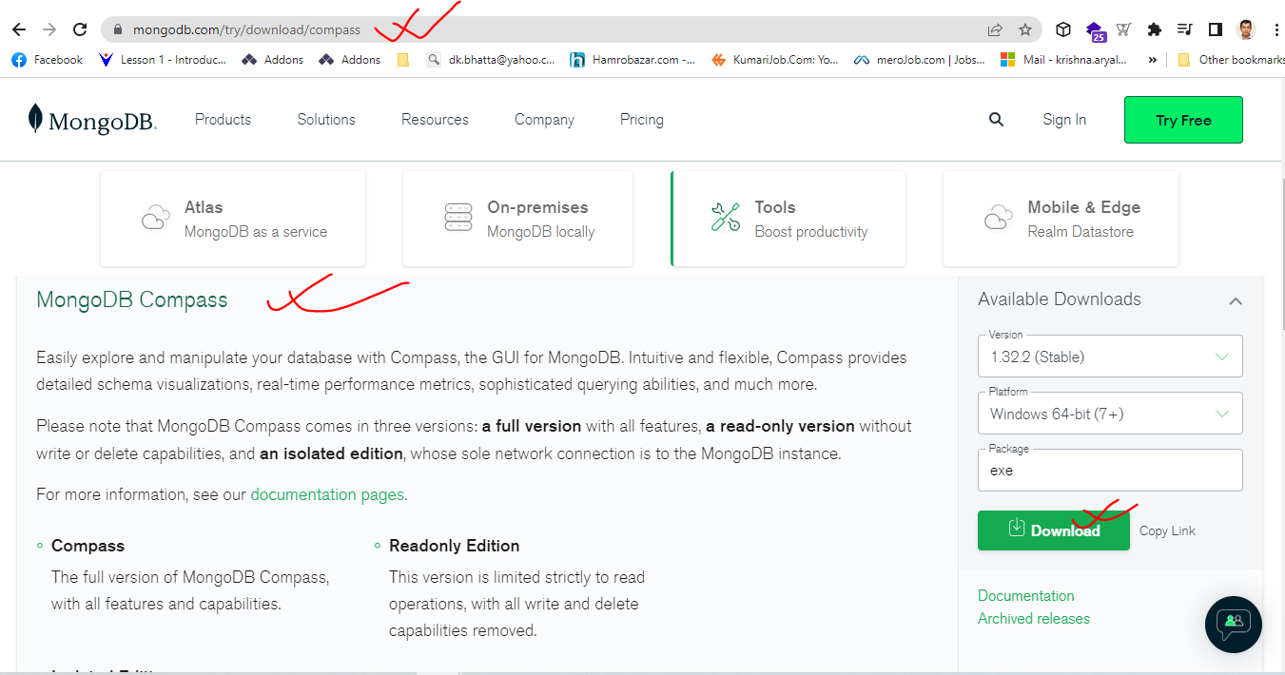
Download Compass – MangoDB GUI
https://www.mongodb.com/try/download/compass

Slide 25
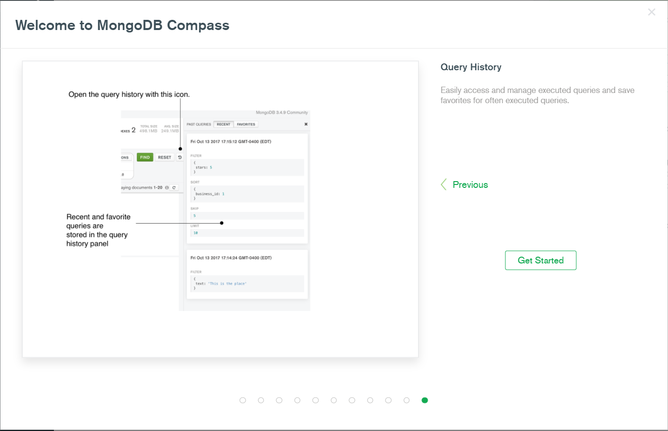
Installing Compass – MangoDB GUI

Slide 26
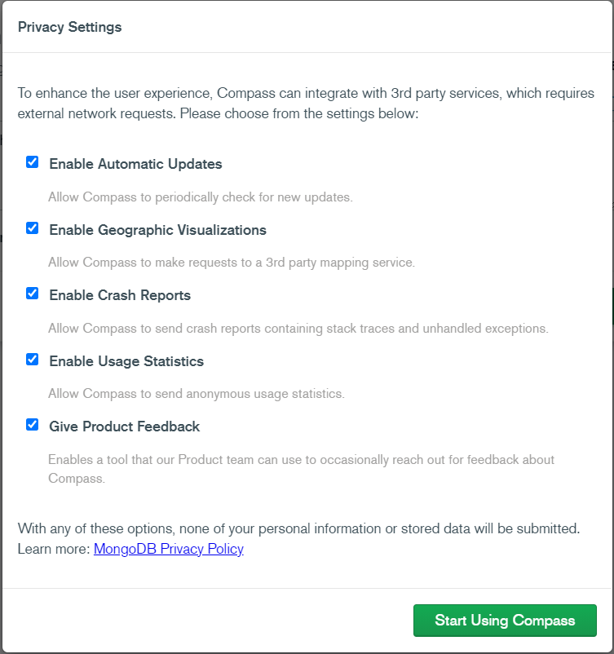
Installing Compass – MangoDB GUI

Slide 27
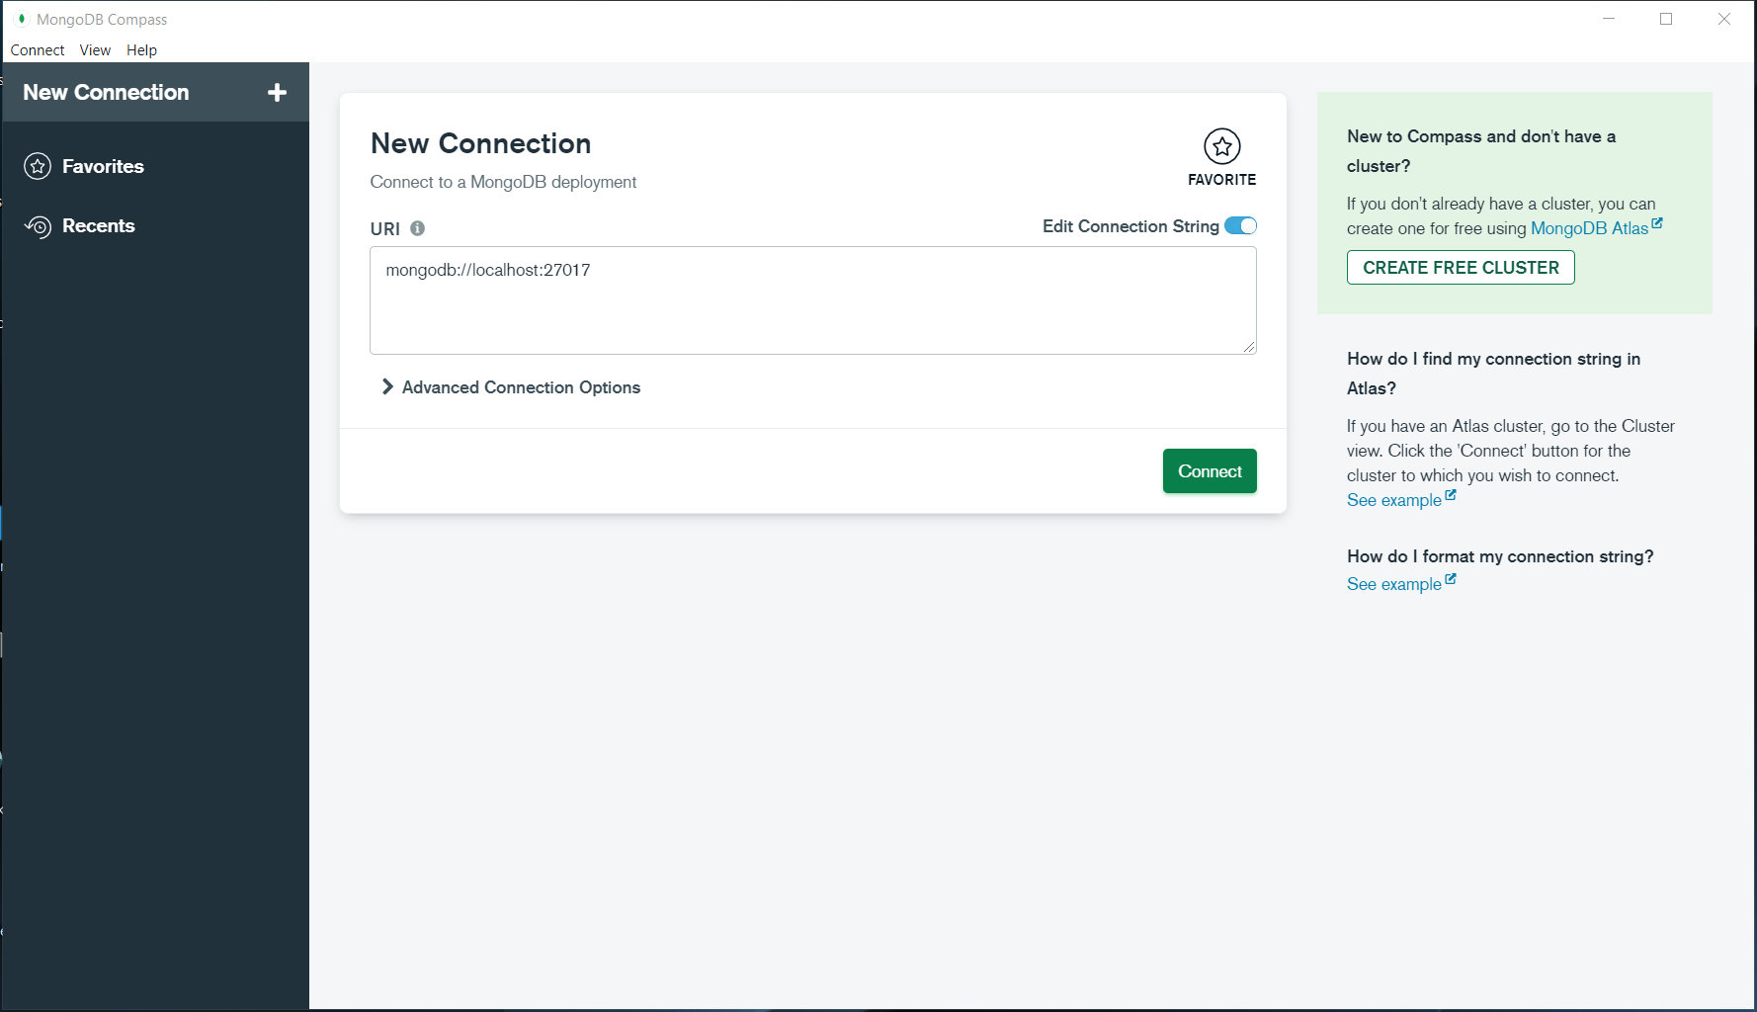
Installing Compass – MangoDB GUI

Slide 28
Introduction
mongo
mongo is the command-line shell that connects to a specific instance of mongod. When you run mongo with no parameters its default to connecting to the localhost on port 27017.
mongod
Mongod is the primary demon process for the MongoDB system. It handles data request, manages data access, and performs background management operations.
mongos
For a shared cluster, the mongos instances provide the interface between the client applications and the sharded cluster. The mongos instances route queries and write operations to the shards. From the perspective of the application, a mongos instance behaves identically to any other MongoDB instance.
mongosh
The MongoDB shell, mongosh, is a fully functional JavaScript and Node.Js 14.x REPL environment for interacting with MongoDB deployments. We can use the MongoDB Shell to test queries and operations directly with your database.

Slide 29
Introduction
mongo
mongo is the command-line shell that connects to a specific instance of mongod. When you run mongo with no parameters its default to connecting to the localhost on port 27017.
Document-oriented NoSQL database used for high volume data storage.
Support NoSQL
mangod is the Mango Daemon is basically the host process for the database
mango is the command-line shell that connects to a specific instance of mangod

Slide 30
Mongoose
Mongoose provides a straight-forward, schema-based solution to model our application data. It includes built-in type casting, validation, query building, business logic hooks and more, our of the box.
System Requirements
Node
MangoDB
Install Mongoose
npm install mongoose

Slide 31
Connect MongoDB using Mongoose
connect()
Mongoose requires a connection to a MongoDB database. You can connect to a locally hosted database with mongoose.connect()
Syntax
connect(uri, options, callback)
Example-1
mongoose.connect(“mongodb://localhost:27017/mydb”)

Slide 32
Connect MongoDB using Mongoose
Example-2
const options = {
useNewUrlParser: true,
useUnifiedTopology: true
}
Note:
user - String
pass - String
dbName - String
authSource - String
autoIndex - boolean
mongoose.connect(“mongodb://localhost:27017/mydb”, options)

Slide 33
Connect MongoDB using Mongoose
Example-2
const options = {
useNewUrlParser: true,
useUnifiedTopology: true,
user:’admin’,
pass:’admin’,
dbName:’mydb’,
authSource:’mydb’
}
mongoose.connect(“mongodb://localhost:27017/mydb”, options)

