Slide 1
Quick RL Concept
By Suraj Singh

Slide 2

Introduction
Rl Stands for reinforcement Learning.
Area Of Machine Learning.
Learn To Take Decisions.
To Maximize Rewards.
Markov Decision Process.

Slide 3
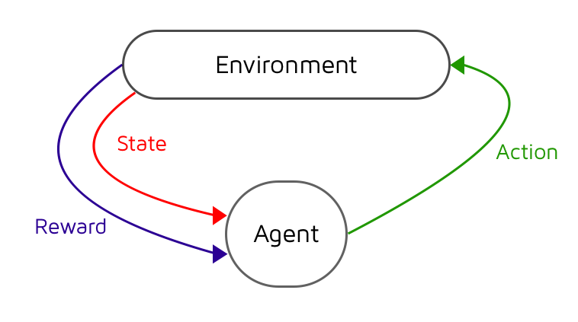
Markov Decision Process
Interact with Environment
Observe Situations
Take Decisions
Apply And Take Feedback
Calculated Reward,
Repeat

Slide 4
Q Learning Agent
Used in machine learning
Learn policy, to take actions
Stochastic Transitions and reward
No adaptations
Markov decision process
Optimal action selection

Slide 5
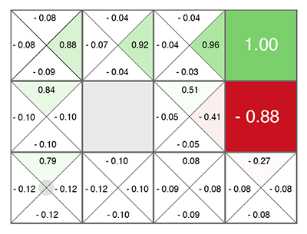
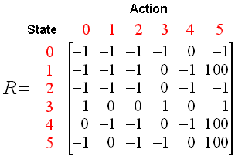
Q Learning Table
Explore
Exploit
Discount factor
Initial condition

Slide 6
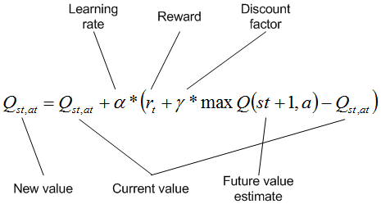
Algorithm

Slide 7
How its Works?
Exploration
Not Stable
Can find shortcuts
Reward doesn’t matter
Partly random
Eplision/Random/stoches
Exploit
Can takes lots of power/time
can’t find shortcuts
Reward does matter
Partly state action quality
Alpha/Gamma/reward

Slide 8
Practical Example
Dog standing in a starting point.
Dog need to find treat on its own.
If he hits wall, reward in negative.
If he find treat treat positive.
Long time, negative reward
Neutral positive reward for every step.
Step in previously walked path, negative reward
Alpha = 0.5 , Gamma = 0.9 , elipson = 0.9 , Episode = 101
Ivalue= [0, 0, 0, 0]

Slide 9
Finish
Yup! That’s It !!! Over!!!
Have A Nice Day!

