Slide 1
Scripps Research · CBB Hackathon 2026 · May 29 – June 1
In Silico Screening of Siglec-6 Ligands Using Multi-Method Cofolding & Docking
Boltz-2 · AlphaFold3 · AutoDock Vina · Experimental Kd Validation
Suraj Ugrani
Julien Heberling

Slide 2
Computational Pipeline Overview
Siglec-6 Protein (FASTA)
333 residues · Vtype + C2type1 + C2type2
14-Compound Library
13 analogs + sialic acid control
Pre-computed MSA
(ColabFold · .a3m format)
COFOLDING (protein + ligand structure prediction)
Boltz-2
Open-source · AWS EC2 g5.xlarge
Docker · GPU · ColabFold MSA input
AlphaFold3 (AF3-MSA)
Garibaldi HPC · built-in MSA search
Automated MSA pipeline
AlphaFold3 (ColabFold-MSA)
Garibaldi HPC · pre-computed MSA
Same MSA as Boltz-2 input
42 Predicted Structures (14 ligands × 3 methods)
ANALYSIS
Confidence Scoring
iPTM · pLDDT · Boltz-2 affinity
AF3 ranking score · PAE
AutoDock Vina
Local-only (minimized pose)
Redocking (SMILES conformer)
Experimental Validation
Spearman / Pearson correlation
vs Kd (n = 13 compounds, SPR)
★ Contact Analysis (gemmi distance search) → hot-spot residues contacted by multiple ligands
Boltz-2
AF3 + AF3-MSA
AF3 + ColabFold-MSA

Slide 3
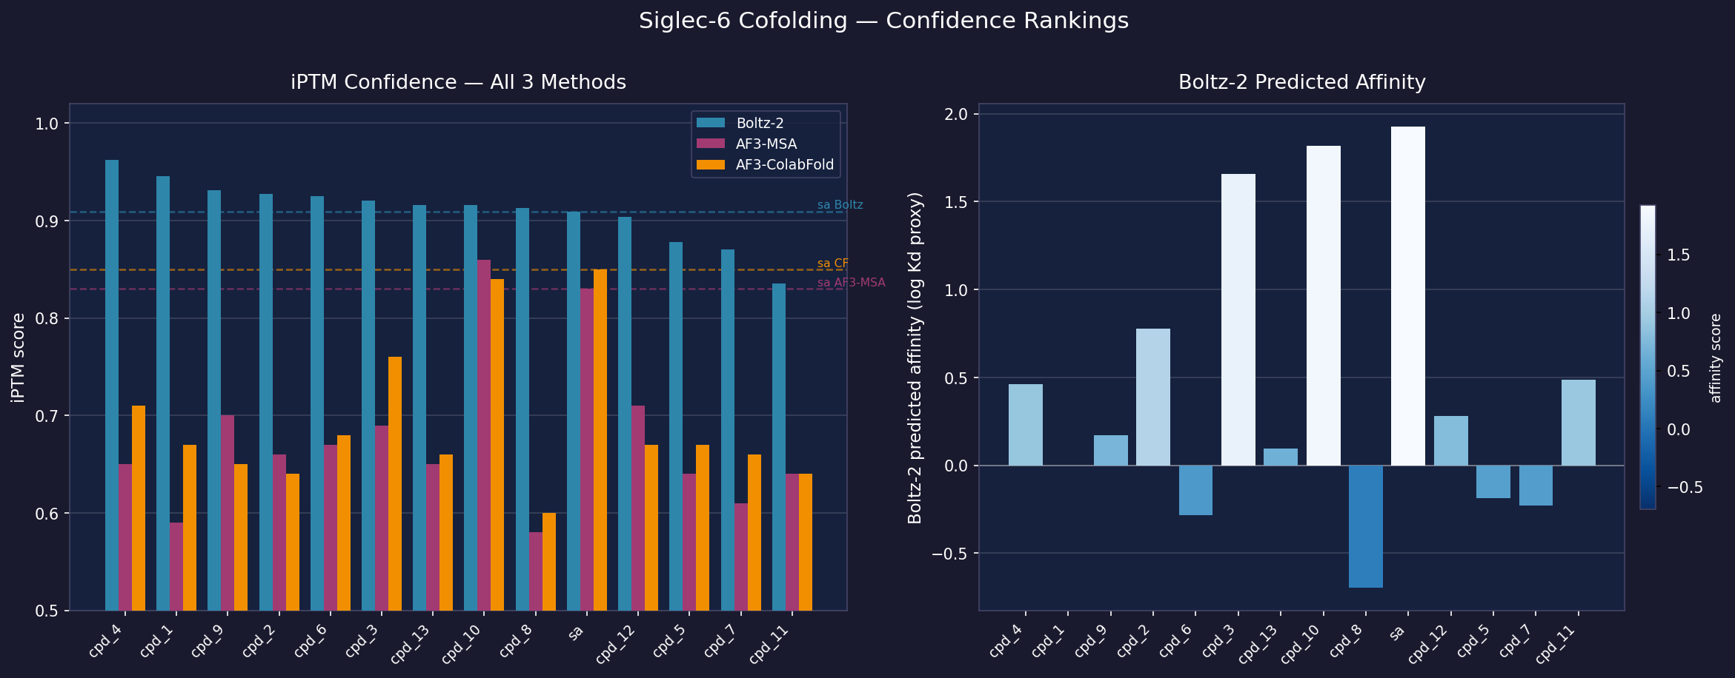
Confidence Rankings — All 3 Methods
Boltz-2 iPTM · AF3 iPTM (both conditions) · Boltz-2 predicted affinity
Left: dashed lines = sialic acid (control) iPTM per method. Right: Boltz-2 affinity value (negative = predicted tighter binder). Top Boltz-2 hits: cpd_4, cpd_1, cpd_9. AF3 top hit: cpd_10, sa.

Slide 4
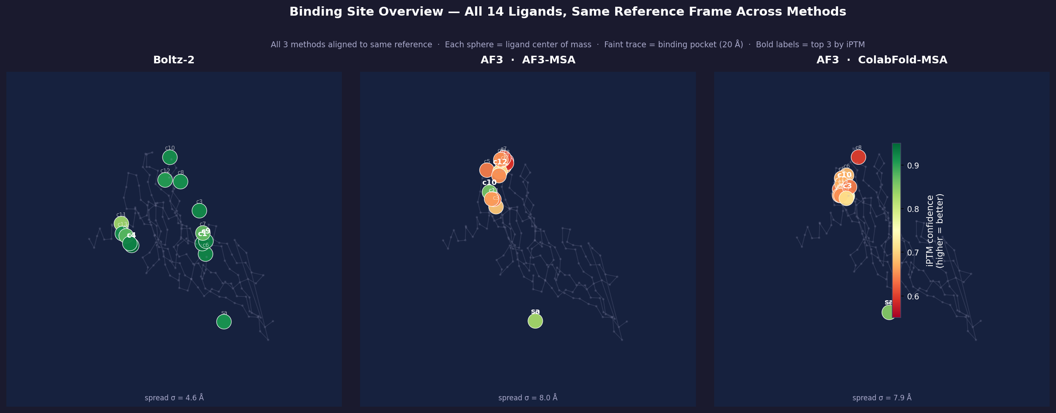
Where Do the Ligands Bind? — All 14 Compounds Overlaid
Receptors aligned by Cα · Each sphere = ligand center of mass · Color = iPTM confidence
Faint trace = pocket residues within 20 Å of any ligand. Tight cluster → consistent binding site prediction. Bold labels = top 3 compounds by iPTM confidence per method.

Slide 5
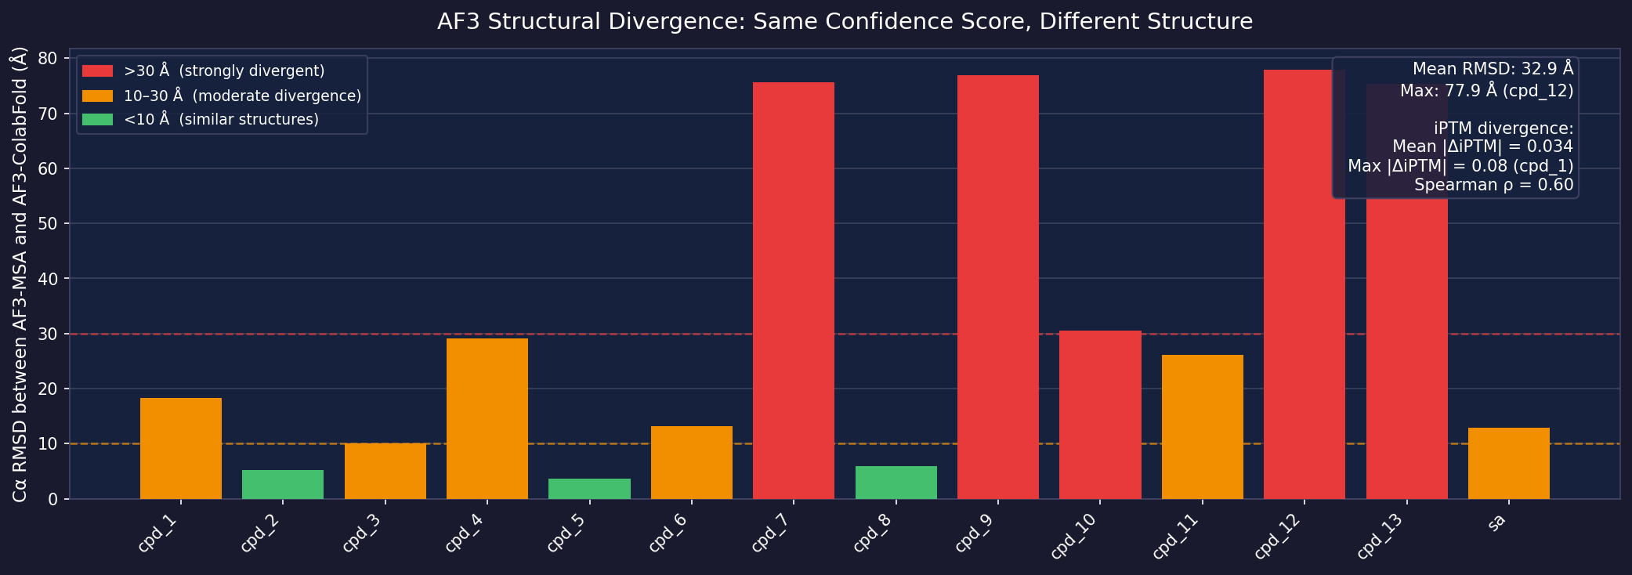
AF3 Structural Divergence: Same Score, Different Structure
AF3-MSA vs AF3-ColabFold | Cα RMSD per ligand
• iPTM scores nearly identical (mean |Δ| = 0.034)
similar confidence numbers hide structural disagreement
• Cα RMSD up to 77.9 Å — structurally completely different models
7 of 14 ligands show RMSD > 30 Å
• Conclusion: AF3 is confidently inconsistent
two runs yield same score, different structure

Slide 6
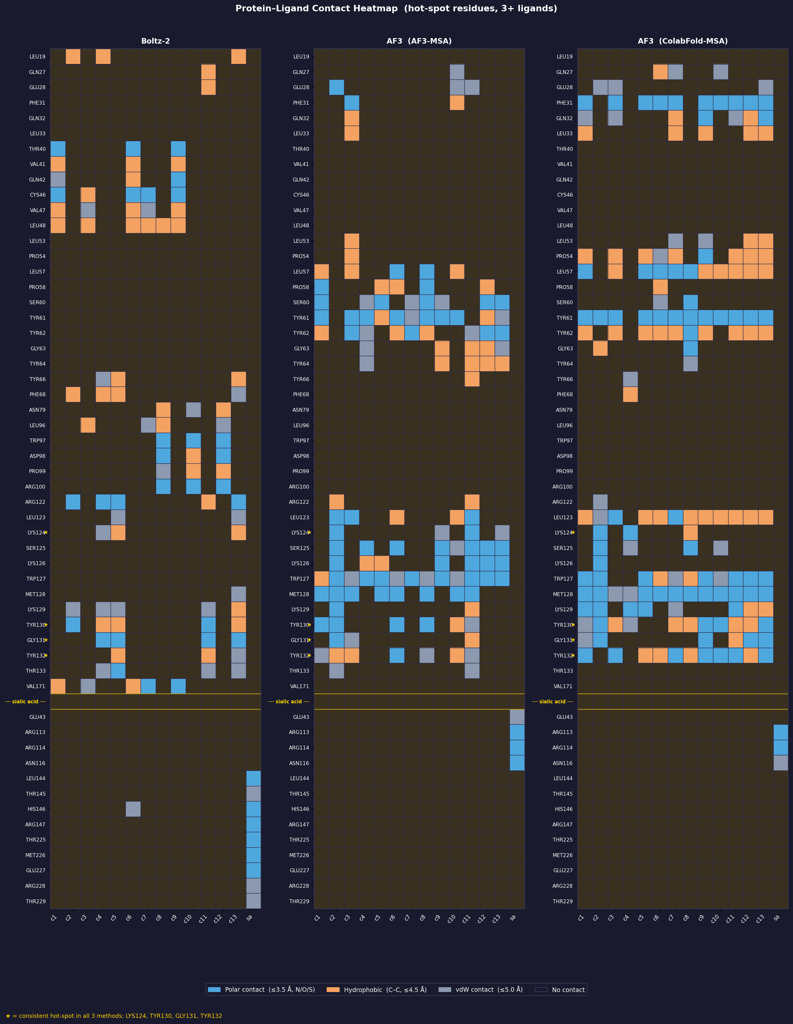
Binding Site Hot-Spots — Contact Analysis
Distance-based contacts (gemmi) · Residues contacted across all 3 methods
● Consistent hot-spot residues (all 3 methods agree):
● Method-specific hot-spots:
● Compounds with CONSISTENT binding mode across methods
● Compounds with DIVERGENT binding modes across methods
● Boltz-2 binding clusters identified:
● AF3 (both conditions) consistently predicts TRP127, TYR61, TYR62,

Slide 7
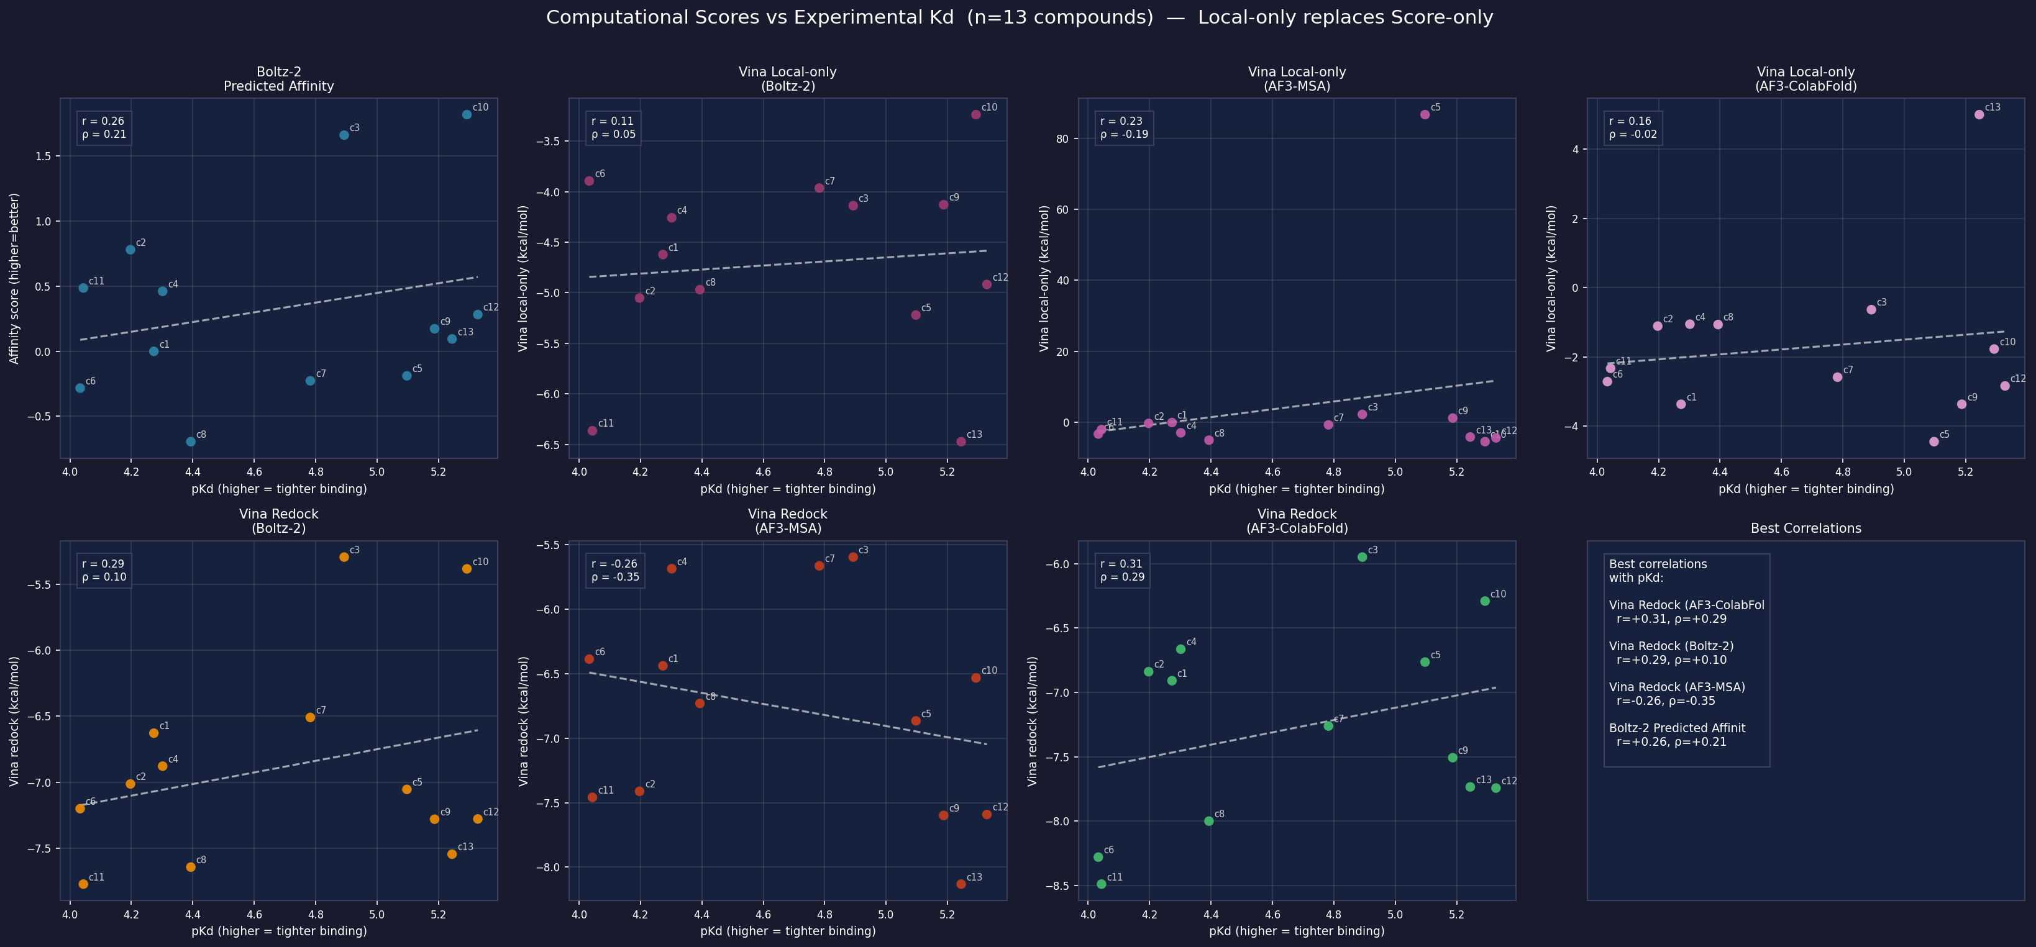
Computational Scores vs Experimental Kd (n = 13)
pKd = 6 − log₁₀(Kd µM) · Higher pKd = tighter binding

Slide 8
Summary & Top Hits
Top Computational Hits — convergent across methods
Consistent binding site residues (all 3 methods)
• cpd_3, cpd_6 (consistent mid-upper tier in Boltz-2 and both AF3 conditions)
• LYS124, TYR130, GLY131, TYR132
Boltz-2-specific top hits
Recommended for wet-lab follow-up
• cpd_4 (#1 by iPTM, 0.963)
• cpd_3, cpd_9, cpd_12 — tight experimental Kd (4.7–12.8 µM) + reasonable computational scores
• cpd_1 (#2 by iPTM, 0.946)
Key findings
AF3-specific top hits
• Sialic acid contacts a distinct sub-pocket — synthetic analogs may target a different site
• cpd_10 (#1–2 in both AF3-MSA and AF3-ColabFold conditions)
• AF3 pose quality assessed by Vina local-only (minimized energy of predicted pose)
• sa (sialic acid) ranked highly by AF3, but contacts distinct site
• All 13 compounds show divergent binding modes across methods (Jaccard < 0.2)

Slide 9
Methods
Cofolding — Boltz-2
Docking — AutoDock Vina
• Version: Boltz-2 (open-source, RCSB pre-release)
• Local-only: predicted pose locally minimized (energy relaxation, no global search)
• Compute: AWS EC2 g5.xlarge (NVIDIA A10G GPU, 24 GB VRAM)
• Redock: SMILES conformer (RDKit ETKDGv3) docked into predicted pocket
• Runtime: ~8 min/ligand · Docker container
• Box size: 30 × 30 × 30 Å centered on predicted ligand centroid
• Input: FASTA protein + SMILES ligand + ColabFold .a3m MSA
• Receptor prep: remove ligand from CIF, convert with Open Babel
Cofolding — AlphaFold3
Experimental Data
• Compute: Garibaldi HPC (Scripps Research)
• Kd values: SPR binding assay (n=13 compounds)
• Condition 1 (AF3-MSA): AF3 built-in MSA pipeline
• Source: Hackathon dataset (Siglec-6 In Silico Library)
• Condition 2 (AF3-ColabFold): pre-computed MSA from ColabFold (same as Boltz-2)
• No Kd for sialic acid (control excluded from correlation analysis)
• 28 jobs total (14 ligands × 2 AF3 conditions)
Contact Analysis
MSA / Sequence
• Tool: gemmi (Python) · distance cutoff 5 Å
• ColabFold MSA server (mmseqs2): pre-computed .a3m for Siglec-6
• Residue-ligand contacts extracted from cofolded CIF/mmCIF structures
• FASTA: Siglec-6 Vtype + C2type1 + C2type2 (333 residues)
• Jaccard similarity computed for top-5 contacted residues per compound

