Slide 1
JavaScript Tutorial
Prashanth Jaligama

Slide 2
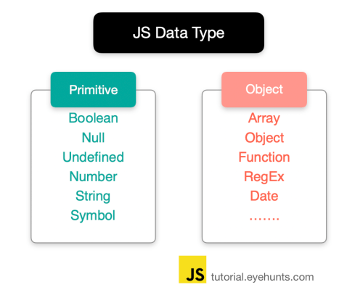
More on Types
typeof => [undefined, boolean, string, number, object, function]
NaN – special numeric value shot for not a number – isNAN()
Number() – convert to number
String() – convert to string
toString() – on any Object
Strings – single quotes vs double quotes
Primitive types are call by value
No Block Level scoping
Code Exercise Using Debug Console & do Ex-7

Slide 3
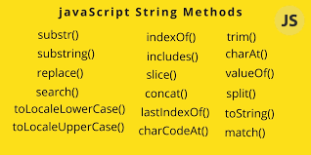
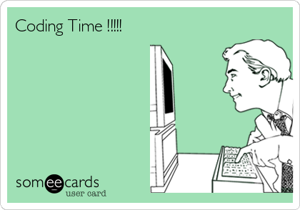
JavaScript String
Code Exercise Using Debug Console & do Ex-8

Slide 4
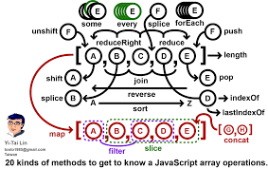
arrays
Also reference types
Instanceof Array check
toString, length, push, pop,
reverse, sort, join, indexof
forEach, map, some, filter, every
reduce, reduceRight
Can store any type of data
Ex: [1, “hello”, false, 3, obj ]
Code Exercise Using Debug Console & do Ex-8

Slide 5
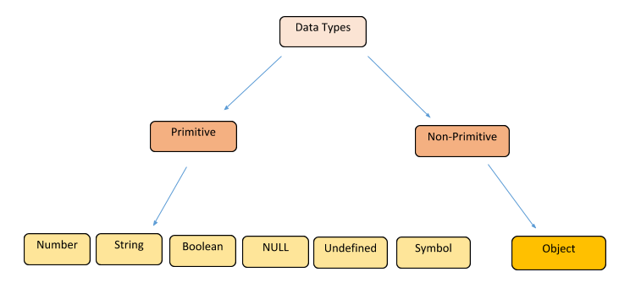
JavaScript Types
Data Types
Loosely typed
Can hold any type of data
var
undefined
null
Operators

Slide 6

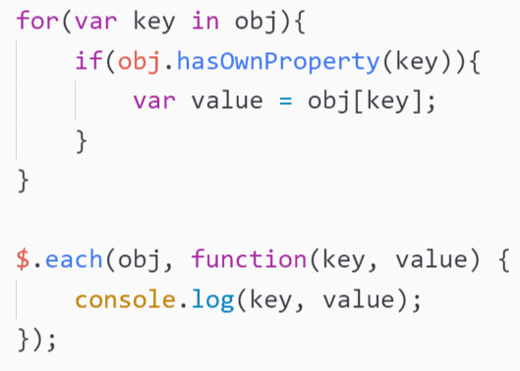
JavaScript Conditional and loops
If else
switch
for statement
for-in
for-each
for-of (ES6)
while loops
do-while
continue
break

Slide 7

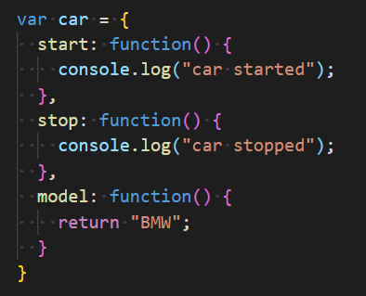

JavaScript functions
Case sensitive names
function keyword
Arguments
No Overloading, arguments are optional
Return statement (optional)
Types of declaring functions
function keyword
Inside a scope
ES6 functions

Slide 8
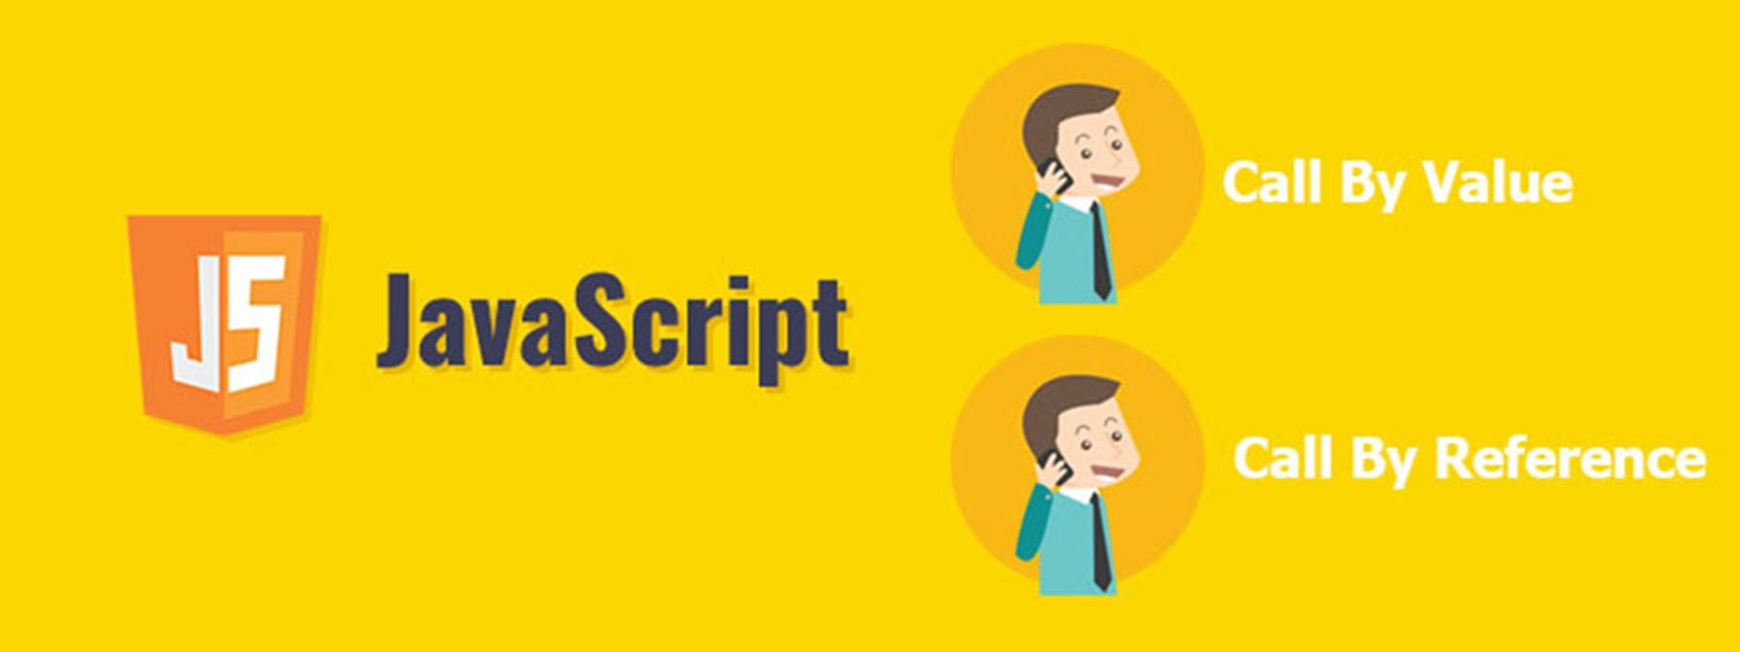
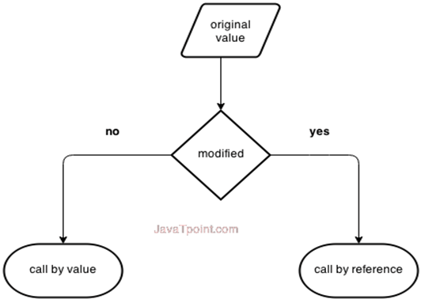
Object Type
Object – non primitive type
Created by new Object()
Can have dynamic property
Object types are Call by reference

Slide 9
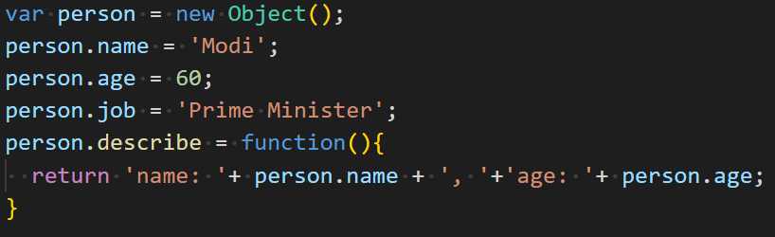
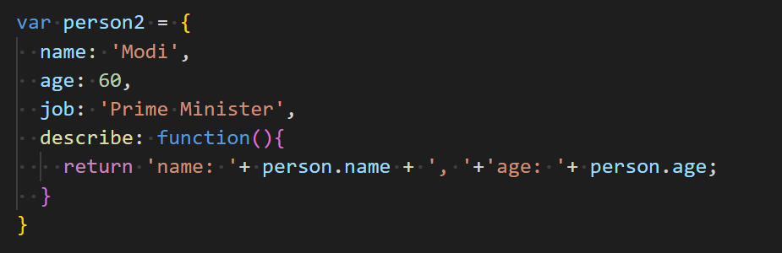
JavaScript – what is Object
ES5 only – ES6 has classes
For learning purpose only
Better to use class
have properties and methods
Two ways to describe
new Object()
Object literal

Slide 10
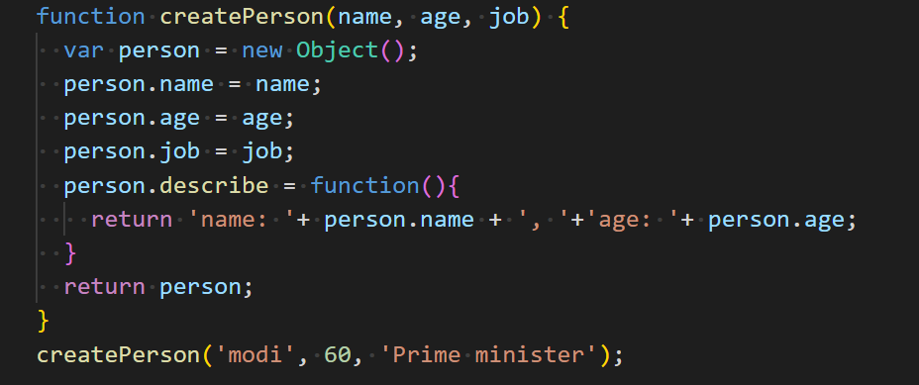
Factory Pattern
Well known design pattern
Abstracts process of creating object
Use a function to create object

Slide 11
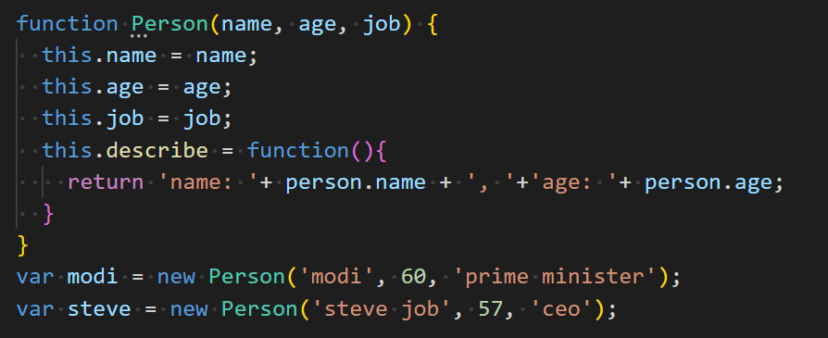
Constructor Pattern
There is no object created explicitly
Uses ‘this’ object to create properties and methods
No return statement
Downside – function are created for every instance

Slide 12
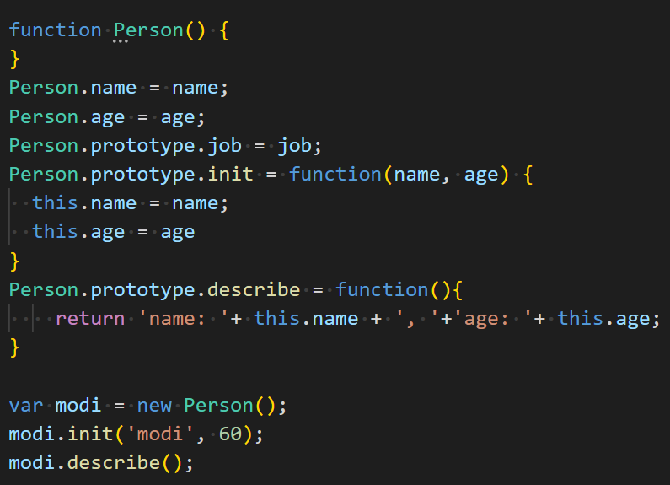
Prototype Pattern
Each function is created with a prototype property
Functions does not create duplicate per instance
Functions knows the context via ‘this’

Slide 13

Coding Exercise
Ex-1. Write JS code for Hello World
Ex-2. Write JS code for adding two numbers
Ex-3. Write JS code for validating given numbers for digits
Ex-4. display addition, subtraction, division and multiplication of two given numbers
Ex-5. find reverse of a given sentence by reversing only words
“Hello World” ➔ “dlroW olleH”
“Sunday is Holiday” ➔ “adiloH si yaduuS”
Ex-6. Write a JavaScript to replace each character of a given string by the next one in the English alphabet. Note: 'a' will be replace by 'b' or 'z' would be replaced by 'a'. Types of declaring functions

Slide 14
Coding Exercise
Ex-7. enhance ex-4 and display addition, subtraction, division and multiplication of two given numbers. Use object literal pattern to create arithmetic object. Use type validations
Ex-8. create StringUtils Object using object literal pattern for reverse, find substring, encode\decode
Ex-9. write arrayUtils for array manipulator for
Return all prime numbers
Return all odd numbers
Return product of all numbers
Find smallest of all numbers
Search for a number

Slide 15
Thank you
Reference
https://books.goalkicker.com/JavaScriptBook/

