Slide 1
JavaScript Tutorial Lession-3
Prashanth Jaligama

Slide 2
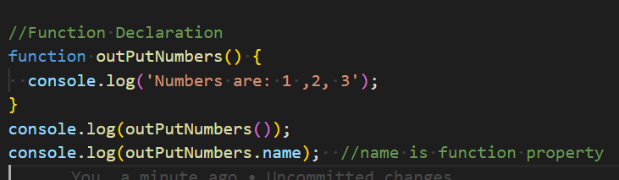
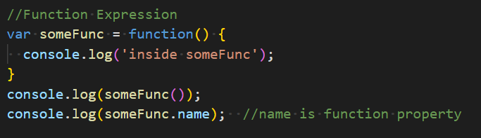
JS Functions
typeof => [function]
Is an Object
Two ways to declare functions
Function declaration
Function Expression
Function Hoisting
Code Exercise Using Debug

Slide 3
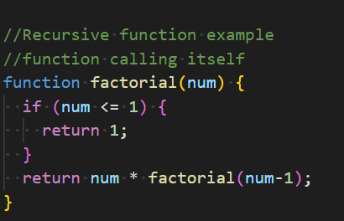
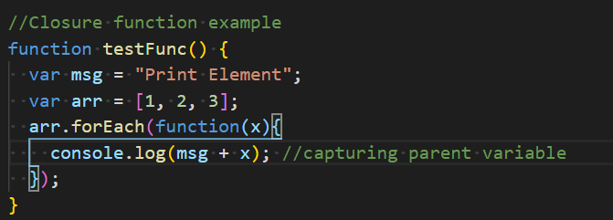
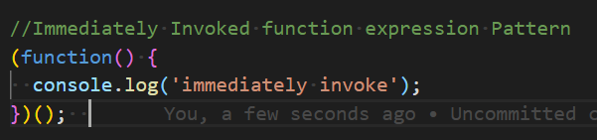
Function continued
Recursive Functions
Anonymous Functions
Closures
Callback
Code Exercise Using Debug Console

Slide 4
IIFE
IIFE- Immediately Invoked Function Expression
Pattern for function Objects
Works only on Function expressions
Mimicking Block Scope
Private Variables
Code Exercise Using Debug Console
do Ex-12

Slide 5
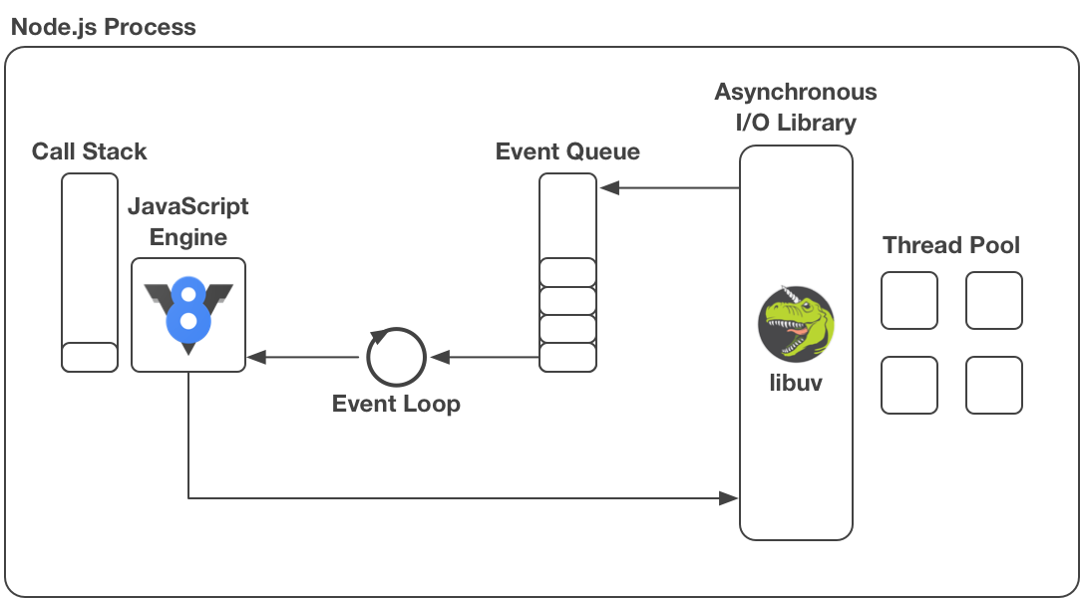
Asynchronous Programming
Remember JS is single Threat language
You cannot create multiple threads
Time based async programs
API
setTimeout: Calls one time after timeout
clearTimeout: Cancels a timout
setInterval: repeats until cancelled
clearInterval: cancels an interval
Code Exercise Using Debug Console
do Ex-13

Slide 6
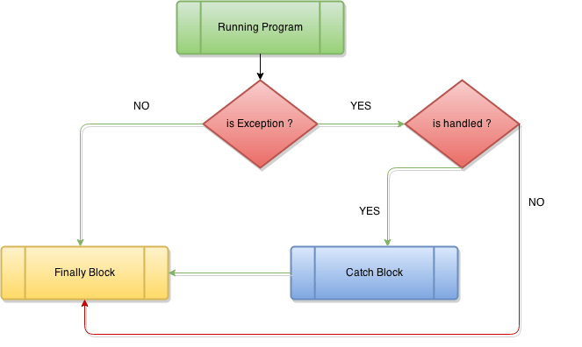
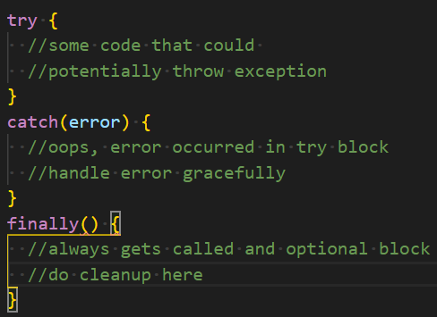
Exception Handling
Import in error handling
Handled exceptions
try-catch
finally
Minimize block inside try
Mindful try blocks
throw - create exception
Error vs Exception
do Ex-13 by adding try catch where necessary

Slide 7

Coding Exercise
Ex-12. Create a Person Contact API. Give a way to add persons. Display Persons by searching part of name
Use IIFE Pattern to create Person Object
Add address Object.
Use callback to return data
Use closures where possible
Ex-13. Enhance Person Contact API exercise. Add Persons from Json object. Add Addresses also from json Object.
Create part of address from json
Use setTimeout to return data asynchronously
Have a scroll method in HTML to display one person at a time for every 3 seconds. Use setInterval to start and clearInterval to Stop

Slide 8
Thank you
Reference
https://books.goalkicker.com/JavaScriptBook/

