Slide 1
JavaScript Tutorial Lession-4 ES6
Prashanth Jaligama

Slide 2

Why ES6,
Some of ES5 shortcomings….
No Block Scope
No classes
No proper way to import third party library
Asynchronous programming is primitive with setTimeout
Callbacks are difficult to debug and understand
Many more…..

Slide 3
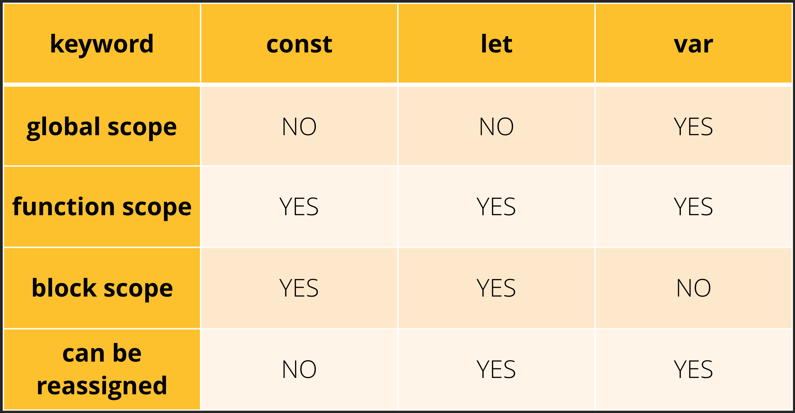
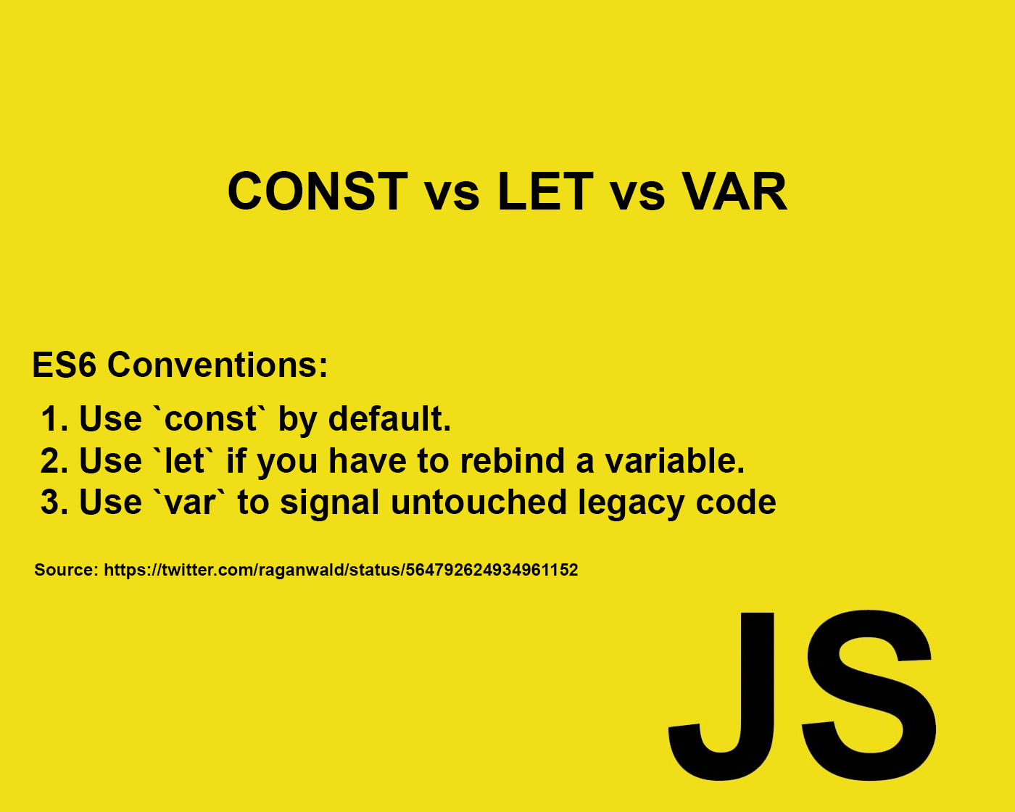
So what is added in ES6
Block Scope
ES5 has only IIFE for block scope
ES6 introduced ‘let’ and ‘const’
Let/const variable bound to the scope where it declared
Using let/const variable early results in reference error
Const is read Only
Use const where possible
Code Exercise Using Debug Console

Slide 4
Functions
functions are also block scoped
Default arguments
Arrow functions
Arrow functions are only for function expressions, not for function declarations
Code Exercise Using Debug Console

Slide 5
New operator …
New operator …
Called either spread or Rest depending on context
Spread – use it before an array variable
Spread syntax useful for array joining’s
Rest – typically used in function arguments
Rest – gather rest of elements
Code Exercise Using Debug Console
do Ex-13

Slide 6

Coding Exercise
Ex-13. Enhance existing exercise to use let, const, default function parameter value, arrow functions

Slide 7
Thank you
Reference
https://books.goalkicker.com/JavaScriptBook/

