Slide 1
JavaScript Tutorial Lession-5
Prashanth Jaligama

Slide 2
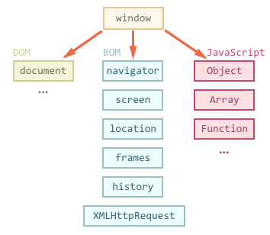
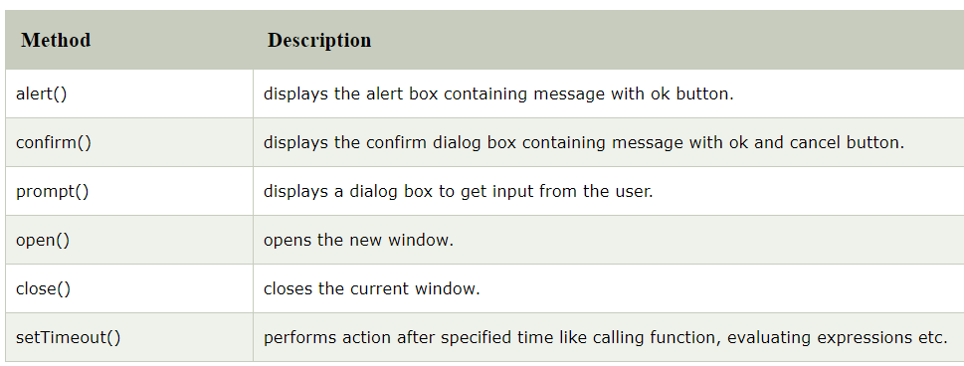
Window – global object
‘window’ is an object represents browser current window
Created by the browser (Chrome\Firefox\edge..)
JavaScript engine (v8) does not create it
Global object, available everywhere
Dom access
BOM access
JavaScript Objects access
Refer: medium article
Code Exercise Using Debug Console

Slide 3
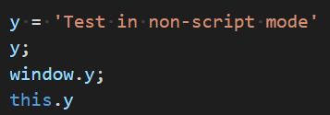
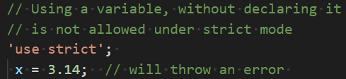
Strict mode
Introduced in ES5 for operating JS in strict context
Less error prone
Silent errors are converted to throw error
Runs faster with V8 engine optimization
Secure JavaScript code
‘use script’;
Global scope - at the beginning of file
Function scope – beginning of function
Code Exercise Using Debug Console
Refer: https://www.geeksforgeeks.org/strict-mode-javascript/

Slide 4
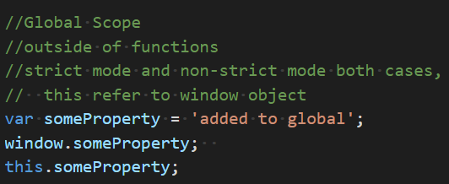
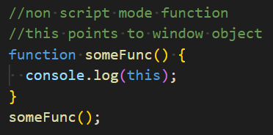
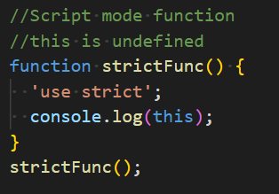
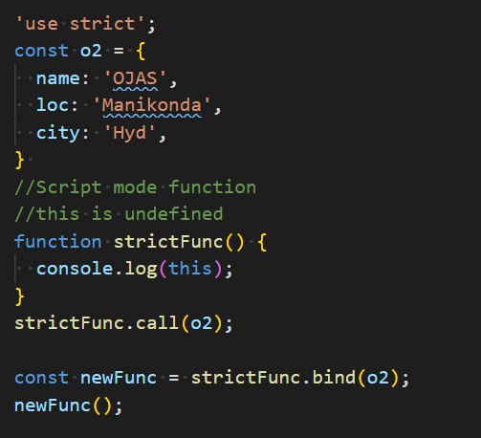
‘this’ context
Dynamically determined property
Also called runtime evolution
Different from other languages
Read only, you cannot set it
Dynamic scoping in ES5
In global scope and regular functions ‘this’ points to window
In functions strict mode, undefined
Undefined can be changed with bind\apply\call in es5
Reference
Code Exercise Using Debug Console

Slide 5
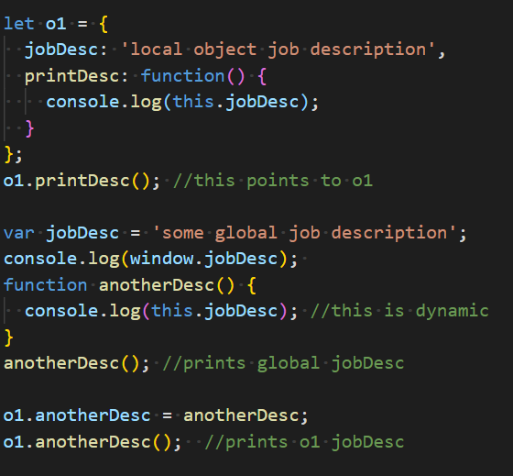
More on ‘this’…
Then how it behaves in Objects?
‘this’ refers to underlying object
In functions ‘this’ refers to the object being called
Code Exercise Using Debug Console
do Ex-13

Slide 6
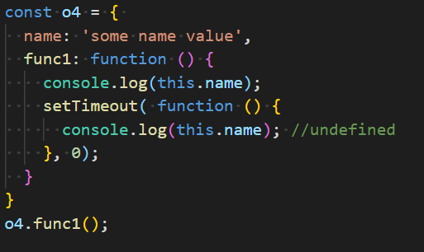
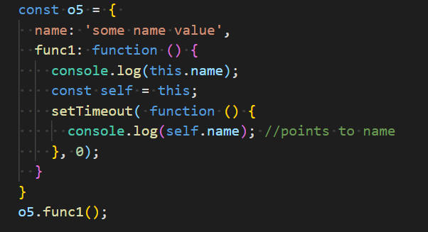
Capturing this
At times when this is used inside a asynchronous function, it has to be stored
See setTimeout callback➔
This is ES5 hack
Solved using closures in ES6
Code Exercise Using Debug Console
do Ex-13

Slide 7
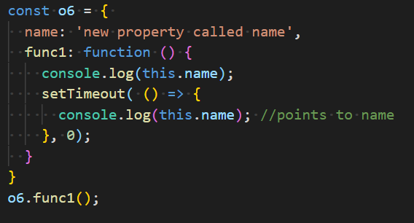
ES6 closure
Closures redefined ‘this’ meaning
Instead of dynamic, ‘this’ is statically bind’s
It’s called Lexical binding
No need to capture ‘this’
See setTimeout callback again ➔
Code Exercise Using Debug Console

Slide 8

Coding Exercise
Ex-13. Enhance existing exercises to use manipulate this

Slide 9
Thank you
Reference
https://books.goalkicker.com/JavaScriptBook/

