Slide 1
JavaScript Tutorial Lession-6
Prashanth Jaligama

Slide 2
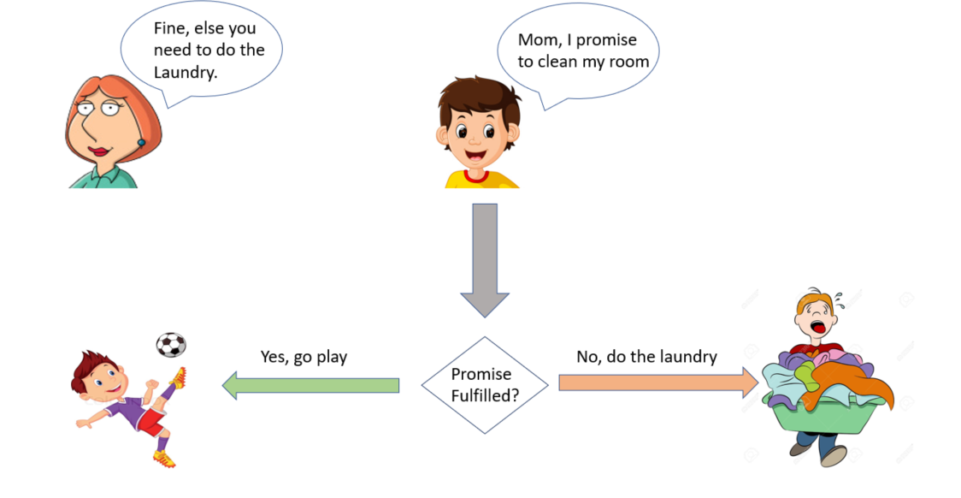
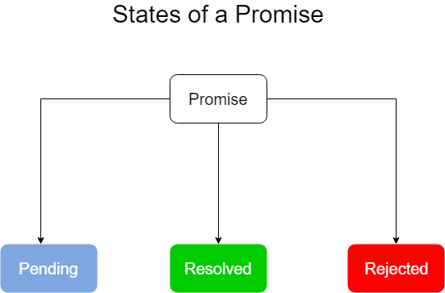
ES6 – Native Asynchronous
Promise Block
Kind of event listeners gets fired only once
Returns future value, time-independent
One of two possible outcomes
Promise fulfilled
Promise rejected
Return is immutable
Once resolved or rejected, you cannot change it
Code Exercise Using Debug Console

Slide 3
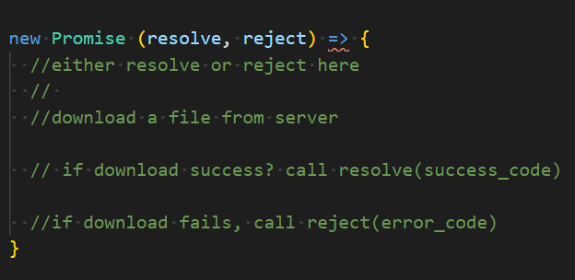
Promise Construct
Promise is an Object
Return a future object
Future Object state can be:
Pending
Rejected
resolved
Promise takes two arguments
resolve
reject
Promise should call either resolve or reject
if either is not called, it is pending forever
Code Exercise Using Debug Console

Slide 4
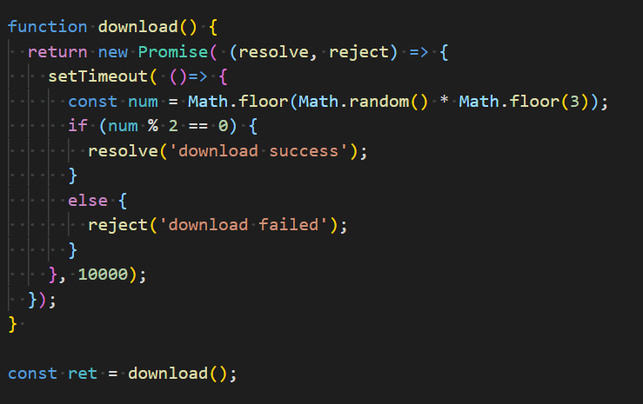
More on promise
resolve with some code - optional
Reject with some code - optional
Caller gets the resolve\reject arguments
Optionally can throw
All throws act like rejects
How do you use it?
Code Exercise Using Debug Console

Slide 5
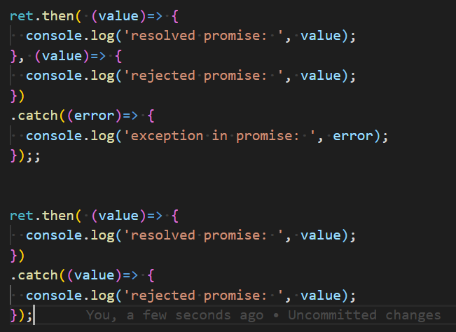
then/catch block
After creating a promise use then block
Then block gets success or failed state
Errors are captured in catch block
Code Exercise Using Debug Console

Slide 6

Coding Exercise
Ex-14. Enhance existing exercises to Promises

Slide 7
Thank you
Reference
https://books.goalkicker.com/JavaScriptBook/

