Slide 1
JavaScript Tutorial Lession-7
Prashanth Jaligama

Slide 2

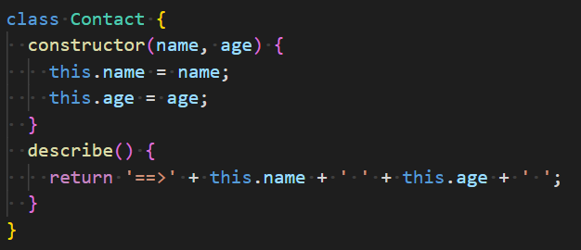
ES6 – Native classes
Improvement over object.prototype
Not a fully featured classes like Java/c++
Binds methods and properties
Supports inheritance (kind of)
Syntactic sugar on class structure
Constructors are provided
Can use instance of
Can create instances with new
Has static key word
No private variables yet
Code Exercise Using Debug Console

Slide 3
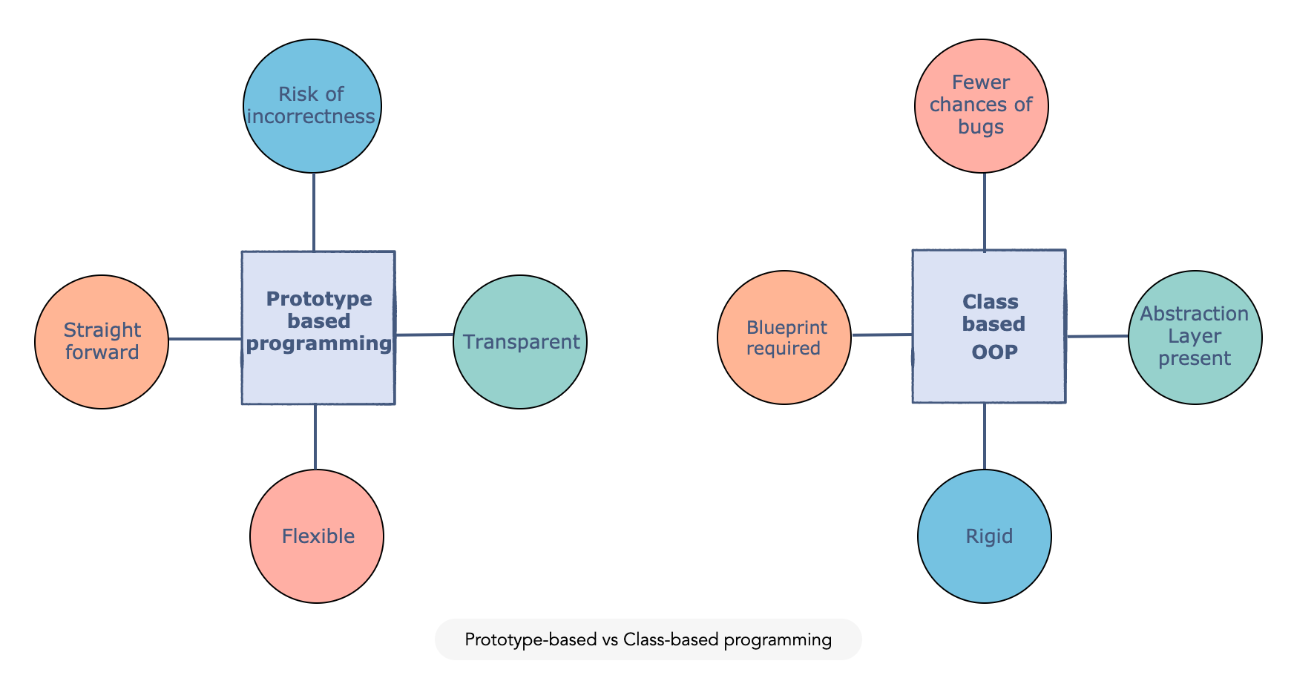
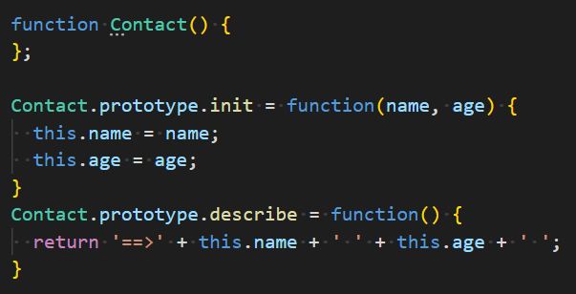
ES6 Class Vs ES5 Object Prototype
Both can create object instances with new
But classes have default constructor
Class constructors are called automatically
Instanceof works for both and is of its class type or object prototype.
Classes are not attached to window object like object prototype
Classes are not hoisted unlike functions
Classes must be defined before use
Code Exercise Using Debug Console

Slide 4
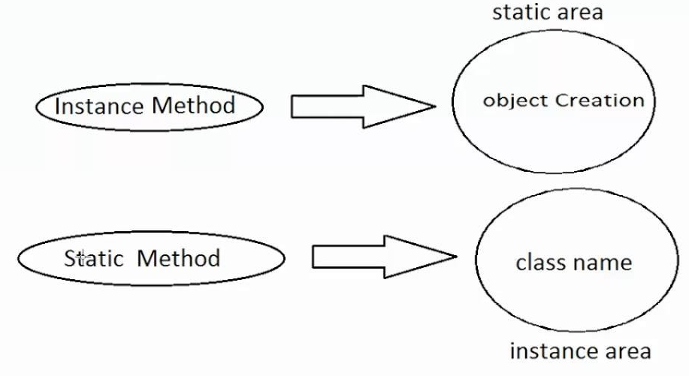
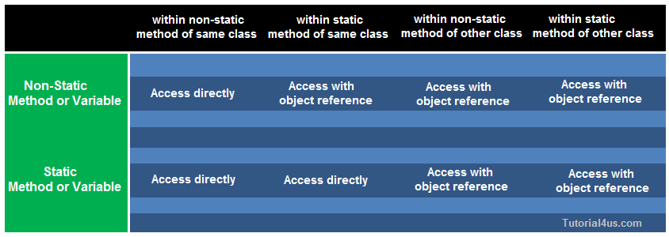
More on class
Instance vs static?
Static key word
When used static on properties or method, instance is not required
Static methods and properties can be accessed from instance methods
Static methods cannot access instance methods or properties
Code Exercise Using Debug Console

Slide 5
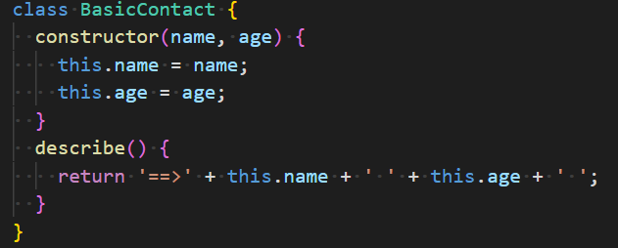
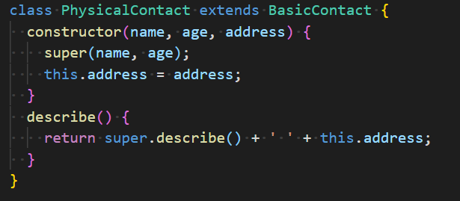
inheritance
What is inheritance
Copying or adopting another class behavior
For code-reuse
Again, small syntactic change from ES5
‘extends’ keyword
‘super’ keyword
No multiple inheritance
Code Exercise Using Debug Console

Slide 6

Coding Exercise
Ex-15. Enhance existing exercises to use class
In class change any one object prototype in previous example to use class

Slide 7
Thank you
Reference
https://books.goalkicker.com/JavaScriptBook/

