Slide 1
Variable,Datatpes and operators

Slide 2
What is Variable?
A JavaScript variable is simply a name of storage
location. Or variables which hold the data value and it can be changed anytime.
Example:
var x = OJAS;
console.log(x); o/p : OJAS;
Two type of variable
Local variable
Global variable
local variable example
<script>
function abc(){
var x = 10; //local variable
}
abc();
</script>

Slide 3
global variable example:
<script>
let data=200; //gloabal variable
function a(){
document.writeln(data);
}
function b(){
document.writeln(data);
}
a();//calling JavaScript function
b(); o/p:200 200
</script>

Slide 4
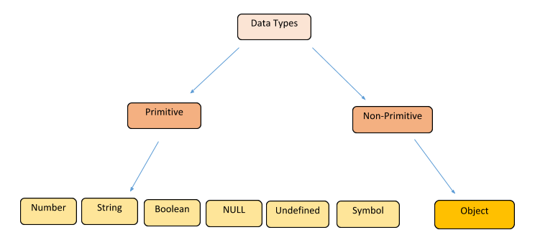
JavaScript Types
Data Types
Loosely typed
Can hold any type of data
var
undefined
null
Operators

Slide 5
Undefined type example:
var x;
console.log(x == undefind) //true
(or)
var x;
console.log(typeof x) //undefind
The Null Type example:
var car = null;
console.log(typeof car) //object
The Number type example:
var x =“300”;
console.log(Number(x)) //o/p:300
Boolean type example:
Boolean has two possiable values:true,false

Slide 6
Operators
operators that can be used to manipulate data values.
1)Arithmetic operators:
Arithmetic operators are :(+, - , * , /, %, ++ , --)
Example:
let a = 20;
let b = 20;
console.log(a++) //o/p:20
console.log(a++)//o/p:21
Example2:
let a = 20;
let b = 20;
console.log(++a) //o/p:21

Slide 7
2)Assignment operators:
Assignment operators are:(= , +=, -= , /=, %=)
Example:
let a = 10;
a+= 10;
console.log(a) //o/p:20
Example2:
let a = 10;
a*= 2;
console.log(a) //o/p:20
3)Comparison operators/Relational operators:
Comparison operators/Relational operators :(==, !=, <, <=, > >=)
Example:
let a = 20;
let b = 20;
if(a!=b){console.log(“true”) }
else {console.log(“false”)}

Slide 8
4)Bitwise operators
Bitwise operators are: (&, |, ^, ~, <<, >>, )
Example:
let a = 45;
let b = 25;
let c = 35;
if(a>b && a>c){console.log(“a is greater than b and c”) }
else if(a>b && c>a) {console.log(“c is greater than b and a”)}
5)Logical operators
Logical operators are: (&&, ||, !)
6) Special operators
Special operators are: (?:, delete, in, instanceof, new, typeof, viod)

Slide 9
Thank you

