Slide 1
DBMS PROJECT — PRESENTATION 3
Dairy Farm Herd & Milk Collection
Management System
User Interface connected to MySQL: Insert · Delete · View
Surakanti Nymisha Reddy · 25WU0102279
Faculty: Dr. Kiran Mayee Adavala

Slide 2
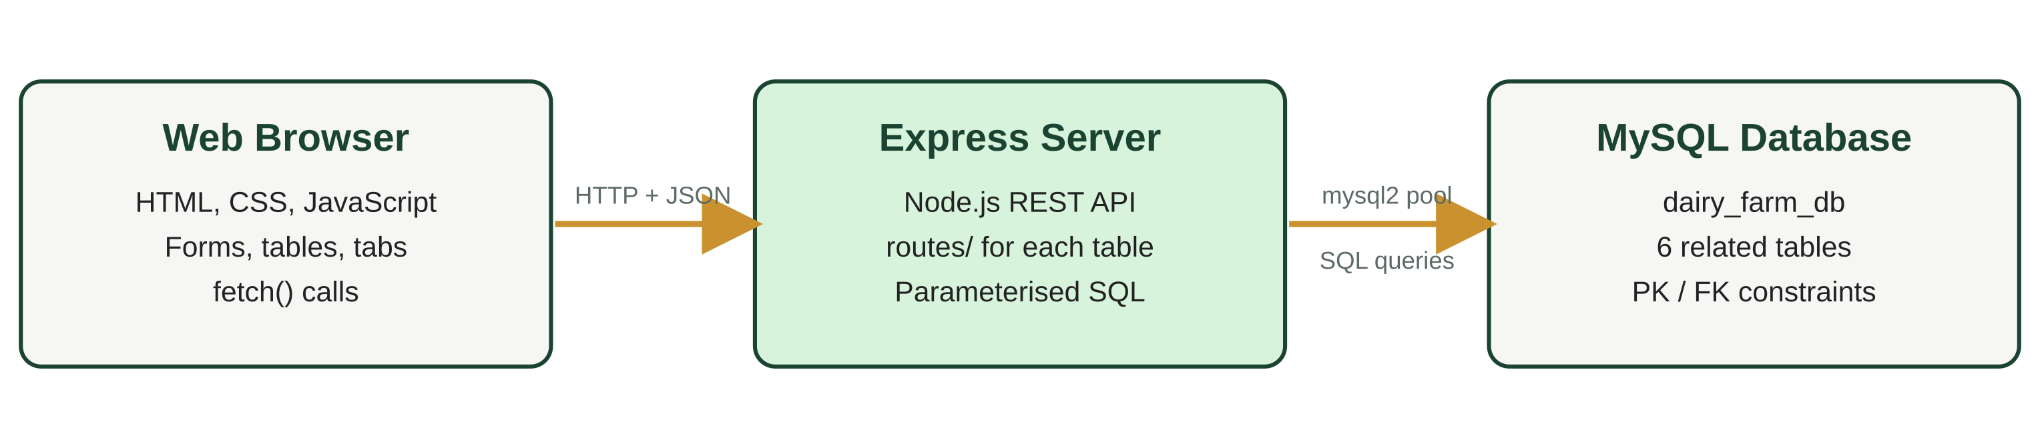
OVERVIEW
A web UI on top of the MySQL database
Website supports Insert, Delete and View for all 6 tables: Farmers, Cattle, Milk Collection, Rate Chart, Payments, Health Records.
A 7th tab runs the amount-due query (milk quantity × fat-band rate, per farmer).
Stack: HTML/CSS/JavaScript frontend, Node.js + Express backend, MySQL 8 database.
2

Slide 3
DATABASE CONNECTION
How the website connects to MySQL
// backend/db.js
const mysql = require("mysql2/promise");
const pool = mysql.createPool({
host: process.env.DB_HOST,
user: process.env.DB_USER,
password: process.env.DB_PASSWORD,
database: "dairy_farm_db",
connectionLimit: 10,
dateStrings: true,
});
module.exports = pool;
Credentials are read from a .env file, which is kept out of GitHub.
A connection pool reuses up to 10 connections.
All SQL uses ? placeholders, which prevents SQL injection.
The green badge “MySQL connected” in the UI comes from /api/health, which runs SELECT 1.
Start: cd backend → npm install → npm start → open http://localhost:5000
3

Slide 4
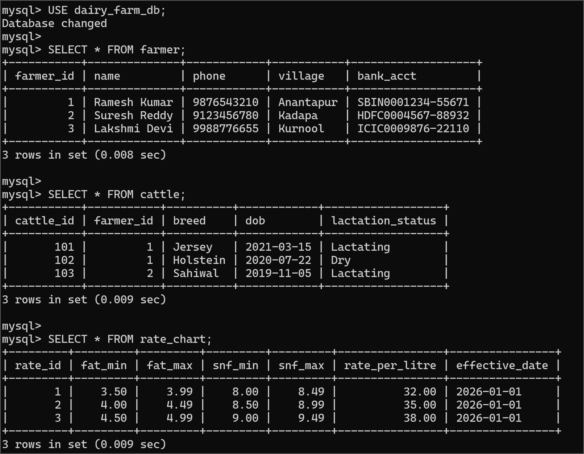
DATABASE
Tables in MySQL (1 of 2)
farmer: 3 farmers; phone is UNIQUE.
cattle: each animal points to its owner through farmer_id.
rate_chart: three fat bands that do not overlap, so a fat value matches only one band.
mysql> SELECT * FROM farmer / cattle / rate_chart;
4

Slide 5
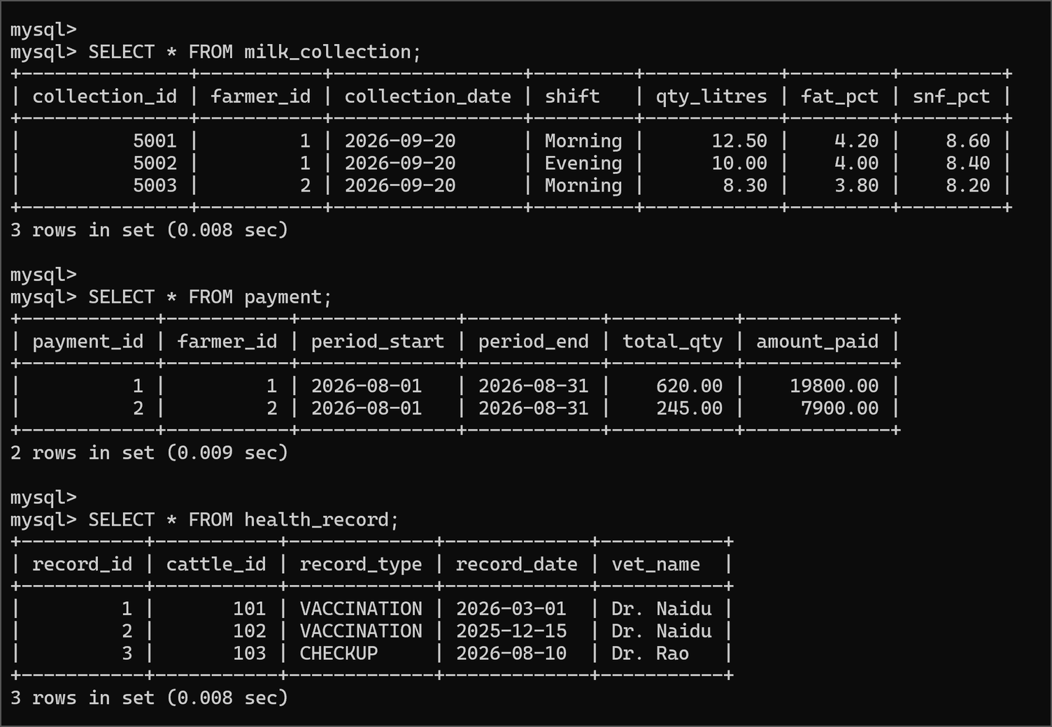
DATABASE
Tables in MySQL (2 of 2)
milk_collection: 3 entries for 2026-09-20 with quantity, fat % and SNF %.
payment: settled August payments for two farmers.
health_record: vaccinations and a checkup linked to cattle.
mysql> SELECT * FROM milk_collection / payment / health_record;
5

Slide 6
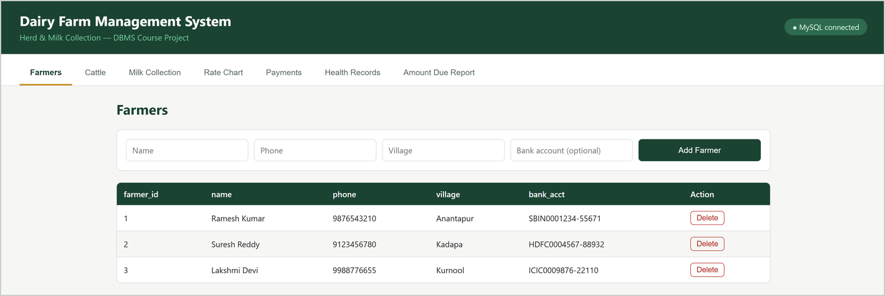
USER INTERFACE — VIEW
Farmers
View: the table is filled by GET /api/farmers.
Insert: fill the form and click Add Farmer.
Delete: each row has a Delete button with a confirmation.
Top-right badge shows the live database connection.
Farmers tab: insert form on top, rows read from MySQL below
6

Slide 7
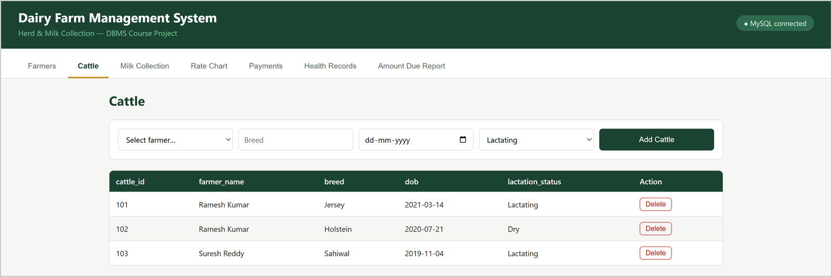
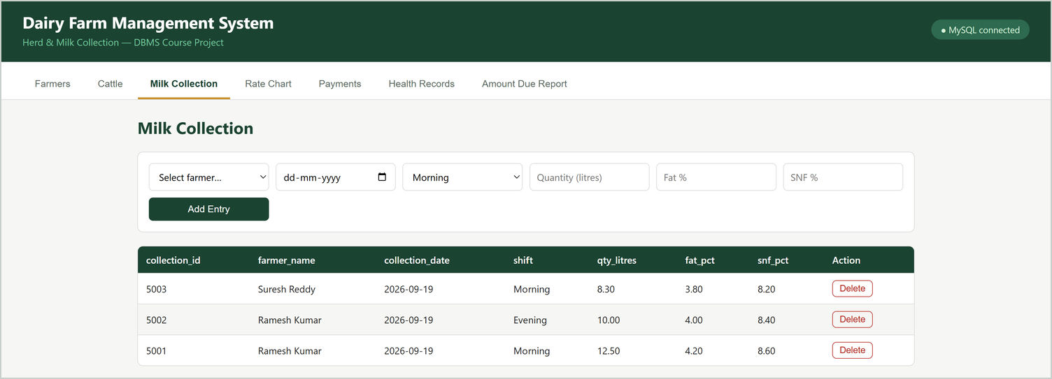
USER INTERFACE — VIEW
Cattle and Milk Collection
Farmer and cattle fields are drop-downs filled from the database, so an invalid owner cannot be entered.
Dates use a date picker; decimals use numeric fields.
Cattle tab: owner name is joined from the farmer table
Milk Collection tab: shift, quantity, fat % and SNF %
7

Slide 8
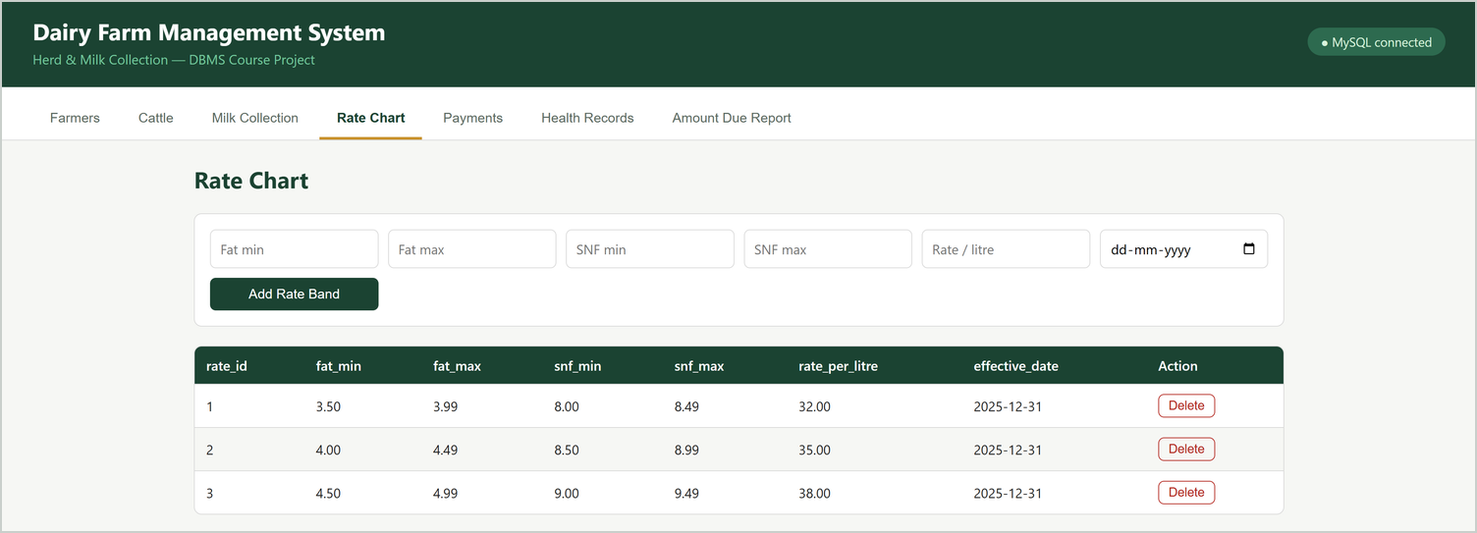
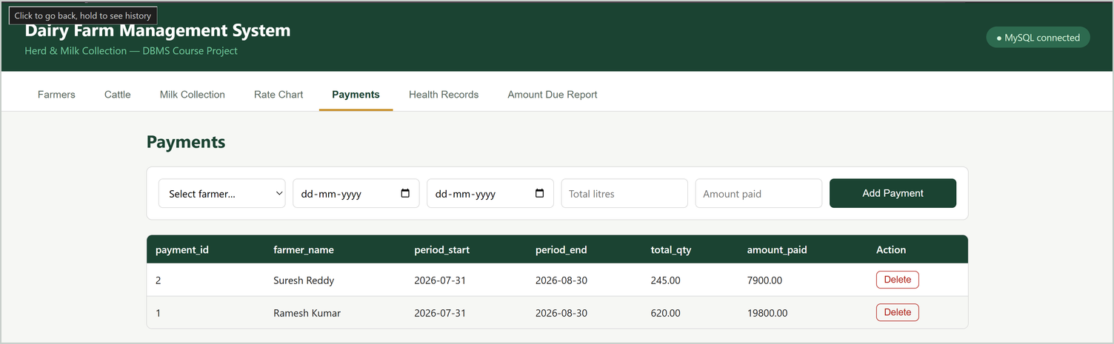
USER INTERFACE — VIEW
Rate Chart and Payments
Rate bands drive the amount-due calculation.
Payments are stored as settled amounts, so later rate changes do not alter past payments.
Rate Chart tab: price per litre for each fat / SNF band
Payments tab: payment per farmer and period
8

Slide 9
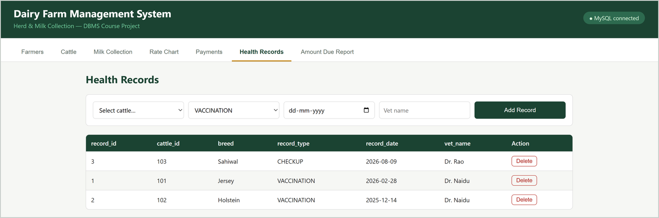
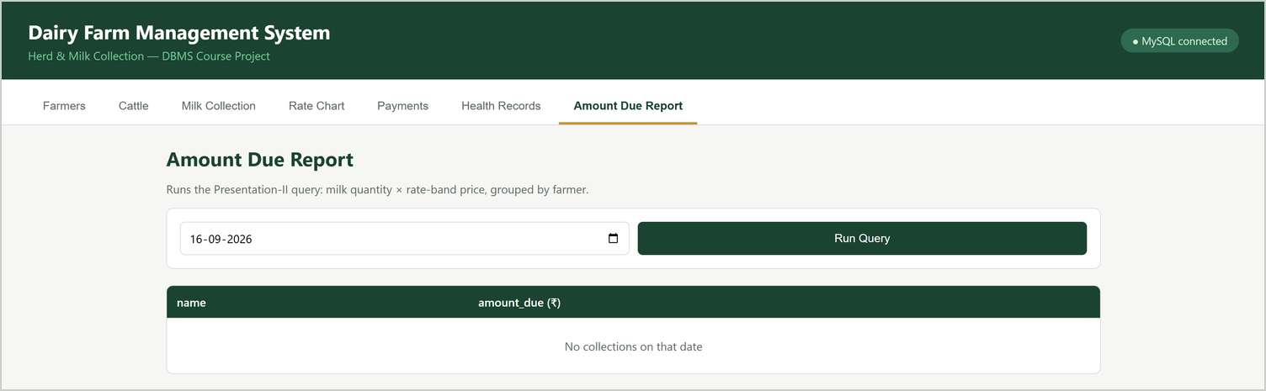
USER INTERFACE — VIEW AND REPORT
Health Records and Amount Due Report
Report tab runs the SQL join of collections with the rate chart.
Choose 2026-09-20 to see the amount due for each farmer.
Health Records tab: vaccination and checkup history per animal
Amount Due Report: shows a message when the chosen date has no collections
9

Slide 10
OPERATIONS
Insert and Delete: from the button to the database
INSERT
DELETE
router.post("/", async (req, res) => {
const { name, phone, village } = req.body;
await pool.query(
"INSERT INTO farmer (name, phone, village)
VALUES (?, ?, ?)", [name, phone, village]);
});
router.delete("/:id", async (req, res) => {
await pool.query(
"DELETE FROM farmer WHERE farmer_id = ?",
[req.params.id]);
});
Flow: form submit → fetch() POST or DELETE → Express route → SQL on MySQL → table reloads with the change.
Integrity: deleting a farmer who still has cattle, milk entries or payments is refused by MySQL (ON DELETE RESTRICT), and the UI shows the error.
Deleting a cattle record also removes its health records (ON DELETE CASCADE).
10

Slide 11
QUERY AND DEMO
Amount due report and live demo steps
SELECT f.name,
SUM(m.qty_litres * r.rate_per_litre) AS amount_due
FROM farmer f
JOIN milk_collection m ON m.farmer_id = f.farmer_id
JOIN rate_chart r
ON m.fat_pct BETWEEN r.fat_min AND r.fat_max
WHERE m.collection_date = '2026-09-20'
GROUP BY f.name;
Live demo
View: open each tab.
Insert: add a farmer, then run SELECT * FROM farmer in MySQL.
Delete: remove that farmer, run the SELECT again.
Integrity: try deleting Ramesh Kumar and show the error.
Report: run the query for 2026-09-20.
Result for 2026-09-20
Ramesh Kumar: (12.5 + 10.0) × ₹35 = ₹787.50
Suresh Reddy: 8.3 × ₹32 = ₹265.60
The UI performs Insert, Delete and View on live MySQL data.
11

