Slide 1

Question and Answer system using Retrieval Augmented Generation
Course code : 20ECSW401
Guided by: Dr. S G Kanakaraddi
Name | USN | Roll No
Suraksha Mummigatti | 01FE21BCS090 | 311
Sheetal Hosamani | 01FE21BCS146 | 221
Bhavana Math | 01FE21BCS202 | 235
Rushikesh Zawar | 01FE22BCS406 | 253

Slide 2
Content
Introduction

Slide 3

Introduction
Developing a question-answering system tailored to the medical field using a technique called Retrieval-Augmented Generation (RAG). In simple terms, this system will be able to read and understand multiple documents related to medical topics, store relevant information, and use it to provide clear and accurate answers to user questions.
The system can offer responses based on the medical information within its documents, assisting users in finding reliable answers to their health-related queries quickly and effectively. This approach is especially useful for making sure that information remains relevant and accurate, even as medical knowledge grows and changes.

Slide 4
Motivation
Improving Accessibility to Medical Knowledge many people struggle to find reliable medical information quickly. This system provides accurate, trustworthy answers, making medical knowledge more accessible
Enhancing Patient Education, by providing clear, accurate answers, the system empowers patients to better understand their health conditions, leading to informed decision-making.

Slide 5
Literature Survey
Paper Name: The Question Answering Systems: A Survey.
Author: Ali Allam.
Date: September 2023.
Aim: The aim of the paper is to summarize and organize recent research results in the field of question answering (QA) systems, providing a comprehensive overview of existing literature, classification of QA components, and evaluation of trends in the field
Procedure: The paper discusses three basic components of QA systems: question classification, document retrieval, and answer extraction. It integrates techniques from natural language processing (NLP), information retrieval (IR), and information extraction (IE). The authors present a chronological analysis of various research contributions, experimental results, and limitations of each study.
Drawback: One notable drawback mentioned is that the experiments primarily focused on "what" and "who" questions, neglecting other factoid questions such as "when" and "where" . Additionally, the survey does not encompass all previous research, focusing instead on top-publishing and top-cited authors in the QA field

Slide 6
Literature Survey
Paper Name: Using Vector Space Model in Question Answering System.
Author: Jovita, Linda, Andrei Hartawan, Derwin Suhartono.
Date: 2022
Aim: The paper aims to propose a new architecture for a Natural Language Question Answering (NLQA) system that utilizes a vector space model to improve the performance of question answering systems.
Procedure: The proposed NLQA system consists of three phases:
Question Processing: Analyzing and classifying the user's question.
Document Processing: Selecting relevant documents and extracting information.
Answer Extraction: Using a vector space model to determine the best answer based on similarity measurements. The system evaluates precision and recall values, achieving an average precision of 0.547 and recall of 0.662 across different question types
.
Drawback: One drawback noted in the study is that the system performed poorly on "what" and "why" questions, achieving only 28% accuracy for these types, indicating challenges in handling questions with diverse answer formats

Slide 7
Literature Survey
Paper Name: For Question Answering and Text Classification: Integrating Knowledge-Based and Statistical Techniques
Author: Peter Clark, John Thompson, and Bruce Porter.
Date: 2023(AAAI Workshop on Text Classification).
Aim: The aim of the paper is to explore the integration of knowledge-based and statistical techniques for improving question answering and text classification systems.
Procedure: The proposed NLQA system consists of three phases:
Question Processing: The paper discusses various methods for query formation, including the deletion of functional words, the use of word frequency tables, and the formation of search engine-specific queries to optimize search outcomes. The process involves selecting search engines, retrieving documents, extracting potential answers, and ranking them based on relevance.
Drawback: One drawback mentioned is the trade-off between speed and recall of answers, as generating complex queries can prolong search response times and complicate the search process

Slide 8
Problem Statement
To develop a Retrieval-Augmented Generation (RAG) question-answering system tailored for the medical domain. Utilizing a diverse set of medical documents, the system will retrieve and synthesize relevant information in real-time, delivering precise, context-rich responses to support accurate medical knowledge and decision-making.

Slide 9
Objectives
To extract and preprocess data from diverse document formats (PDF, PPT, DOCX) to integrate text for further processing.
To split the large data into smaller, context-preserving chunks and generate high-dimensional embeddings using sentence-transformers.
To Implement a Retrieval-Augmented Generation (RAG) technique for augmenting LLM knowledge to provide accurate, context-aware answers while referencing the retrieved documents

Slide 10
Functional Requirements
Search Functionality: Users should be able to search for specific medical topics, symptoms, or treatments.

Slide 11
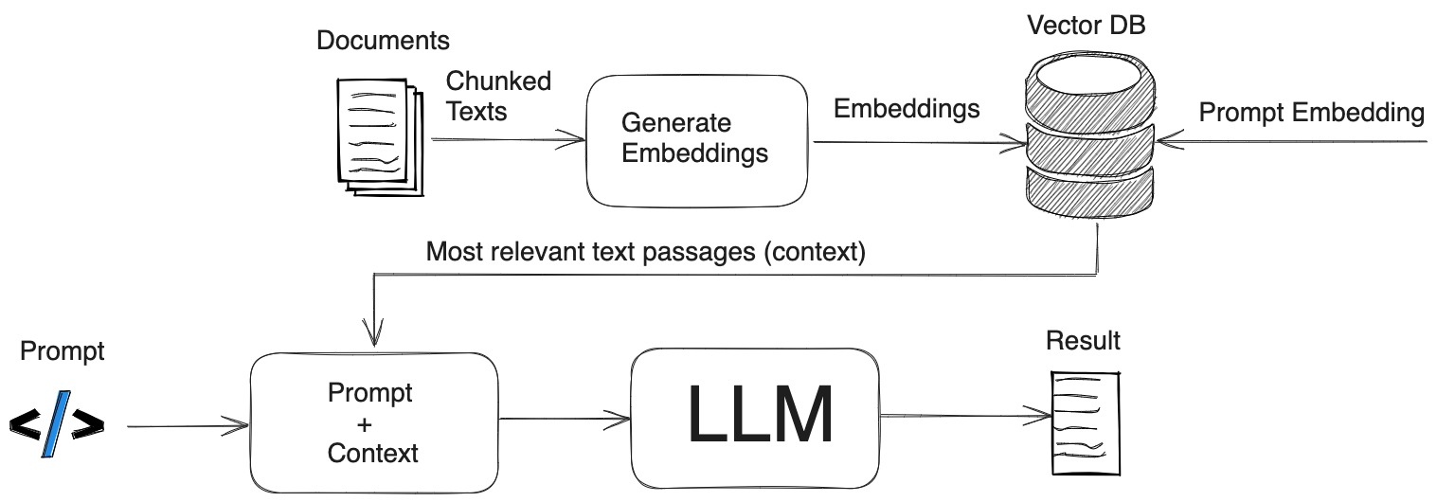
Proposed System

Slide 12

Architectural Diagram
LLM Generates the answer based on the documents
Query
Document
Retrieval
LLM Response Synthesis
Document
Retrieval
Prompt
user
Custom Knowledge Base
Index

Slide 13
LLM Generates the answer based on the documents
Query: A user submits a question or query to the system.
Document Retrieval: The system searches a custom knowledge base (an indexed collection of documents) to find the N most relevant documents related to the query. This step enables the system to focus only on information pertinent to the query.
Prompt: The system expands the prompt by including the retrieved relevant documents, providing context to the query for more informed answer generation.
LLM Response Synthesis: A large language model (LLM) generates the answer based on the expanded prompt, synthesizing information from the documents to deliver a precise and contextually enriched answer.

Slide 14
Architectural Diagram
Indexing
JSON
[0.3, 0.4, 0.1, 1.8, 1.1…]
[0.7, 1.4,2.1, 4.8, 4.1….]
URLs
[0.3, 0.4, 0.1, 1.8, 1.1…]
[0.7, 1.4,2.1, 4.8, 4.1….]
LOAD
SPLIT
EMBED
STORE

Slide 15
Indexing
Load: First we need to load our data. This is done with Document Loaders.
Split: Text splitters break large Documents into smaller chunks. This is useful both for indexing data and for passing it in to a model, since large chunks are harder to search over and won’t fit in a model’s finite context window.
Embed: This process involves converting textual data from documents and questions into dense, high-dimensional vectors known as embeddings. These embeddings are designed to capture the semantic meaning of words, sentences, or even entire documents, enabling the Q&A system to understand and process natural language more effectively.
Store: We need somewhere to store and index our splits, so that they can later be searched over. This is often done using a Vector Store and Embeddings model.

Slide 16

Architectural Diagram
Retrieval and Generation
Question
+
Answer
Prompt
LLM
Retrieve

Slide 17
Retrieval and Generation
Retrieve: Given a user input, relevant splits are retrieved from storage using a Retriever.
Generate: A Chat Model / LLM produces an answer using a prompt that includes the question and the retrieved data.

Slide 18
Thank you

