Slide 1

Eco-Tracker: Tracking Consumption, Reducing Footprint
Minor Project 1 (Course Code:23ECSW303)
Team Number : 94
Guide : Prof. Vijayalakshmi S
Sl.Num. | Student Name | USN | Roll Num. | Division
1 | Sneha Shatagar | 01FE21BCS362 | 157 | A
2 | Nidhi Sudheer | 01FE21BCS331 | 153 | A
3 | Suraksha | 01FE21BCS090 | 311 | C

Slide 2
Overview
Problem Statement
Objectives
Functonalities mapped to SDGs Target Goals
User Interface using React

Slide 3
Problem Statement:
Create a web application that enables users to track their personal consumption habits and carbon footprint, providing insights and recommendations for reducing waste and adopting more sustainable purchasing choices. The platform should integrate features such as personalized goal setting, and community sharing for tips and support.
Objectives:
Develop a user-friendly interface that allows users to easily input and track their consumption habits across various categories such as food, transportation, energy, and household products.
Implement efficient data management systems to store and process user consumption data securely.

Slide 4

SDG 12 - Responsible Consumption and Production:
By enabling users to track their personal consumption habits and carbon footprint, the web application promotes responsible consumption.
Providing insights and recommendations for reducing waste and adopting sustainable purchasing choices contributes to promoting sustainable production and consumption patterns.

Slide 5
Functionalities mapped to SDGs Target goals:
Tracking Personal Consumption Habits and Carbon Footprint:
Mapped to SDG 12, Target 12.3: By 2030, halve per capita global food waste at the retail and consumer levels and reduce food losses along production and supply chains, including post-harvest losses.
This functionality supports the target to reduce food waste by enabling users to track their consumption habits and make informed decisions to minimize waste.
Mapped to SDG 13, Target 13.3: Improve education, awareness-raising, and human and institutional capacity on climate change mitigation, adaptation, impact reduction, and early warning.
Tracking carbon footprint raises awareness about individual contributions to climate change and supports efforts to mitigate its impact.

Slide 6
2. Personalized Goal Setting:
Mapped to SDG 12, Target 12.8: By 2030, ensure that people everywhere have the relevant information and awareness for sustainable development and lifestyles in harmony with nature.
This functionality enables users to set personalized sustainability goals fosters awareness and empowers individuals to make informed choices aligned with sustainable development principles.

Slide 7
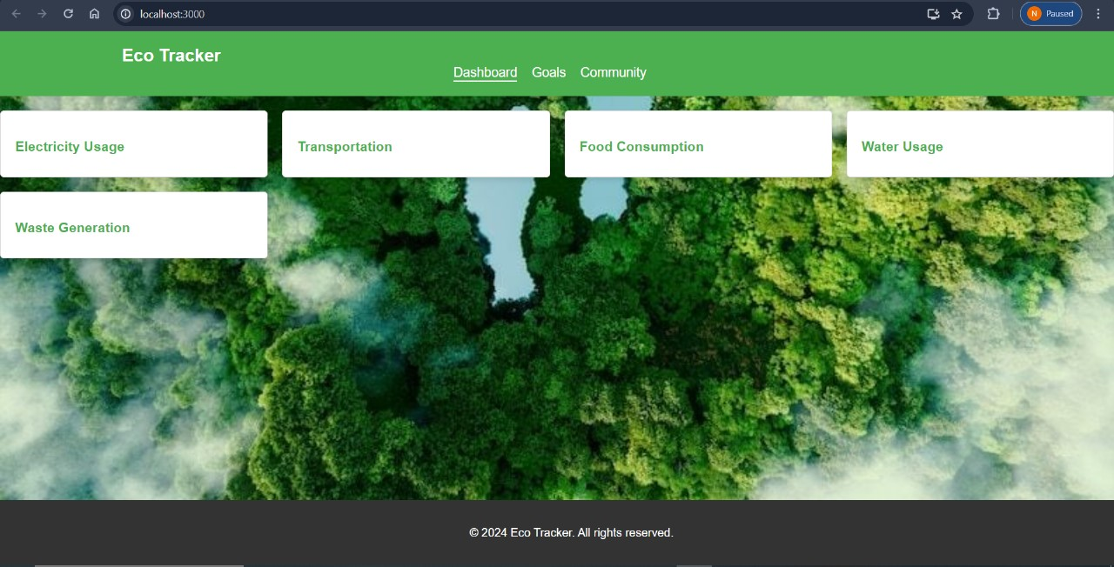
User Interface using React

Slide 8
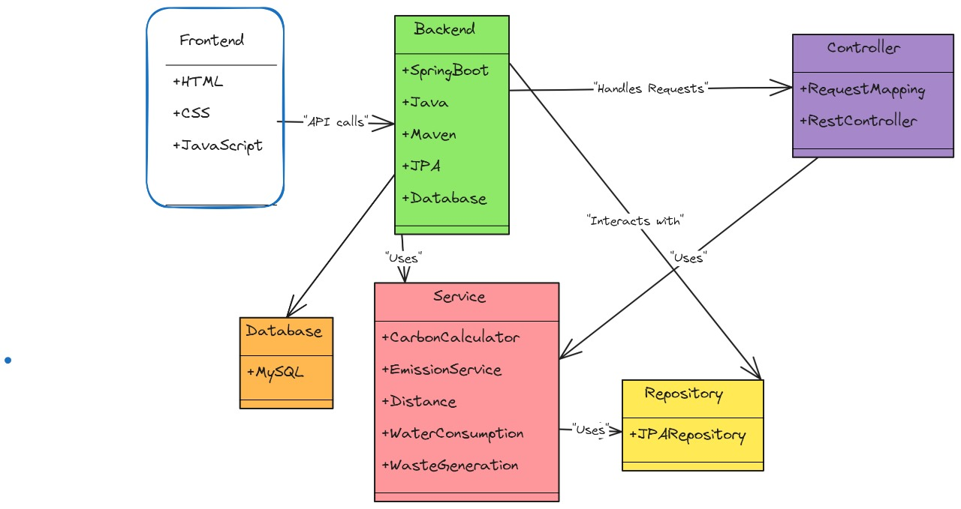
System Design

Slide 9
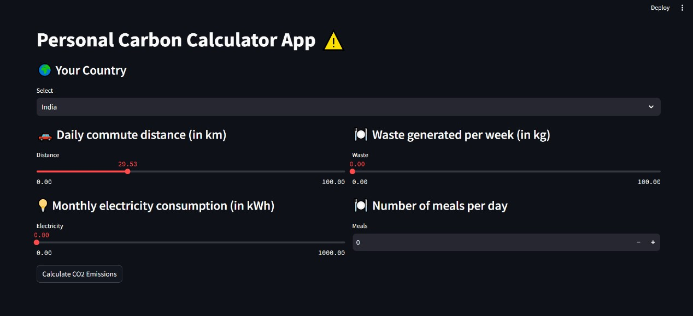

Slide 10
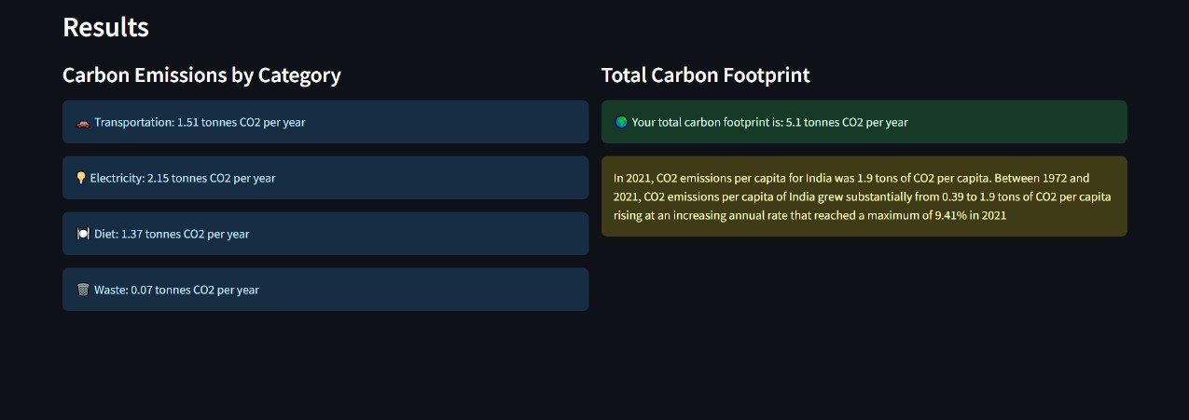

Slide 12
Thank You

