Slide 1







NIT TRICHY
ANPR SYSTEM
An addtional security layer for NITT
Presentation by Surandra Meena

Slide 2









SECURITY ISSUE
Unauthorized vehicle enters through a gate
Every thing is manual
No Proper Security Records
No Scanners

Slide 3

THESE SESECURITY ISSUE CAN
LEAD TO...
Theft and Vandalism: Intruders entering the campus can engage in criminal activities, such as theft or vandalism, causing damage to property and stealing valuable assets.
Potential for Terrorism or Hostile Acts: Uncontrolled access to the campus may create opportunities for individuals with malicious intent to carry out acts of terrorism or other hostile activities.
Compromised Student and Faculty Safety: The presence of unauthorized vehicles may compromise the safety of students, faculty, and staff.

Slide 4
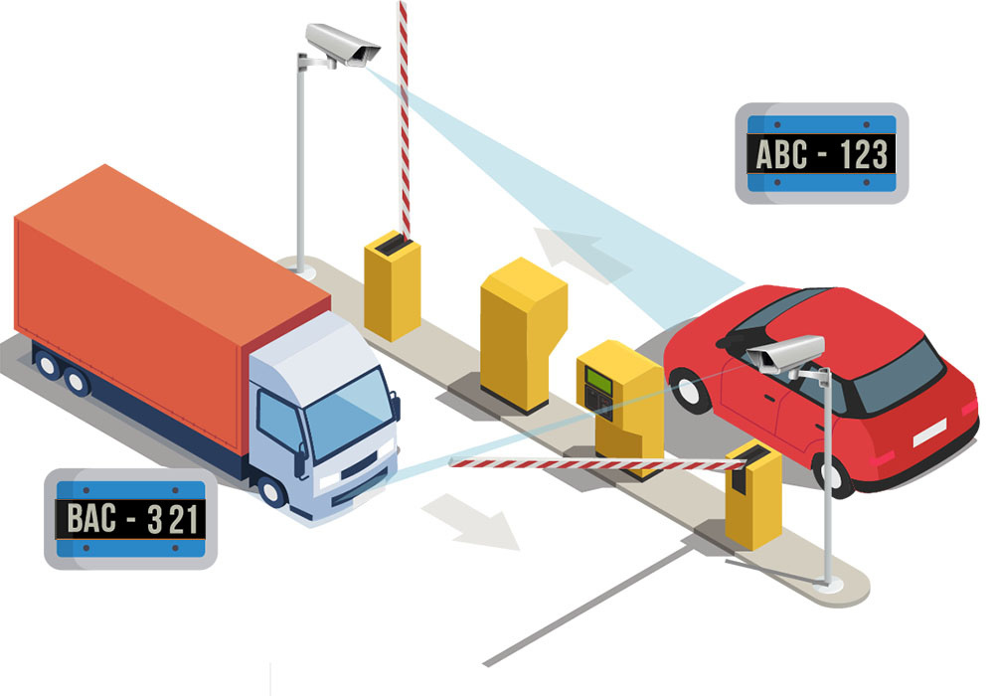
ANPR SYSTEM
ANPR System cameras quickly read license plates on vehicles using the trained machine learning model as vehicles approach the barrier gate.
It does not require any manual input from the driver or security personnel.
This makes the process of authorizing
vehicles to enter or exit a secure area
fast and efficient.

Slide 5

DATABASE FOR THE AUTHENTICATION OF CAMPUS VEHICLE’S
ID
NO. PLATE
NAME
VEHICLE TYPE
DEPT
101
TN-02-2034
MICHAEL
BIKE
CA
205
ABC - 123
BALAJI
CAR
ICE
197
XYZ- 24 - PQ
BALASUNDARAM
CAR
EEE

Slide 6

DATABASE FOR THE AUTHENTICATION of Visitor vehicle’s
ID
NO. PLATE
NAME
VEHICLE TYPE
PURPOSE
EXIT TIME
101
TN-02-2034
RISHI
BIKE
PLACEMENT
6:00 PM
205
ABC - 123
AYAN
CAR
ALUMNI
5:00 PM
197
XYZ- 24 - PQ
CHOUDHARY
CAR
ADMISSIONS
8:00 PM

Slide 7

MODEL USED: INCEPTION-RESNET-V2
WHAT IS INCEPTION-RESNET-V2?
Inception-ResNet-v2 is a neural network that is trained on more than a million images from the ImageNet database.
The network is 164 layers deep and can classify images into 1000 object categories

Slide 8
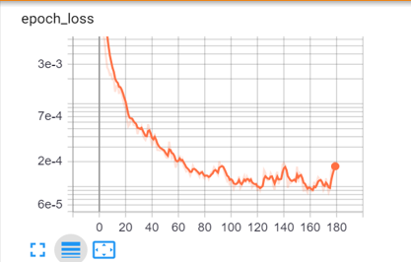
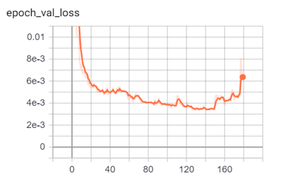
MODEL EVALUATION
Tensorboard

Slide 9


THANK YOU FOR LISTENING!

