Slide 1

Oracle Cloud
An Overview

Slide 2
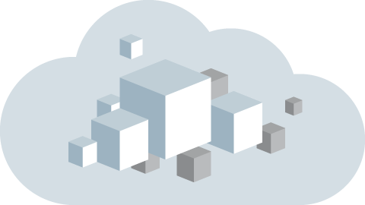
Agenda
1
What is Cloud Computing?
Cloud Evolution
Components of Cloud Computing
Characteristics and Benefits of Cloud
Cloud Deployment Models
Cloud Service Models
Oracle Cloud Services
2
3
4
5
6
7
Notes:
Java SE 8 Programming 20 - <number>

Slide 3

What is Cloud?
The term Cloud refers to a Network or Internet.
It is a means to access any Software that is available remotely.
Notes:
Java SE 8 Programming 20 - <number>

Slide 4
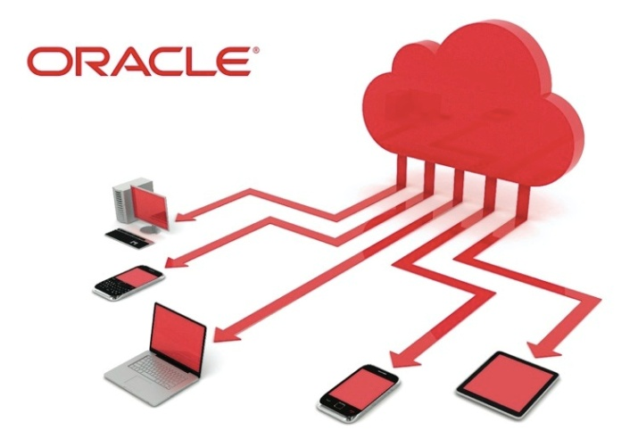
What is Cloud Computing?
  It is a means to access any Software that is available remotely.
  Refers to the practice of using remote Servers hosted on Internet to store, manage and process data
  When you store your photos online instead of on your
  home computer, or use webmail or a social networking
  site, you are using a “cloud computing” service.
Notes:
Java SE 8 Programming 20 - <number>

Slide 5
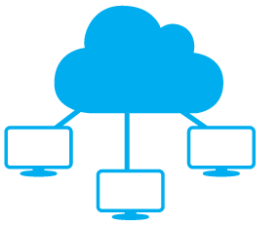
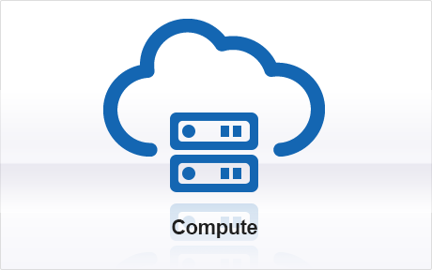

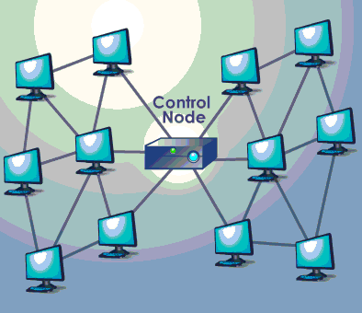
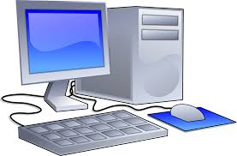
History – Cloud Evolution
Cloud Computing
SaaS Computing
Next generation Internet Computing and next generation Data Centers
Utility Computing
Network based subscription to applications
Grid Computing
Offering Computing Resources as a metered service
Silos Computing
Solving large problems with parallel Computing
Basic computing with dedicated physical hardware
Notes:
Java SE 8 Programming 20 - <number>

Slide 6



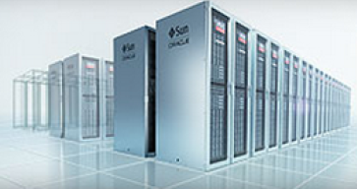

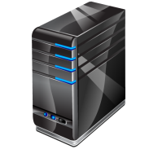
Components of Cloud Computing
Client Computers
Distributed Servers
Data Centers
Data
Devices that end user interact with cloud. Types of client Thick, Thin (Most popular), Mobile
Often Servers are in geographically different places, but server acts as if they are next to each other
Collection of servers where application is placed and is accessed via Internet
Notes:
Java SE 8 Programming 20 - <number>

Slide 7





Characteristics of Cloud
Description
Allows users to use the service on demand
Anywhere, Anytime and Any Device
Draw from a pool of computing resources, usually in remote data centers
Request and manage own computing resources
Service is measured and customers are billed accordingly
Select a configuration of CPU, Memory and storage
Services can be scaled larger or smaller
On Demand Self Service
Rapid Elasticity
Ubiquitous Network Access
Measured Service
Resource Pooling
Pay as you use
Virtualization
Application Programming Interface
Notes:
Java SE 8 Programming 20 - <number>

Slide 8
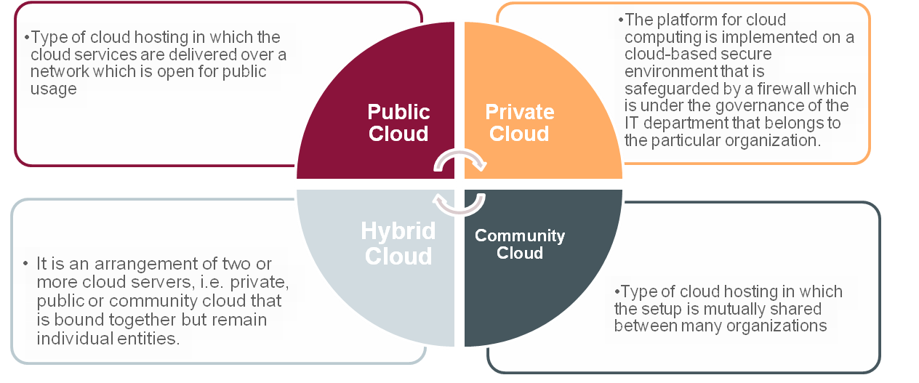
Cloud Deployment Models
Deployment models define the type of access to the Cloud.
Notes:
Java SE 8 Programming 20 - <number>

Slide 9


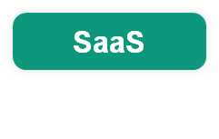
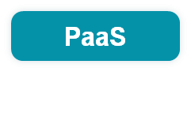
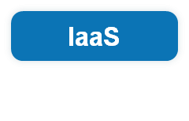
Cloud Service Models
All three tiers of computing delivered as Service via global network
  Applications: Software as a Service - SaaS
  Platform: Database, Middleware, Analytics, Integration as a Service – Platform as a Service - PaaS
  Infrastructure: Storage, Compute, and Network as a service – Infrastructure as a Service - IaaS
Notes:
Java SE 8 Programming 20 - <number>

Slide 10


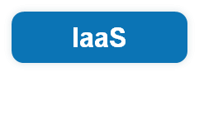
Cloud Service Models
Provides computer hardware (servers, networking technology, storage and data center space) as a web based service.
Virtual Machines with pre-installed Operating System
Target: Administrators
Ready to Rent
IT Professional
Customizations
Application
Consumer
Platform
Provider
Notes:
Java SE 8 Programming 20 - <number>

Slide 11

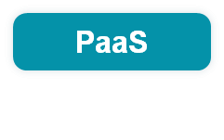
Cloud Service Models
Provides platform to develop and deploy applications
Up to Date Software
Target: Application Developers
Ready to Use
Developer
Customizations
Application
Consumer
Provider
Notes:
Java SE 8 Programming 20 - <number>

Slide 12

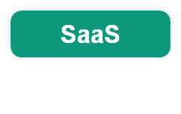
Cloud Service Models
Allows usage of the software remotely as a web based service
Software are automatically Upgraded and Updated
All Users are running the same version of the Software
Target: End Users
Ready to Wear
Business End User
Customizations
Consumer
Provider
Notes:
Java SE 8 Programming 20 - <number>

Slide 13
Industry Shifting from On-Premises to the Cloud
Transition to the Cloud is driven by a desire for:
  Agility: Self-service provisioning – deploy a database in minutes
  Elasticity: Scale on demand
  Lower cost: Reduction in management and total cost – pay for what is used
  Back to core business: Focus on core activities
  More mobility: Access from any device
Notes:
Java SE 8 Programming 20 - <number>

Slide 14

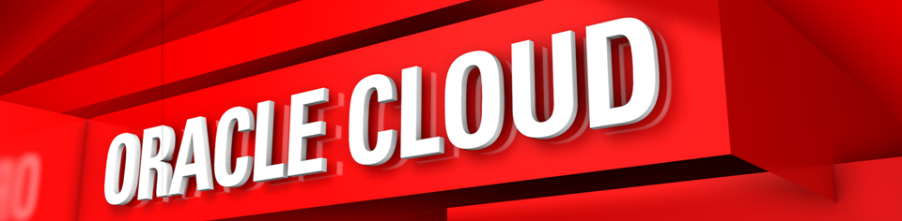
Notes:
Java SE 8 Programming 20 - <number>

Slide 15
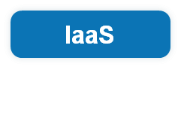
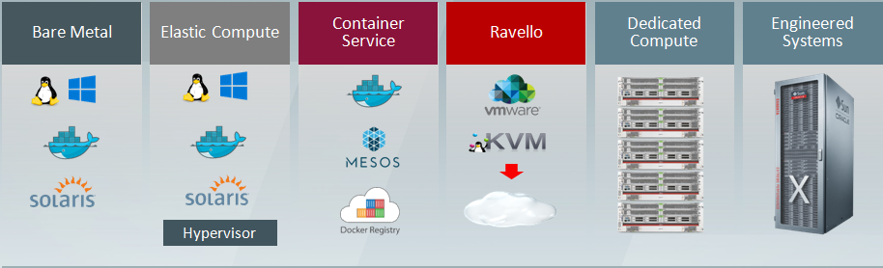
Oracle IaaS Overview
Designed for large enterprises, which allow them to scale up their computing, networking, and storage systems into the cloud, rather than expanding their physical infrastructure.
  Allows large businesses and organizations to run their workloads, replicate their network, and back up their data in the cloud.
Notes:
Java SE 8 Programming 20 - <number>

Slide 16
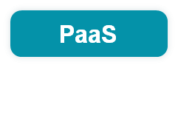
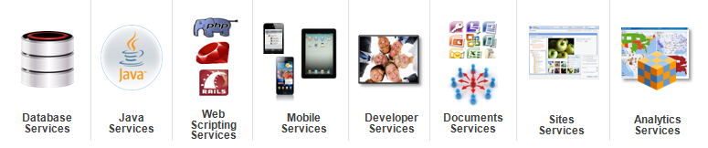
Oracle PaaS Overview
  Develop, deploy, integrate and manage applications on cloud.
  Seamless integration across PaaS and SaaS Applications.
Notes:
Java SE 8 Programming 20 - <number>

Slide 17
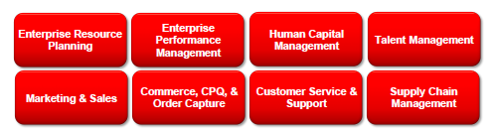
Oracle SaaS Overview
Delivers modern cloud applications that connect business processes across the enterprise.
  Only Cloud integrating ERP, HCM, EPM, SCM
  Seamless co-existence with Oracle’s On-Premise Applications
Notes:
Java SE 8 Programming 20 - <number>

Slide 18
Summary
In this lesson, you should have :
  Got an overview of Cloud Computing, its Characteristics, History and Technology
  Understood the various components , Deployment Models and Service Models of Cloud Computing
  Understood the Oracle Cloud Services
Notes:
Java SE 8 Programming 20 - <number>

