Slide 1


Mechanical tools image using CNN and VGG16
Foram Suratwala 1549
Prajakta Umbarkar 1552
Prashant Karhale Akshay Tilekar (External Guide)
Center Coordinator
Presented by:

Slide 2
Introduction
Machine tools employ some sort of tool that does the cutting or shaping. All machine tools have some means of constraining the workpiece and provide a guided movement of the parts of the machine.
Mechanical engineers design power-producing machines, such as electric generators, internal combustion engines, and steam and gas turbines, as well as power-using machines, such as refrigeration and air-conditioning systems. Mechanical engineers design other machines inside buildings, such vectors and escalators

Slide 3
Dataset Name and Count
Training name | count
Gasoline Can | 0-210
Hammer | 211-1837
Pebbles | 1838-2435
pliers | 2436-2807
Rope | 2808-3177
Screw Driver | 3178-4503
Toolbox | 4504-4930
Wrench | 4931-6261

Slide 4
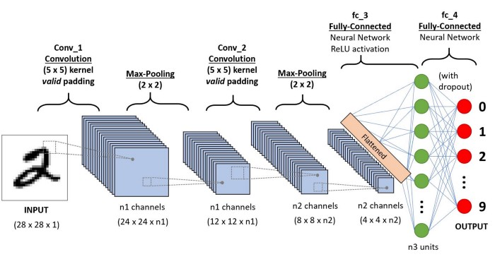
Convolution Neural Network
In deep learning, a convolutional neural network is a class of deep neural networks, most commonly applied to analyzing visual imagery. They are also known as shift invariant or space invariant artificial neural networks, based on their shared-weights architecture and translation invariance characteristics.

Slide 5
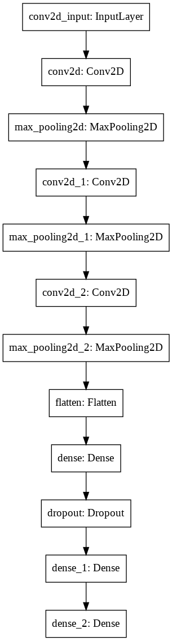
Main Steps to build a CNN (or) Conv. net:
Convolution Operation
ReLU Layer (Rectified Linear Unit)
Pooling Layer (Max Pooling)
Flattening
Fully Connected Layer

Slide 6
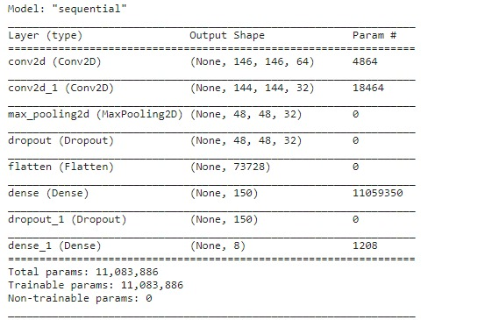
Model Summary CNN

Slide 7
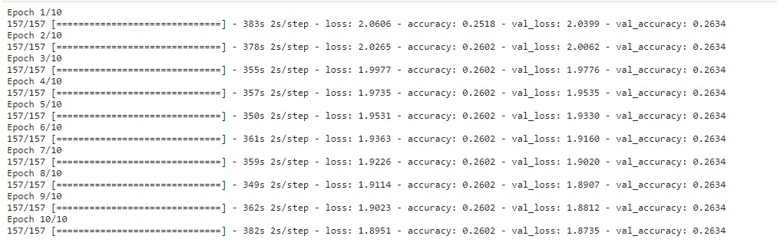
Accuracy of CNN
Accuracy of CNN is very low for 25% (train data and validation accuracy ) are Constance not increase so it is underfitting model or bad models.

Slide 8
Transfer learning
Transfer learning, used in machine learning, is the reuse of a pre-trained model on a new problem. In transfer learning, a machine exploits the knowledge gained from a previous task to improve generalization about another.
Types
VGG (e.g. VGG16 or VGG19).
GoogLeNet (e.g. InceptionV3).
Residual Network (e.g. ResNet50)

Slide 9
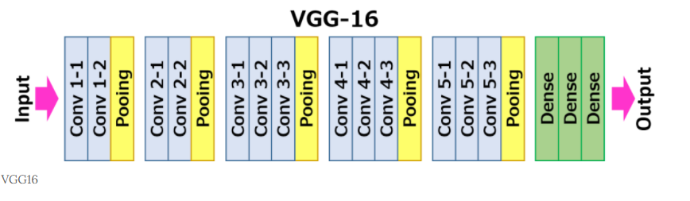
VGG16
VGG16 is a convolutional neural network model proposed by K. Simonyan and A. Zisserman from the University of Oxford in the paper “Very Deep Convolutional Networks for Large-Scale Image Recognition”.

Slide 10
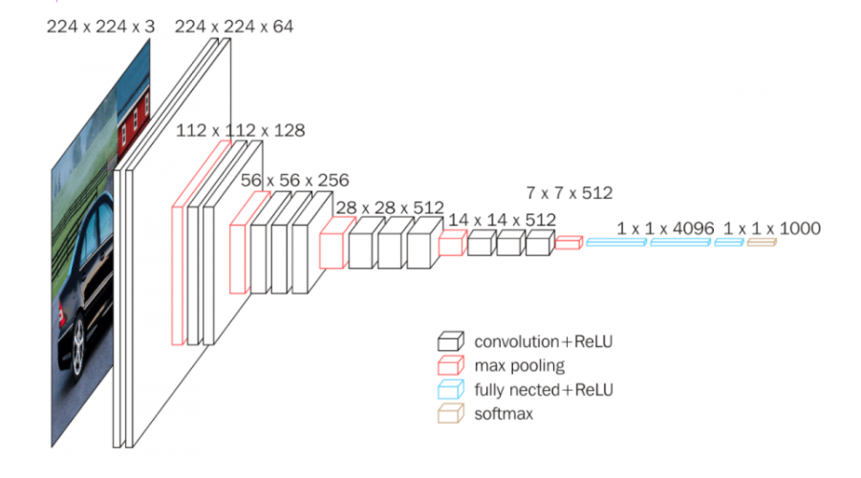
VGG16 Structure

Slide 11
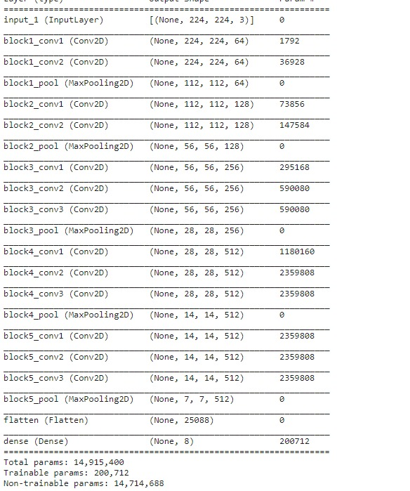
Model vgg16

Slide 12
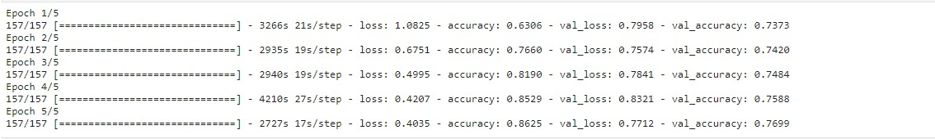
Accuracy of VGG16
Vgg16 is good accuracy because valid accuracy is continuous increase so it is not overfit and underfit. Training accuracy is 86.25% and validation accuracy is 76%.

Slide 13
Feature Selection
Our project we have use different feature selection as following:
Thresholding
Horizontal and Vertical Flip
Rotate
Crop
Canny edge detection
Gaussian-blur
Salt-pepper noise
Speckles noise
Gaussian noise

Slide 14
References
Dataset link:-
https://www.kaggle.com/salmaneunus/mechanical-tools-dataset?select=Mechanical+Tools+Image+dataset
CNN:-
https://towardsdatascience.com/convolution-neural-network-for-image-processing-using-keras-dc3429056306
https://bdtechtalks.com/2020/01/06/convolutional-neural-networks-cnn-convnets/
VGG16:-
https://towardsdatascience.com/step-by-step-vgg16-implementation-in-keras-for-beginners-a833c686ae6c

Slide 15
Thank you

