Slide 1
Bridge Pattern
8 June 2022

Slide 2




background
Mario
At SuperCool startup, we are designing a game where our hero (Mario) fights different villains. For instance, Bower, King Boo and Boom Boom.
Bower
King Boo
Boom Boom

Slide 3
attacks
Of course, villains need to attack our hero. That’s what villains do. We have different forms of attack. Kicking, punching, shooting, biting you name it.
The rule is each type of villain can perform only one form of attack. Each type of villain can perform any form of attack.
Let’s say we for now we have three forms of attach that is kicking, punching and biting.

Slide 4
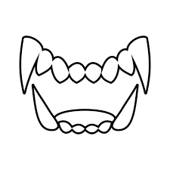


Let put it in perspective
We have 3 types of villain.
We have 3 forms of attack.
Bower
King Boo
Boom Boom
kicking
biting
punching

Slide 5
Classes we need
So altogether we need 9 classes in order to produce villains with each attack form.
BowerWithKick.java | BowerWithFist.java | BowerWithBite.java
KingBooWithKick.java | KingBooWithFist.java | KingBooWithBite.java
BoomBoomWithKick.java | BoomBoomWithFist.java | BoomBoomWithBite.java

Slide 6
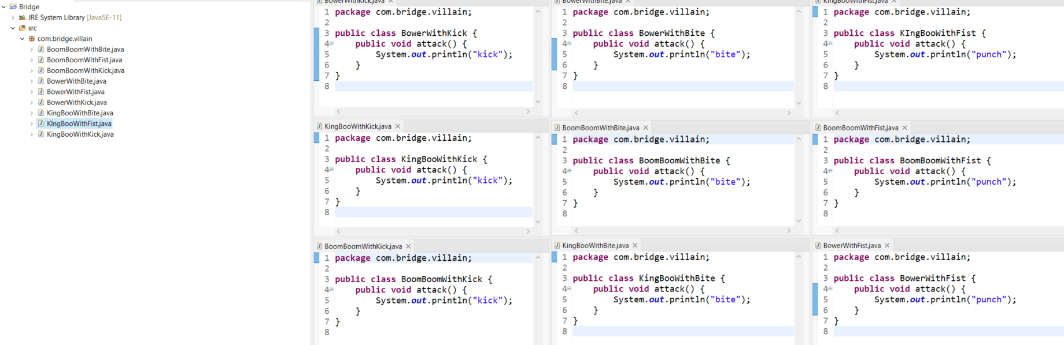
No worries I can do it

Slide 7




Version 2
Later the game got popular, in version 2 we need to introduce 4 more villains and 2 more attacks which are shooting and casting spell.
Larry Koopa
Clawgrip
Cackletta
Croco

Slide 8
We are in trouble.
Bridge pattern to the rescue.
The problem the bridge pattern in trying to solve is when you want to divide and organize a monolithic class that has several variants of some functionality. Like the previous example

Slide 9
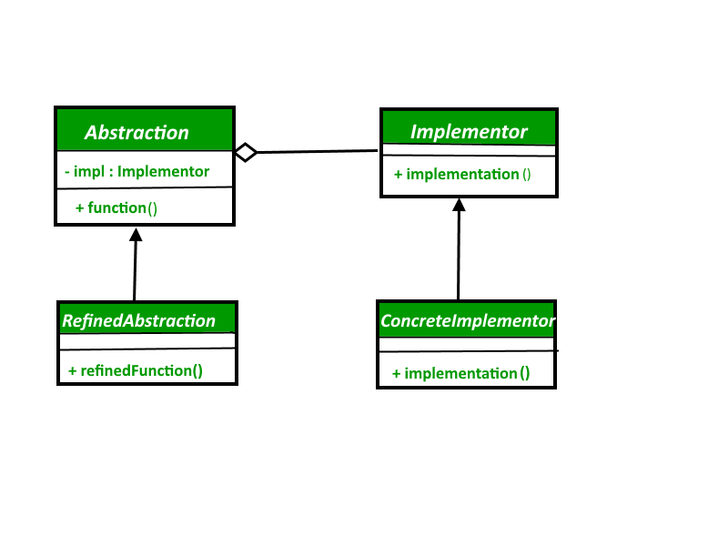
Here is the pattern
The reason this pattern is named bridge because it simply looks like a bridge!

Slide 10
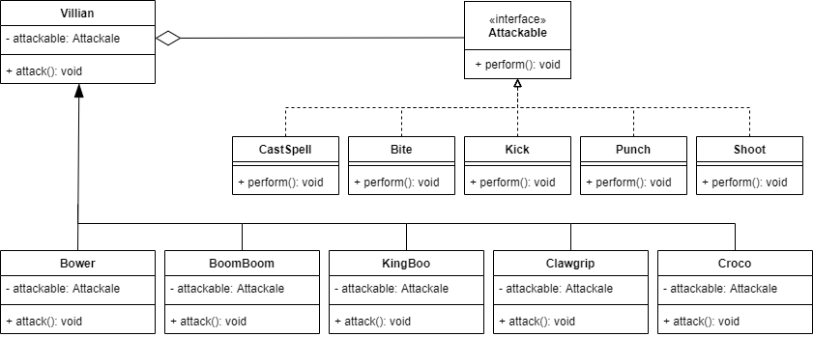
Convert the pattern to our case

Slide 11
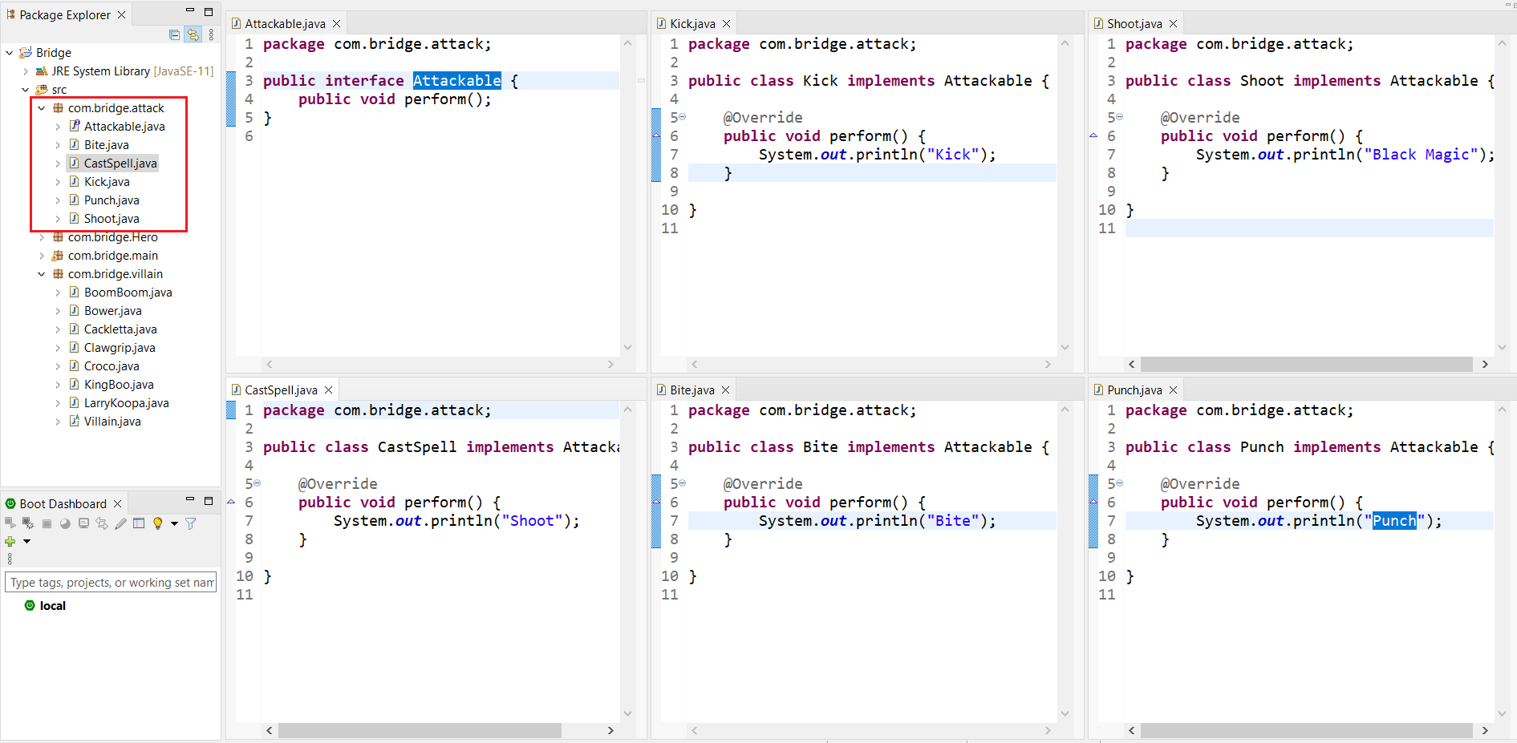
The code (attack part)

Slide 12
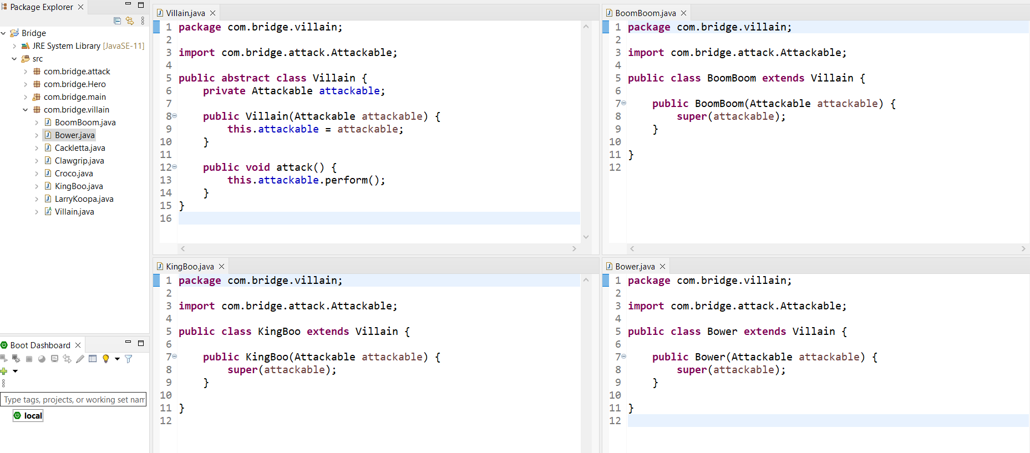
The code (villain part)

Slide 13
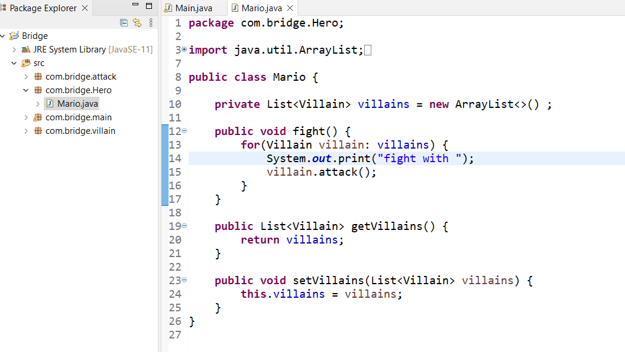
The code (Mario)

Slide 14
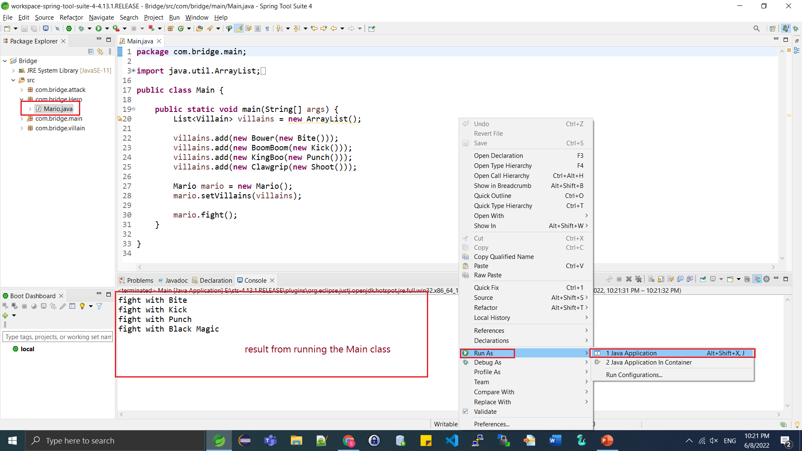
The code (Main)

Slide 15
The code (download)
You can come a see the code on my machine or you can download from github.com in master branch https://github.com/surawatthana/bridgePattern.git

Slide 16
More info
For more information please refer to this website https://refactoring.guru/design-patterns/bridge

Slide 17
The End

